Slide 1
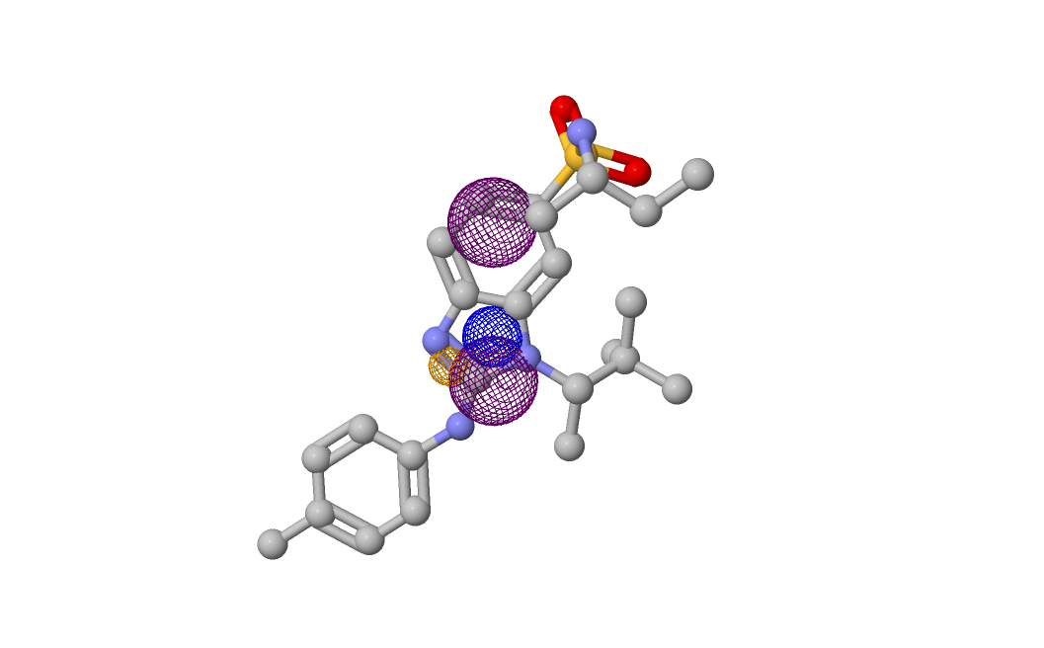
a

Slide 2
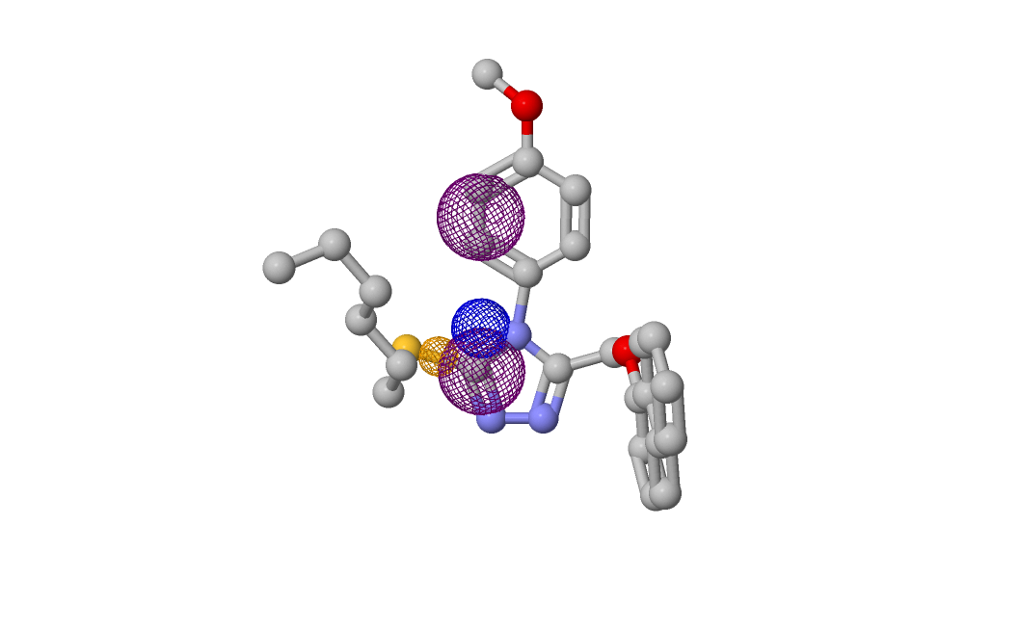
b

Slide 3
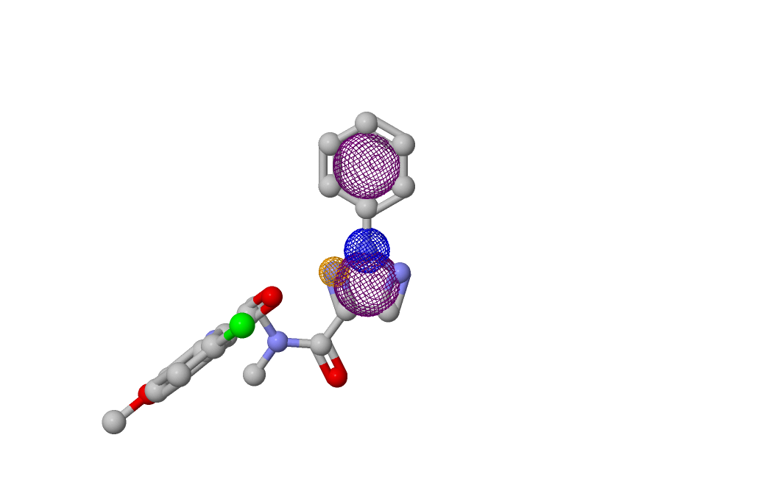
c

Slide 4
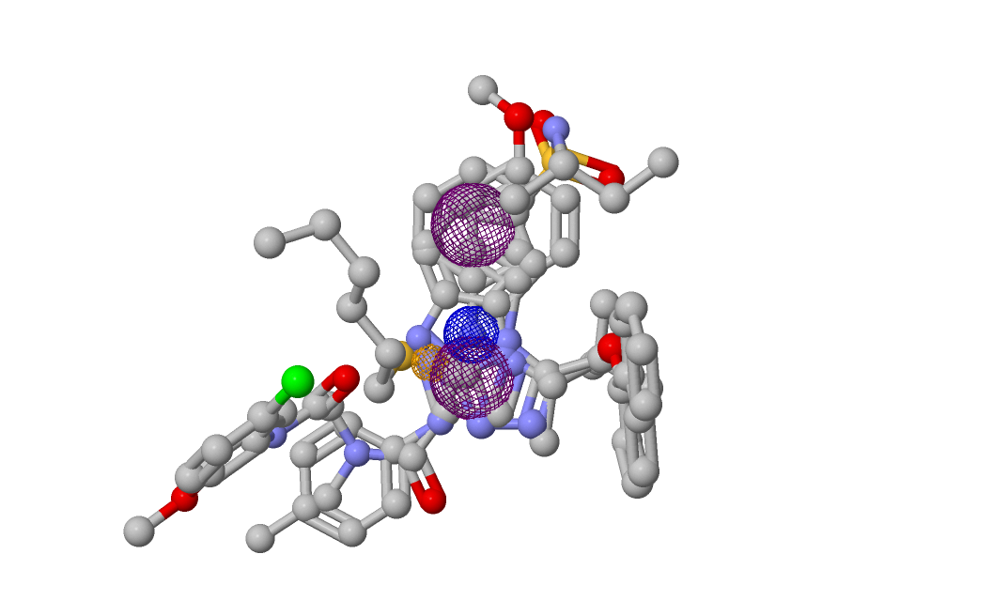
Alignment

Slide 5
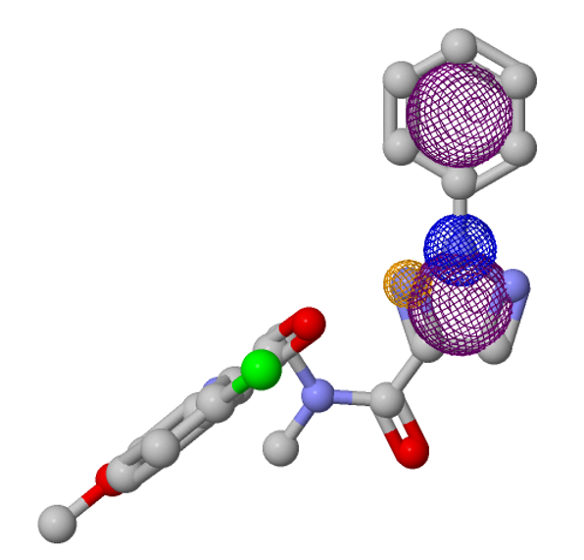
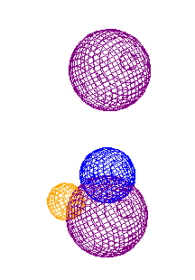
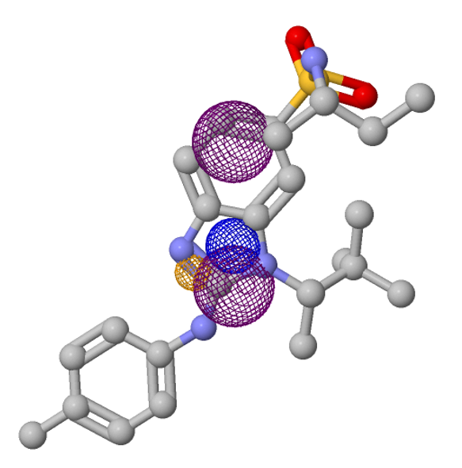
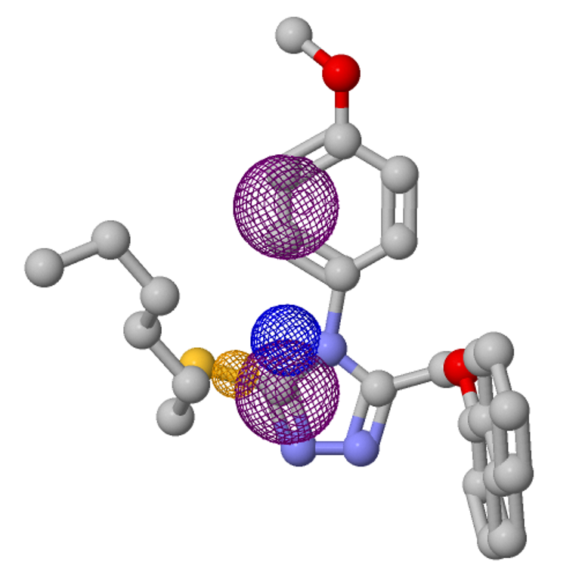
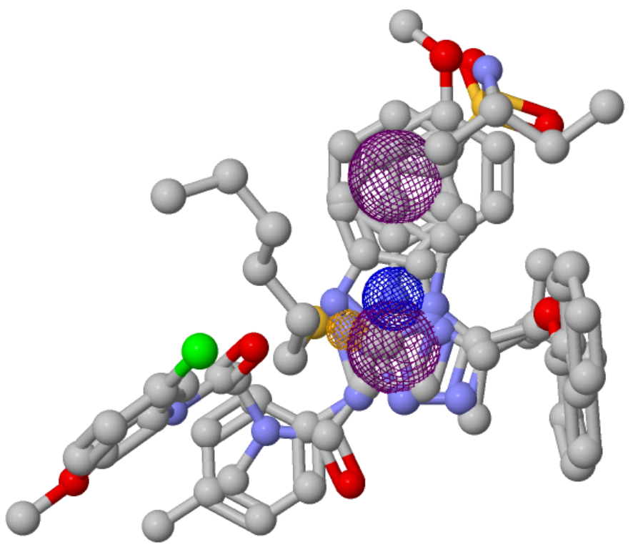
molecule-c: pivot molecule
Pharmacophore model
Aromatic
3.7
3.9
Hydrogen
Acceptor
Positivelon
1.2
Aromatic
molecule-a
molecule-a,b,c alignment
molecule-b
Model link: http://bioinfo3d.cs.tau.ac.il/pharma/runs/abc.mol2_14_20_11_15_5_121/

