Slide 1
Tensor Force Effect on the structure of light nuclei
Jianzhong Gu
(China Institute of Atomic Energy, Beijing, China)
Annual meeting of the Creative research group
December 14, 2012, Fragrant Mountain, Beijing

Slide 2
1. 张量力对轻原子核结构的影响。
2. 核物质和有限核的对称能以及中子星的整体性质。
On the one hand one can combine different models or theories and figure out the most degrees of freedom to understand the nuclear many-body problem better and more. On the other hand one should complete indispensable ingredients for nucleon-nucleon interactions.

Slide 3
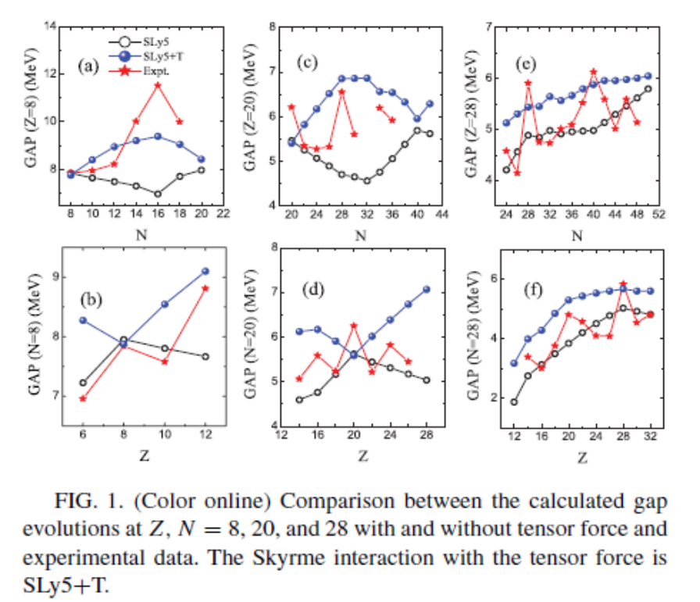
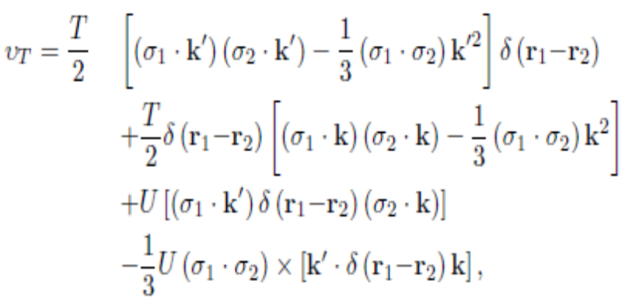
The tensor force is a necessary and important component of the nuclear force and had been ignored for a long time.It has crucial influence on the nuclear structure. Some exotic features in the shell evolution, giant resonances and nuclear deformation are successfully described with the inclusion of the tensor force. In the framework Skyrme-HFB the tensor force effects on nuclear structure were investigated by YZ Wang, JM Dong et al.
Tensor force is non-central and non-local spin-spin interaction, within the framework of Skyrme-HFB, has the following form:
For light nuclei, their structure changes due to the tensor force are significant.
Yanzhao Wang, Jianzhong Gu, Xizhen Zhang et al., Phys. Rev. C 83,054305 (2011).

Slide 4
There are Many parameterizations which are obtained by fitting to the binding energies and radii. Their validity should be checked.
Constrain them using additional criteria.

Slide 5
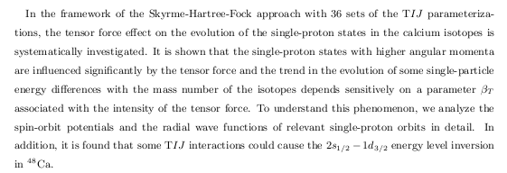

Slide 6
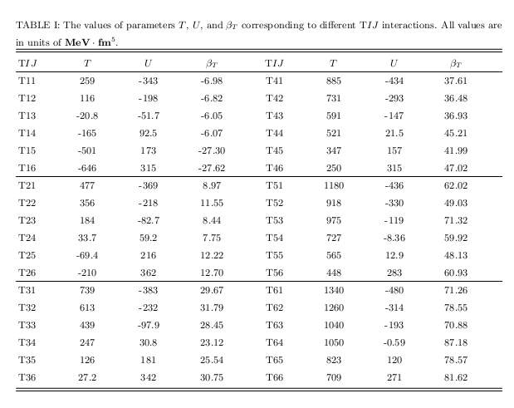

Slide 7
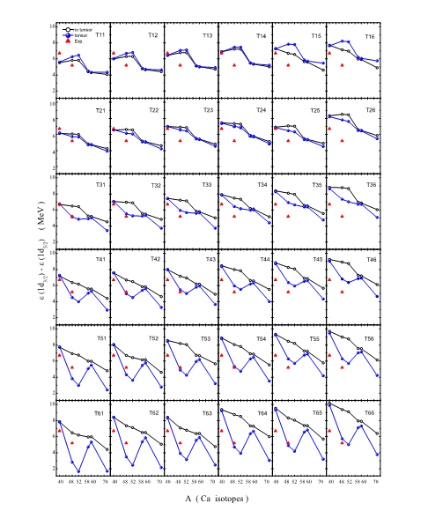

The single-particle energy differences in the cases with and without the tensor force within the Skyrme-HF framework with the TIJ parameterizations.
By ZY Li , YZ Wang, GL Yu et al.

Slide 8
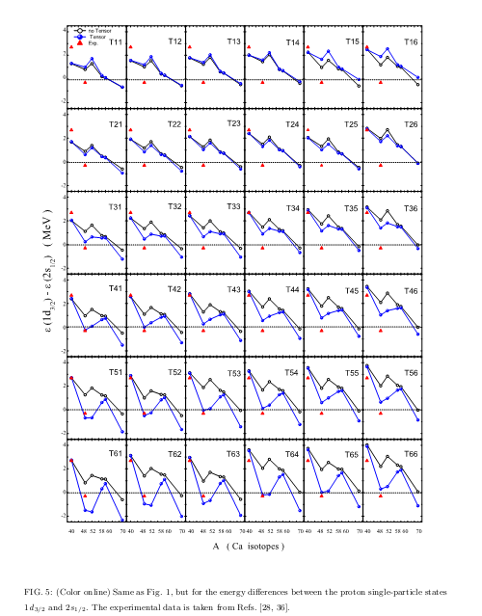
The single-particle energy differences in the cases with and without the tensor force within the Skyrme-HF framework with the TIJ parameterizations.
By ZY Li , YZ Wang, GL Yu et al.

Slide 9
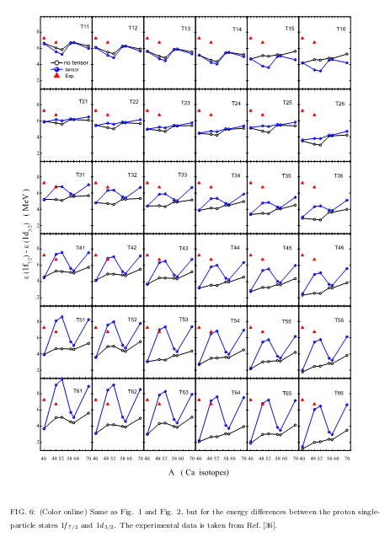
The shell gaps in the cases with and without the tensor force within the Skyrme-HF framework with the TIJ parameterizations.
By ZY Li , YZ Wang, GL Yu et al.

Slide 10
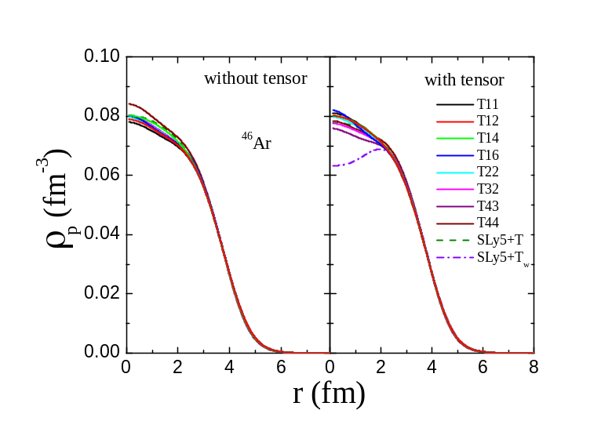
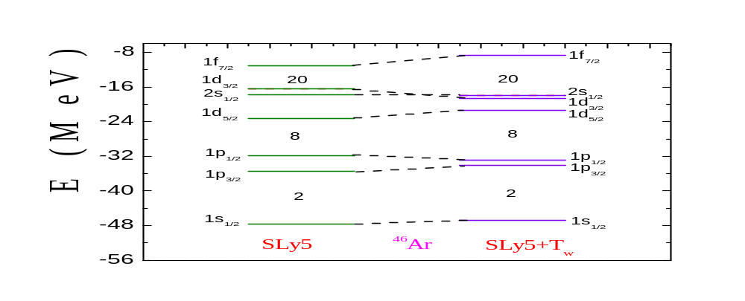
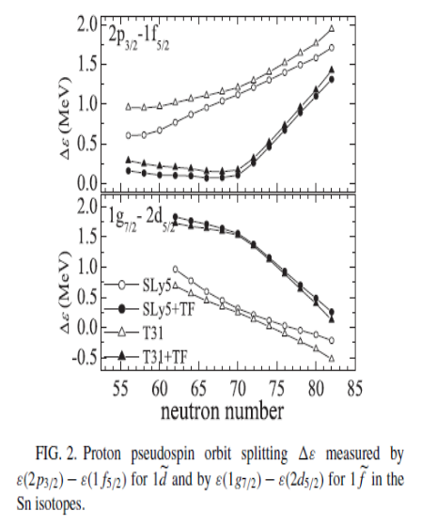
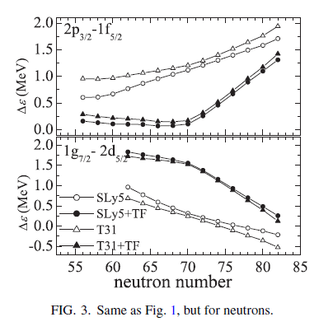
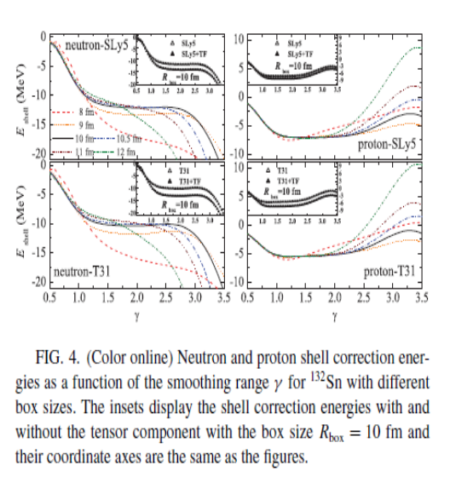
The tensor force causes the inversion between the levels of 2s1/2 and 1d3/2 in the nuclei around ⁴⁶Ar. The inversion results in the proton bubble formation in ⁴⁶Ar.
Yanzhao Wang, Jianzhong Gu, Xizhen Zhang et al., Chin. Phys. Lett. 28,102101 (2011).
Yanzhao Wang, Jianzhong Gu, Xizhen Zhang et al., Phys. Rev. C 84, 044333 (2011).
The tensor force has significant influence on the pseduo-spin energy splittings and shell correction energy.
Jianmin Dong, Wei Zuo, Jianzhong Gu et al., Phys. Rev. C 84 (2011) 014303.

Slide 11
核力的张量项（张量力）是核力的一个重要组成部分，而它在核结构计算中长期被忽略。我们在Skyrme有效相互作用中引入了张量力。研究结果表明张量力能够明显地改变轻原子核的结构；张量力能引起氩同位素原子核⁴⁴⁻⁵⁶Ar的质子单粒子能级的反转，并诱发这些原子核的质子气泡的形成；张量力与对关联的竞争导致了上述质子气泡的形成。
Shell correction and bubble structure, bulk properties of nuclei, just like binding energy and potential energy surfaces, more reliable than properties of single-particle energies (gaps, spin-orbit splittings, magic numbers, pseudo-spin splittings).

Slide 12
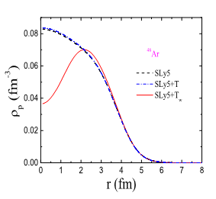
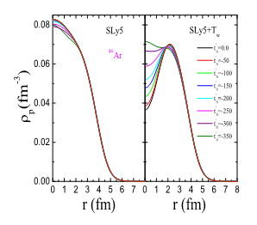
The competition between the tensor force and pairing correlation affects the bubble structure formation, taking ⁴⁶Ar as an example to explore the bubble formation mechanism. And we found that the bubble structure formation originates from the competition between the tensor force and pairing correlation and the tensor force plays a more important role than the pairing correlation in the bubble structure formation of ⁴⁶Ar. This is certainly an important finding.

Slide 13
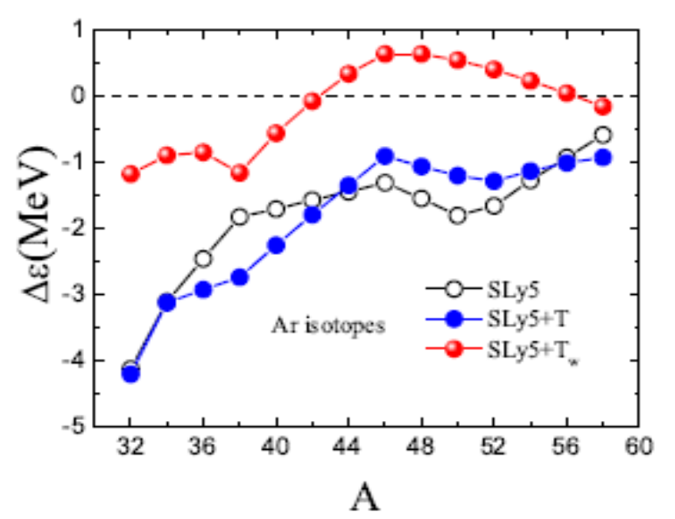
It is found that the tensor force effect from the SLy5+Tw interaction favours the bubble structure in 44-56Ar due to the inversion between the 2s1/2-1d3/2 levels. This is a new discovery.
氩同位素原子核⁴⁴⁻⁵⁶Ar的质子单粒子能级的反转，并诱发这些原子核的质子气泡的形成。
Both the bubble structure, tensor force and paring correlation are important aspects in nuclear study. Combining the three important aspects together, we studied how the tensor force and pairing correlation induce the bubble structure in the Ar isotopes.

Slide 14
Our focus was placed on the proton density distribution and the bubble formation mechanism. We would mention here that both the proton density distribution and the bubble structure are the ground state properties, which could be well described by an energy density functional theory. Therefore, the bubble structure in ⁴⁴⁻⁵⁶Ar predicted by the density functional theory with the Skyrme interaction should be more reliable than the SPE given by this theory.
It is well known that the shell model and the energy density functional theories are main tools to attack nuclear structure. Both of them can give the SPE. Precisely speaking, the energy density functional theories give the SPE in the canonical basis or the equivalent SPE, and the shell model can give the effective SPE. Nevertheless, for a strongly interacting system, the SPE can not be well defined in any sense. And the SPE just serve as a kind of scaffolding or a reference for nuclear structure study.

Slide 15
The ideal experiment to probe the charge density from which one can see the proton bubble structure would be electron scattering. Presently electron scattering on unstable nuclei like 44-56Ar is not possible, but it is expected in next generation facilities such as RIBF in Riken and FAIR in GSI (B. Rubio and T. Nilsson, Nucl. Phys. News 16 (2006) 5). In this case accelerated electrons would scatter on a radioactive beam of unstable nuclei, so to speak, 46Ar. Such an experiment may be feasible in the next decade. Therefore, we do hope our predicted bubble structure could be tested by experiment in future.

Slide 16
今后工作
1）新的位能曲面群方法在A=80,190质量区获得成功，将用于快速质子俘获路径
上原子核的结构研究。
2）快速质子俘获路径上原子核的Alpha衰变。
3）氧同位素原子核的结构,新的幻数,实验非常重视。
4）研究中子星的整体性质。

Slide 17
Based on our combined method of calculation of the AMPPESs,for ^{80,82,84}Zr, we investigate their structure and structural evolution with deformation and spin.
Near the N=Z line, abundant and exotic nuclear structure due to large parts of protons and neutrons in pfg orbitals, level density high, and a severe competition between single-particle motions and collective motions. and the intruder of the 1g_{9/2} further complicates the structure and plays an important role in the shape coexistence.
^{80,82,84}Zr lie near the proton drip-line and are very exotic nuclei.
The even-even N=Z waiting point nuclei are very important for nuclear astrophysical rp process.
Recently, experimental study for nuclei with N=Z：Nature 469 (2011) 68.

Slide 18
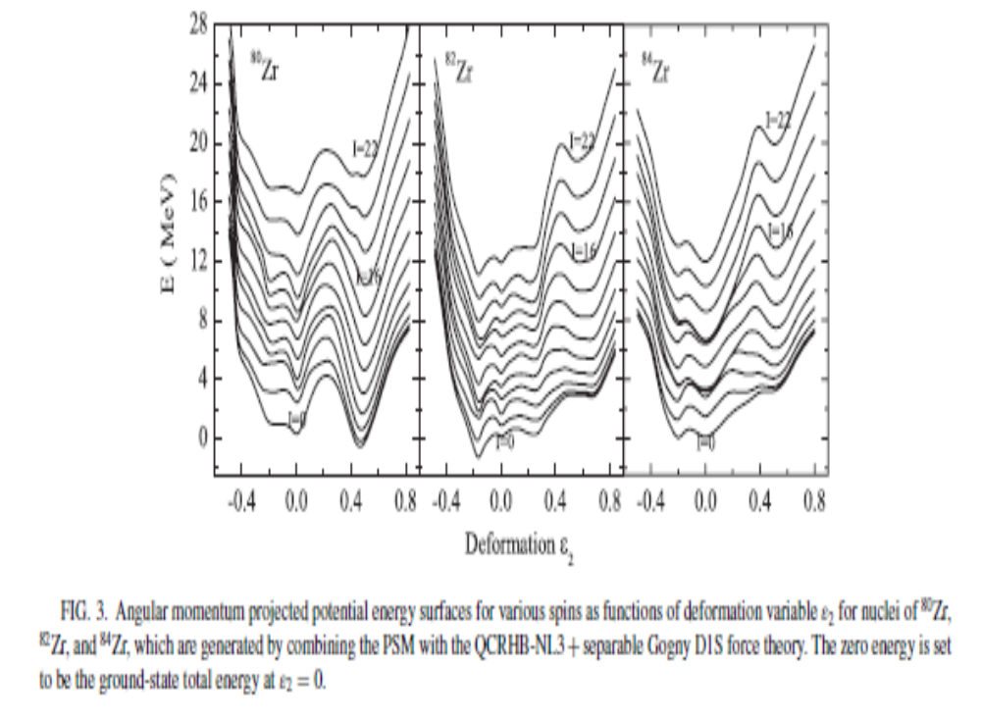
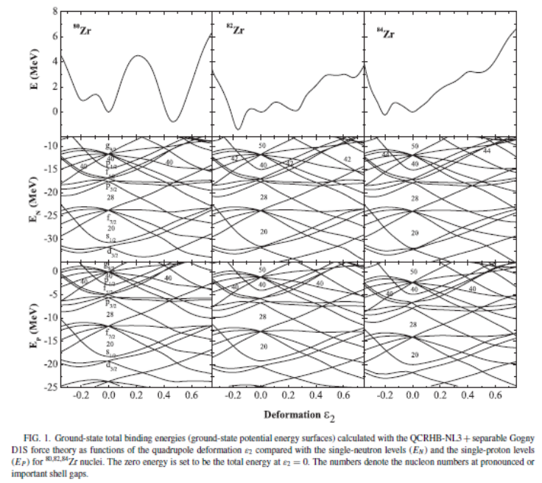
基于位能面群方法我们在国际上首次研究了A≈80 区丰质子奇特原子核^{80,82,84}Zr的结构及其随形变和角动量（自旋）的演化。这些原子核的质子数和中子数相等或相近，其核结构极其复杂。⁸⁰Zr还是快质子俘获过程中重要的等待点核。
Wen-hua Zou, Yuan Tian, Jian-zhong Gu* et al., “Microscopic description of nuclear structure around 80Zr”, Phys. Rev. C 82 (2010) 024309.
西班牙核结构专家J. L. Egido教授引用了我们的工作(Phys.Lett.B705:255-259,2011).
发现⁸⁰Zr和⁸⁴Zr存在形状相变，这是由布居在1g9/2轨道上的核子顺排驱动的。而⁸²Zr存在强烈的形状混杂，这源于单粒子运动与集体运动的剧烈竞争。
还发现在高自旋时， 分隔⁸²Zr和⁸⁴Zr这两个核的正常形变转动带和超形变转动带的位垒随着自旋的升高会变得越来越低而且窄，这预示着这两个核在高自旋超形变状态下会发生跃迁到正常形变带的带外衰变。与上述两原子核迥然不同，在高自旋情形下，原子核⁸⁰Zr的位垒又高又厚。因此，超形变带的带外衰变不会发生在⁸⁰Zr原子核。
确定了它们的平衡形状，这些平衡形状的四极形变值与实验值相符。由这些核的单粒子谱结构可以理解它们的平衡形状和形状共存。

Slide 19
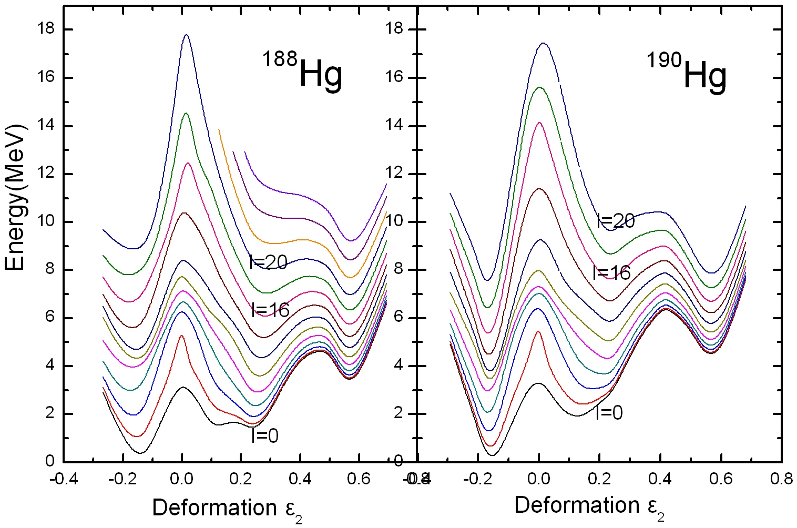
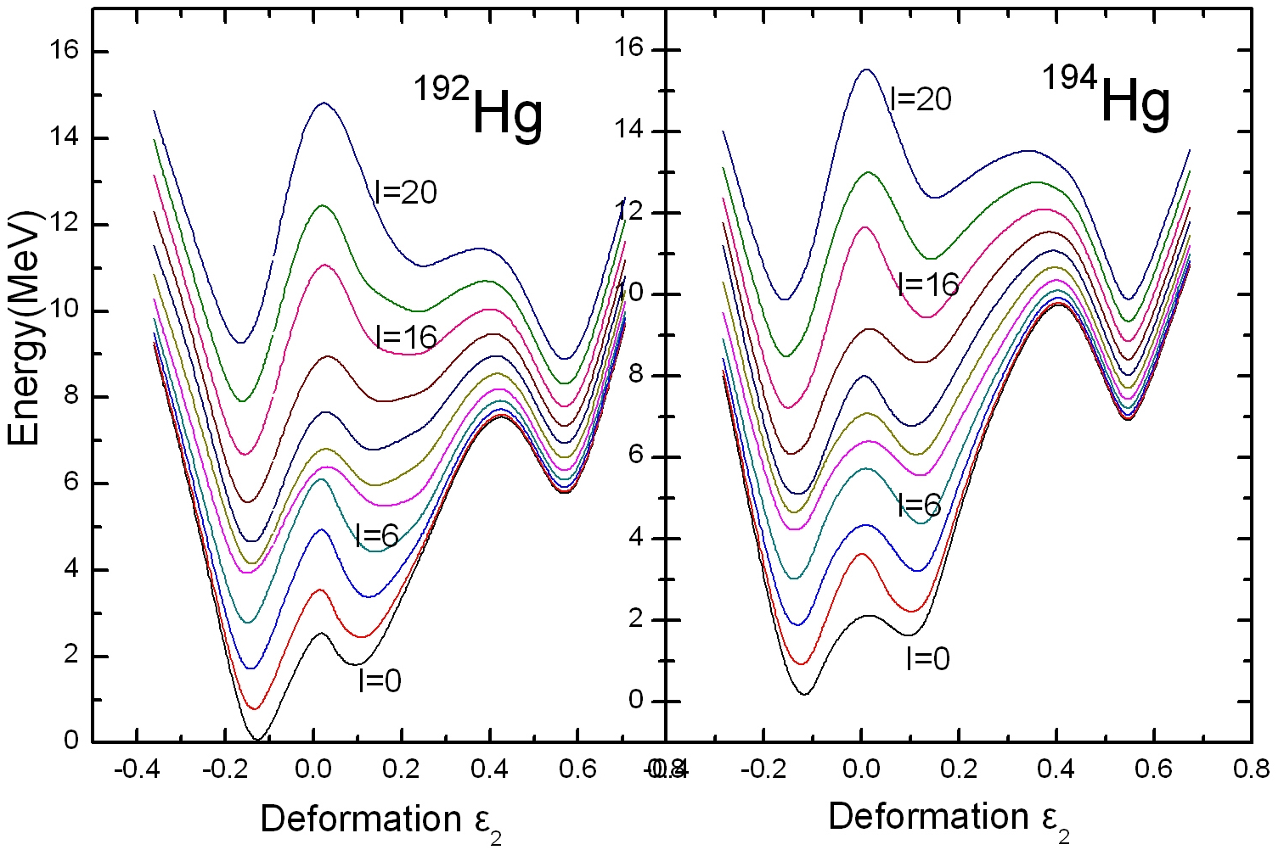
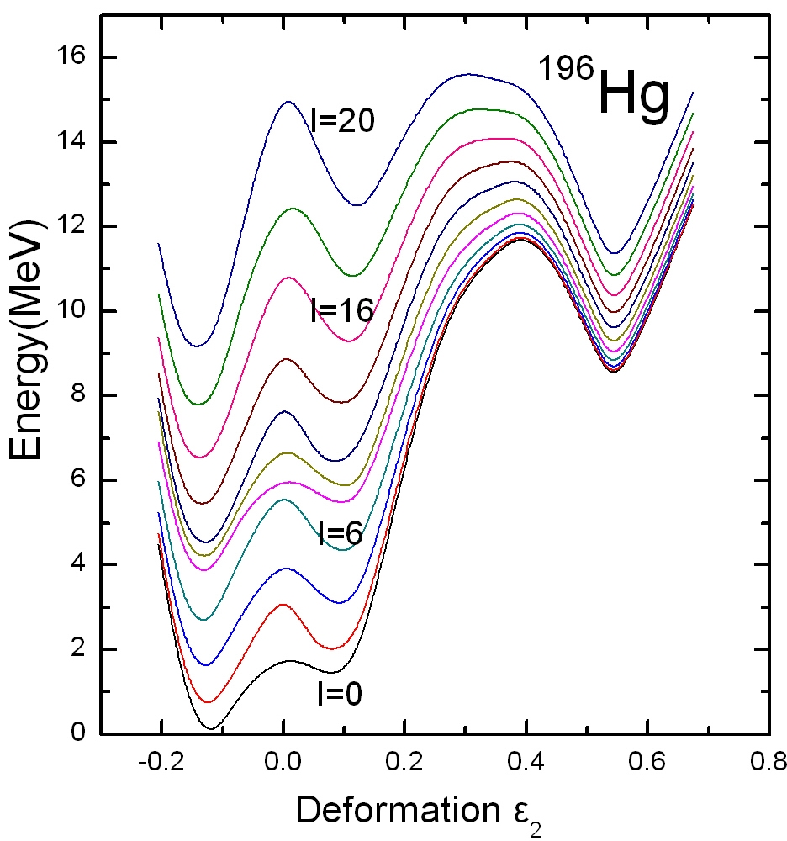
Experiments: for A=190 mass region, I=8-12 hbar at decay out points.
Calculations: the barrier gets thin and low at such spins, and the decay out suddenly happens.
Information for the excitation energies and spins at decay out points can be obtained, which is the most wanted for experiments.
Bandheads here are taken from Eur. Phys. J. A 33 (2007) 237. A HFB approach based on the D1S Gogny force.
Jianzhong Gu, Bangbao Peng, Wenhua Zou and Shuifa Shen,
Nucl. Phys. A 834 (2010) 87c.

Slide 20
Summary
(a) Significant influence of the tensor force on the structure of light
nuclei and their evolution has been found and the effect of the
tensor force on pseudo-spin energy splittings and shell correction
is evident.
(b) The proton bubble in ⁴⁴⁻⁵⁶Ar has been found which results from the
inversion of the proton single particle levels and competition
between the tensor force and pairing correlation.
(c) One may constrain extant the Skyrme interactions with the tensor
force by using additional criteria.

Slide 21
2012年创新基金支持下的研究论文:
1. Lie-Wen Chen and Jian-Zhong Gu, Correlations between the nuclear breathing mode energy
and properties of asymmetric nuclear matter, J. Phys. G :Nucl. Part. Phys. 39 (2012) 035104.
2. Jianmin Dong, Wei Zuo, Jianzhong Gu and U. Lombardo, Density Dependence of the Nuclear
Symmetry Energy Constrained by Mean-Field Calculations, Phys. Rev. C 85 (2012) 034308.
3. Jianmin Dong, Wei Zuo and Jianzhong Gu, Origin of symmetry energy in finite nuclei and
density dependence of nuclear matter symmetry energy from measured alpha-decay energies,
Phys. Rev. C (in press, 2012).
4. Li Zhenyu, Wang Yanzhao, Yu Guoliang and Gu Jianzhong, Tensor force effect on proton
shell structure in neutron-rich Ca isotopes, Science in China Series G: Physics,
Mechanics&Astronomy (in press,2012).
5. Yanzhao Wang, Jianzhong Gu，Xizhen Zhang et al., Tensor effects on the proton sd states in
neutron-rich Ca isotopes and bubble structure of exotic nuclei, Phys. Rev. C 84, 044333
(2011). (2011年度漏报)

