Slide 1
s-process of fifty years
Y. S. Chen (陈永寿）
China Institute of Atomic Energy, Beijing, China
Presentation at Xiangshang, 14-15 Dec., 2012.
1 Introduction
2 Nuclear uncertainties in s-process simulations
3 Neutron capture rates
4 Odd-even difference of Barium abundances
5 Remarks

Slide 2


Slide 3
古代宇宙学与人类认识史一样早
地球中心说：天像一把伞罩着平坦大地；天地像一只蛋，中心是地，周围是天。
太阳中心说，银河中心说，总之，宇宙有心，心即是我。
人类认识到宇宙无中心，无界限，人类本身是宇宙中普通的一员。仅到此时，人类才真正进入了宇宙的研究。

Slide 4
爱因斯坦猜想：
在大尺度上，宇宙是均匀的，各向同性的。
宇宙没有中心，也没有边界。
在任何一个星系上观测宇宙及其规律都是一样的。
爱因斯坦猜想，后来被称为宇宙学原理
百年宇宙学
五十年慢中子过程

Slide 5
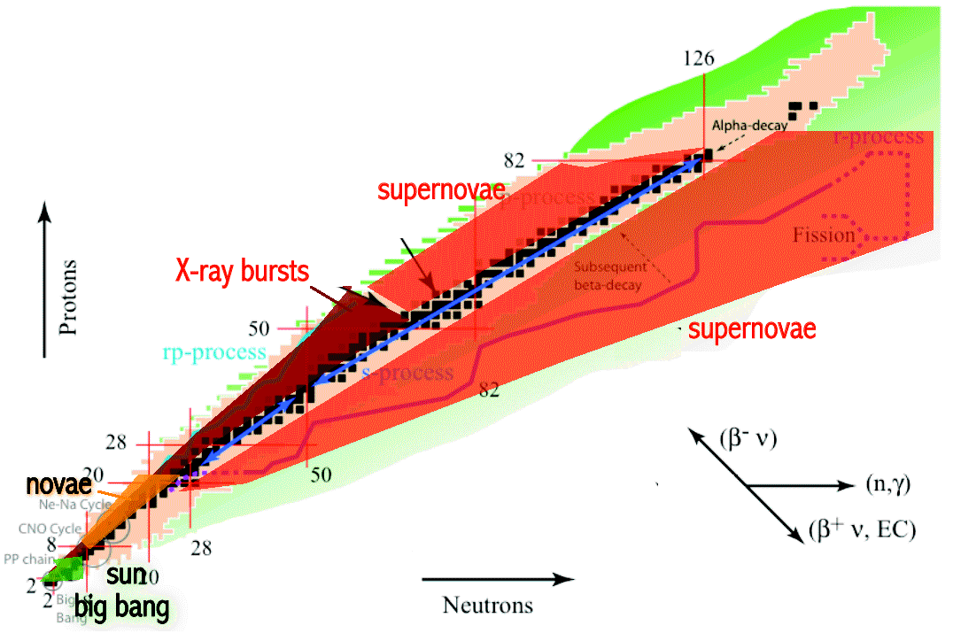
天体核过程
快质子过程
慢中子过程
快中子过程
恒星静态演化
大爆炸

Slide 6
Origin of heavy elements
Elements heavier than the iron peak are mainly produced
through neutron capture reactions in two main processes,
the s-process (slow) and r-process (rapid).
s-nuclei are produced during the thermally pulsing
asymptotic giant branch phase of low- mass stars
(of 2-4 M_sun)
r-nuclei are produced in explosive conditions in SNeII.

Slide 7
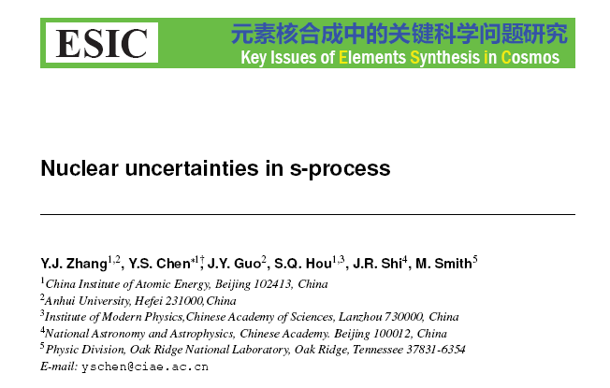

Slide 8
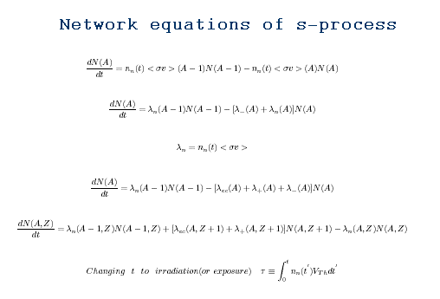
Nuclear uncertainties

Slide 9
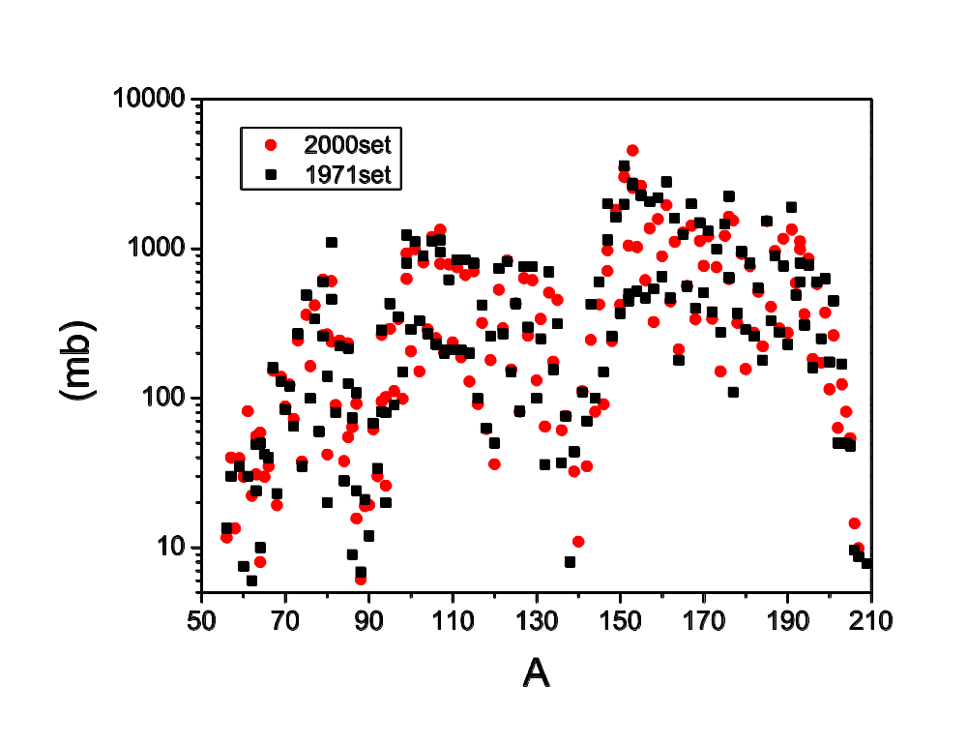
Nuclear uncertainties
Neutron cross section

Slide 10
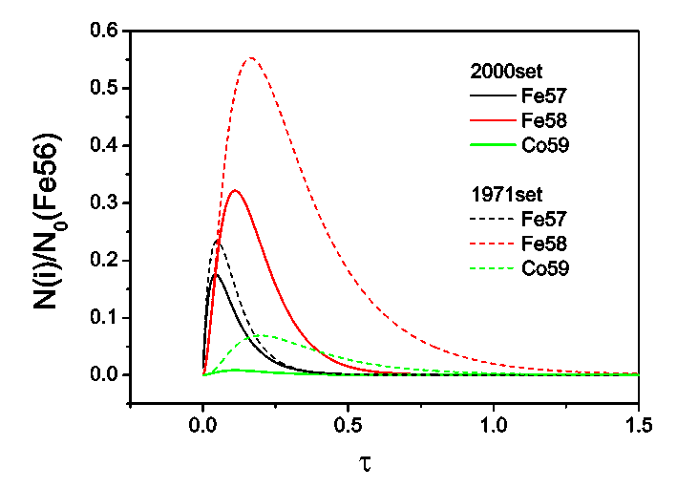
Nuclear uncertainties
Abundances of Fe-family

Slide 11
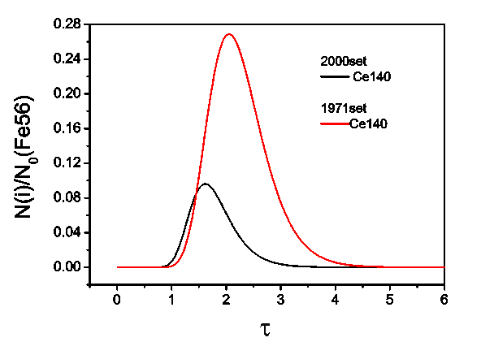
Nuclear uncertainties
Abundances in middle of s-chain

Slide 12
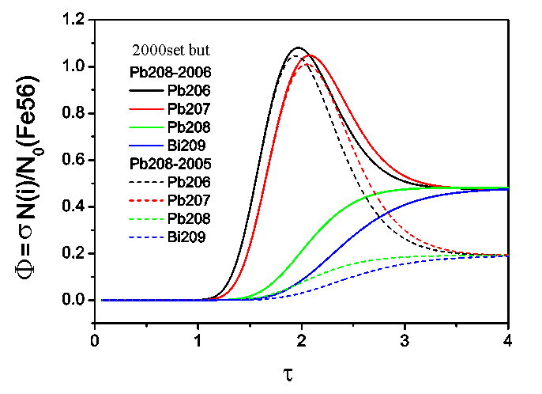
Nuclear uncertainties
Solutions of s-termination nuclei

Slide 13
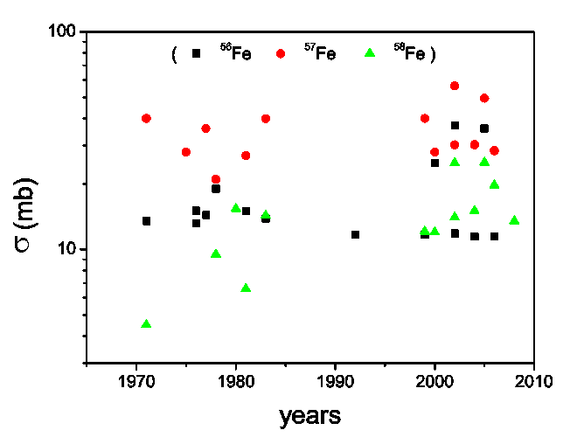
Neutron capture cross sections
Bigenning of s-chain

Slide 14
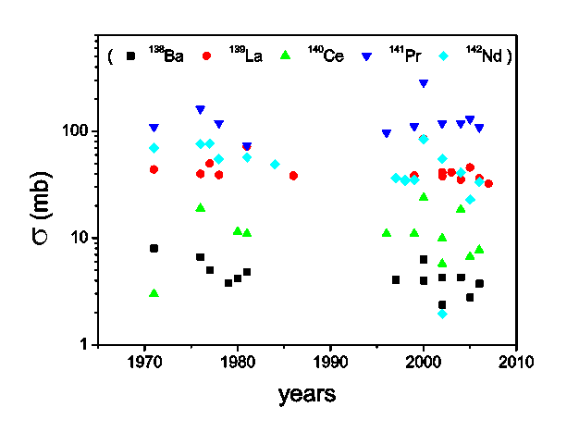
Neutron capture cross sections
Middle of s-chain

Slide 15
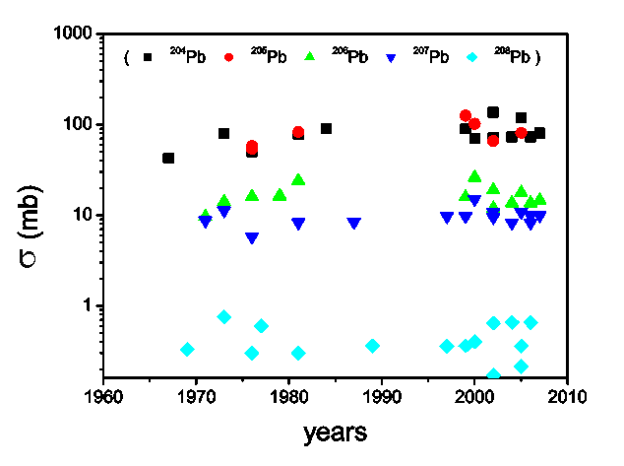
Neutron capture cross sections
Termination of s-chain

Slide 16
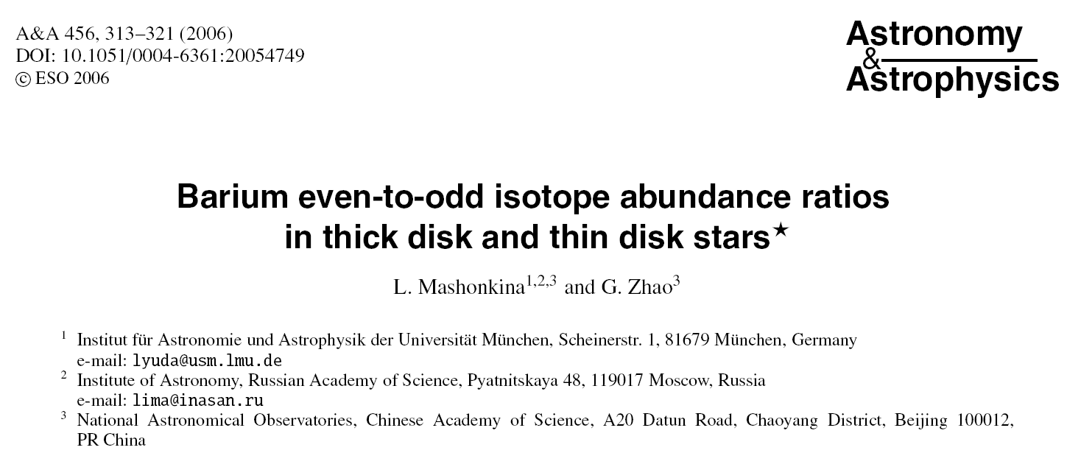
Odd-even difference of Ba abundances
Understanding the relative importance of
s- and r- synthesis mechanisium
throughout the Galaxy history

Slide 17
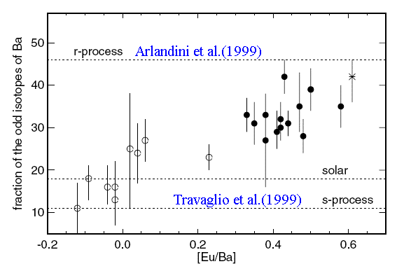
Odd-even difference of Ba abundances

Slide 18
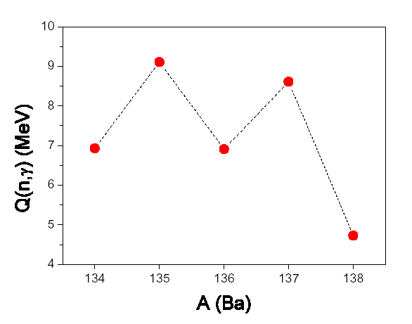
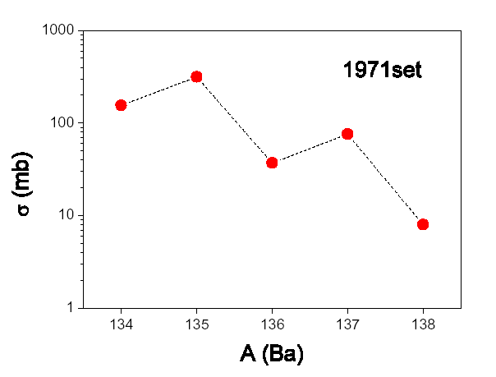
Odd-even difference of Ba abundances
Pairing correlation
Shell effects

Slide 19
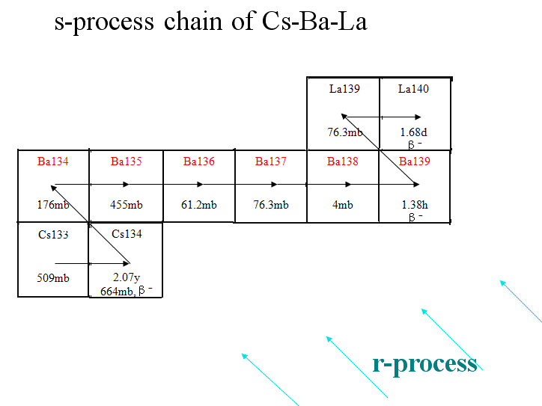
Odd-even difference of Ba abundances

Slide 20
Odd-even difference of Ba abundances
Neutron capture cross section σ (mb)
(2000-2010)
1971set Set1 Set2
¹³⁴Ba 155 117 232.5
¹³⁵Ba 315 500.8 259
¹³⁶Ba 37 49.4 108
¹³⁷Ba 76 140 58.4
¹³⁸Ba 8 2.38 6.3

Slide 21
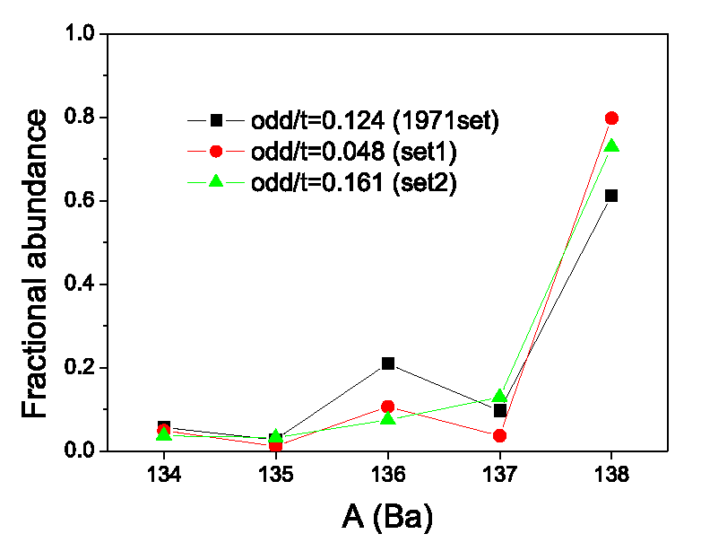
Odd-even difference of Ba abundances
Calculated Ba-abundances

Slide 22
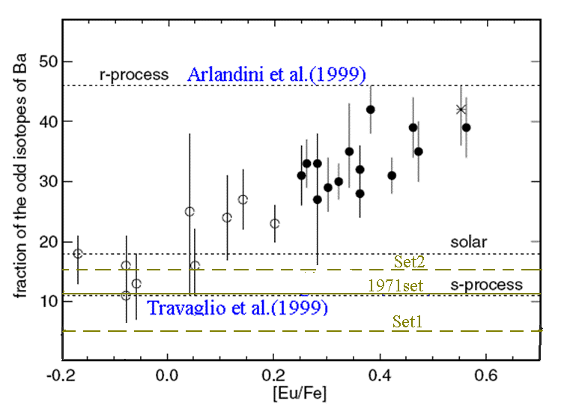
Odd-even difference of Ba abundances

Slide 23
Remarks
* Two important stages for the fifty years of s-process
Solar system → Galaxy
Start of s-process study → r- and s- process (twin processes)
Stable nuclei → unstable nuclei
* Many n-capture cross sections for s-nuclei must be improved
* The nucleosynthesis theory is not able to predict
the yields of the r-process;
The nucleosynthesis theory is not able to
predict enough accurately the yields of the s-process.

Slide 24
Thank you

