Slide 1
Name: xsfddns04
Password: xsfddns046042

Slide 2
Spectroscopic factors in the projected shell model
Zao-Chun Gao
高早春
China Institute of Atomic Energy
2012-12-14 Beijing Xiangshan

Slide 3
The contents
Definition of the spectroscopic factor.
The Projected Shell Model（PSM）.
Relevant Formulae in the PSM.
Improvement of PSM——
Particle number projection .
Calculations of the Cr（Z=24）isotopes。
Summary and outlook。

Slide 4

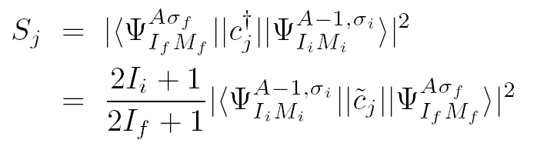

Definition
Wigner-Eckhart Theorem
Spectroscopic Factors:

Slide 5
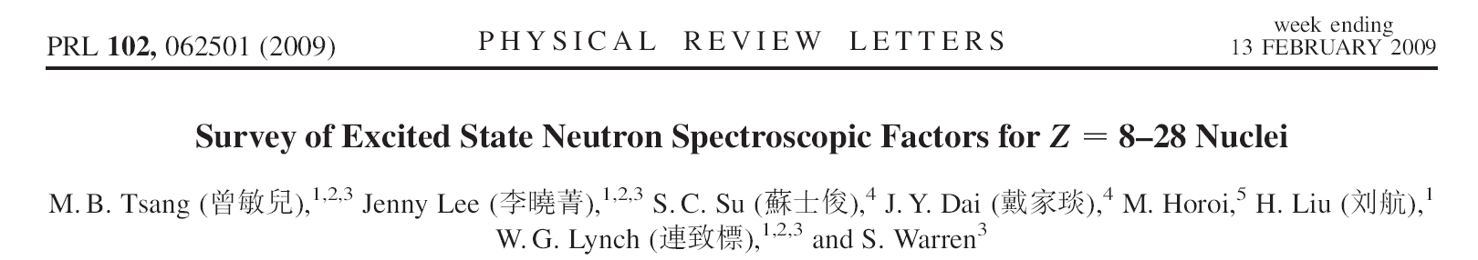
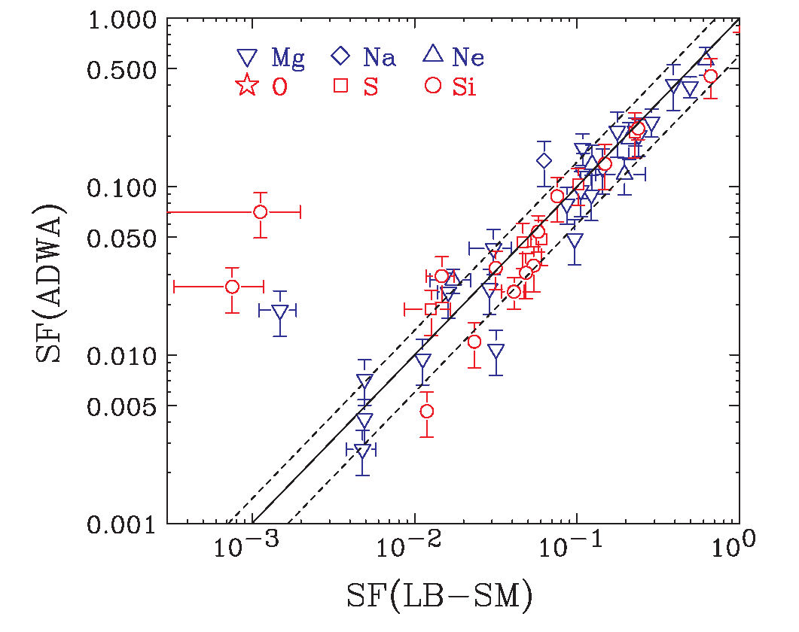
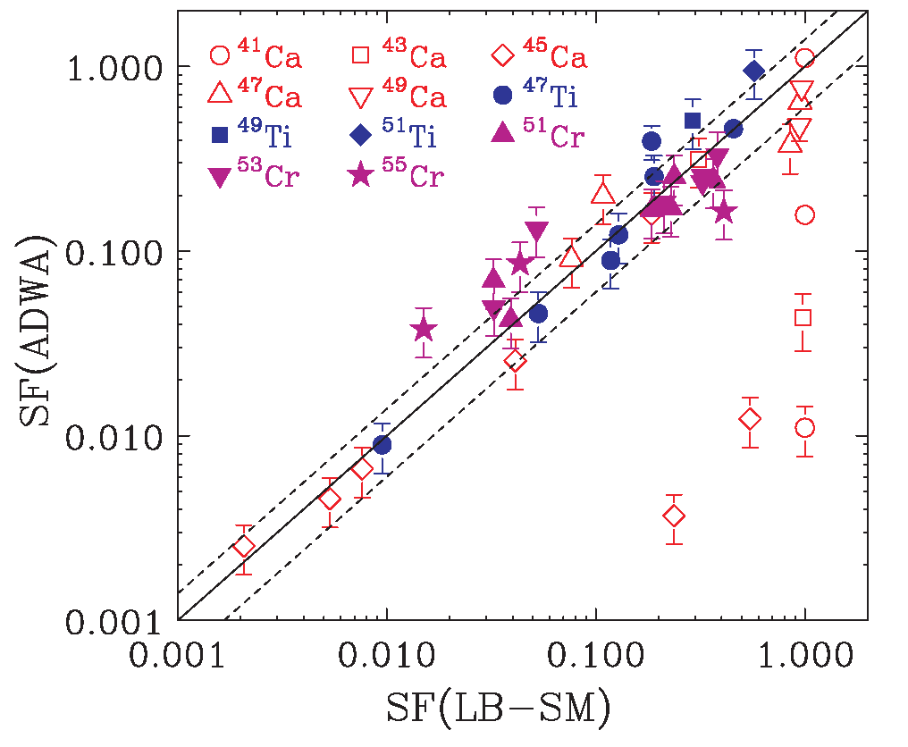
USDA and USDB
GXPF1A

Slide 6
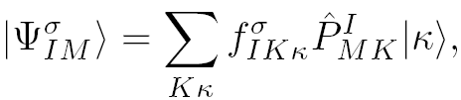
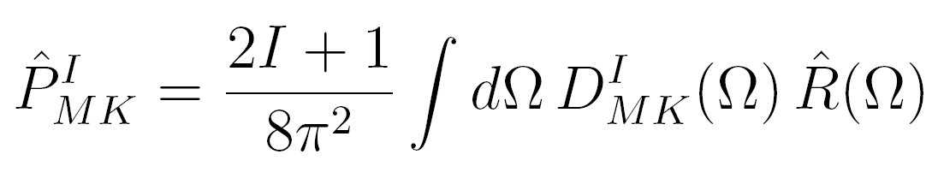

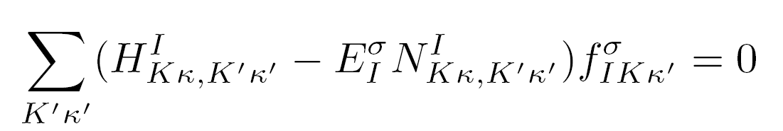


The Projected Shell Model (PSM)
The nuclear wave function is assumed to be
Where,
’s are to be determined by the eigenvalue equation

Slide 7
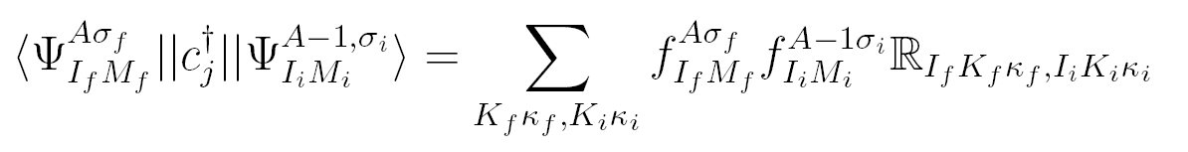
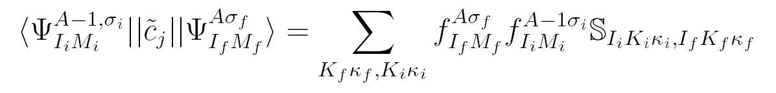
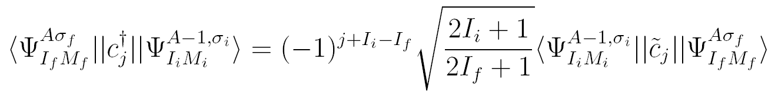
Relevant Formulae in the PSM
Symmetry Check: Very useful to confirm the correctness of the code!

Slide 8

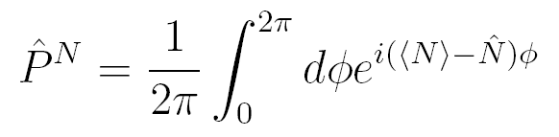
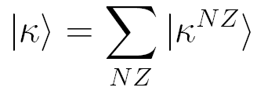
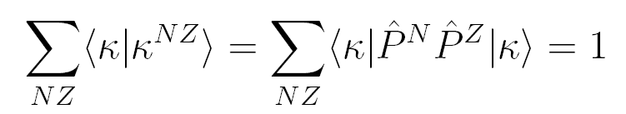
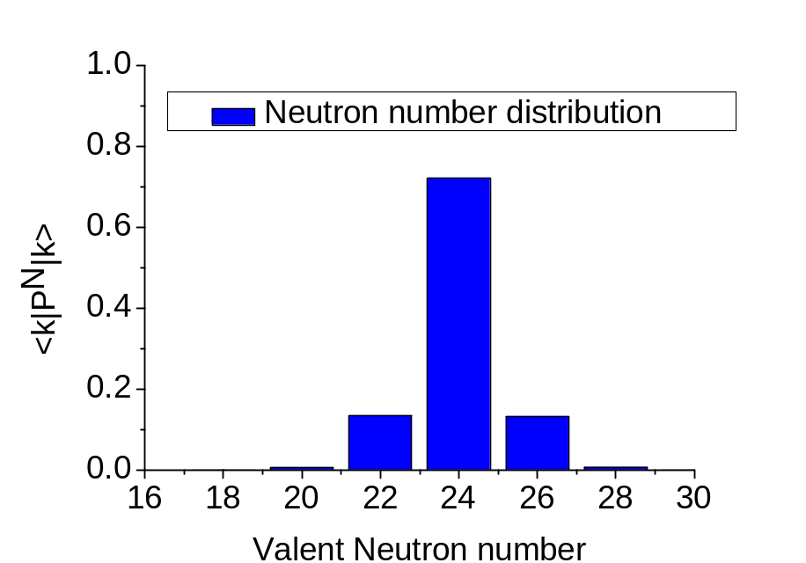
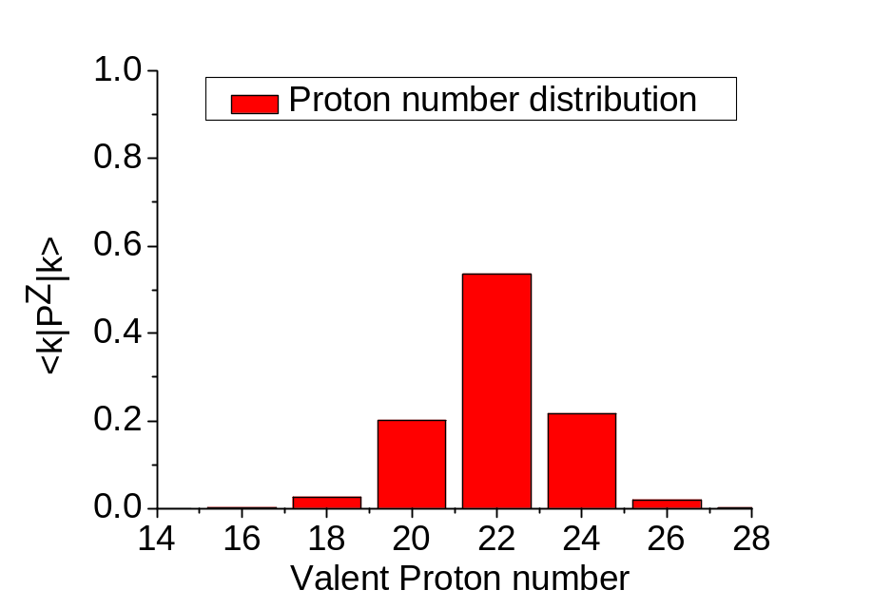
Improvement of PSM——
Particle number projection
⁵⁰Cr, N=26,Z=24
N_Val=24
Z_Val=22
Δ_{N}=0.79MeV
Δ_{P}=1.18MeV

Slide 9
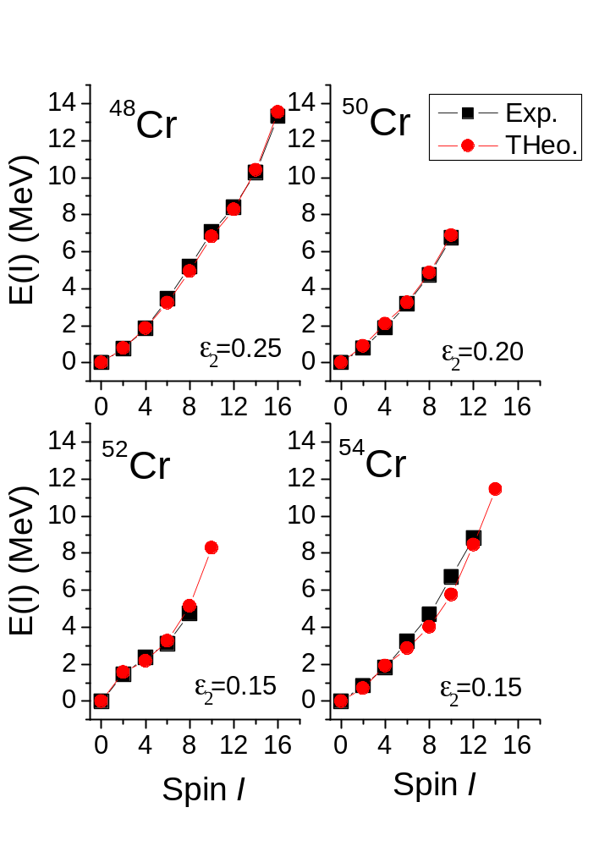
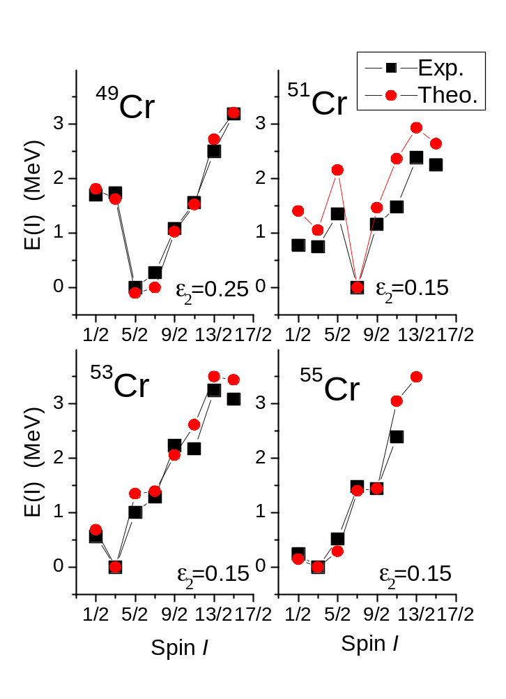
PSM description of the Yrast states in Cr isotopes
Data are taken from Nuclear Data Sheets
The parameters are taken from Hara&Sun&Mizusaki PRL83 1922(1999)

Slide 10
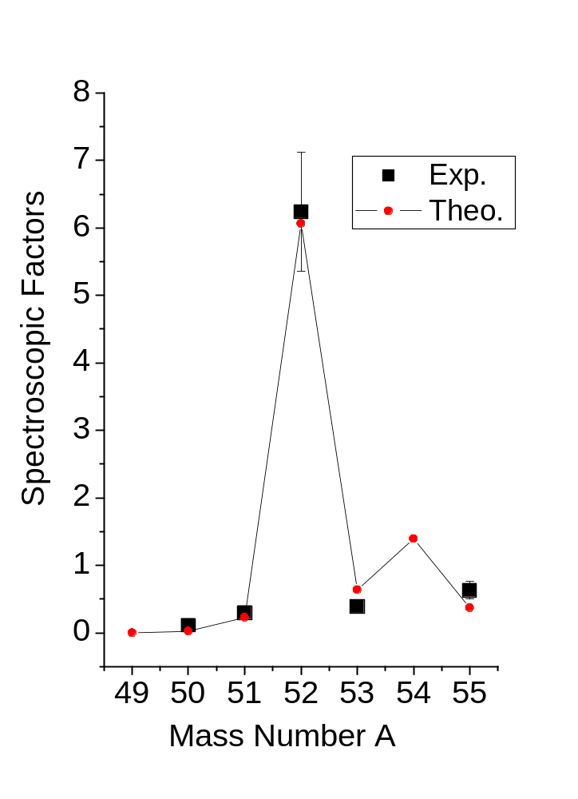
The Calculated S-Factors
Data taken from Tsang et al PRL95,222501(2005)
Nucleus | lj | Exp. | PSM
⁴⁹Cr | 5/2 | ----- | 0.00
⁵⁰Cr |  | 0.11±0.02 | 0.02
⁵¹Cr | f7/2 | 0.30±0.08 | 0.23
⁵²Cr |  | 6.24±0.88 | 6.06
⁵³Cr | p3/2 | 0.39±0.03 | 0.64
⁵⁴Cr |  | ----- | 1.39
⁵⁵Cr | p3/2 | 0.63±0.13 | 0.37

Slide 11
Summary and outlook
Summary：
For the first time, the particle number projection (PNP) has been applied to the Projected Shell Model.
Based on the improved PSM wavefunctions( with PNP), the code for the calculations of the spectroscopic factors has been established.
The spectroscopic factors of the ground states in the Cr isotopes has been calculated and compared with the experimental data. Good agreements have been achieved.
Outlook:
Only limit to axial symmetry, will be extended to the triaxial and octupole cases。
Cooperation and application。

Slide 12
Thanks

