Slide 1
核反应网络方程计算程序的界面设计和灵敏度计算
国防基础项目进展报告
舒能川，陈永寿
中国原子能科学研究院
（核数据测量与评价国防科技重点实验室）
2012年12月13日星期四

Slide 2
报告内容
引言
核反应网络计算程序界面设计
例子：CNO循环
计划
总结

Slide 3
1.引言（JINAWeb.org）
Online Tools ( Clemson GCE, NSE calculators and nuclear reaction network with easy web interfaces )
Some Astronomy Codes（ Arizona State University ） ( Frank Timmes repository of astronomy codes, including reaction networks )
Modules for Experiments in Stellar Astrophysics (MESA) ( Bill Paxton's stellar evolution code )
TYCHO: A Stellar Evolution Code ( A general, one dimensional stellar evolution code )
Reaction Network & Rates Calculations & Tools ( Nucastrodata - datasets - infrastructure )
Liquid Drop Model of Nuclear Binding Energy (The site for you to modify the formula and make your own fit)

Slide 4
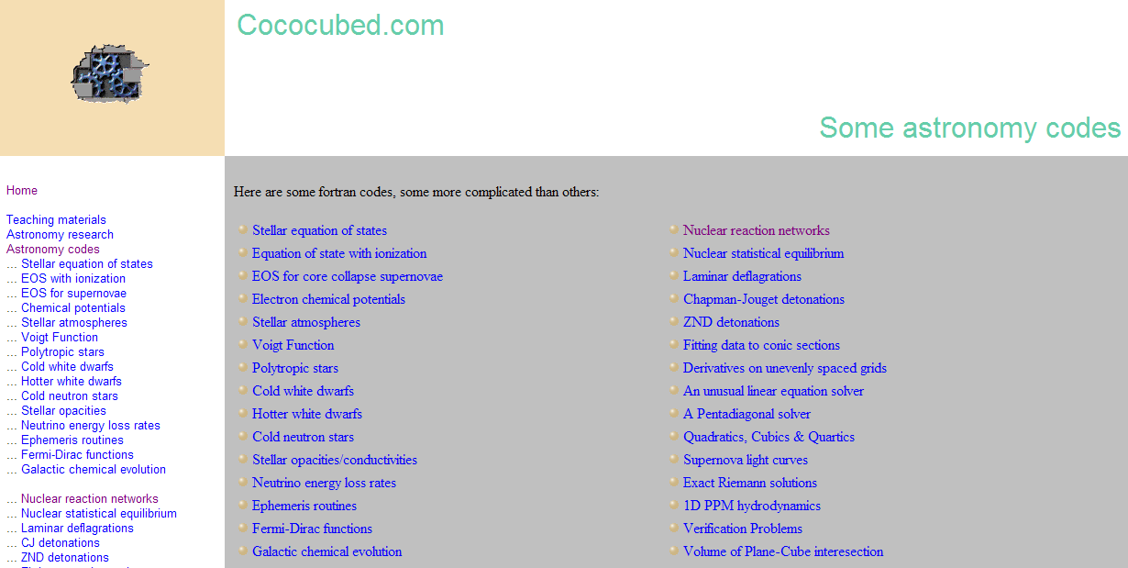
1.1.Cococubed.com:Some astronomy codes (Arizona State University)
Nuclear Reaction Network

Slide 5
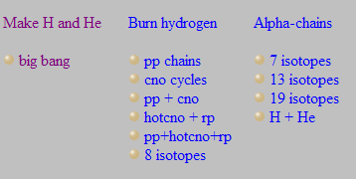
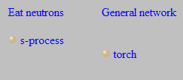
1.1 ( Frank Timmes repository of astronomy codes)

Slide 6
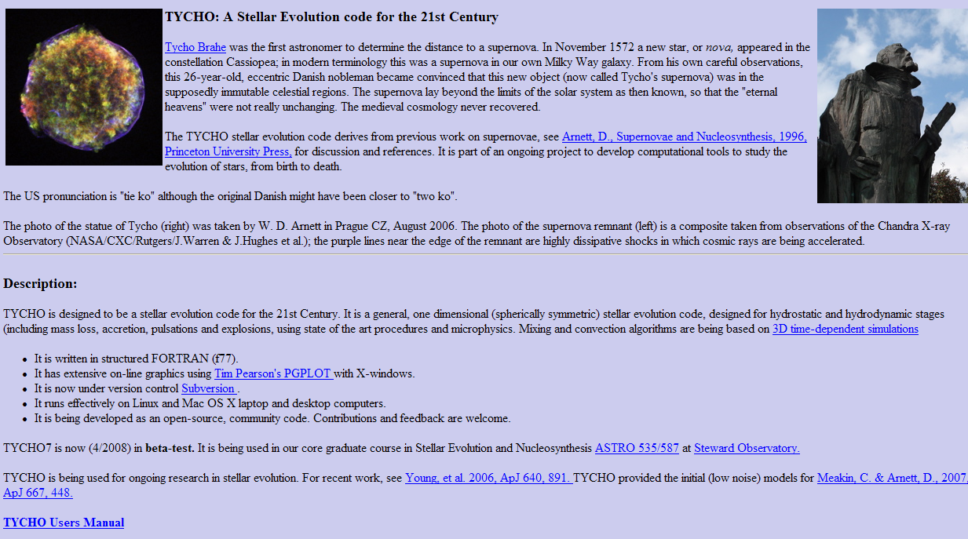
1.2 TYCHO: A Stellar Evolution code for the 21st Century

Slide 7
2.2 TYCHO: A Stellar Evolution code for the 21st Century
TYCHO is designed to be a stellar evolution code for the 21st Century. It is a general, one dimensional (sp-herically symmetric) stellar evolution code, designed for hydrostatic and hydrodynamic stages (including mass loss, accretion, pulsations and explosions, using state of the art procedures and microphysics. Mixing and convection algorithms are being based on 3D time-dependent simulations
in structured FORTRAN (f77).
on-line graphics using Tim Pearson's PGPLOT with X-windows.
It is being developed as an open-source, community code. Contributions and feedback are welcome.
TYCHO7 is now (4/2008) in beta-test. It is being used in our core graduate course in Stellar Evolution and Nucleosynthesis ASTRO 535/587 at Steward Observatory.

Slide 8
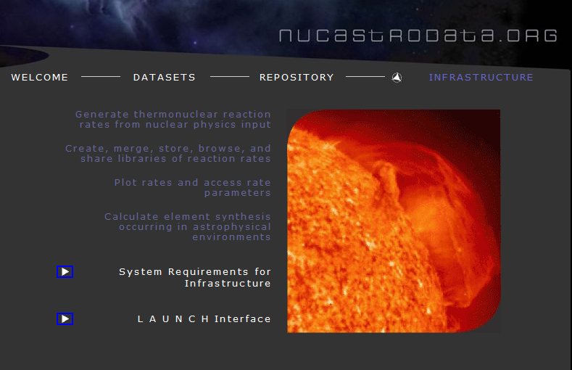
1.3. Nucastrodata.org

Slide 9
NucAstrodata.org
Generate thermonuclear reaction rates from nuclear physics input
Create, merge, store, browse, and share libraries of reaction rates
Plot rates and access rate parameters
Calculate element synthesis occurring in astrophysical environments

Slide 10
1.4.本程序特点：
基于给定模型的温度、密度profile；
计算核合成的丰度随时间的变化；
计算反应路径；
计算特定核素对于某个反应率的灵敏度；
窗口界面。

Slide 11
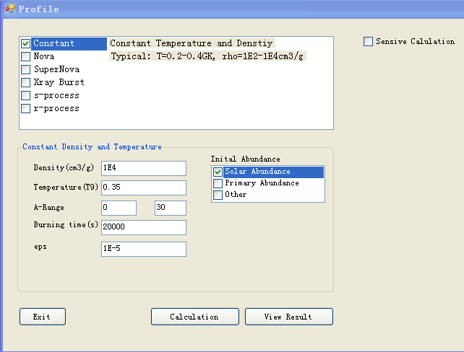
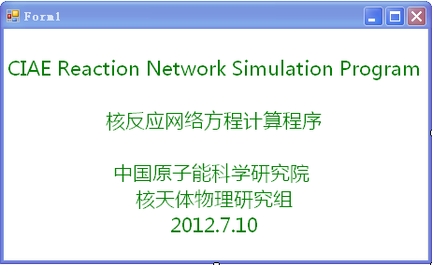
2.核反应网络计算程序界面设计
Constant
ρ=1E4 (g/cm3)
T=0.35 (GK)
Solar Abundance

Slide 12
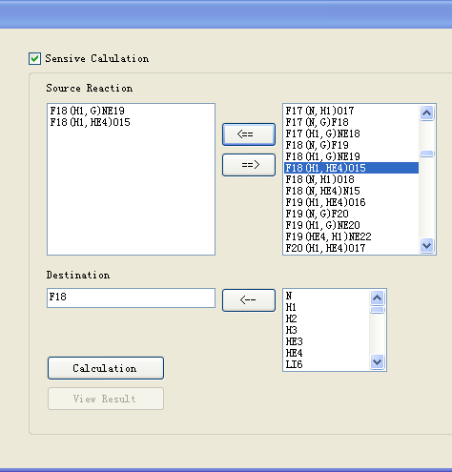
2.核反应网络计算程序界面设计
Sensitivity calculation

Slide 13
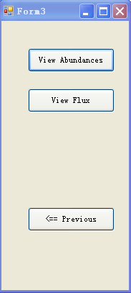
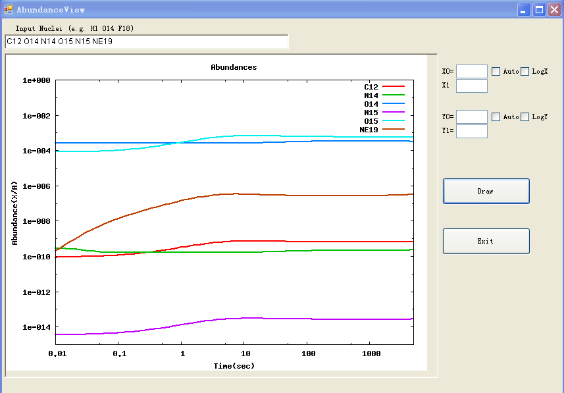
2.核反应网络计算程序界面设计(Result View)

Slide 14
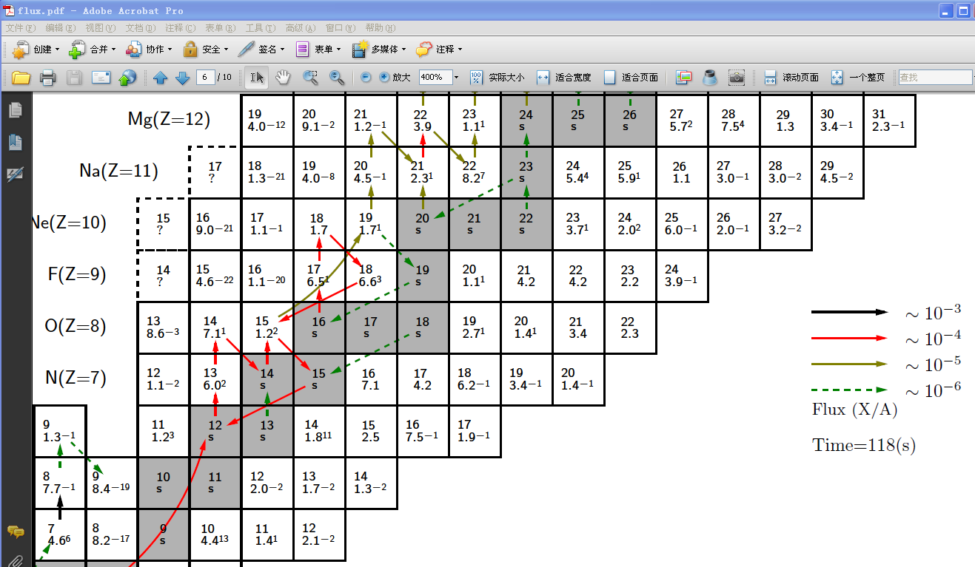
2.核反应网络计算程序界面设计

Slide 15
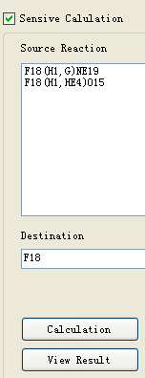
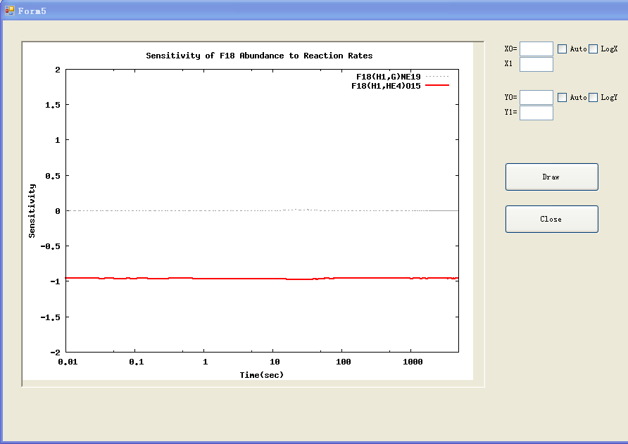
2.核反应网络计算程序界面设计

Slide 16
4.计划
程序开发：
继续程序开发，完成各模型的计算；
增加反应率管理查看功能；
开发网络在线平台，方便使用和管理。

Slide 17
Thanks

