Slide 1
Doodle Recognition by CNN
Yucong Shen

Slide 2
Introduction
”Quick, Draw!” was released as an experimental game to educate the public in a playful way about how AI works. The game prompts users to draw an image depicting a certain category, such as ”banana,” “table,” etc.
The game generated more than 1B drawings. Google public released 50M image in 340 categories.

Slide 3
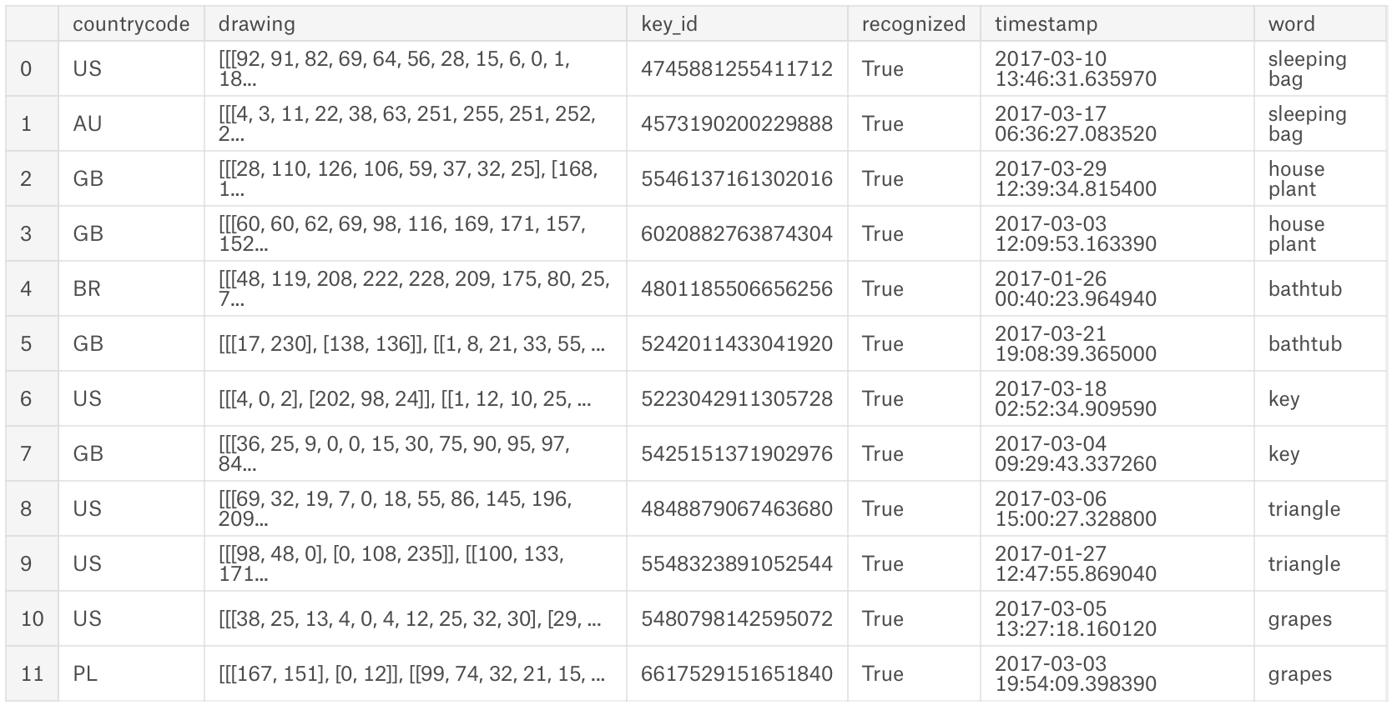
Dataset Overview
Select 2000 images from each categories, 680000 image in total.
544000 image for training, 136000 images for testing.
Draw the strokes in greyscale images of size 32*32.
Here’s what the data frame looks like:

Slide 4
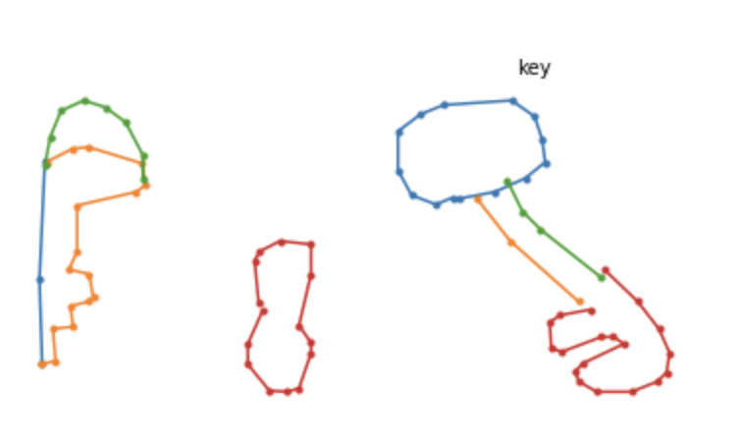
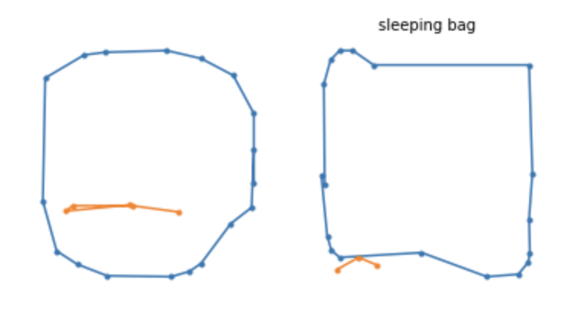
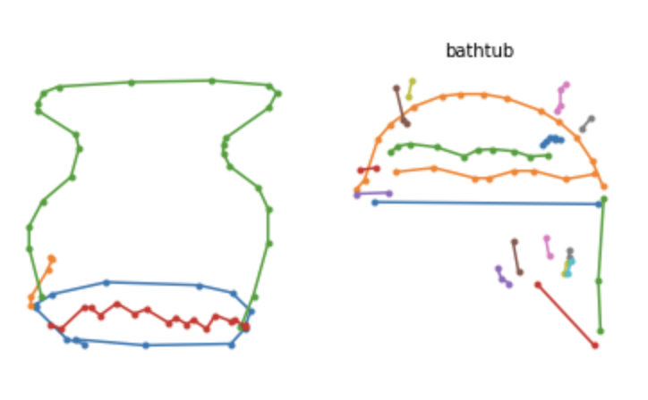
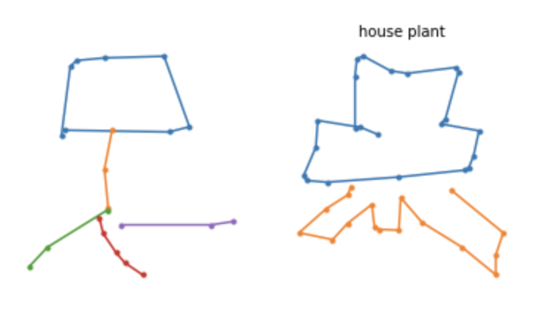
Dataset Overview

Slide 5
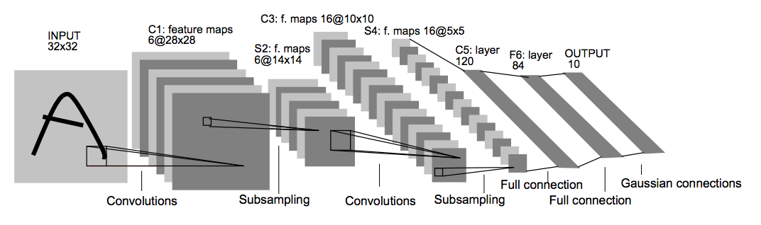
Convolutional Neural Network
CNN usually includes convolutional layer, pooling layer and fully-connected layer.
There’s many successful Convolutional Neural Network structures such as LeNet, AlexNet, GoogleNet, VGG, ResNet etc.
Below is a typical CNN network proposed by Yann Lecun in 1980s.

Slide 6



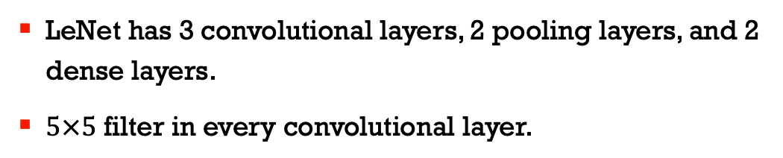



LeNet
LeNet has 3 convolutional layers, 2 pooling layers, and 2 dense layers.
$5×5$ filter in every convolutional layer.
Input, $32×32×1$
Conv, $32×32×16$
Conv, $16×16×32$
Conv, $8×8×64$
Dense, $1024$
Dense, $512$
Output

Slide 7
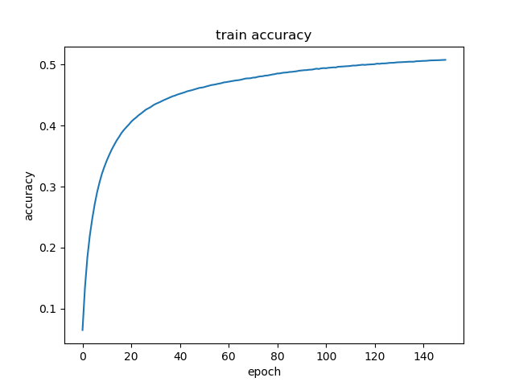
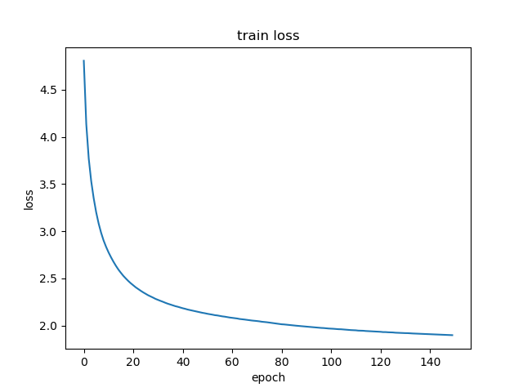
LeNet
Batch size: 200
Optimizer: Adam optimization algorithm
Learning rate: 0.0001
Loss: function: cross-entropy loss function with softmax function
Testing accuracy: 48.65%

Slide 8
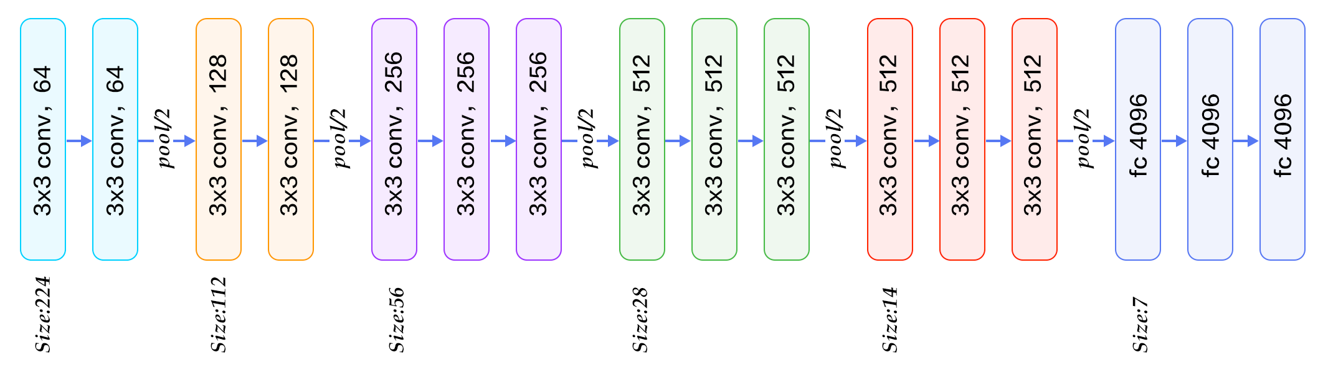
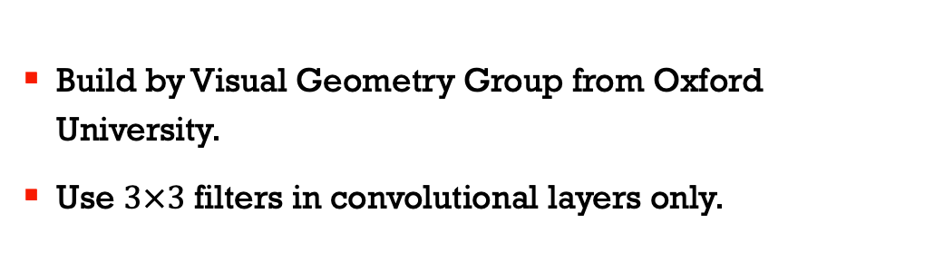
VGG Net
Build by Visual Geometry Group from Oxford University.
Use $3×3$ filters in convolutional layers only.

Slide 9





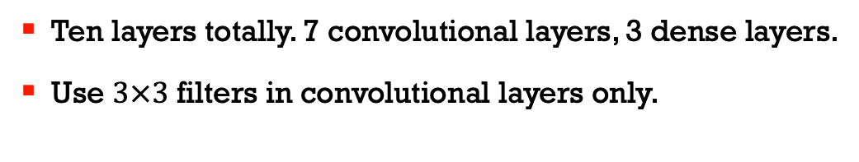






VGG-based Network
Ten layers totally. 7 convolutional layers, 3 dense layers.
Use $3×3$ filters in convolutional layers only.
Dense, $4096$
Dense, $4096$
Dense, $4096$
Conv, $8×8×256$
Output
Conv, $8×8×256$
Conv, $32×32×64$
Conv, $16×16×128$
Conv, $8×8×256$
Conv, $32×32×64$
Input, $32×32×1$
Conv, $16×16×128$

Slide 10
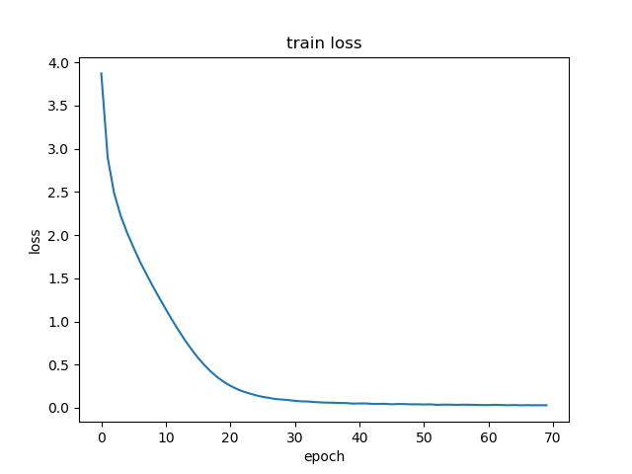
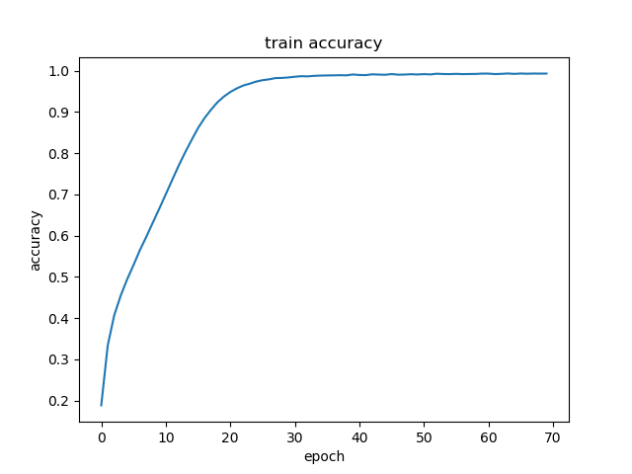
VGG-based Network (Without Drop out)
Batch size: 200
Optimizer: Adam optimization algorithm
Train time: 2.5 hours
Learning rate: 0.0001
Loss function: cross-entropy loss function with softmax function
Test accuracy: 48.50%

Slide 11
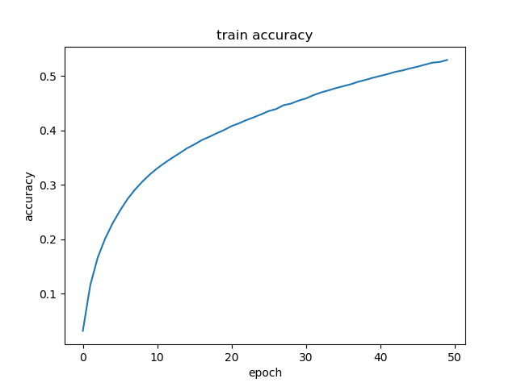
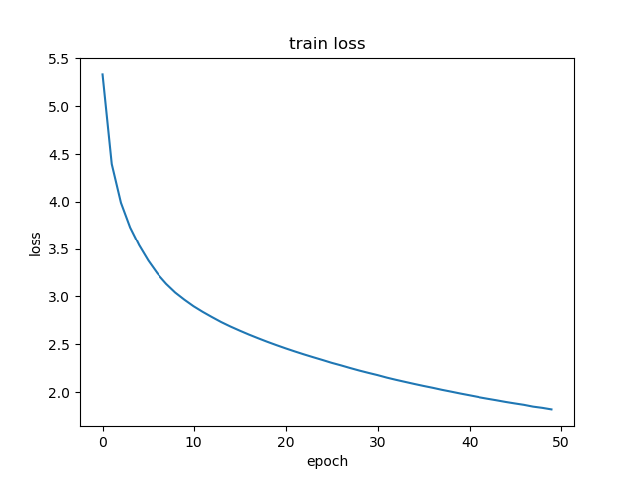
VGG-based Network (With Drop out)
Batch size: 200
Optimizer: Adam optimization algorithm
Train time: 2.5 hours
Learning rate: 0.0001
Loss function: cross-entropy loss function with softmax function
Test accuracy: 50.9%

Slide 12
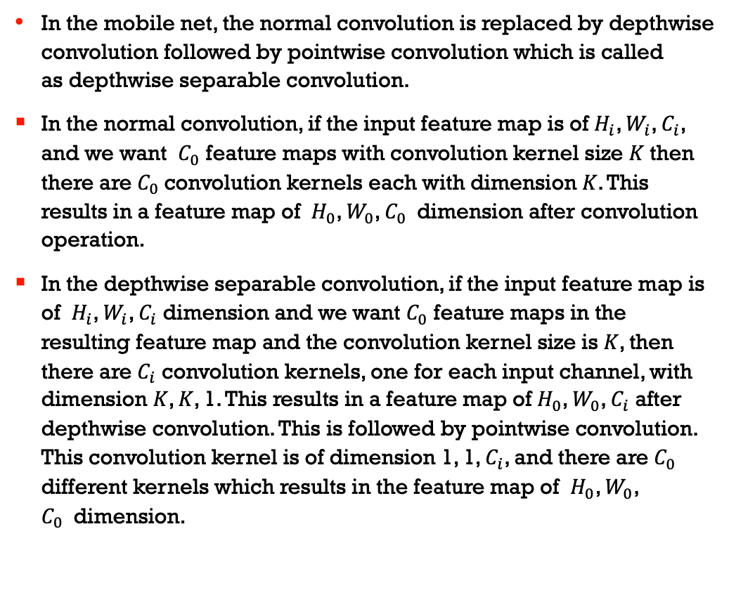
Mobile Net
In the mobile net, the normal convolution is replaced by depthwise convolution followed by pointwise convolution which is called as depthwise separable convolution.
In the normal convolution, if the input feature map is of $H_{i}$, $W_{i}$, $C_{i}$, and we want $C_{0}$ feature maps with convolution kernel size 𝐾 then there are $C_{0}$convolution kernels each with dimension 𝐾. This results in a feature map of $H_{0}$, $W_{0}$, $C_{0}$ dimension after convolution operation.
In the depthwise separable convolution, if the input feature map is of $H_{i}$, $W_{i}$, $C_{i}$ dimension and we want $C_{0}$ feature maps in the resulting feature map and the convolution kernel size is 𝐾, then there are $C_{i}$ convolution kernels, one for each input channel, with dimension 𝐾, 𝐾, 1. This results in a feature map of $H_{0}$, $W_{0}$, $C_{i}$ after depthwise convolution. This is followed by pointwise convolution. This convolution kernel is of dimension 1, 1, $C_{i}$, and there are $C_{0}$ different kernels which results in the feature map of $H_{0}$, $W_{0}$, $C_{0}$ dimension.

Slide 13
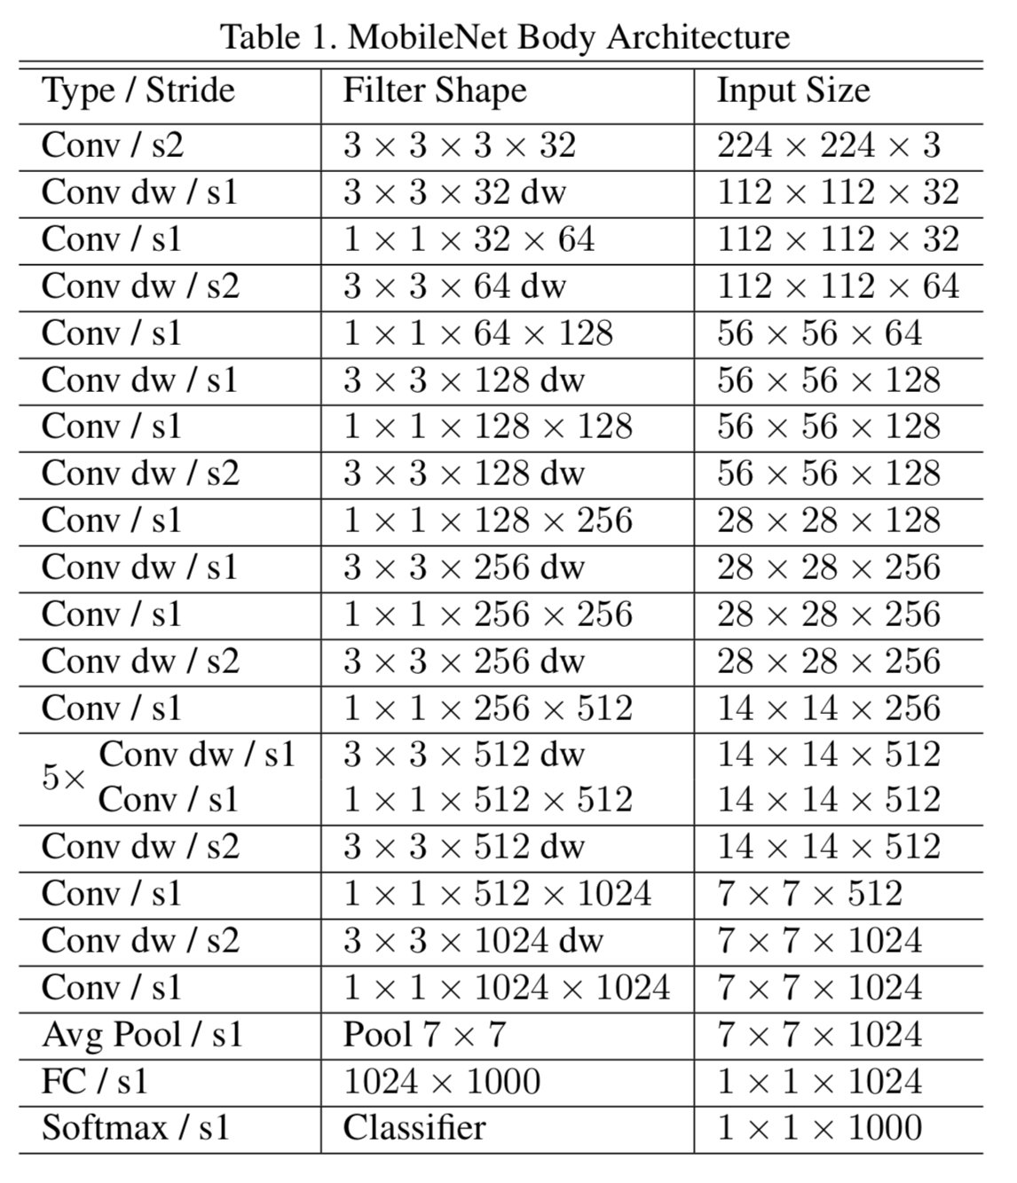
Mobile Net

Slide 14
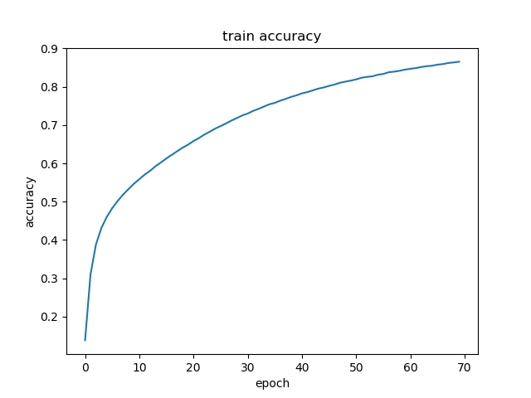
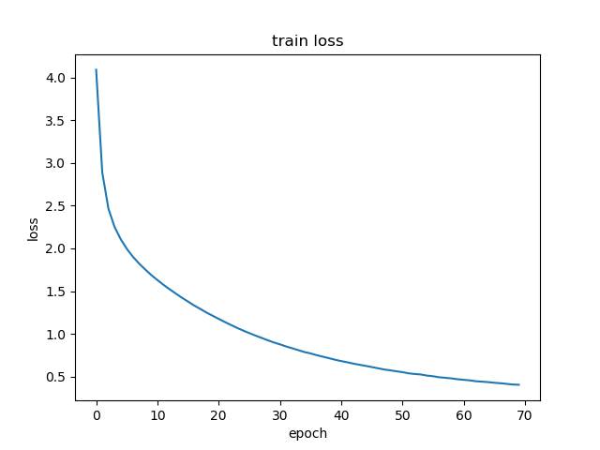
Mobile Net
Batch size: 200
Optimizer: Adam optimization algorithm
Train time: 1.5 hours
Learning rate: 0.0001
Loss function: cross-entropy loss function with softmax function
Test accuracy:

Slide 15
Thank you

