Slide 1
Quick, Draw! Doodle Recognition Challenge
Yucong Shen

Slide 2
Introduction
Quick, draw is an experimental game to educate the public in a playful way about how AI works.
In the game, you can add your drawings in 20s, and the neural networks will recognize your doodling.
https://quickdraw.withgoogle.com/

Slide 3
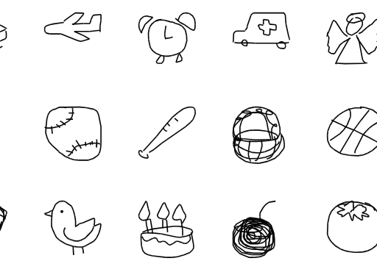
Dataset
The game generated more that 1B images.
Here I will use the publicly released dataset which contains 50M images in 340 label categories.
https://quickdraw.withgoogle.com/data

Slide 4
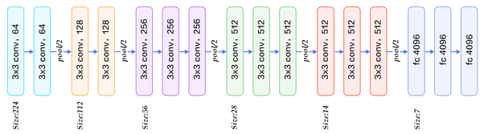
Possible Solution
Machine Learning SVM, logistic regression;
Deep Learning Convolutional Neural Network ( LeNet, AlexNet, VGG, GoogleNet, etc.), Recurrent Neural Network (LSTM)

