Slide 1
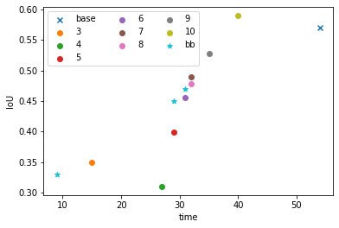
Last meeting: Drew ‘IoU vs. annotation time’ plot for same train set size
-> to draw plot for same annotation time, different train set size (based on my annotate time)
To get better estimation of annotation time, design a task distribution method

Slide 2
I got some data. But before look into them…
# edge | 3 | 4 | 5 | 6 | 7 | 8 | 9 | 10 | Inf (base) | Bounding box
Anno time | 15 | 27 | 29 | 31 | 32 | 32 | 35 | 40 | 54 | 29
Train set size #1 | 8000 | 8000 | 8000 | 8000 | 8000 | 8000 | 8000 | 8000 | 8000 | 8000
IoU | 0.349 | 0.310 | 0.399 | 0.456 | 0.490 | 0.478 | 0.528 | 0.590 | 0.571 | 0.451
Train set size #2 | 17067 | 9481 | 8828 | 8258 | 8000 | 8000 | 7314 | 6400 | 4741 | 8828
IoU | 0.172 | 0.368 | 0.432 |  | 0.490 | 0.478 | 0.548 | 0.540
Train set size #3 | 21333 | 11851 | 11034 | 10322 | 10000 | 10000 | 9143 | 8000 | 5926
IoU |  | 0.378 |  |  | 0.539 | 0.552 | 0.528 | 0.590

Slide 3
Train set size | 8k | 17k
Valid IoU | 0.349 | 0.172

Slide 4
Guess #1: Wrong IoU calculate
Train set size | 8k | 17k
Valid IoU | 0.349 | 0.172

Slide 5
Guess #1: Wrong IoU calculate
Guess #2: Corrupted data
Test 1: From 8k to 17k, 9k data are added; from 17k to two 8.5k, simply split 17k set into two
Test 2: Except 8k and 17k using previous data, all other train sets are randomly sampled from a 23k set
Test 3: I checked all generated triangle annotations (23k samples) one by one
Train set size | 8k | 17k
Valid IoU | 0.349 | 0.172
Train set size | 8k | 17k
 |  | 8.5k | 8.5k
Valid IoU | 0.349 | 0.349 | 0.335
Train set size | 17k | 14k | 12k | 10k | 8k | 6k | 4k | 2k | 1k
Valid IoU | 0.273 | 0.391 | 0.246 | 0.382 | 0.345 | 0.339 | 0.322 | 0.255 | 0.212

Slide 6
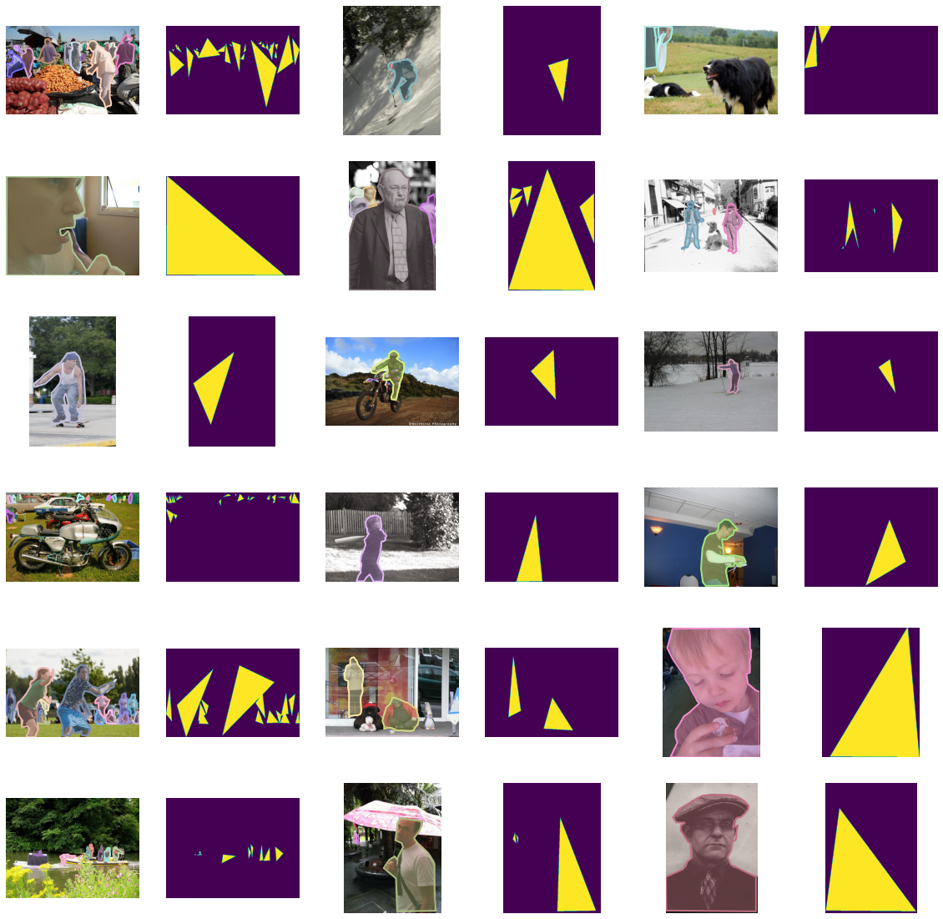
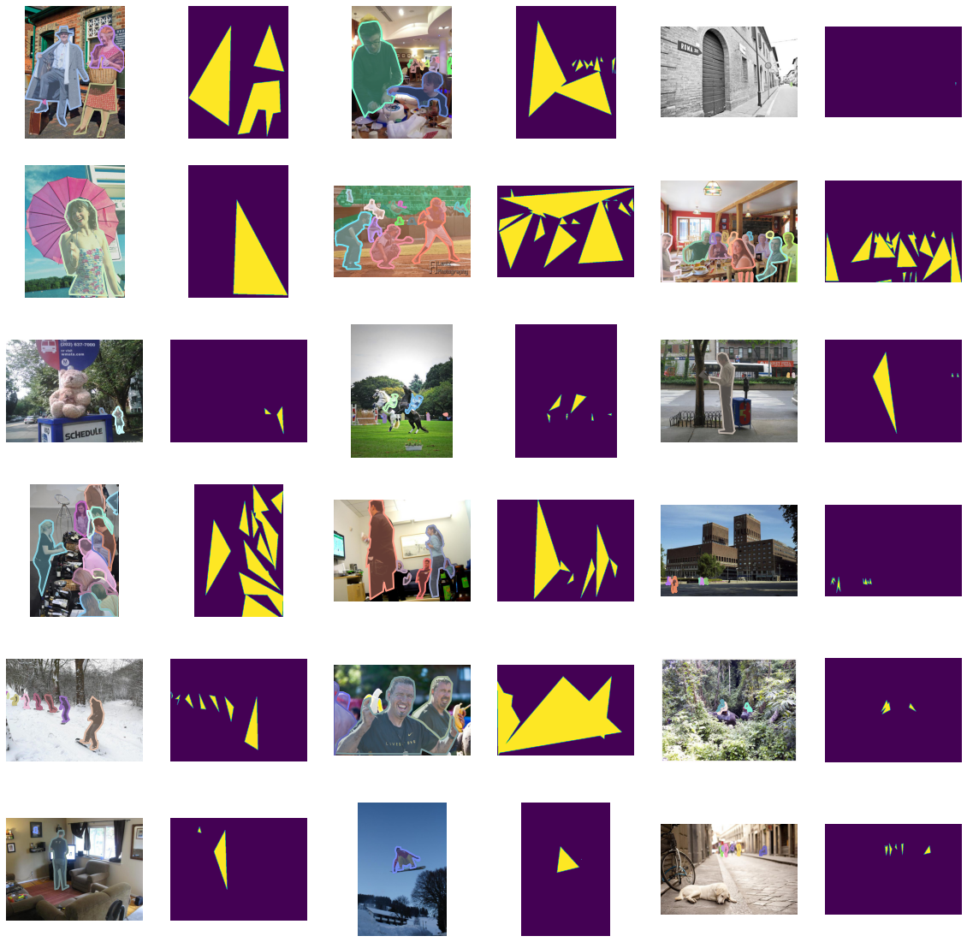

Slide 7
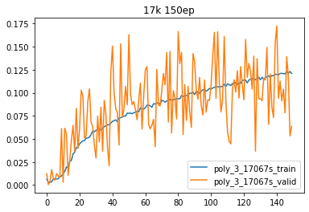
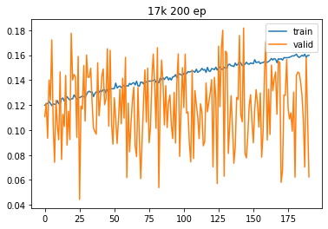
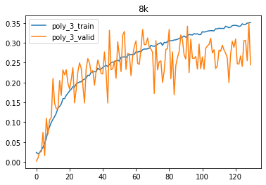
Guess #1: Wrong IoU calculate
Guess #2: Corrupted data
Guess #3: not fully trained because of large dataset
Previous learning rate scheduler: start at 1e-4; decrease to 0.1 every 30 epochs; 150 epochs in all
New testing scheduler: start at 1e-4; decrease to 0.5 every 40 epochs; 240 epochs in all
Train set size | 8k | 17k
Valid IoU | 0.349 | 0.172

Slide 8
Guess #1: Wrong IoU calculate
Guess #2: Corrupted data
Guess #3: not fully trained because of large dataset
Guess #4: Unet model doesn’t support such large data; should make Unet deeper
Change from 5 layers to 7, and 3 for reference
Train set size | 8k | 17k
Valid IoU | 0.349 | 0.172
Unet depth | 3 | 5 (origin) | 7
Valid IoU | 0.175 | 0.172 | 0.194

Slide 9
Guess #1: Wrong IoU calculate
Guess #2: Corrupted data
Guess #3: not fully trained because of large dataset
Guess #4: Unet model doesn’t support such large data; should make Unet deeper
Guess #5: data doesn’t transfer correctly from my Google Drive to model
Path: Google Drive –download--> PC –FileZilla--> RYSY –dataLoader--> model
My current stage: first two transfer checked
After python getting data from data loader, before putting data into model, I stored these input data to check
Guess #4-2 (from Haoyu): change to larger network such as double Unet. (Most user of COCO dataset applies resnet which is much larger than Unet)
I’m little confused here, trying to understand model capacity in deep learning
Train set size | 8k | 17k
Valid IoU | 0.349 | 0.172

Slide 10
Annotation methods
1 bounding box
1-1 one box for one object
1-2 allow one boxes for many objects
2 filter
2-1 approximate mask
2-2 larger approx mask to cover whole object
2-3 smaller approx mask
3 polygon
3-1 triangle
3-2 quadrangle (optinal)
3-3 polygon - around 8 edges (optional)
3-4 polygon – as many edges as annotator want
4 scribble

Slide 11
10 tasks
For example, if we have 5 annotators, each annotator gets 4 tasks, so that we have 2 samples for each of tasks
30 images for each task: it won’t take long
Randomly sampled images; different images for different annotator
I will provide samples to most of cases to avoid long time consideration
I hope annotators could save their annotations for me to check how similar their annos are compared to generated one and perfect one
Software, online tool, paint with special color …

Slide 13
