Slide 1
This week:
Generating scribble
Add error to bounding box
Start drafting paper

Slide 2
Scribble – methods looks good now
Method 1: as what polygon is from, create a line by Douglas-Peucker algorithm
Method 2: start from a polygon with 6 – 8 edges; triangulation polygon; connect triangles
Use sinusoidal curve to replace lines

Slide 3
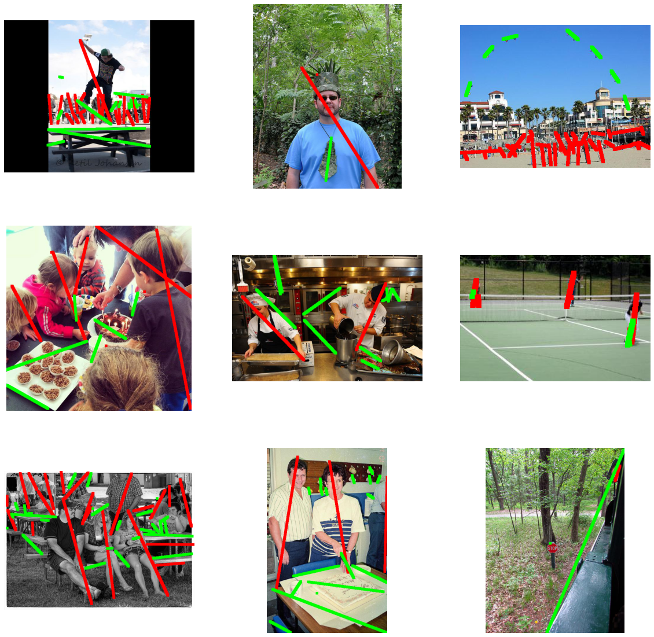
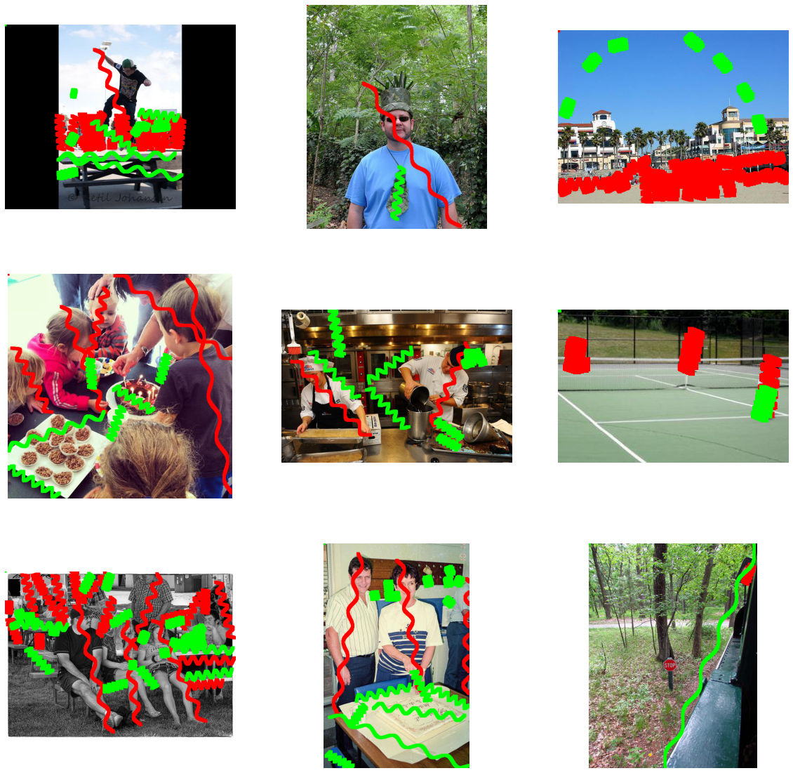
Method 1: as what polygon is from, create a line by Douglas-Peucker algorithm (red for target)

Slide 4
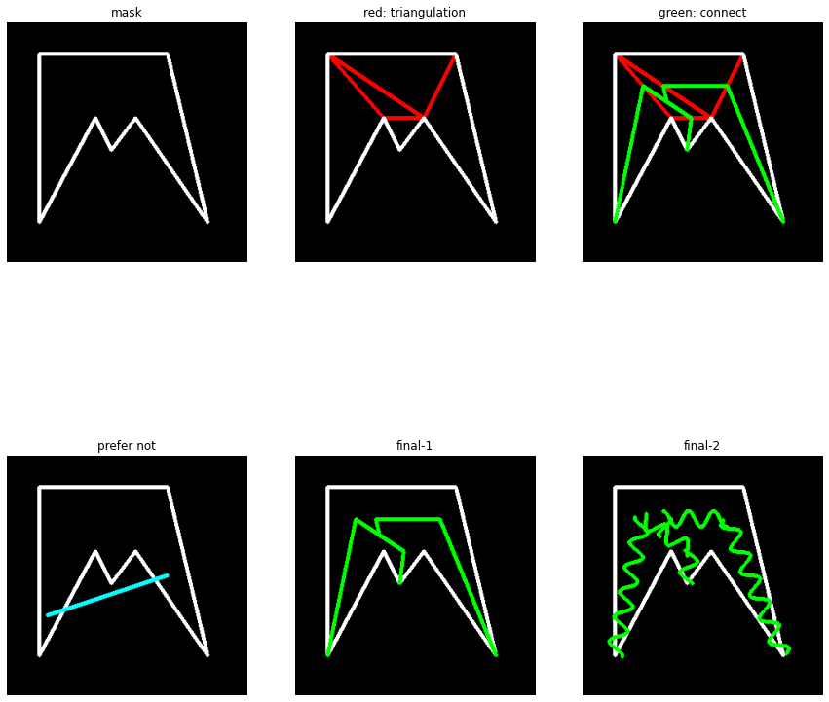
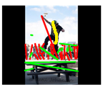

Method 2: start from a polygon with 6 – 8 edges; triangulation polygon; connect triangles

Slide 5
Tried but failed method
Random walk inside perfect mask
Also tried to use PI control as P – distance towards boundary; I – distance along current direction
Symmetry axis for bounding box, and polygon with 4, 6, 8 edges
Longest middle line for triangle
Cut bounding box into several small rectangles (like 3*4 = 12 rectangles)
Calculate pixel number with label 1 (target), ignore box if number is smaller than a threshold (like 20% of pixels)
Get density center for each small box, and connect them together

Slide 6
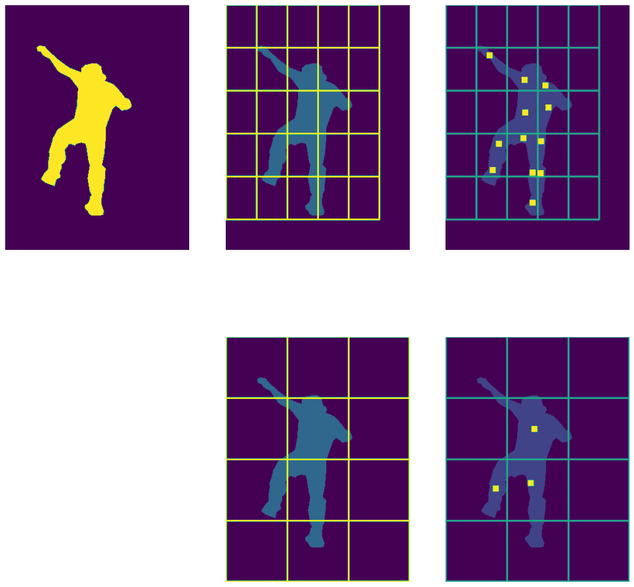
Cut bounding box into several small rectangles (like 3*4 = 12 rectangles)
Calculate pixel number with label 1 (target), ignore box if number is smaller than a threshold (like 20% of pixels)
Get density center for each small box, and connect them together
Problem: size; unknown order

Slide 7
Tried but failed method
Random walk inside perfect mask
Also tried to use PI control as P – distance towards boundary; I – distance along current direction
Symmetry axis for bounding box, and polygon with 4, 6, 8 edges
Longest middle line for triangle
Cut bounding box into several small rectangles (like 3*4 = 12 rectangles)
Calculate pixel number with label 1 (target), ignore box if number is smaller than a threshold (like 20% of pixels)
Get density center for each small box, and connect them together
If we can’t generate proper scribble, maybe we have to annotate by ourselves if we still want to include scribble

Slide 8
Add error to bounding box
Shift: move whole box i% pixels along x-axis and j% pixels along y-axis; i, j are a random integers from range –k to k where k is a parameter
Resize: wrt bounding box center, adjust box size by p%; p is random integers from range –q to q where q is a parameter
Input is valid IoU
Maybe we can take annotation error into consideration
We could obtain value distribution for k and q from our annotation
Train set size | 8k | 14k | 18k
Origin (k=q=0) | 0.396 | 0.412 | 0.413
k=20, q=10 | 0.399 | 0.414 | 0.410
k=30, q=20 | 0.340 | 0.377 | 0.382
k=30, q=10 | 0.352 |  | 0.391
k=20, q=20 | 0.394 |  | 0.411

Slide 9
Adjust loss layer
Add DCS – no improvement

Slide 10
Draft paper: just start

