Slide 1
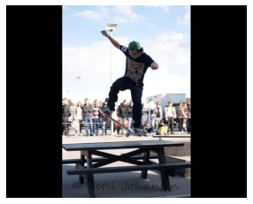

Trying to obtain a good u-net for human detection
Currently, I don’t separate instances

Slide 2
I want to achieve at least 0.65
My current best is 0.59 (with 5k train sample, 2.7k valid)
IoU | size | dataset | size | year
73.7* | 8523 | PASCAL VOC 2017 | 512 | 2018
52.5 | 8523 | PASCAL VOC 2012 | 321 | 2016
53.6 | 8523 | PASCAL VOC 2017 | 321 | 2017
68.4 | 8523 | PASCAL VOC 2017 | 512 | 2020
68.5 | 8523 | PASCAL VOC 2012 |  | 2016
69.1 | 8523 |  |  | 2016
67.6(average for all) | 8523 |  |  | 2015
63.8 |  | PASCAL VOC 2012 | origin | 2015
68.1 | 133869 | Coco 2012 |  | 2015

Slide 3
What I tried:
Optimizer: SGD, ADAM, RMSprop
Loss: cross entropy, BCE with logits
Data augmentation: crop, flip, inverse
U-Net: transpose/bilinear, same convolution/padding
5k train, 80 epoch, -> 13-15h
2.5k train -> 7h
Each column for one setting, input number is IoU
2.5k are origin data, 5k and 7.5k are augmented
2.5k | 0.51 | 0.52 | 0.51 | 0.52 | 0.56 | 0.52 | 0.52
5k | 0.58 | 0.52 | 0.52* | 0.55 | 0.55 | 0.59
7.5k |  |  |  |  |  |  |  | 0.53 | 0.52 | 0.54

Slide 4
I am looking into unet implement on github to check where I can modify mine
Question 1: what is data augmentation
Most papers transform training data every epoch and calls it data augmentation.
For me, I transform training data and add them to train dataset
Question 2: GPU usage increases along with epochs

