Slide 1
Result for our annotation
Time in second; accuracy in IoU w.r.t. perfect mask
 | perfect | individual_bounding_box | multiple_bounding_box | approx_contour | less_precise_contour | triangle | pentagon | 8_to_12_edges | one_point | scribble
Shen time | 767.8 | 45.3 | 101.8 | 424.1 | 285.7 | 136.5 | 143.7 | 230.7 | 28.3 | 38.2
Xian time | 539.3 | 30.1 | 34.8 | 147 | 84.8 | 152.7 | 152.6 | 194.5 | 22.5 | 26.5
Chris time | 1143.7 | 271.2 | 214.3 | 371 | 207.2 | 157.6 | 233.8 | 281.4 | 56.1 | 98.3
Shen IoU | 0.84 | 0.44 | 0.41 | 0.73 | 0.66 | 0.53 | 0.62 | 0.76
Xian IoU | 0.82 | 0.50 | 0.39 | 0.74 | 0.64 | 0.46 | 0.58 | 0.69
Chris IoU | 0.83 | 0.46 | 0.45 | 0.82 | 0.78 | 0.51 | 0.68 | 0.77
Ave IoU | 0.83 | 0.47 | 0.42 | 0.76 | 0.69 | 0.50 | 0.63 | 0.74

Slide 2
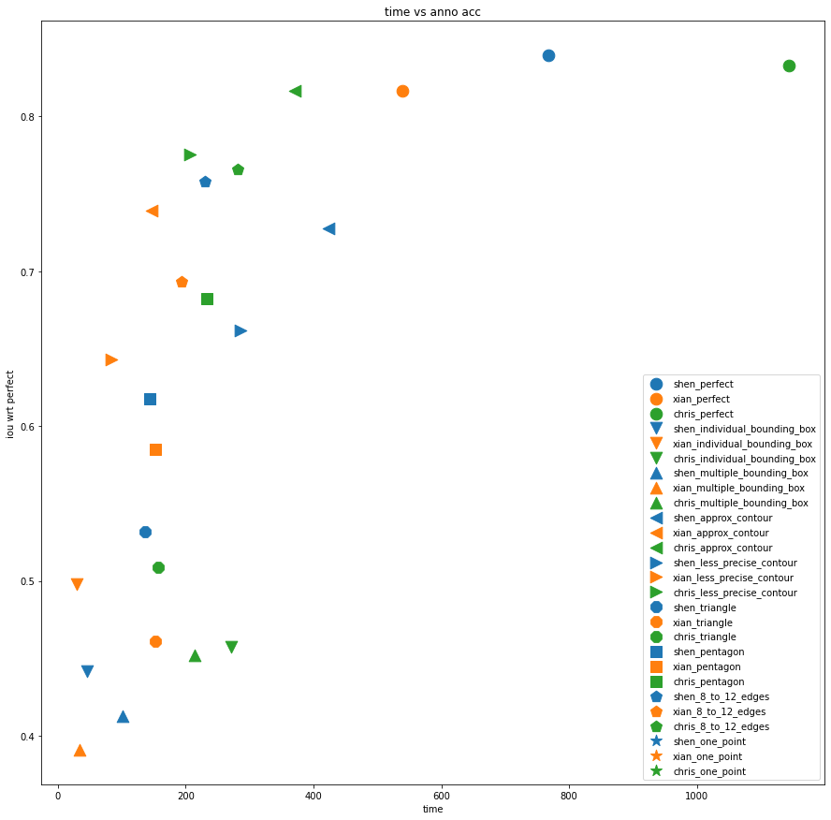

Slide 3
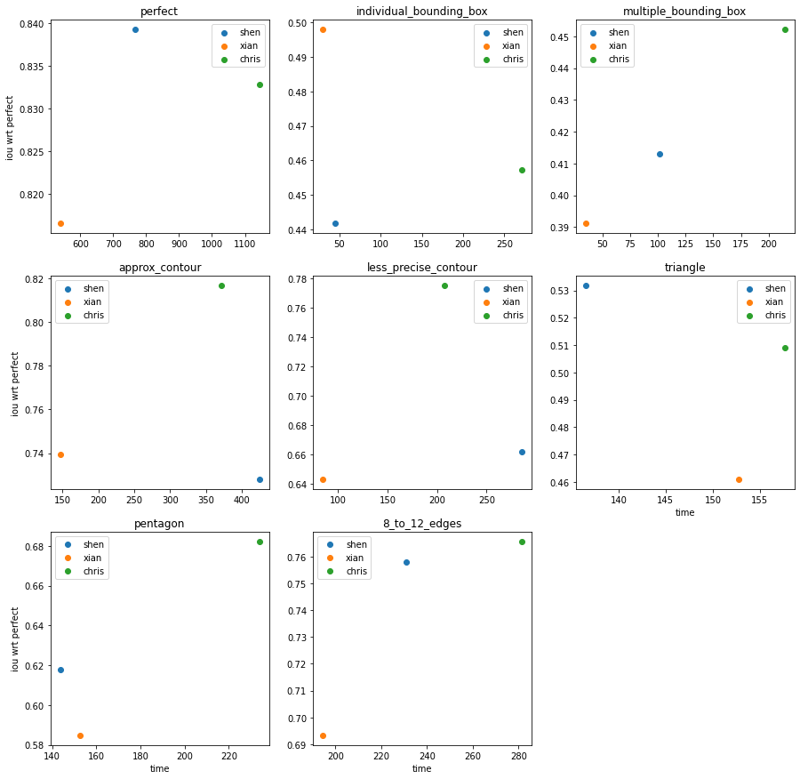

Slide 4
IoU for previous generated annotation compared to perfect mask
 | filter_3 | filter_5 | filter_11 | filter_21 | poly_3 | poly_4 | poly_5 | poly_6 | poly_7 | poly_8 | poly_9 | poly_10 | box
IoU wrt perfect mask | 0.941 | 0.839 | 0.653 | 0.467 | 0.517 | 0.518 | 0.611 | 0.687 | 0.745 | 0.789 | 0.822 | 0.845 | 0.529
 | perfect |  |  | individual_bounding_box | multiple_bounding_box | approx_ contour | less_ precise_ contour | triangle | pentagon | 8_to_12_edges
IoU: anno vs perfect | 0.83 |  |  | 0.47 | 0.42 | 0.76 | 0.69 | 0.50 | 0.63 | 0.74
Generated method | Filter_5 | #1 | perfect | #2 | #3 | Filter_7 | Filter_9 | Poly_3 | Poly_5 | Poly_7 | Poly_8
IoU: generated vs perfect | 0.839 | 0.84 | 1 | 0.475 | 0.421 | 0.761 | 0.704 | 0.517 | 0.611 | 0.745 | 0.789
IoU: anno vs generated | 0.83 | 0.79 | 0.83 | 0.82 | 0.78 | 0.91 | 0.93 | 0.85 | 0.80 | 0.82 | 0.77
Ave _time | 816.93 | 816.93 | 816.93 | 115.53 | 116.97 | 314.03 | 192.57 | 148.93 | 176.70 | 235.53 | 235.53
size | 4603 | 4603 | 4603 | 32545 | 32146 | 11973 | 19526 | 25246 | 21279 | 16000 | 16000

Slide 5
Method #1: randomly shift perfect mask by 0-26 pixels (to right or left)
Method #2: randomly shift bounding box by 0-13 pixels (to right or left)
Method #3: randomly shift bounding box by 0-20 pixels (to right or left)
Method #4: randomly enlarge perfect mask by 0-15%, whose center point is randomly selected in the overlap area of the mask itself and a 10*10 square centered at center of bounding box of mask
For method #2 and #3, I will try to enlarge with shift other than only shift
 | perfect |  |  |  | individual_bounding_box | multiple_ bounding_box | approx_ contour | less_ precise_ contour | triangle | pentagon | 8_to_12_edges
IoU: anno vs perfect | 0.83 |  |  |  | 0.47 | 0.42 | 0.76 | 0.69 | 0.50 | 0.63 | 0.74
generated | Filter_5 | #1 | #4 | perfect | #2 | #3 | Filter_7 | Filter_9 | Poly_3 | Poly_5 | Poly_7 | Poly_8
IoU: generated vs perfect | 0.839 | 0.84 | 0.83/0.80/0.80 | 1 | 0.475 | 0.421 | 0.761 | 0.704 | 0.517 | 0.611 | 0.745 | 0.789
IoU: anno vs generated | 0.83 | 0.79 | 0.67/0.92/0.79 | 0.83 | 0.82 | 0.78 | 0.91 | 0.93 | 0.85 | 0.80 | 0.82 | 0.77
Ave _time | 816.93 | 816.93 | 816.93 | 816.93 | 115.53 | 116.97 | 314.03 | 192.57 | 148.93 | 176.70 | 235.53 | 235.53
size | 4603 | 4603 | 4603 | 4603 | 32545 | 32146 | 11973 | 19526 | 25246 | 21279 | 16000 | 16000

Slide 6
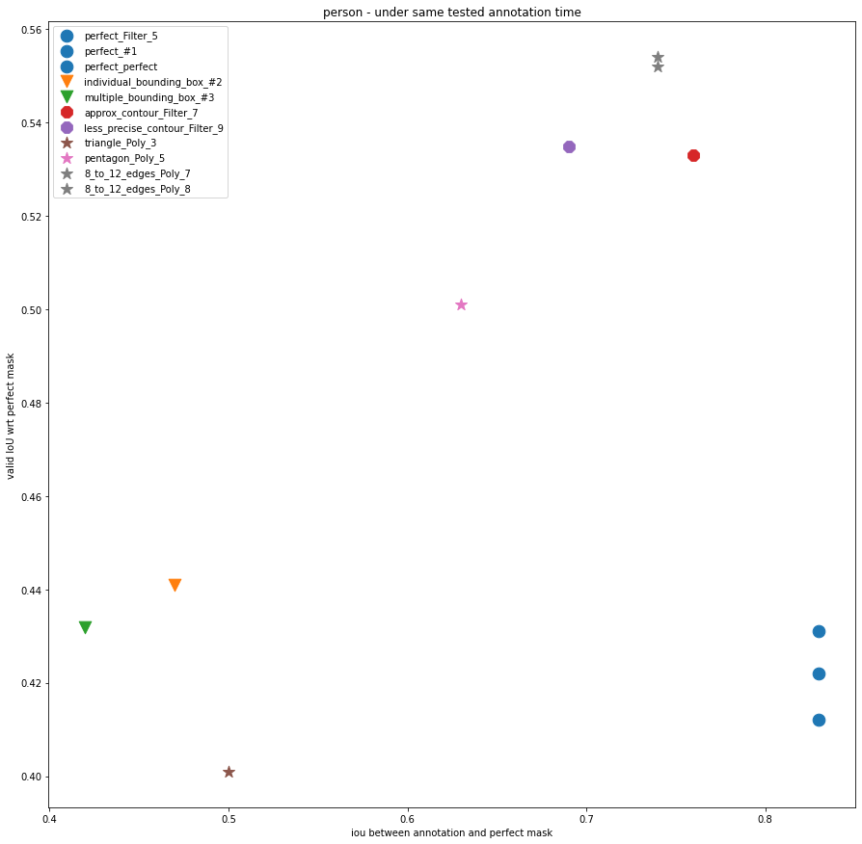

Slide 7
 | perfect |  |  | individual_bounding_box | multiple_ bounding_box | approx_ contour | less_ precise_ contour | triangle | pentagon | 8_to_12_edges
IoU: anno vs perfect | 0.83 |  |  | 0.47 | 0.42 | 0.76 | 0.69 | 0.50 | 0.63 | 0.74
generated | Filter_5 | #1 | perfect | #2 | #3 | Filter_7 | Filter_9 | Poly_3 | Poly_5 | Poly_7 | Poly_8
Ave _time | 816.93 | 816.93 | 816.93 | 115.53 | 116.97 | 314.03 | 192.57 | 148.93 | 176.70 | 235.53 | 235.53
size | 4603 | 4603 | 4603 | 32545 | 32146 | 11973 | 19526 | 25246 | 21279 | 16000 | 16000
Valid IoU | 0.431 | 0.412 | 0.422 | 0.441 | 0.432 | 0.533 | 0.535 | 0.401 | 0.501 | 0.554 | 0.552

Slide 8
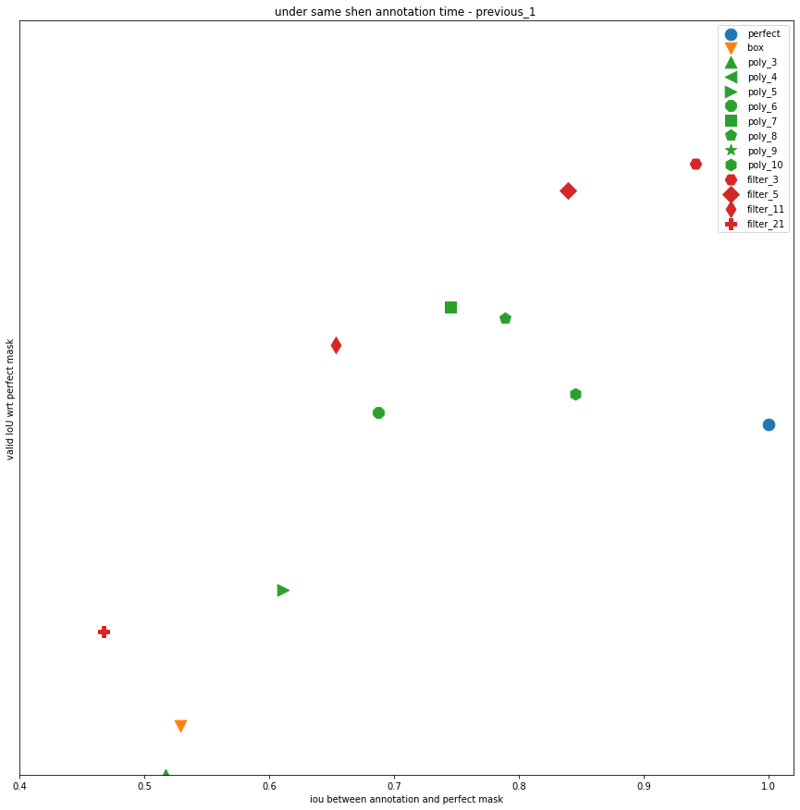
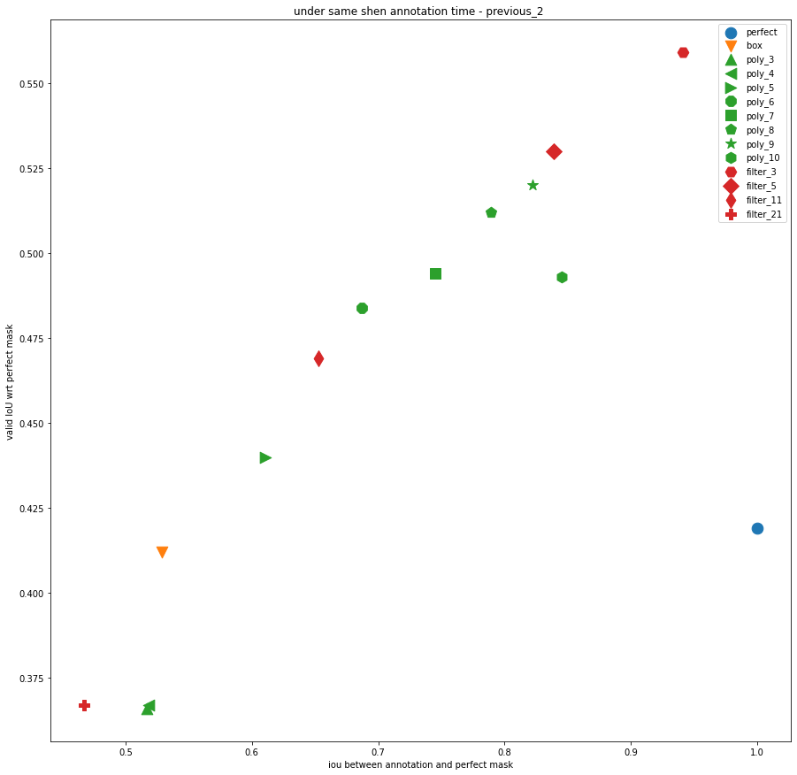
Result of my previous work (based on my own time)

Slide 9
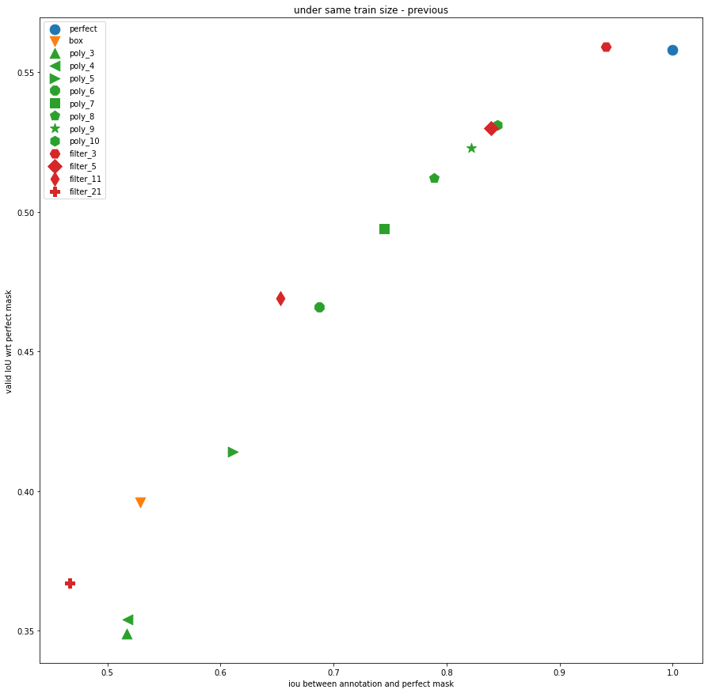
Result of my previous work

Slide 10
For other object (road and car)
Under same training size 11k
 | filter_3 | filter_5 | filter_11 | filter_21 | poly_3 | poly_4 | poly_5 | poly_6 | poly_7 | poly_8 | poly_9 | poly_10 | perfect | box
Car valid IoU | 0.329 | 0.3 | 0.288 | 0.266 | 0.162 | 0.271 | 0.309 | 0.321 | 0.324 | 0.321 | 0.33 | 0.326 | 0.348 | 0.261
Car iou wrt perfect | 0.925 | 0.717 | 0.428 | 0.246 | 0.541 | 0.761 | 0.833 | 0.882 | 0.912 | 0.933 | 0.945 | 0.956 | 1 | 0.667
Road valid IoU | 0.536 | 0.487 | 0.441 | 0.399 | 0.368 | 0.45 | 0.471 | 0.47 | 0.505 | 0.511 | 0.521 | 0.519 | 0.557 | 0.396
Road iou wrt perfect | 0.972 | 0.904 | 0.779 | 0.657 | 0.557 | 0.696 | 0.758 | 0.804 | 0.837 | 0.86 | 0.876 | 0.889 | 1 | 0.498

Slide 11
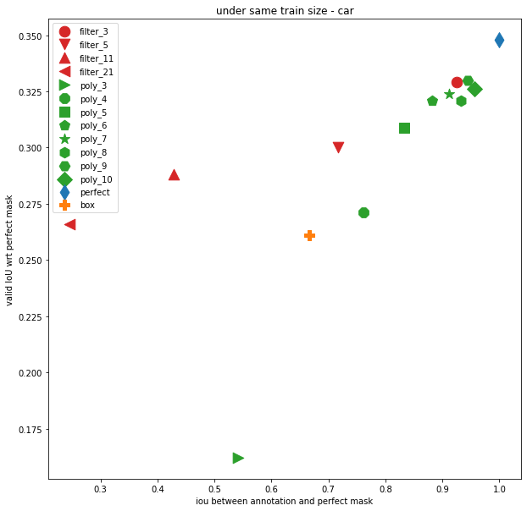
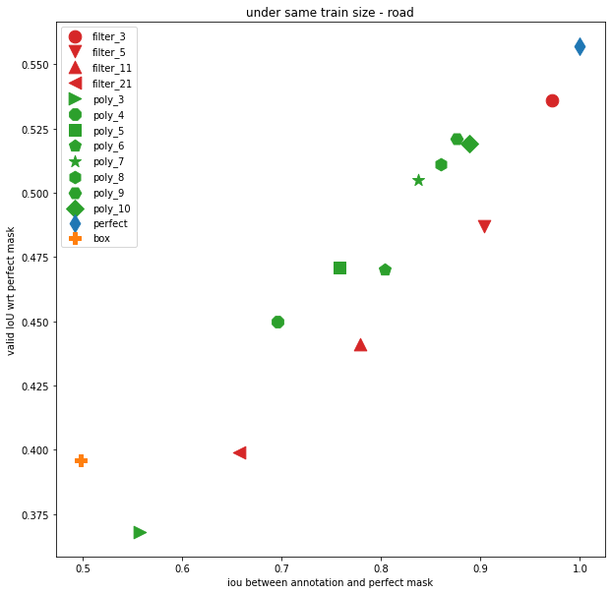

Slide 12
I would like to apply annotation on human to estimate annotation time on other object based on similar mask iou wrt perfect mask
road | perfect |  | individual_bounding_box | multiple_bounding_box | approx_ contour | less_ precise_ contour | triangle | pentagon |  | 8_to_12_edges
IoU: anno vs perfect | 0.83 |  | 0.47 | 0.42 | 0.76 | 0.69 | 0.50 | 0.63 |  | 0.74
Generated method | Filter 7 | #1 | #2 | #3 | Filter 11 | Filter 21 | Poly 3 | Poly 4 | Poly 5*
IoU: generated vs perfect | 0.851 |  |  |  | 0.779 | 0.657 | 0.557 | 0.696 | 0.758
Ave _time | 816.93 |  | 115.53 | 116.97 | 314.03 | 192.57 | 148.93 | 176.70 |  | 235.53 | 235.53
Train size | 2187 |  | 15402 | 15275 | 5689 | 9278 | 11996 | 10111 |  | 7585 | 7585
Valid iou | 0.201 |  |  |  | 0.388 | 0.395

Slide 19
