Slide 1
Method 1: randomly enlarge perfect mask by 15% wrt center of bounding box
Method 2: randomly enlarge perfect mask by 15% and shift 0-15 pixels for all four direction
Method 3: enlarge by 15%, and shift 0-30 pixels
IoU between perfect and directly generated bounding box is 0.53
IoU between perfect and #2/#3 is 0.47/0.42 (average for 10k images 5 times)
IoU between our annotation and #2/#3 is 0.88 and 0.86
 | perfect | perfect2 | perfect3 | individual_bounding_box | multiple_bounding_box | approx_contour | less_precise_contour | triangle | pentagon | 8_to_12_edges2
Train anno IoU wrt perfect | 0.83 | 0.83 | 0.83 | 0.47 | 0.42 | 0.76 | 0.69 | 0.5 | 0.63 | 0.74
generated | Filter_5 | #1 | perfect | #2 | #3 | Filter_7 | Filter_9 | Poly_3 | Poly_5 | Poly_8
Ave_time | 816.93 | 816.93 | 816.93 | 115.53 | 116.97 | 314.03 | 192.57 | 148.93 | 176.7 | 235.53
50h | 2203 | 2203 | 2203 | 15580 | 15389 | 5732 | 9347 | 12086 | 10187 | 7642
iou50 | 0.219 | 0.361 | 0.419 | 0.391 | 0.388 | 0.469 | 0.471 | 0.333 | 0.449 | 0.521
100h | 4407 | 4407 | 4407 | 31161 | 30777 | 11464 | 18695 | 24172 | 20374 | 15285
iou100 | 0.447 | 0.405 | 0.411 | 0.424 | 0.405 | 0.523 | 0.513 | 0.393 | 0.382 | 0.524
104h | 4603 | 4603 | 4603 | 32545 | 32146 | 11973 | 19526 | 25246 | 21279 | 16000
iou104 | 0.431 | 0.412 | 0.422 | 0.441 | 0.432 | 0.533 | 0.535 | 0.401 | 0.501 | 0.552
150h | 6610 | 6610 | 6610 | 46741 | 46166 | 17196 | 28042 | 36259 | 30560 | 22927
iou150 | 0.491 | / | 0.491 | 0.451 | 0.444 | 0.555 | 0.555 | 0.4 | 0.503 | 0.555

Slide 2
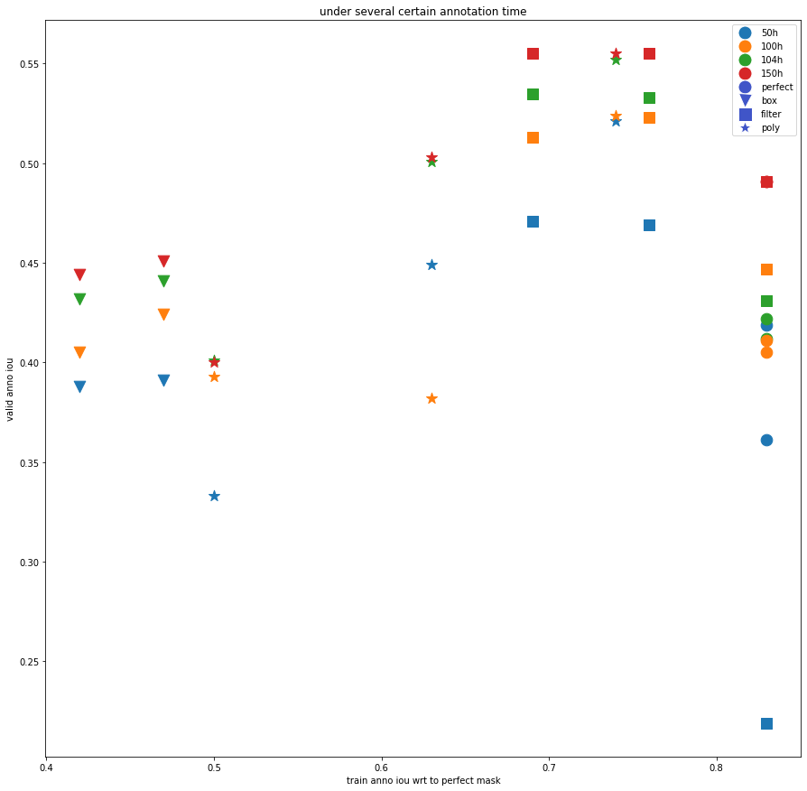
For most cases(50h, 100h, 104h), Poly-8 shows best performance under same annotation time
While for 150h, filter-9, filter-7, poly-8 shows almost same results.

Slide 3
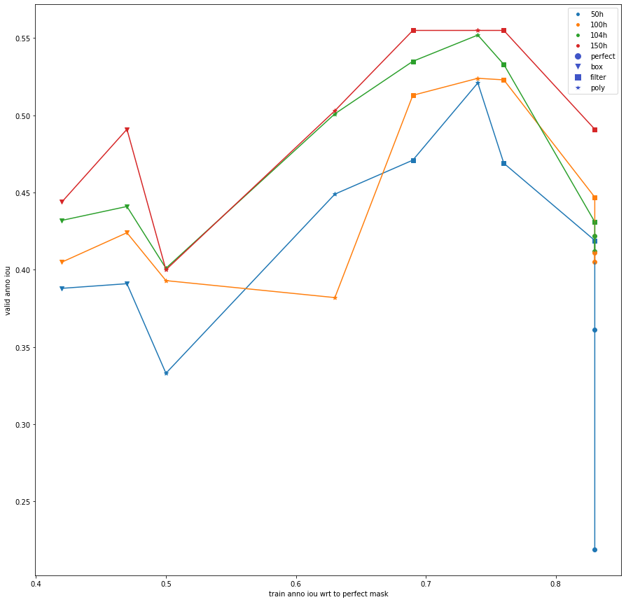
50h | 10187
iou5 | 0.449
100h | 20374
iou10 | 0.382
104h | 21279
iou104 | 0.501
150h | 30560
iou15 | 0.503
Error?

Slide 4
Main problem: only do one time
Train with same 20k data: valid iou 0.382 0.408 0.393
Train with same 10k data: 0.344 0.356 0.355
Train with different 20k data: 0.399 0.394 0.423, 0.372
Train with different 10k data: 0.345 0.339 0.352, 0.333
(data above trained for 50 epochs while others for 150 epochs)
Need update annotation time data, and then do multiple time and take average
50h | 10187
iou5 | 0.449
100h | 20374
iou10 | 0.382
104h | 21279
iou104 | 0.501
150h | 30560
iou15 | 0.503

Slide 5
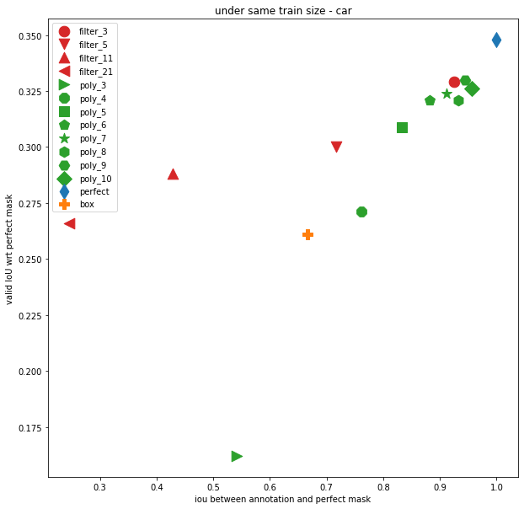
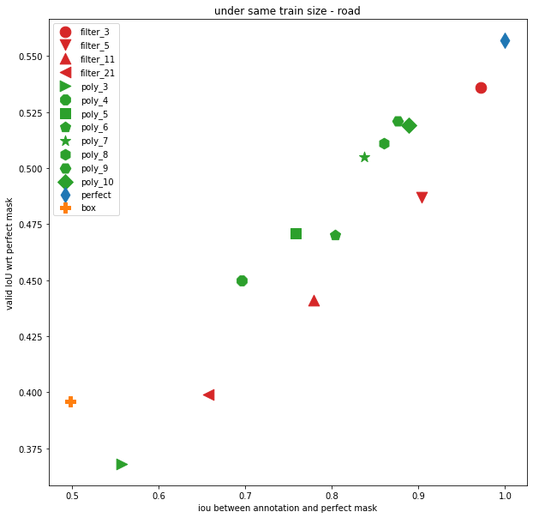

Slide 6
road | perfect | perfect2 | individual_bounding_box | multiple_bounding_box | approx_contour | less_precise_contour | triangle | pentagon | 8_to_12_edges2
IoU | 0.83 | 0.83 | 0.47 | 0.42 | 0.76 | 0.69 | 0.5 | 0.63 | 0.74
generated | Filter_7 | perfect | #4 | #5 | Filter_11 | Filter_21 | Poly_3 | Poly_5 | Poly_8
Ave_time | 816.93 | 816.93 | 115.53 | 116.97 | 314.03 | 192.57 | 148.93 | 176.7 | 235.53
50h | 2203 | 2203 | 15580 | 15389 | 5732 | 9347 | 12086 | 10187 | 7642
iou5 | 0.201 |  | 0.355 |  | 0.388 | 0.395 |  |  | 0.448

