Slide 1
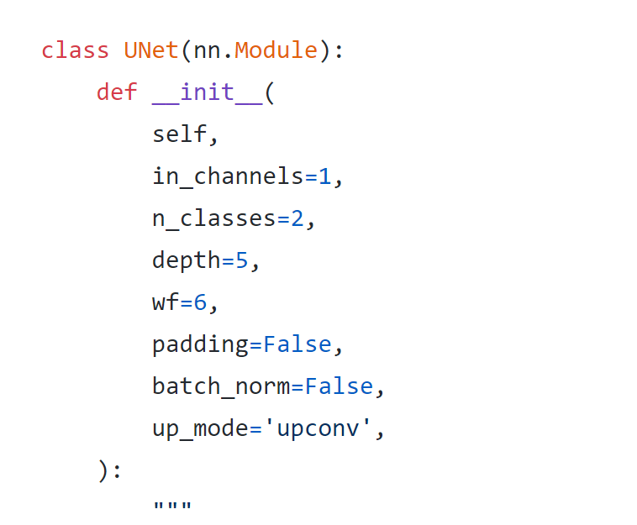
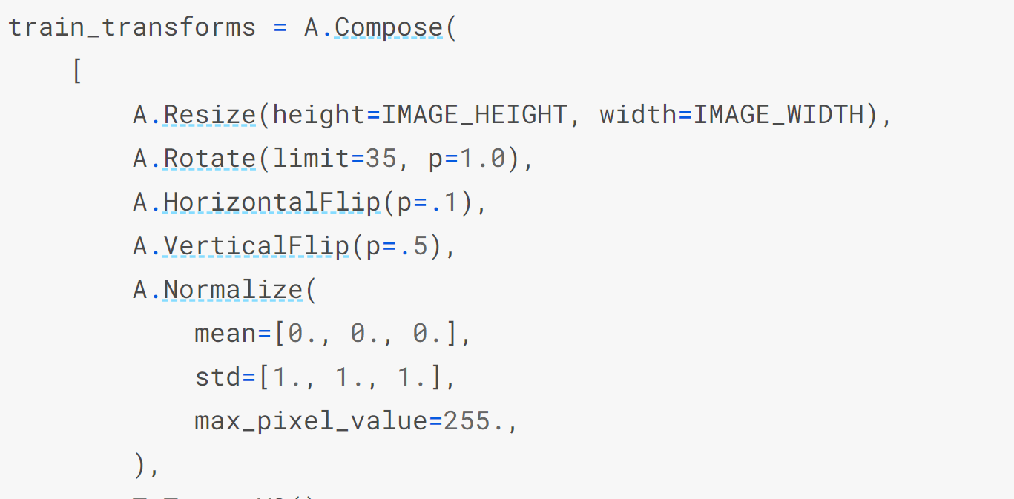
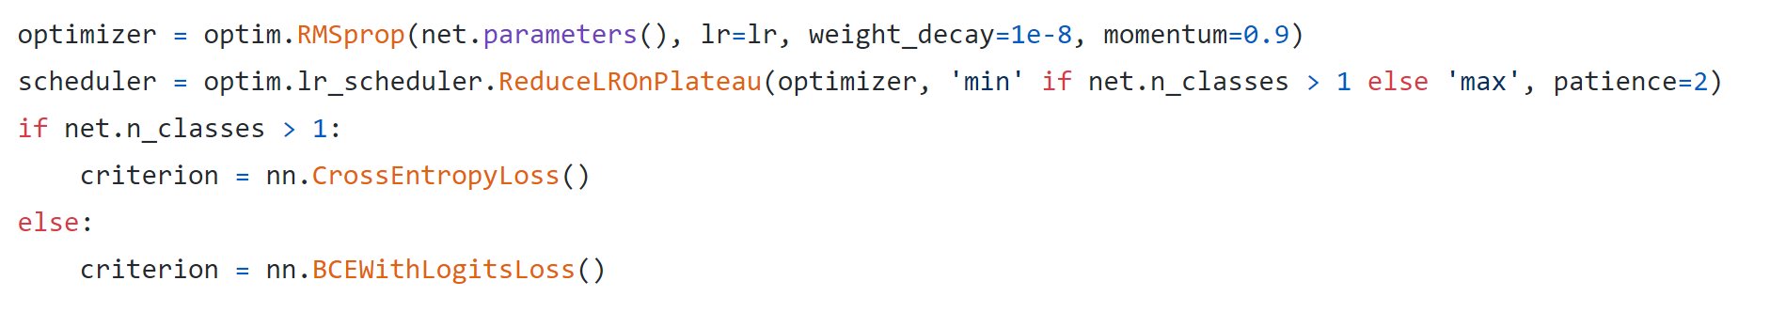
How I test publicly available code for U-Net
Basically, I apply their U-Net model and use same setting, but train with my own dataset.
Copy class U-Net as model
Adjust loss function, optimizer, learning rate scheduler and transformation; only different parameter only is batch size

Slide 2
Model 0: Jaxony Github
Many of discussion about Unet on stack overflow refer to this implementation
Many stack overflow users report their test IoU, on PASCAL VOC 2012/2017 with 10k train images and 1k-5k test images, larger than 0.65
My test result IoU, 8k train and 2.7k test, is 0.52
My best model now is trained from a modified version of this model, whose IoU is 0.62
Model 1: Joris jvanvugt Github, from stack overflow
He test on BSDS (Berkeley Segmentation Dataset and Benchmark), 3.2k train 1k test, and test IoU 0.67
My result IoU is 0.55

Slide 3

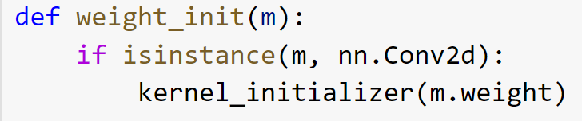
Model 2: milesial Github, from Kaggle competition ‘Carvana Image Masking Challenge’
Target is car instead of human
10k train 1k test, 0.88 IoU
My result IoU: 0.57
Model 3: Ren Jie notha99y Github
Using pixel-wise accuracy as criteria
Only 765 images while achieving 0.73 accuracy
Origin in keras, I translate to pytorch line by line
My result IoU: 0.51

Slide 4
About calculating IoU
I did find many implementations on github applying batch-wise IoU, but based on my current understanding, it should be picture-wise.

Slide 5
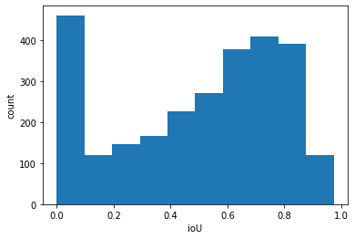
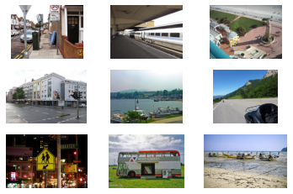

Common 0.00 IoU samples from 4 models
9 out of 179
152 out of 179 samples have tiny annotation
Pixel-wise accuracy for these 179 samples: 0.99

Slide 6
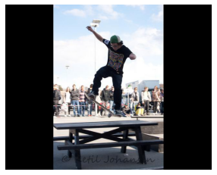
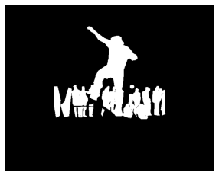
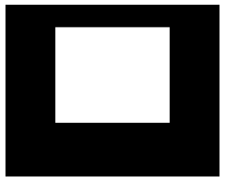
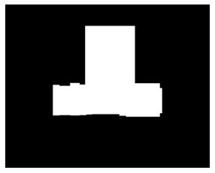
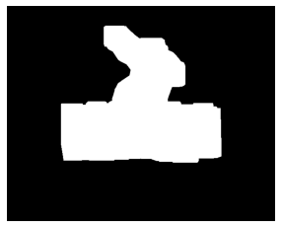
Bounding box trail
Test IoU on two totally different train set but same test set
0.62 / 0.63 0.43 / 0.43 0.52 / 0.55 0.60 / 0.61
Perfect mask one bounding box bounding boxes general shape
generated by dilate

Slide 7
