Slide 1
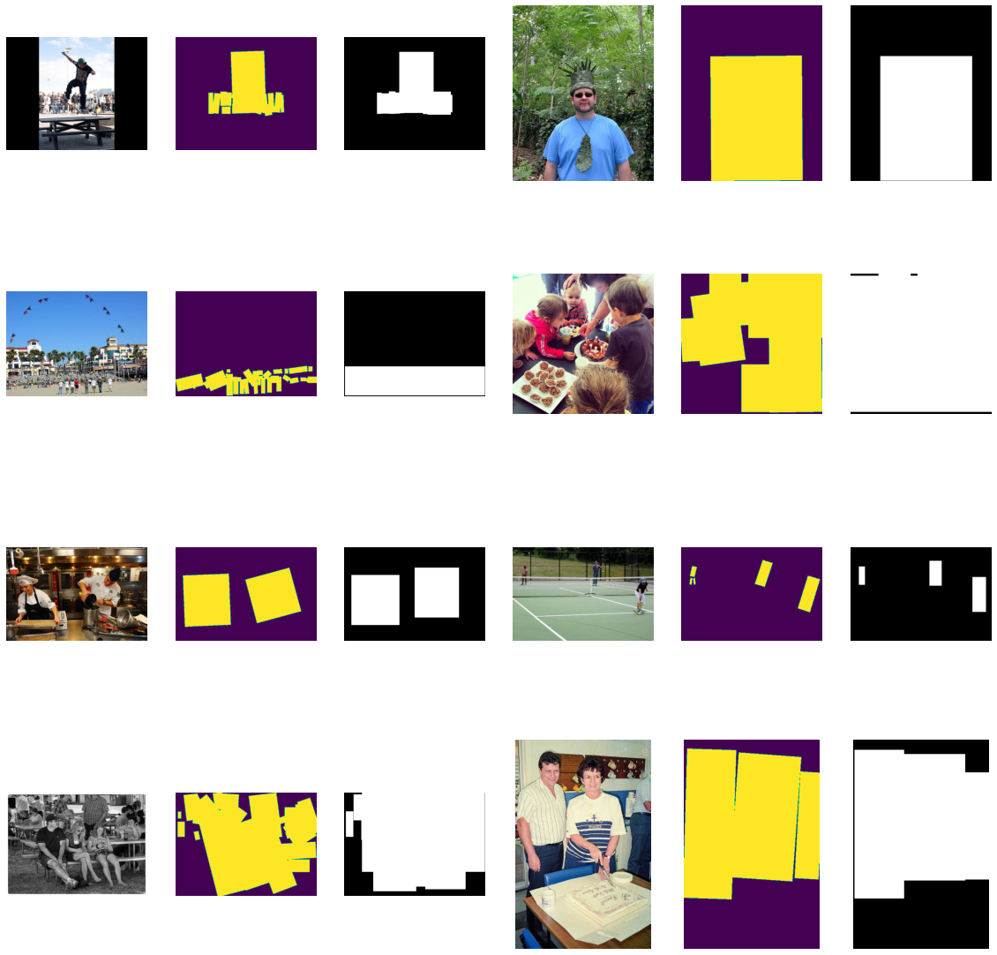
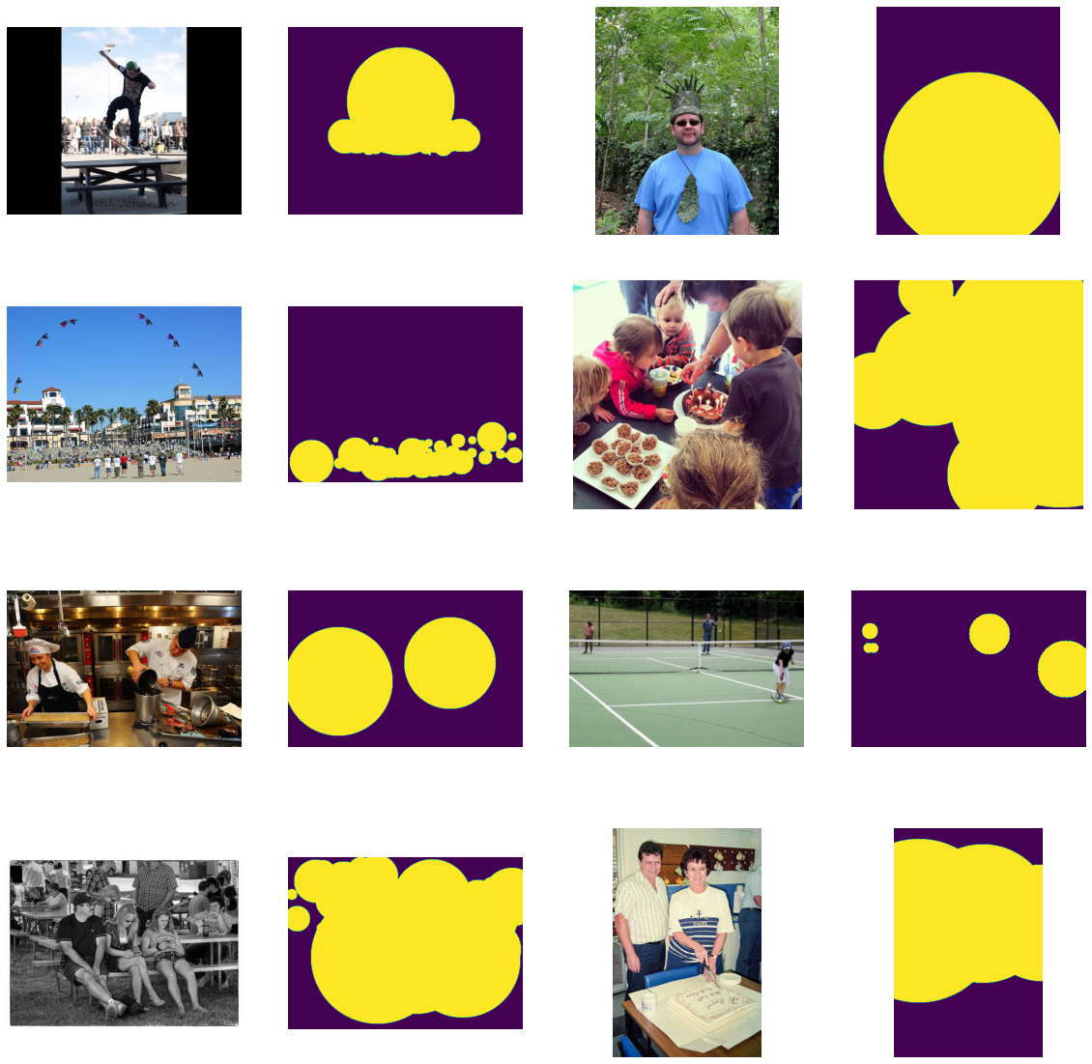
Box, circle, and polygon
A better bounding box
IoU 0.45 ->0.47
Bounding circle
IoU 0.41

Slide 2
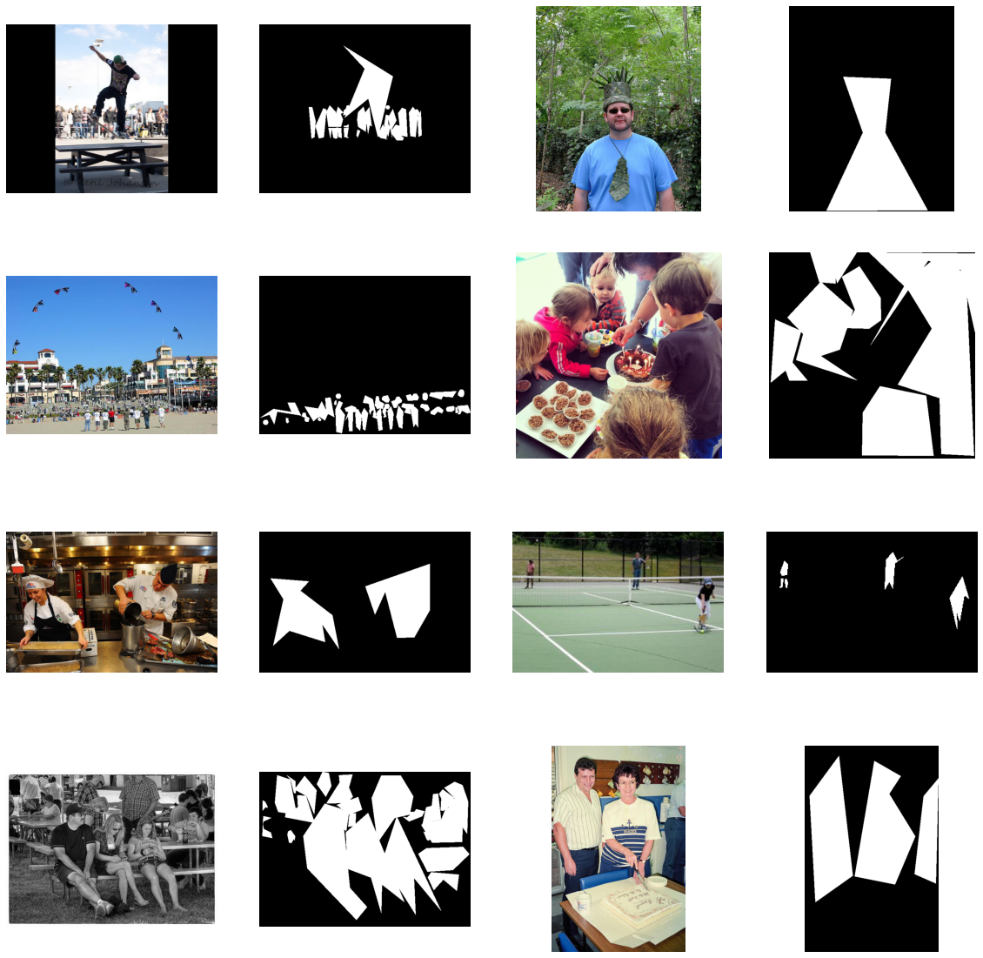
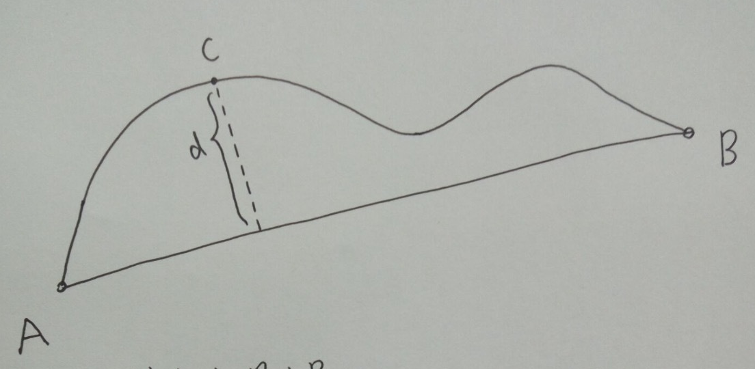
Generate polygons
only with random flip and crop
One polygon for one object

Slide 3
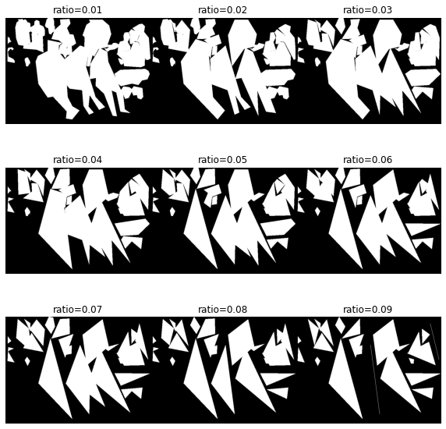
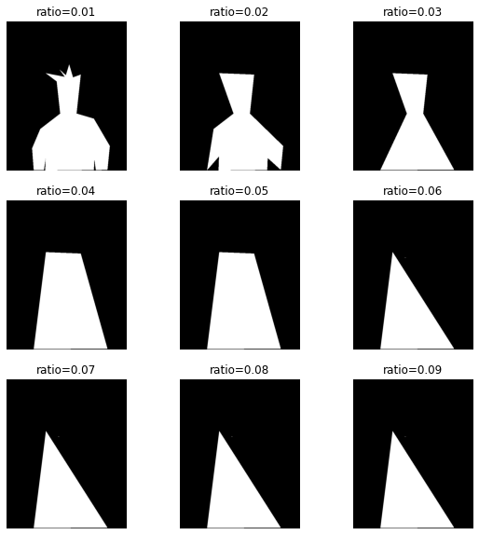
ratio | origin | 0.01 | 0.03 | 0.05 | 0.07 | 0.09
Valid IoU | 0.59 | 0.57 | 0.59 | 0.53 | 0.49 | 0.41

Slide 4
Problem
Accuracy looks depend on the number of objects
Take ratio=0.03, valid IoU=0.57 as example
In validation set IoU for image with less than or equal to 3 objects is 0.52 while for those with larger than 3 objects is 0.61
Cannot decide the edge number of polygon
Cannot estimate the annotation time consumption
Annotating manually (start from 5 and 10 points)

Slide 5
Filter
Three types of filters
 | 1 | 0
Filter #1 Average | If surroundings average > 0.5 | If surroundings average < 0.5
Filter #2 Dilate | If surroundings average > 0.5 OR it was 1 | If surroundings average < 0.5 AND it was 0
Filter #3 Erode | If surroundings average > 0.5 AND it was 1 | If surroundings average < 0.5 OR it was 0

Slide 6
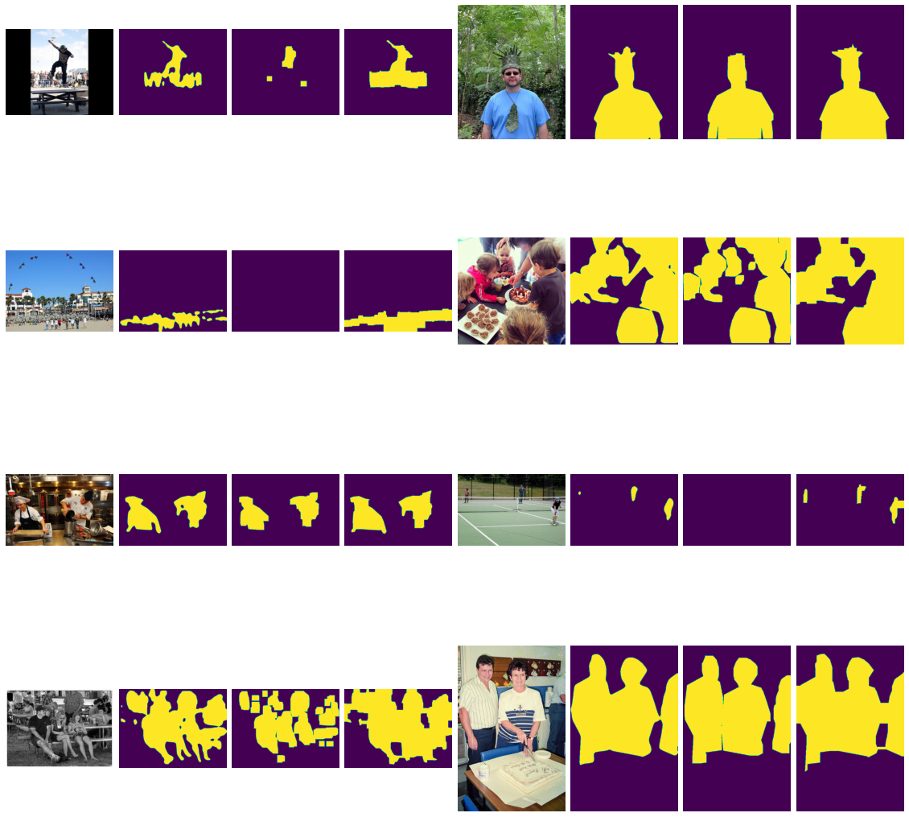
Filter #1 – average; Filter #2 – dilate; Filter #3 – erode
Input data: IoU \ kernel size | 3 | 5 | 9
#1 * 10 (perform average filter 10 times) | 0.50 | 0.55 | 0.47
#3 *5 + #2 *5 | 0.52 | 0.53 | 0.37
#2 *5 + #3 *5 | 0.54 | 0.50 | 0.53
One idea
Maybe we could use a criteria to measure how far the imperfect annotations are away from perfect ones

Slide 9
Also tried
Intersection of bounding boxes and circles (0. 48)
Polygon generated by the intersection points of bounding boxes and circles (0.42)

