Slide 1
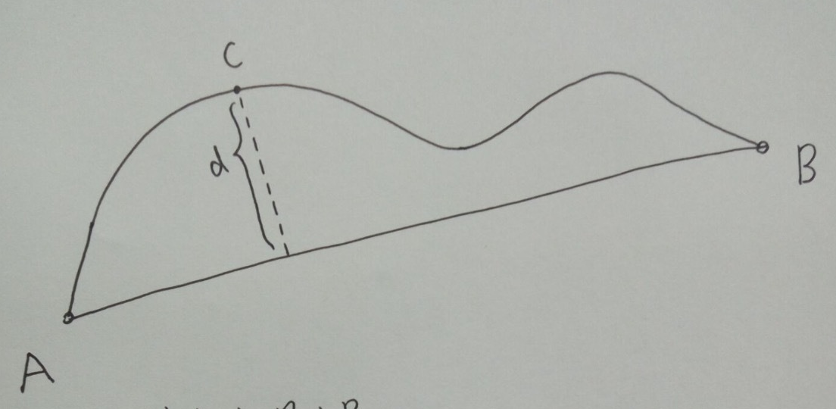
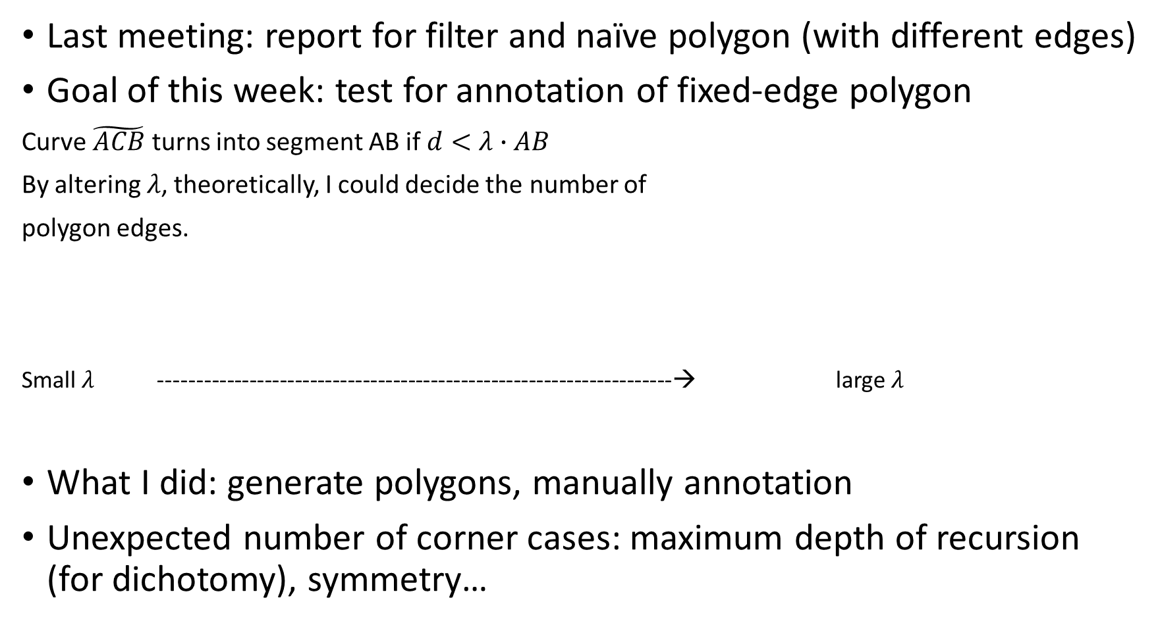
Last meeting: report for filter and naïve polygon (with different edges)
Goal of this week: test for annotation of fixed-edge polygon
Curve $\tilde{ACB}$ turns into segment AB if $d<λ∙AB$
By altering $λ$, theoretically, I could decide the number of
polygon edges.
Small $λ$ --------------------------------------------------------------------→ large $λ$
What I did: generate polygons, manually annotation
Unexpected number of corner cases: maximum depth of recursion (for dichotomy), symmetry…
10 | … | 4 |  |  |  | 3

Slide 2
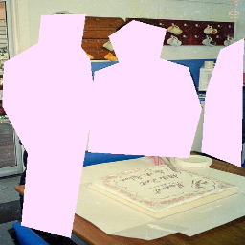
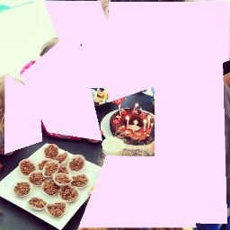
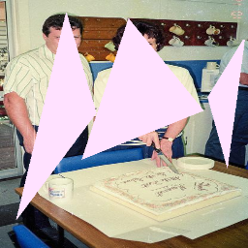
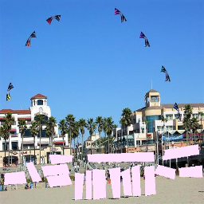
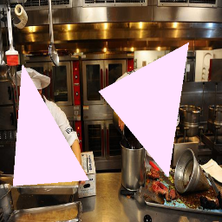
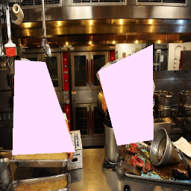
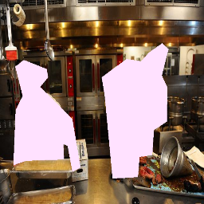
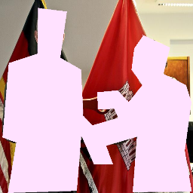
Samples of manually annotated
(resized)

Slide 3
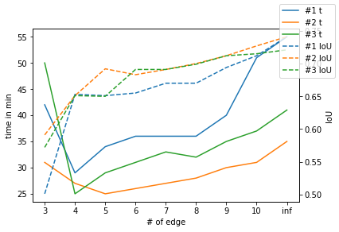
Manually annotation – compared to perfect
Maximum number of edges: 3 to 10 (8 cases)
Number of annotated image: 60 (trail 1,2 use same images, trail 3 uses another set)
Input: time(in min),
IoU of annotated one compared to perfect annotation
# trail\# edge | 3 | 4 | 5 | 6 | 7 | 8 | 9 | 10 | Inf
1 | 42 | 29 | 34 | 36 | 36 | 36 | 40 | 51 | 55
 | .501 | .653 | .651 | .655 | .670 | .670 | .694 | .712 | .741
2 | 31 | 27 | 25 | 26 | 27 | 28 | 30 | 31 | 35
 | .591 | .651 | .692 | .683 | .691 | .700 | .712 | .727 | .741
3 | 50 | 25 | 29 | 31 | 33 | 32 | 35 | 37 | 41
 | .572 | .651 | .650 | .691 | .691 | .699 | .712 | .715 | .721
Average of 1,3 | 46 | 27 | 32 | 33 | 35 | 34 | 38 | 44 | 48
 | .537 | .652 | .650 | .673 | .681 | .685 | .703 | .712 | .731
Average | 41 | 27 | 29 | 31 | 32 | 32 | 35 | 40 | 44
 | .561 | .652 | .678 | .674 | .684 | .690 | .706 | .722 | .741
IoU between whole trail 1 and
2 is 0.959

Slide 4
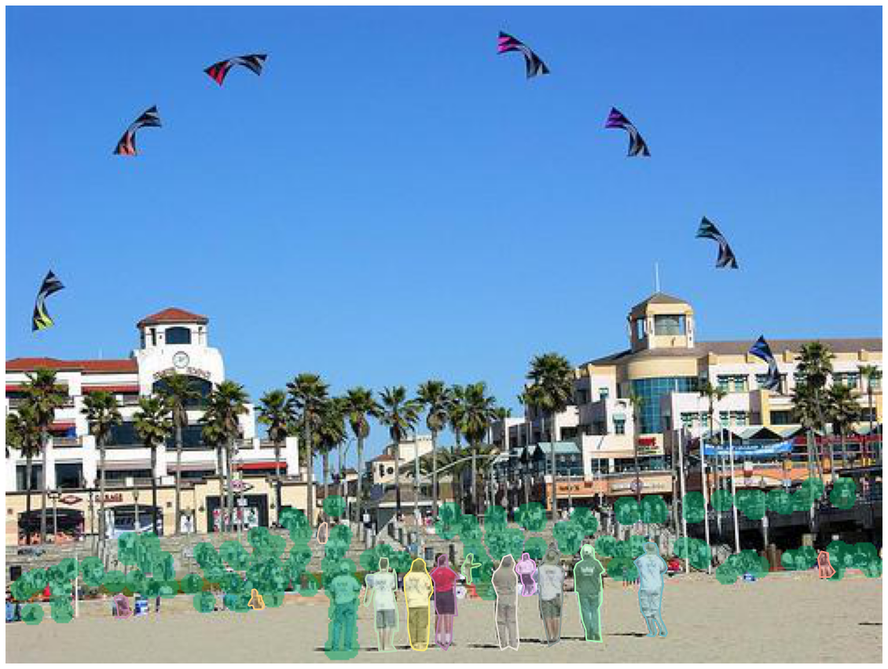
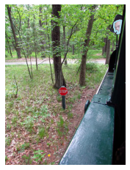
Manually annotation
Typical confusion matrices
(pos for mask, neg for background;
true for perfect annotation, pred for what I drew)
most common cases crowded people
tiny object
 | Pred neg | Pred pos
True neg | 270602 | 24649
True pos | 627 | 31802
 | Pred neg | Pred pos
True neg | 228050 | 19081
True pos | 10247 | 70942
 | Pred neg | Pred pos
True neg | 273043 | 614
True pos | 0 | 263
 | Pred neg | Pred pos
True neg | 155309 | 26651
True pos | 14596 | 110644

Slide 5
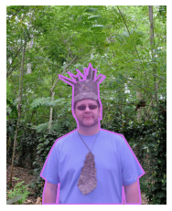
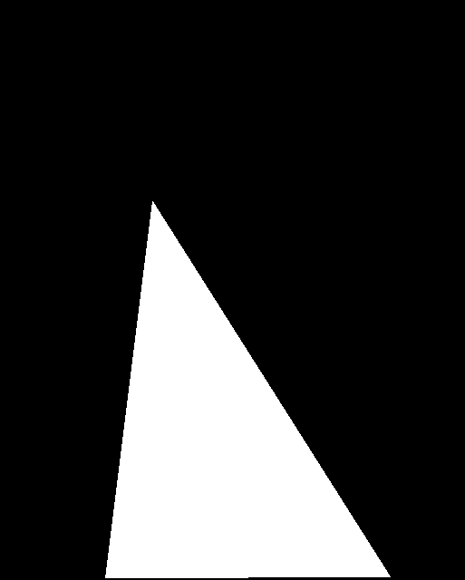
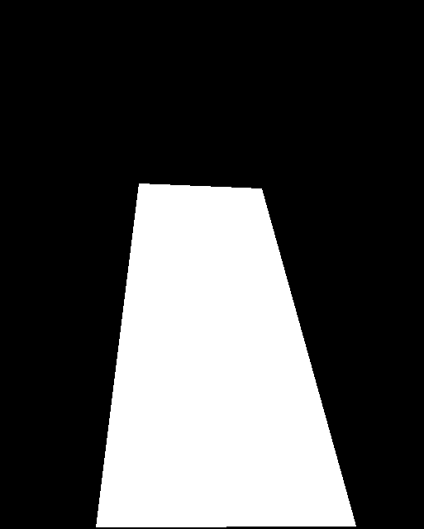

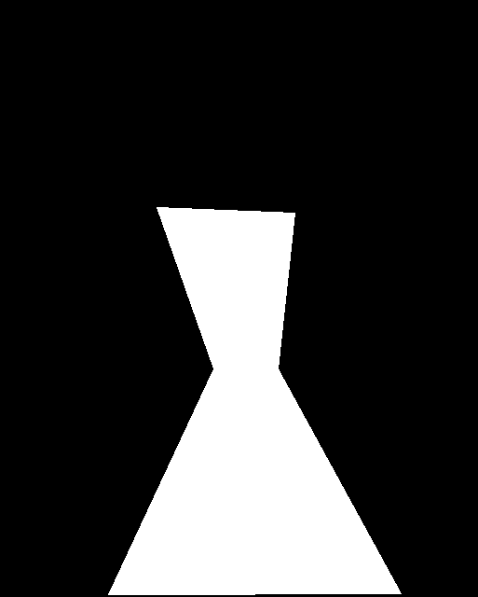
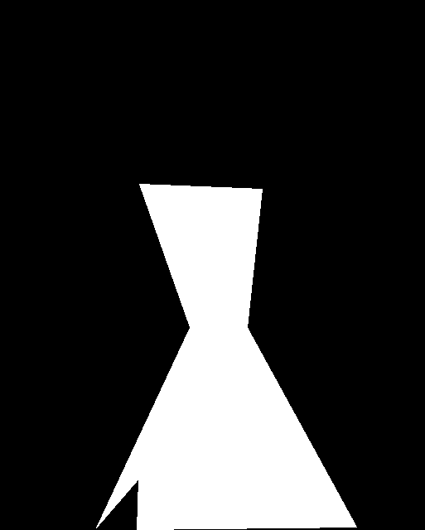
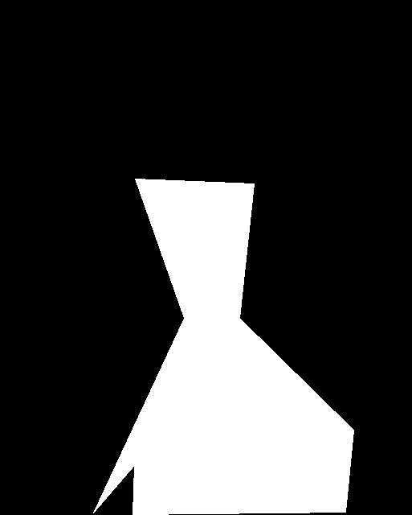
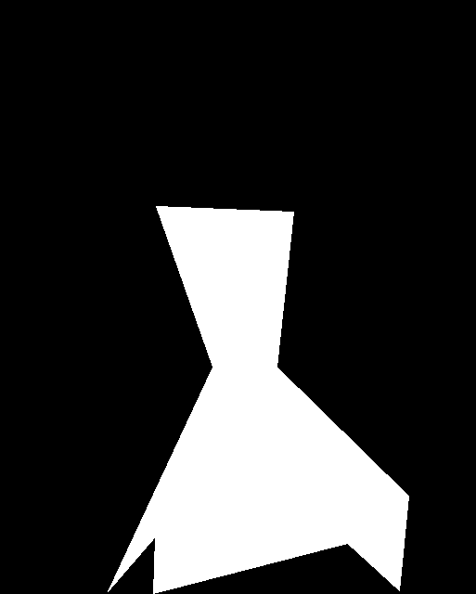
Generated polygon
Examples: first line 3-6, second line 7-10

Slide 6
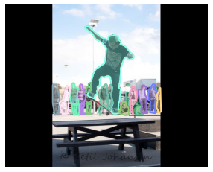







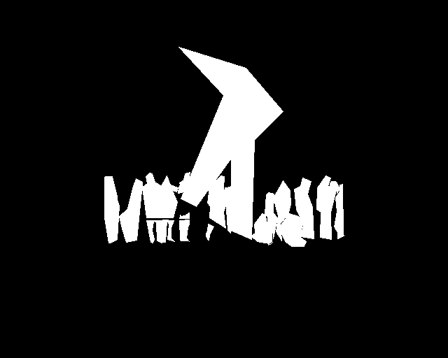
Examples: first line 3-6, second line 7-10

Slide 7
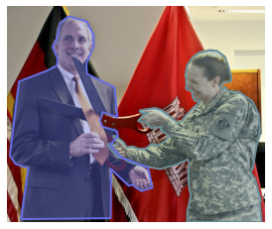
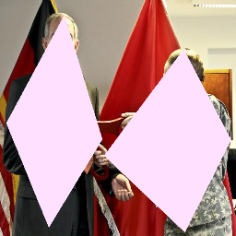

Generated polygon
Input: IoU of generated mask compared to perfect annotation or annotated mask(picture-wise average)
compared to perfect mask
compared to manually annotated mask (60 images in trial 3)
Edge | 3 | 4 | 5 | 6 | 7 | 8 | 9 | 10
IoU | .505 | .552 | .597 | .530 | .656 | .673 | .687 | .697
Edge | 3 | 4 | 5 | 6 | 7 | 8 | 9 | 10
IoU | .403 | .436 | .582 | .506 | .552 | .618 | .703 | .666

Slide 13
time\# edge | 3 | 4 | 5 | 6 | 7 | 8 | 9 | 10 | Inf
1 | 42 | 29 | 34 | 36 | 36 | 36 | 40 | 51 | 55
 | .701 | .853 | .851 | .855 | .870 | .870 | .894 | .912 | .941
2 | 31 | 27 | 25 | 26 | 27 | 28 | 30 | 31 | 35
 | .791 | .851 | .892 | .883 | .891 | .900 | .912 | .927 | .941
3 | 50 | 25 | 29 | 31 | 33 | 32 | 35 | 37 | 41
 | .772 | .851 | .850 | .891 | .891 | .899 | .912 | .915 | .921
Average of 1,3 | 37 | 38 | 25 | 31 | 31 | 32 | 35 | 41 | 45
 | .746 | .852 | .871 | .869 | .881 | .885 | .903 | .920 | .941
Average | 41 | 27 | 29 | 31 | 32 | 32 | 35 | 40 | 44
 | .761 | .852 | .878 | .874 | .884 | .890 | .906 | .922 | .941

