Slide 1
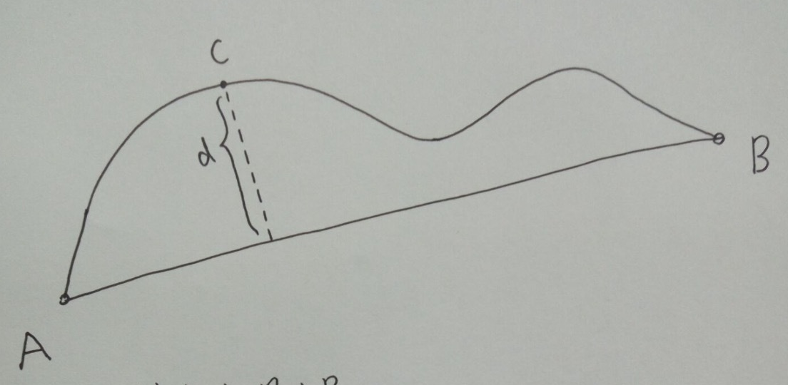
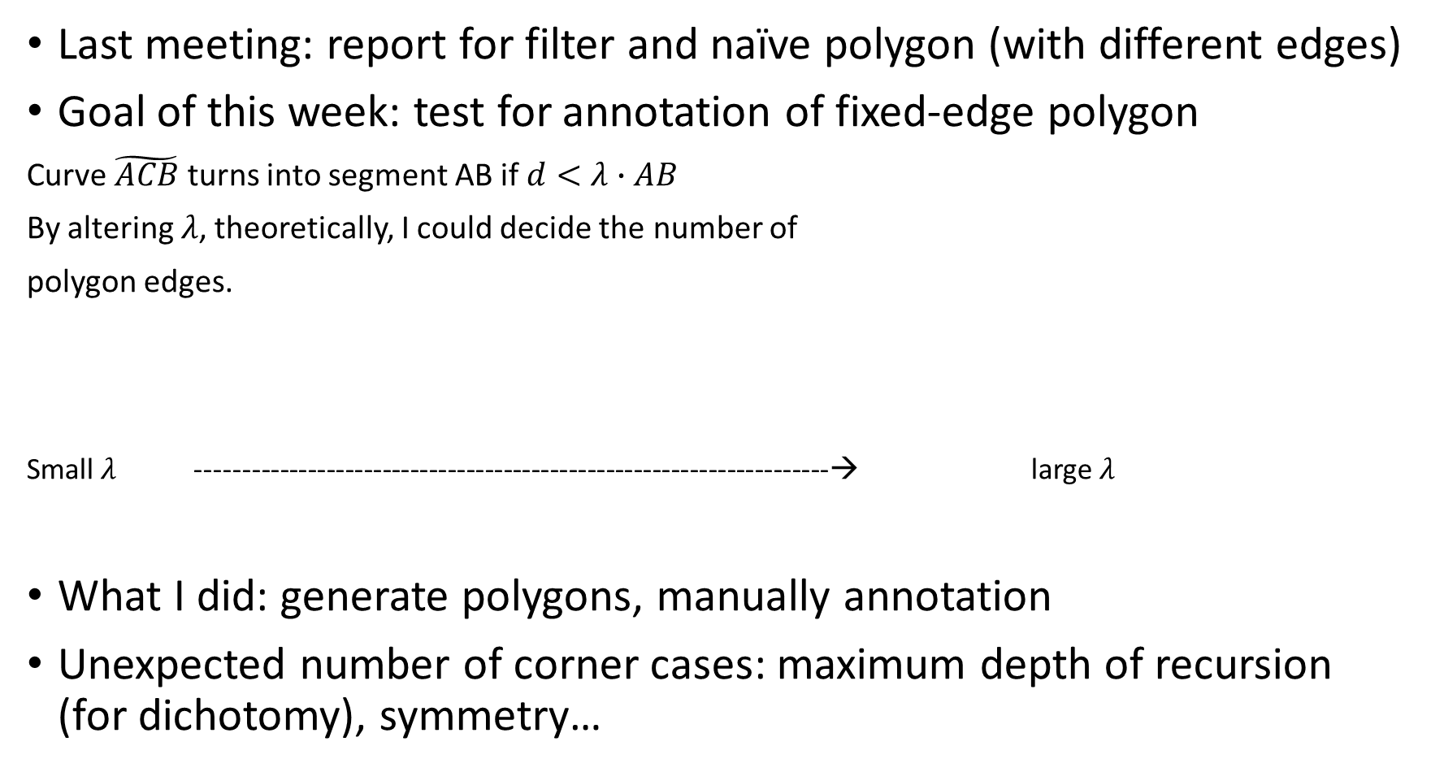
Last meeting: report for filter and naïve polygon (with different edges)
Goal of this week: test for annotation of fixed-edge polygon
Curve $\tilde{ACB}$ turns into segment AB if $d<λ∙AB$
By altering $λ$, theoretically, I could decide the number of
polygon edges.
Small $λ$ --------------------------------------------------------------------→ large $λ$
What I did: generate polygons, manually annotation
Unexpected number of corner cases: maximum depth of recursion (for dichotomy), symmetry…
10 | … | 4 |  |  |  | 3

Slide 2
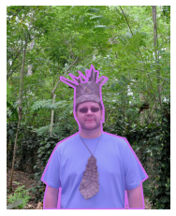
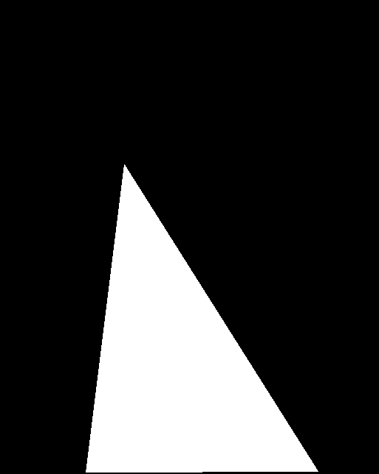
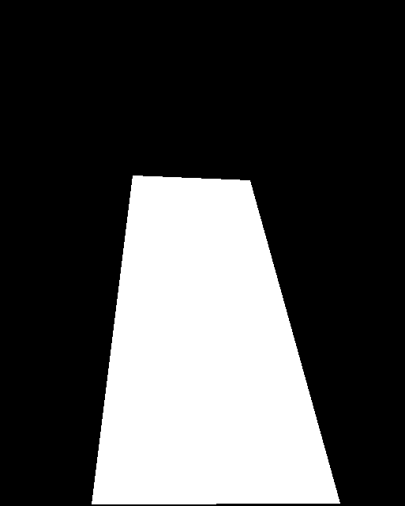
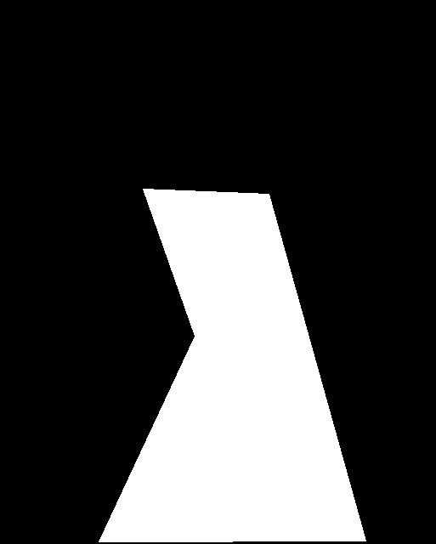
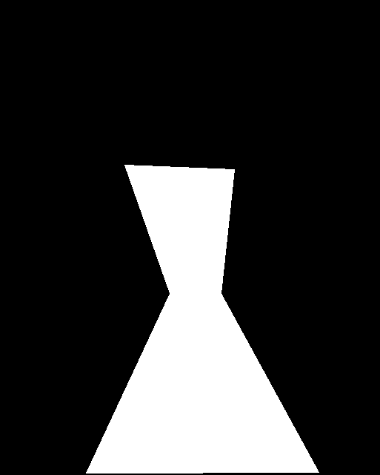
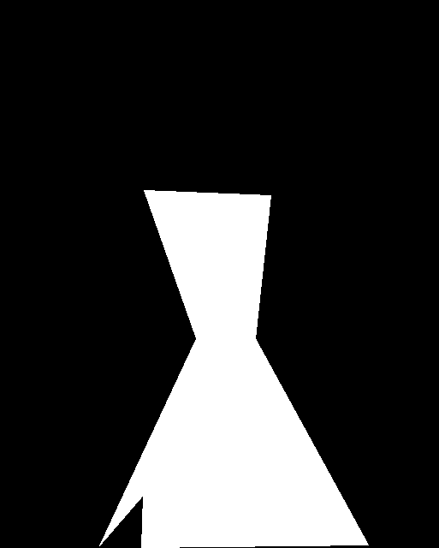
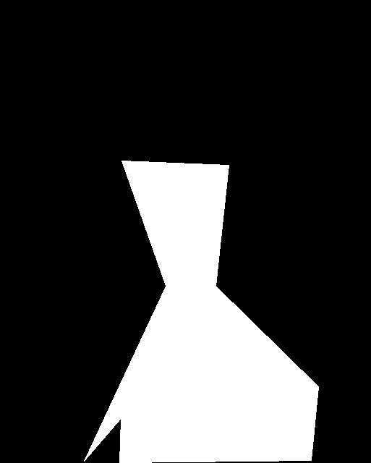
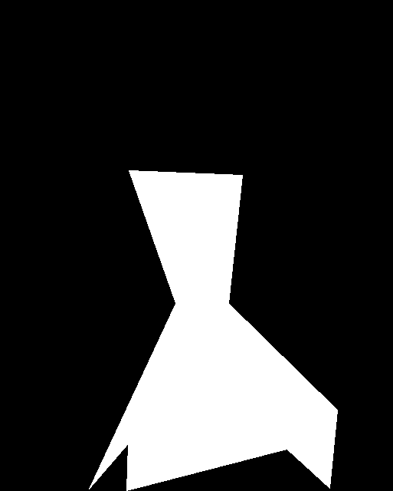
Generated polygon
Examples: first line 3-6, second line 7-10

Slide 3
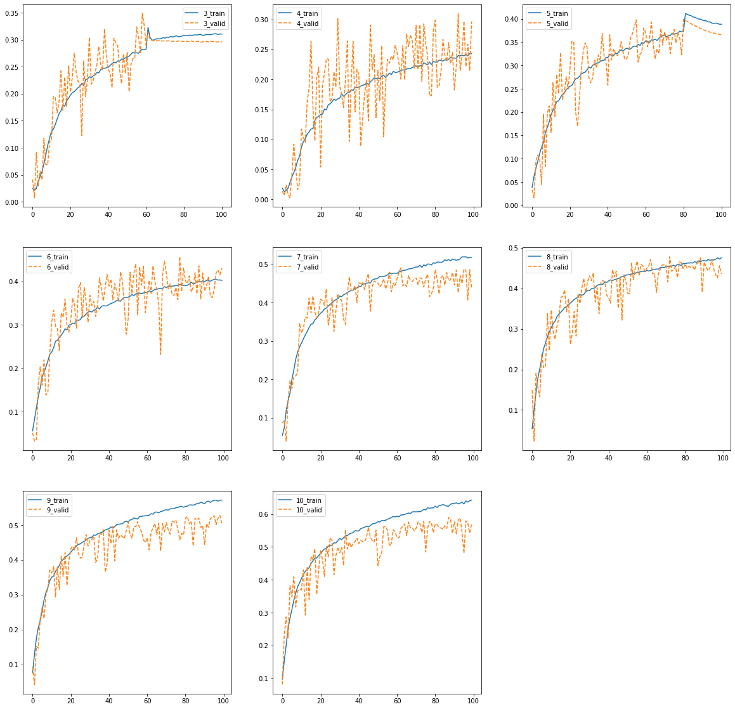
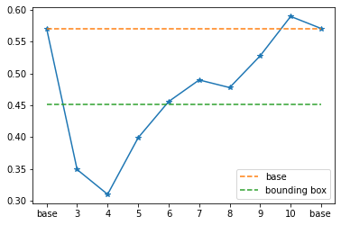
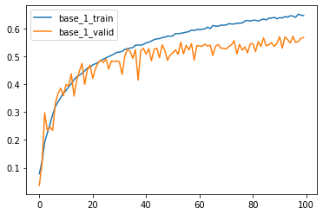
# edge | 3 | 4 | 5 | 6 | 7 | 8 | 9 | 10 | perfect
Valid IoU | 0.349 | 0.310* | 0.399 | 0.456 | 0.490 | 0.478 | 0.528 | 0.590 | 0.571
Valid IoU for bounding box is 0.451

Slide 4
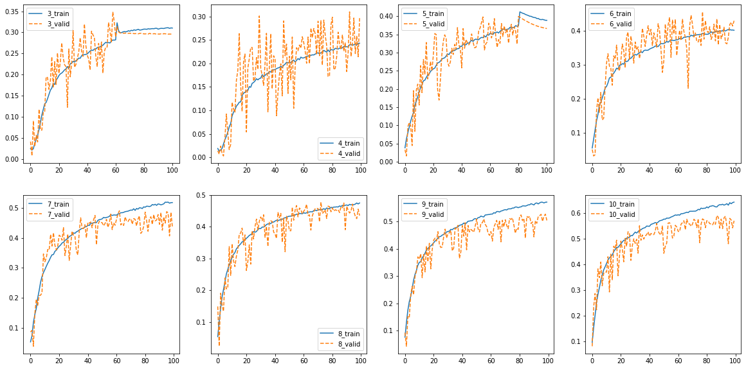

Slide 5
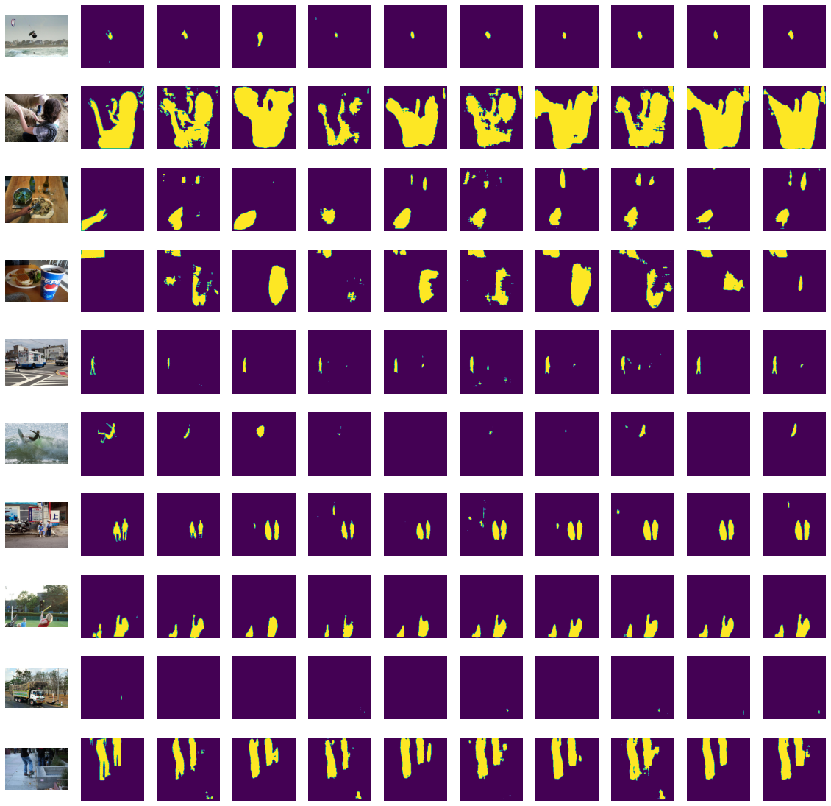
From left to right: image, perfect annotation, perfect mask, num of edge from 3 to 10

Slide 6
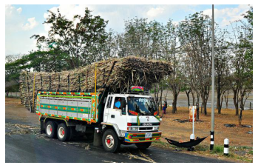

In training set, 431 out of 8k images cannot get IoU higher than 0.01
In valid set, 143 out of 2693 images have 0.00 IoU in all cases like this one

Slide 7
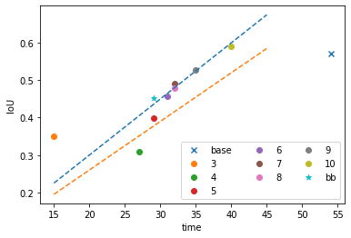
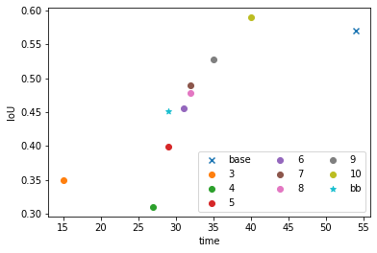
Input time is time cost for 80 images; taking average of three trails
# edge | 3 | 4 | 5 | 6 | 7 | 8 | 9 | 10 | Inf (base) | Bounding box
time | 15 (41) | 27 | 29 | 31 | 32 | 32 | 35 | 40 | 54 | 29
Valid IoU | 0.349 | 0.310 | 0.399 | 0.456 | 0.490 | 0.478 | 0.528 | 0.590 | 0.571 | 0.451

