Slide 1
License
All the datasets belong to one of the following licenses:
CC0 1.0 Universal (CC0 1.0) Public Domain Dedication
Attribution-NonCommercial-NoDerivatives 4.0 International (CC BY-NC-ND 4.0)
Attribution-NonCommercial 4.0 International (CC BY-NC 4.0)

Slide 2
Samples for generated imperfect annotation

Slide 3
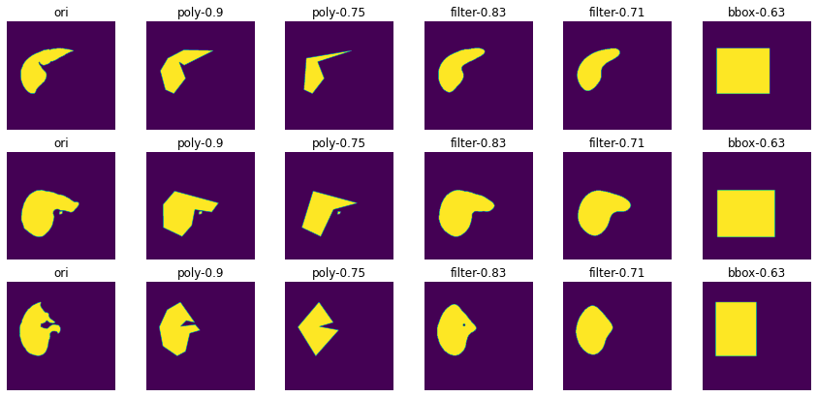
liver

Slide 4
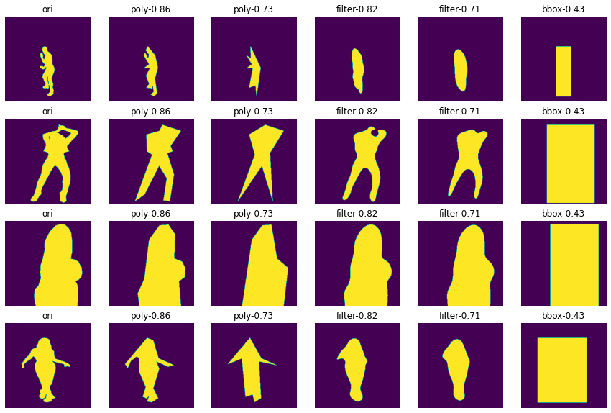
person

Slide 5
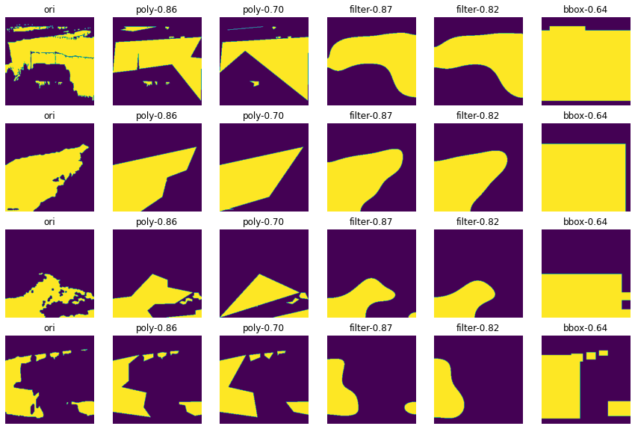
river

Slide 6
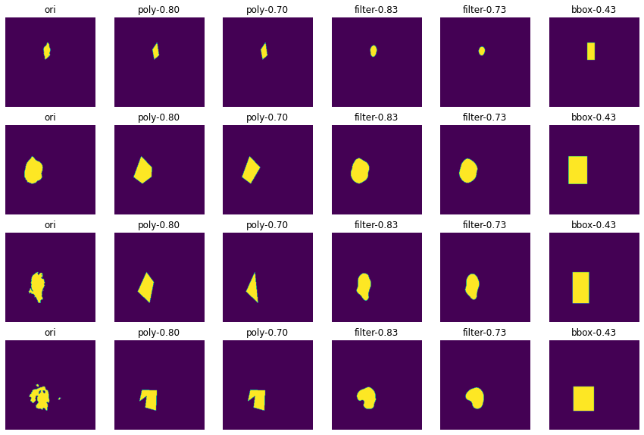
brain
tumor

Slide 7
Annotation time
I didn’t find a paper talking about annotation time for different methods
When I explored, I thought pricing for image annotation services may reflect the time or labor cost. Here are some prices in format {segmentation; polygon; bounding box, service provider} for 1000 instances in $:
870, 257, 63, google ai and labeller
840, 200, 36, amazon sage maker
1500, 1000, 500, taqadam
500, 80, 40, dyto
600, 190, 45, scale
900, 230, 60, hive
600, 200, 60, cloud factory
I would conclude that the ratio is around 13:4:1

Slide 8
Meanwhile, for our annotation time:
You: 1601, 587, 120
Me: 767, 200, 70
Also close to 13:4:1
So I use this ratio for the testing

Slide 9
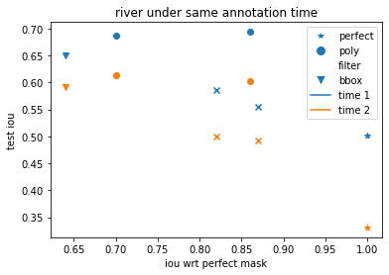
Test result: river
Perfect : bbox = 13:1
# train set = 1700, perfect -> 1700/13=131
 | river
 | perfect | poly1 | poly2 | filter1 | filter2 | bbox
generated method iou | 1 | 0.86 | 0.7 | 0.87 | 0.82 | 0.64
size1 | 131 | 523 | 523 | 523 | 523 | 1700
iou1 | 0.502 | 0.694 | 0.688 | 0.554 | 0.587 | 0.65
size2 | 92 | 369 | 369 | 369 | 369 | 1200
iou2 | 0.331 | 0.603 | 0.613 | 0.493 | 0.499 | 0.591

Slide 10
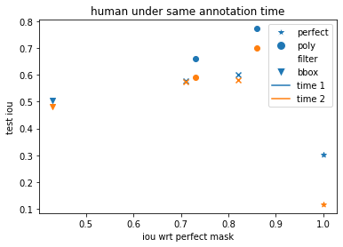
Test result: person
 | person
 | perfect | poly1 | poly2 | filter1 | filter2 | bbox
generated method iou | 1 | 0.86 | 0.73 | 0.82 | 0.71 | 0.43
size1 | 462 | 1846 | 1846 | 1846 | 1846 | 6000
iou1 | 0.301 | 0.772 | 0.659 | 0.601 | 0.576 | 0.505
size2 | 308 | 1231 | 1231 | 1231 | 1231 | 4000
iou2 | 0.117 | 0.701 | 0.591 | 0.579 | 0.575 | 0.481

Slide 11
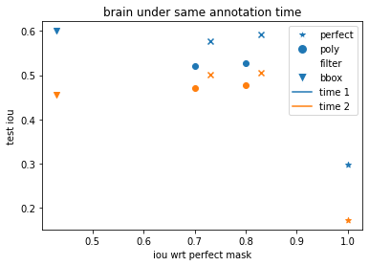
Test result: brain
 | brain
 | perfect | poly1 | poly2 | filter1 | filter2 | bbox
generated method iou | 1 | 0.8 | 0.7 | 0.83 | 0.73 | 0.43
size1 | 1538 | 6154 | 6154 | 6154 | 6154 | 20000
iou1 | 0.299 | 0.528 | 0.521 | 0.591 | 0.576 | 0.6
size2 | 1154 | 4615 | 4615 | 4615 | 4615 | 15000
iou2 | 0.173 | 0.478 | 0.471 | 0.505 | 0.501 | 0.455

Slide 12
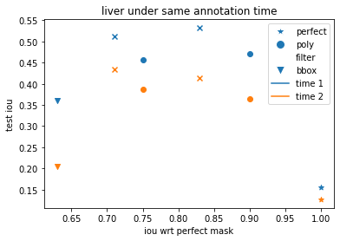
Test result: liver
 | liver
 | perfect | poly1 | poly2 | filter1 | filter2 | bbox
generated method iou | 1 | 0.9 | 0.75 | 0.83 | 0.71 | 0.63
size1 | 1308 | 5231 | 5231 | 5231 | 5231 | 17000
iou1 | 0.155 | 0.471 | 0.456 | 0.532 | 0.512 | 0.361
size2 | 923 | 3692 | 3692 | 3692 | 3692 | 12000
iou2 | 0.127 | 0.365 | 0.388 | 0.413 | 0.434 | 0.205

Slide 14
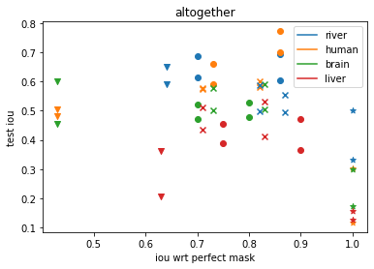
I can’t conclude anything from the results

Slide 15
Repeatedly training
Using predictions of one training cycle as the label for the next generation
Method 1: If 10% of one prediction is outside the previous bounding box, then don’t update
Trial #1: person, 6k train set, bounding box:
R1: 0.505, 4851 updated R2: 0.501, 3714 updated
R3: 0.441, 2914 updated R4: 0.475, 1401 updated
R5: 0.531, 1203 updated R6: 0.481, 1992 updated
R7: 0.505, 3192 updated R8: 0.500, 4613 updated
Trial #2: river, 1.5k train set, bounding box:
R1: 0.603, 1037 updated R2: 0.601, 615 updated
R3: 0.600, 1114 updated R4: 0.563, 127 updated
R5: 0.555, 134 updated

Slide 16
Method 2: reset all pixels outside the bounding box to 0; reset to the origin bounding box if the mask size is smaller than half of the box
Trial #3: person, 6k train set, bounding box:
0.505 -> 0.503 -> 0.507 -> 0.511 -> 0.508 -> 0.502 -> 0.510
Trial #4: river, 1.5k train set, bounding box:
0.603 -> 0.600 -> 0.593 -> 0.580 -> 0.555

Slide 17
I don’t think I could finish this project. I think I could:
1. try to realize the repeatedly training workflow
2. write documents including:
Code usage and structure
Dataset source
Work pipeline: image preprocessing, annotation generator
Tried but failed method

