Slide 1
Requirement from the last meeting:
Using different predicted annotation times for polygon and filter with different accuracy.
No progress. Please tell me when you are available for around 1.5-hour annotation, or use my annotation time
Two images from each set, so 8 images in all
6-8 methods: as good as possible, 2-3 polygons, 2-3 filters, bounding box
Get recursive bounding box training work
Almost no progress. I made sure that the mask-updator is correct individually. But I don’t have GPU until Monday, and I had an onsite interview for the whole day yesterday. Haven’t checked the output and next input for each round.
Find popular methods for weakly annotation, and decide whether or not they can be applied in this project

Slide 2
When I explored, I thought pricing for image annotation services may reflect the time or labor cost. Here are some prices in format {segmentation; polygon; bounding box, service provider} for 1000 instances in $:
870, 257, 63, google ai and labeller
840, 200, 36, amazon sage maker
1500, 1000, 500, taqadam
500, 80, 40, dyto
600, 190, 45, scale
900, 230, 60, hive
600, 200, 60, cloud factory
I would conclude that the ratio is around 13:4:1
New received pricing:
600, 450, 50, desicrew
5000, 1500, 500, rapid
500, 350, 120, shaip
13:4:1 may not fit, need update when having your/my annotation time data

Slide 3
Q: What I should look for is data preprocessing, like creating masks from scribble, or training workflow, like recursively training for bounding box; but not some new models targeted to specific annotation method, right?
If I use different models for different methods, then it seems I’m comparing the performance of models instead of the performance of annotation methods.

Slide 4
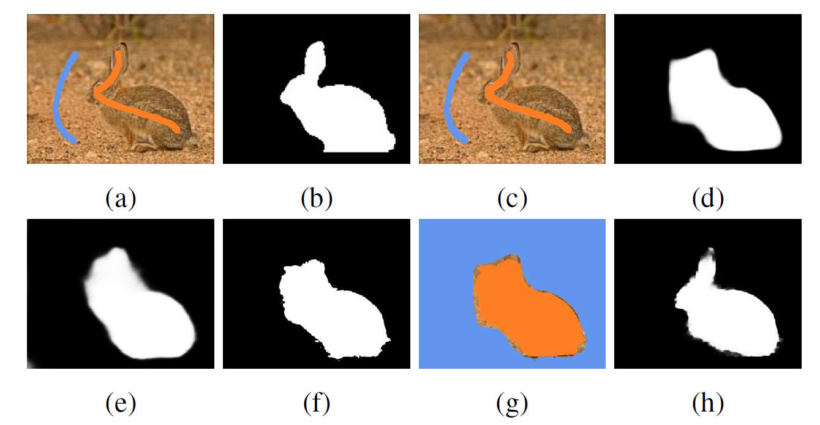
For scribble
get the mask from scribble, like from a to g, and use obtained mask to train in U-Net
Problem: this algorithm combines everything into a VGG16; I need to extract the mask generation part from the model structure

Slide 5
Bounding box
Using dense CRF (don’t understand how CRF works now)
Three ways to apply: Apply to bbox before input to refine it; Apply to the last layer before argmax; Only apply to results in the test stage
Need to tune parameters of CRF in a train set with perfect masks. (“We implement this by appropriately setting the unary terms of the CRF”)
Multiscale Combinatorial Grouping (MCG)
Get masks from MCG (possible boundaries), and find the mask most similar to bbox
Boxsup: no code, don’t understand how to do it iteratively
No python code for MCG
Grab-cut
Get segmentation from bounding box and user interaction
We can simply apply grabcut to get a better masks from bbox as input
box-driven class-wise region masking (BCM)
Average filling rate: sum of mask / sum of bbox

Slide 6
Treat filtered mask as perfect
Polygon can be done in both/either way

Slide 8
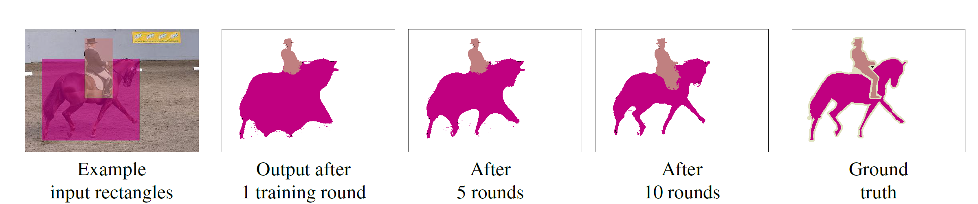

Slide 9
Repeatedly training
Using predictions of one training cycle as the label for the next generation
Method 1: If 10% of one prediction is outside the previous bounding box, then don’t update; otherwise, update by the overlap of prediction and bbox
Trial #1: person, 6k train set, bounding box:
R1: 0.505, 4851 updated R2: 0.501, 3714 updated
R3: 0.441, 2914 updated R4: 0.475, 1401 updated
R5: 0.531, 1203 updated R6: 0.481, 1992 updated
R7: 0.505, 3192 updated R8: 0.500, 4613 updated
Trial #2: river, 1.5k train set, bounding box:
R1: 0.603, 1037 updated R2: 0.601, 615 updated
R3: 0.600, 1114 updated R4: 0.563, 127 updated
R5: 0.555, 134 updated

Slide 10
Method 2: reset all pixels outside the bounding box to 0; reset to the origin bounding box if the mask size is smaller than half of the box
Trial #3: person, 6k train set, bounding box:
0.505 -> 0.503 -> 0.507 -> 0.511 -> 0.508 -> 0.502 -> 0.510
Trial #4: river, 1.5k train set, bounding box:
0.603 -> 0.600 -> 0.593 -> 0.580 -> 0.555
Method 3: only set x%, 20% for example, in the middle of bounding box as 1, target

Slide 12
