Slide 1
Measurement-device-independent detection of beyond-quantum states
Shenzhen-Nagoya Workshop on Quantum Science 2023
Baichu Yu
Southern University of Science and Technology, China

Slide 2
Overview
1. Non-detectability of beyond-quantum positive-over-all-pure-tensors (POPT) states in standard Bell scenario (device-independent).
2. Generalized Bell scenario with quantum input (measurement-device-independent).
3. Detection of beyond-quantum POPT states with measurement-device-independent (MDI) Bell test.

Slide 3
Standard Bell scenario
x
y
Alice
Bob
Device-independent (DI)
The DI property of Bell scenario makes it a convenient tool for studying theories other than quantum mechanics: physical principles, mathematical on experimental statistics.
a
b
p(a,b|x,y)

Slide 4
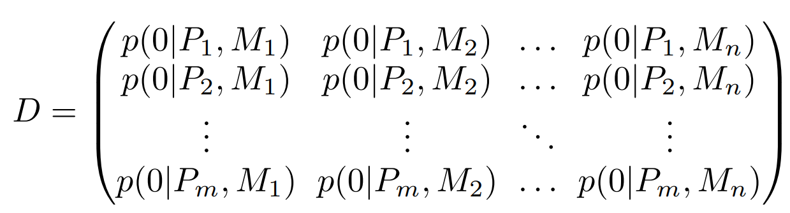
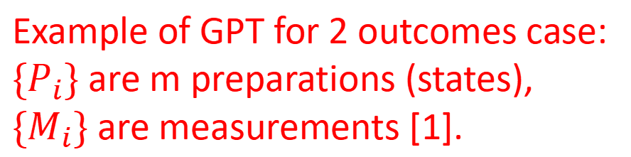
General Probabilistic Theory (GPT)
GPT is a general framework to assign probabilities for each outcome in an experiment.
Two weak assumptions of GPT [1]:
1. Each choice of preparation is made independently from each choice of measurement.
2. Repeated runs of the same experiment yields an independent and identically distributed (i.i.d.) source of data.
Example of GPT for 2 outcomes case: ${\{P}_{i}\}$ are m preparations (states), ${\{M}_{i}\}$ are measurements [1].
[1] Grabowecky M J, Pollack C A J, Cameron A R, et al. Experimentally bounding deviations from quantum theory for a photonic three-level system using theory-agnostic tomography[J]. Physical Review A, 2022, 105(3): 032204.

Slide 5

States and effects of GPT
1. If the rank of matrix $D$ is $k$, we can find a set of k-dimensional state vectors $\{s_{i}\}$ ($i$=1,...,m) and set of k-dimensional effect vectors $\{e_{j}\}$ ($j$=1,...,n), such that [1]
$$D_{i,j}=s_{i}.e_{j}$$
2. (Based on Ref. [2]) If $k=d^{2}$, then we can find set of matrices $\{S_{i}\}$ in space $L_{H}(d)$ and set of matrices $\{E_{j}\}$ in space $L_{H}(d)$, such that
$D_{i,j}=Tr(S_{i}.E_{j})$
The following contents will be based on the assumption in result 2, where we assume the (local) dimension of the system.
[2] Arai H, Hayashi M. Derivation of Standard Quantum Theory via State Discrimination[J]. arXiv preprint arXiv:2307.11271, 2023.

Slide 6
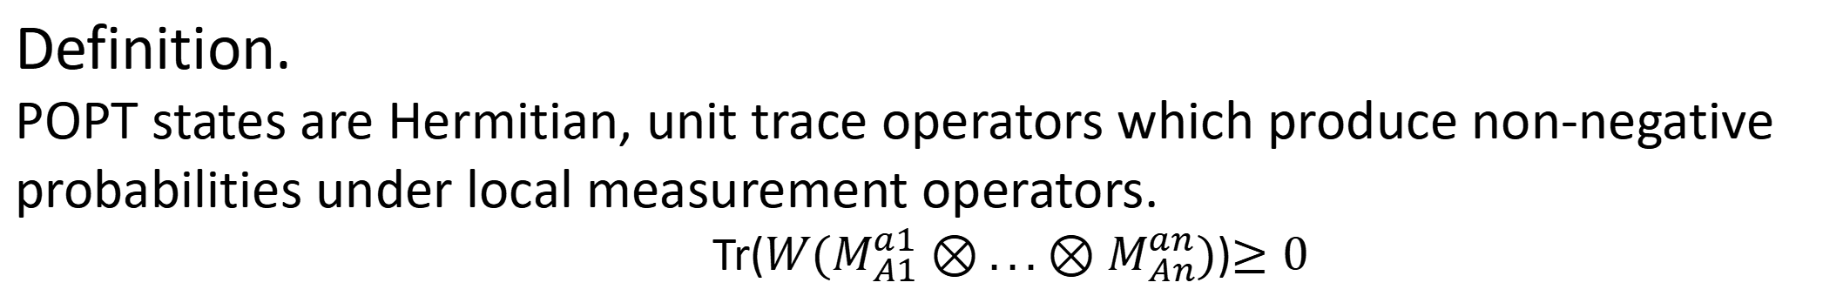
Positive-over-all-pure-tensors (POPT) states
Definition.
POPT states are Hermitian, unit trace operators which produce non-negative probabilities under local measurement operators.
Tr($W(M_{A1}^{a1}⊗{...⊗M}_{An}^{an})$)$≥0$
POPT states
POPT states can have negative eigenvalues but does not produce negative probabilities in Bell scenario, we call the POPT states with negative eigenvalues beyond-quantum states.
Quantum states

Slide 7
Goal of distinguishing (detecting) BQPOPT states
Usually we don’t consider the existence of POPT states, they are still possible to exist, since the knowledge of measurement operators is a strong assumption in practical scenarios, we could not exclude the possibility that the measurement operators are not actually those we think, e.g. in the process of an entangled measurement, a quantum channel is also included which changes the tested state (measurement).
Goal: Distinguishing beyond-quantum POPT states without the knowledge (trust) to measurement operators and moreover, without the knowledge of the tested state.
DI protocol

Slide 8
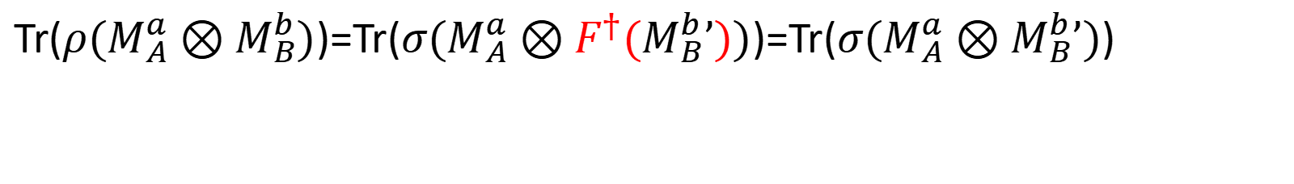
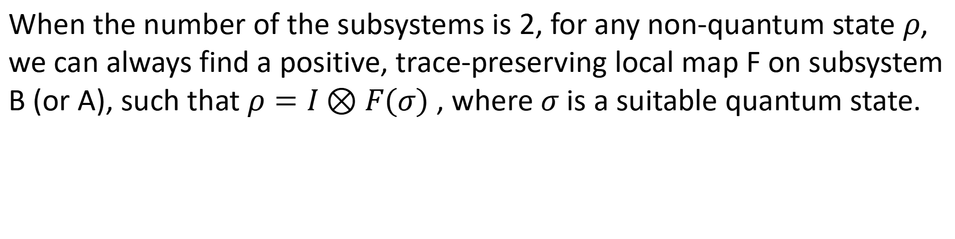
Standard Bell scenario cannot detect
beyond-quantum POPT state
When the number of the subsystems is 2, for any non-quantum state $ρ$, we can always find a positive, trace-preserving local map F on subsystem B (or A), such that $ρ=I⊗F(σ)$ , where $σ$ is a suitable quantum state.
Tr($ρ(M_{A}^{a}⊗M_{B}^{b})$)=Tr($σ{(M}_{A}^{a}⊗F^{†}(M_{B}^{b}’))$)=Tr($σ(M_{A}^{a}⊗M_{B}^{b}’)$)

Slide 9


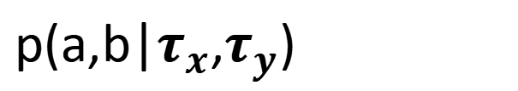
Generalized Bell scenario with quantum inputs [3]
$$τ_{x}$$
$$τ_{y}$$
Assumption that we know the form (trust) the input state.
Measurement-Device-independent (MDI)
By introducing additional trust on the quantum input states, MDI Bell scenario certifies properties of measurement operators. No loopholes of DI Bell secenarios.
Alice
Bob
a
b
p(a,b|$τ_{x}$,$τ_{y}$)
[3] Buscemi F. All entangled quantum states are nonlocal[J]. Physical review letters, 2012, 108(20): 200401.

Slide 10
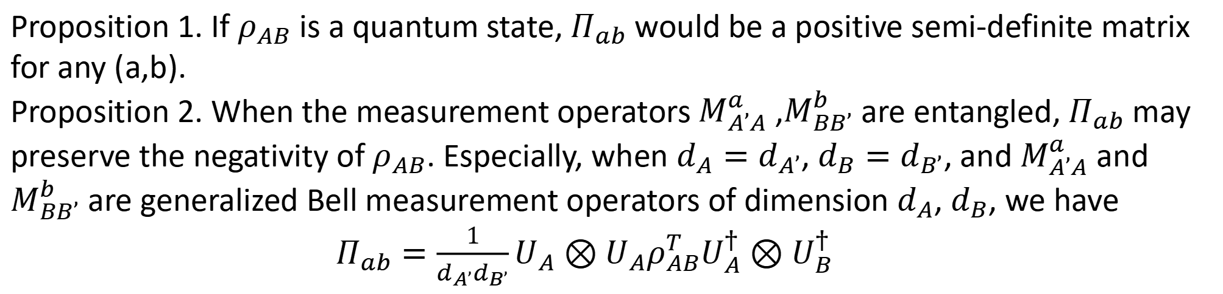
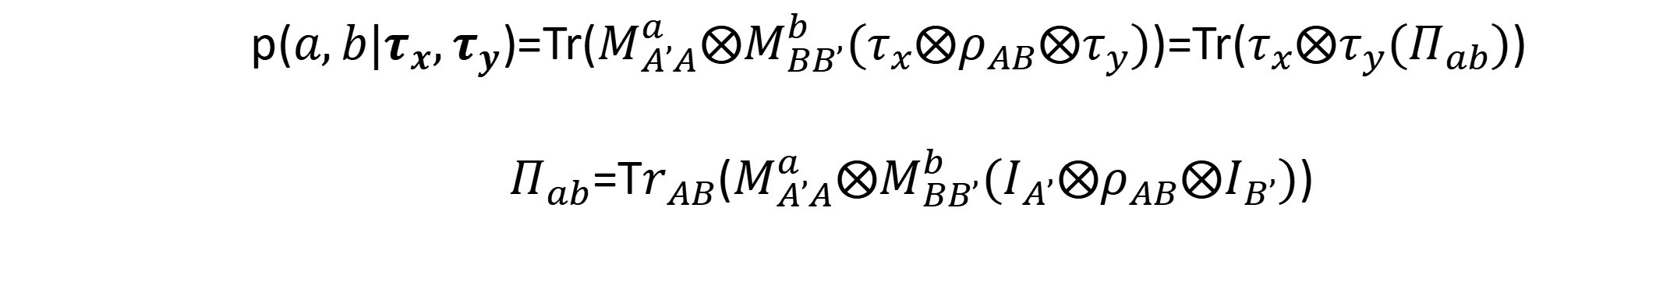
MDI detection of beyond-quantum states
Joint measurement operator on Alice’s side
POPT state
p($a,b|τ_{x},τ_{y}$)=Tr($M_{A’A}^{a}⨂M_{BB’}^{b}(τ_{x}⨂ρ_{AB}⨂τ_{y})$)=Tr($τ_{x}⨂τ_{y}(Π_{ab})$)
$Π_{ab}$=T$r_{AB}$($M_{A’A}^{a}⨂M_{BB’}^{b}(I_{A’}⨂ρ_{AB}⨂I_{B’})$)
Proposition 1. If $ρ_{AB}$ is a quantum state, $Π_{ab}$ would be a positive semi-definite matrix for any (a,b).
Proposition 2. When the measurement operators $M_{A’A}^{a}$ ,$M_{BB’}^{b}$ are entangled, $Π_{ab}$ may preserve the negativity of $ρ_{AB}$. Especially, when $d_{A}=d_{A’}$, $d_{B}=d_{B’}$, and $M_{A’A}^{a}$ and $M_{BB’}^{b}$ are generalized Bell measurement operators of dimension $d_{A}$, $d_{B}$, we have
$Π_{ab}=\frac{1}{d_{A’}d_{B’}}U_{A}⊗U_{A}ρ_{AB}^{T}U_{A}^{†}⊗U_{B}^{†}$

Slide 11
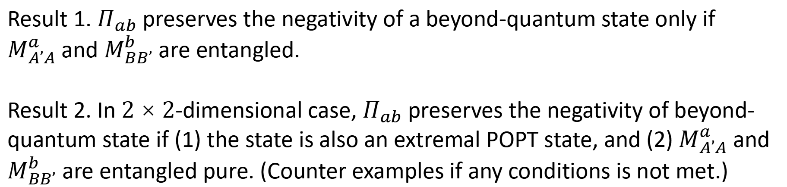
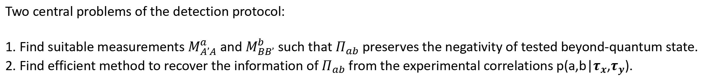
MDI detection of beyond-quantum states
Two central problems of the detection protocol:
1. Find suitable measurements $M_{A’A}^{a}$ and $M_{BB’}^{b}$ such that $Π_{ab}$ preserves the negativity of tested beyond-quantum state.
2. Find efficient method to recover the information of $Π_{ab}$ from the experimental correlations p(a,b|$τ_{x}$,$τ_{y}$).
Result 1. $Π_{ab}$ preserves the negativity of a beyond-quantum state only if $M_{A’A}^{a}$and $M_{BB’}^{b}$ are entangled.
Result 2. In $2×2$-dimensional case, $Π_{ab}$ preserves the negativity of beyond-quantum state if (1) the state is also an extremal POPT state, and (2) $M_{A’A}^{a}$ and $M_{BB’}^{b}$ are entangled pure. (Counter examples if any conditions is not met.)
Key point of the proof: Any $2×2$ beyond quantum state $ρ_{AB}=Γ_{B}(σ_{AB})$ , where $Γ_{B}=I_{A}⊗T_{B}$ is the partial transposition and $σ_{AB}$ is a suitable entangled quantum state.

Slide 12
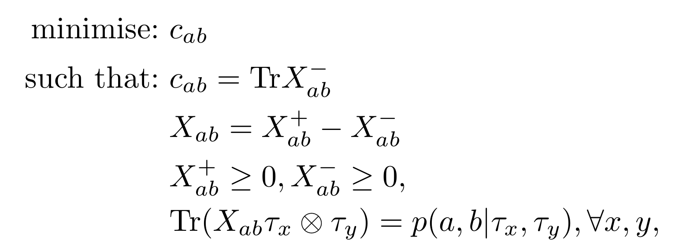

MDI detection of beyond-quantum states
A semi-definite program to address the second problem (inspired by Ref. [4])
Reconstruct the least negative matrix $X_{ab}$ (minimise the absolute value of the smallest eigenvalue) which produces correlations compatible with $Π_{ab}$. When there exist (a,b) s.t. $c_{ab}>0$, we confirm that the state is beyond-quantum.
[4] Rosset D, Martin A, Verbanis E, et al. Practical measurement-device-independent entanglement quantification[J]. Physical Review A, 2018, 98(5): 052332.

Slide 13
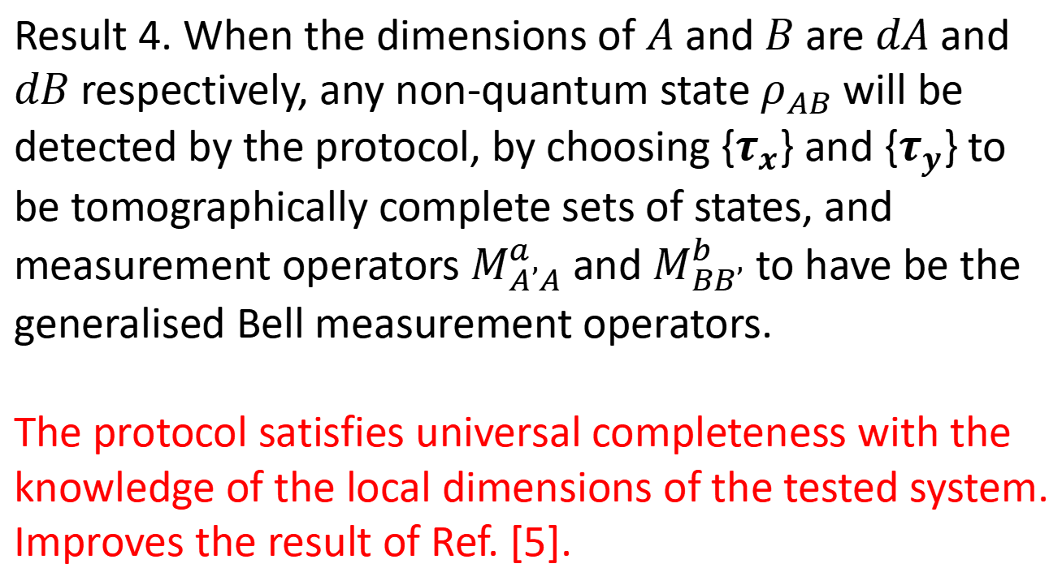

Performance of our scheme
Two criteria of performance:
1. Universal completeness: Any beyond-quantum state can be detected by the protocol when the experimental devices are well-chosen.
2. Soundness: A quantum state will never be detected as a non-quantum state by the protocol.
Result 3. We can confirm that the tested state is non-quantum whenever we obtain $c_{ab}$ > 0 for some (a,b).
The protocol guarantees soundness with the trust on the input states.
Result 4. When the dimensions of $A$ and $B$ are $dA$ and $dB$ respectively, any non-quantum state $ρ_{AB}$ will be detected by the protocol, by choosing {$τ_{x}$} and {$τ_{y}$} to be tomographically complete sets of states, and measurement operators${ M}_{A’A}^{a}$ and $M_{BB’}^{b}$ to have be the generalised Bell measurement operators.
The protocol satisfies universal completeness with the knowledge of the local dimensions of the tested system. Improves the result of Ref. [5].
[5]Lobo E P, Naik S G, Sen S, et al. Certifying beyond quantumness of locally quantum no-signaling theories through a quantum-input Bell test[J]. Physical Review A, 2022, 106(4): L040201.

Slide 14
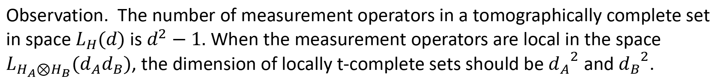
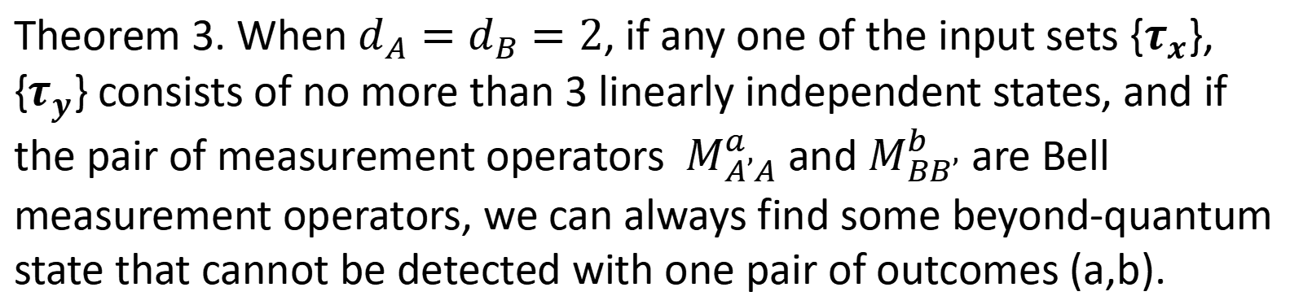
Performance when the input set is
not tomographically complete
Observation. The number of measurement operators in a tomographically complete set in space $L_{H}(d)$ is $d^{2}−1.$ When the measurement operators are local in the space $L_{H_{A}⊗H_{B}}(d_{A}d_{B})$, the dimension of locally t-complete sets should be ${d_{A}}^{2}$ and ${d_{B}}^{2}$.
Theorem 3. When $d_{A}=d_{B}=2$, if any one of the input sets {$τ_{x}$}, {$τ_{y}$} consists of no more than 3 linearly independent states, and if the pair of measurement operators ${ M}_{A’A}^{a}$ and $M_{BB’}^{b}$ are Bell measurement operators, we can always find some beyond-quantum state that cannot be detected with one pair of outcomes (a,b).
Using tomographically incomplete set of input states does not necessarily reduce the complexity of the experiment.

Slide 15
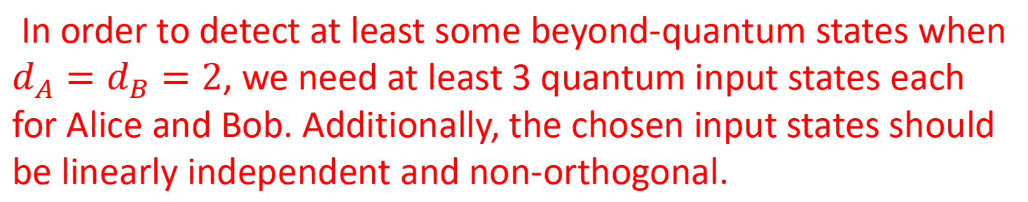
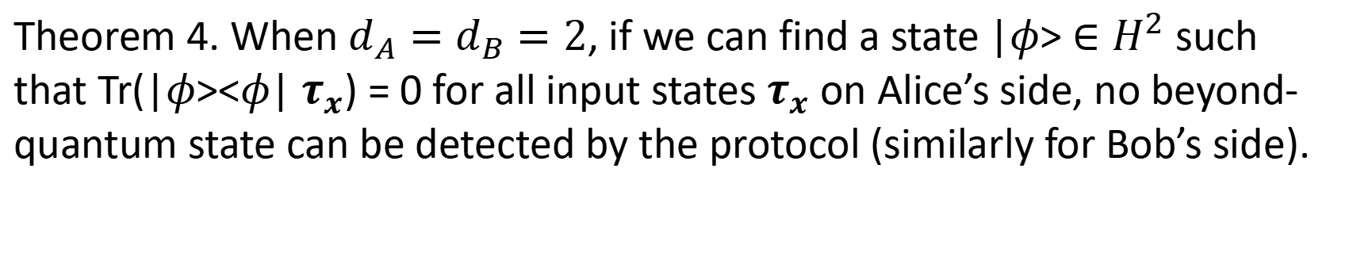
Performance when the input set is
not tomographically complete
Theorem 4. When $d_{A}=d_{B}=2$, if we can find a state |$φ$> $∈H^{2}$ such that Tr(|$φ$><$φ$| $τ_{x}$) = 0 for all input states $τ_{x}$ on Alice’s side, no beyond-quantum state can be detected by the protocol (similarly for Bob’s side).
In order to detect at least some beyond-quantum states when $d_{A}=d_{B}=2$, we need at least 3 quantum input states each for Alice and Bob. Additionally, the chosen input states should be linearly independent and non-orthogonal.

Slide 16
Summary
We proposed a MDI Bell test protocol which can distinguish beyond-quantum state, we show that our protocol just need to assume the local dimensions of the tested system to achieve universal completeness.
To be done
1. Take into account of the experimental errors.
2. Make the results of the tomographically incomplete case stronger.

