Slide 1
Segmentation of Restaurants
by Median Household Income in Metro Vancouver

Slide 2
Background
Objective: Find segmentation of restaurants and effect of income levels
Location: Metro Vancouver
Reasons for this location:
Highly diverse urban
Wide range of income level
World-famous food collection

Slide 3
Data Source
2016 Census Profile from Statistics Canada
Geolocation Services API
Foursquare API

Slide 4
Methodology
Python – Jupyter Notebook
Pandas
Requests
Sklearn
Etc.

Slide 5
Data Process Pipeline
Read CSV and import Metro Vancouver FSAs
Query the Geolocation Service and get coordinates
Join the income and FSA coordinates datasets
Read CSV and import median household income from 2016 Canada Census
Normalize the income and prepare for KMeans Clustering
Run the sklearn's KMeans algorirhtm
Visualize the results in Folium

Slide 6
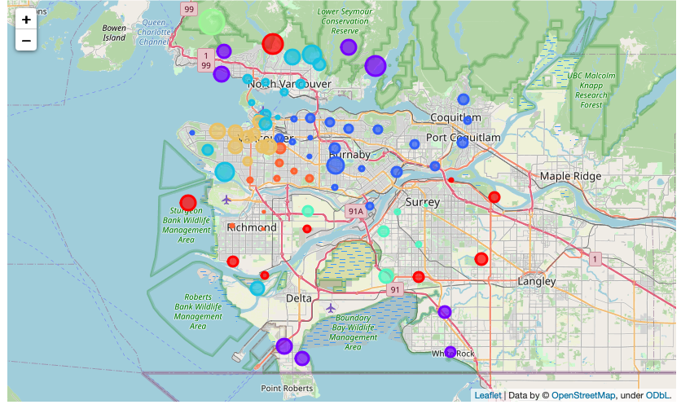
Results
Color: Clusters based on common restaurants
Size: Median Household Income

Slide 7
Example
Yellow Cluster:
Most Common Restaurants:
Bakery Restaurant
Seafood
Japanese
French
Income: $107562
Blue Cluster:
Most Common Restaurants:
Sushi
Japanese
Burgers
Vietnamese
Pizza
Income: $86775

Slide 8
Discussion
Higher income -> More expensive restaurants
More factors may affect the restaurant categories, such as:
Culture
Race
Household size
Etc.

Slide 9
Thank you
Zhongjie Shen

