Slide 1

Cross-Rack-Aware Updates in Erasure-Coded Data Centers
Zhirong Shen, Patrick P. C. Lee
The Chinese University of Hong Kong
ICPP 2018

Slide 2
Background
Properties of modern data centers (DCs)
Failures are prevalent
Hierarchical topological structure, with nodes organized in racks
Cross-rack bandwidth is limited
Cross-rack bandwidth is the bottleneck!
Network Core
Node
Rack
Rack
Rack
Hierarchical topology of DC

Slide 3
Erasure Coding
Erasure coding: a promising technique for fault tolerance
Minimum data redundancy via “data encoding”
Higher reliability with same storage redundancy than replication
Deployed in Google, Azure, Facebook’s data centers
e.g., Azure reduces redundancy from 3x (replication) to 1.33x → PBs saving
Construction of erasure coding:
Encode: Generate n-k parity chunks from k data chunks
Decode: Any k out of n chunks can recover original file
A
File
A
B
A
B
A+B
B
Encode
A+2B
Decode
(n, k) = (4, 2)

Slide 4
Updates in Erasure Coding
Practical erasure codes satisfy linearity
A parity chunk is a linear combination of k data chunks in Galois Field arithmetic
e.g., parity chunk P_{j} = a_{1j}D₁ + a_{2j}D₂ + a_{3j}D₃ + a_{4j}D₄
k = 4, coefficients a_{ij}’s, and data chunk D_{i}’s
Delta-based update:
If D₁ is updated to D₁’
P_{j} ’= a_{1j}D₁’ + a_{2j}D₂ + a_{3j}D₃ + a_{4j}D₄ = P_{j} + a_{1j}(D₁’- D₁)
parity delta chunk
data delta chunk

Slide 5
High Update Penalty
Updates are common (e.g., in Yahoo! and Microsoft DCs)
Existing DCs store n chunks in n nodes in distinct racks to maximize rack-level fault tolerance
Every data chunk update triggers n-k parity chunk updates
→ High cross-rack update traffic
update
data node
parity node
parity node
Rack
Rack
Rack

Slide 6
Motivation
Rack failures rarely happen in practice
e.g., Only 20 rack failures vs 1000 node failures per year in Google DC
Idea: store n chunks in r < n racks
Aggregate update traffic within each rack
Trade rack-level fault tolerance for less cross-rack update traffic
Literature on erasure coding aims for mitigating repair traffic
Question: Can we mitigate cross-rack update traffic?

Slide 7
Our Contributions
Cross-rack-Aware Update (CAU), a general technique to reduce cross-rack update traffic in DCs
Selective parity updates
Data grouping
Interim replication
Extensive evaluation:
Reliability analysis
Trace-driven analysis
Experiments on both local cluster and Amazon EC2
Our work applies to geo-distributed data centers
Reduce cross-rack update traffic
Tolerate a single rack failure

Slide 8
Append-Commit
Idea: batch updates by deferring parity updates
Append: append new updated data chunks into append-only log
Commit: update parity chunks in other nodes
Trade reliability for performance (to be addressed later)
Update
Append to log
Append Phase
Update
Append to log
Delta
Delta
Delta
Delta
Commit Phase
Data Node
Data Node
Parity Node
Parity Node

Slide 9
Selective Parity Updates
Goal: mitigate cross-rack update traffic due to parity updates at nodes in different racks
Selective parity updates
Based on
Patterns of data chunk updates
Distributions of parity chunks
Two approaches:
Data-delta commit
Parity-delta commit

Slide 10

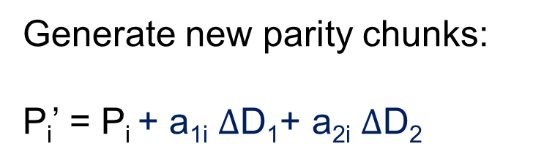

Data-delta Commit
Idea: update multiple parity chunks based on the change of each data chunk
If Rack i has i’ data chunks updated and Rack j stores j’ parity chunks, send i’ data delta chunks from Rack i to Rack j
$∆$D₁
D₂’
P₁
P₂
Generate new parity chunks:
P_{i}’ = P_{i} + a_{1i} $∆$D₁+ a_{2i} $∆$D₂
D₁’
$∆$D₂
P₃
Rack i
Rack j
i’ = 2; j’ = 3

Slide 11
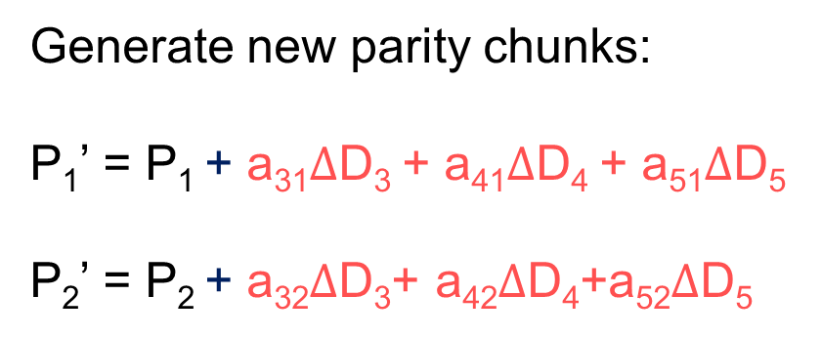

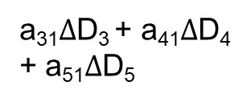
Parity-delta Commit
Idea: update each parity chunk by aggregating changes of multiple data chunks
If Rack i has i’ data chunks updated and Rack j stores j’ parity chunks, send j’ parity delta chunks from Rack i to Rack j
a₃₂$∆$D₃+ a₄₂$∆$D₄+a₅₂$∆$D₅
Generate new parity chunks:
P₁’ = P₁ + a₃₁$∆$D₃ + a₄₁$∆$D₄ + a₅₁$∆$D₅
P₂’ = P₂ + a₃₂$∆$D₃+ a₄₂$∆$D₄+a₅₂$∆$D₅
D₃’
D₄’
P₁
P₂
a₃₁$∆$D₃ + a₄₁$∆$D₄ + a₅₁$∆$D₅
D₅’
Rack i
Rack j
i’ = 3; j’ = 2

Slide 12
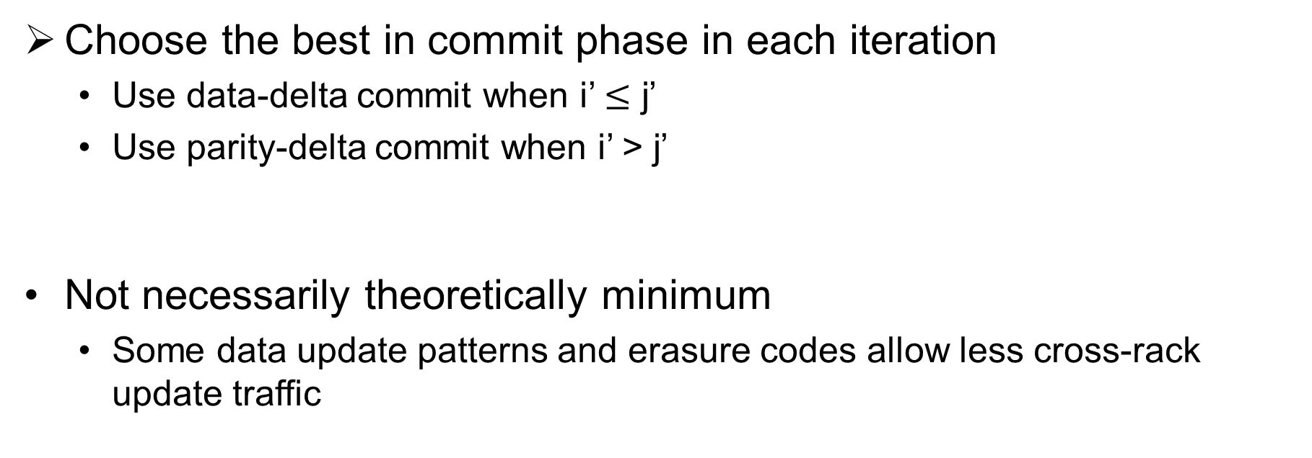
Selective Parity Updates
Choose the best in commit phase in each iteration
Use data-delta commit when i’ $≤$ j’
Use parity-delta commit when i’ > j’
Not necessarily theoretically minimum
Some data update patterns and erasure codes allow less cross-rack update traffic
Cross-rack update traffic = min{i’, j’}

Slide 13
Data Grouping
Relocate updated chunks to save update costs in next commits
Several data chunks of a stripe are likely updated again
Trade-off: extra swap traffic
Activate data grouping only when there is performance gain
Details in the paper
D₁’
D₂’
D₅’
P₁
P₂
P₃
D₃’
D₄
swap
Rack 1
Rack 2
Rack 3
Rack 4
Rack 5
Swapping D₅’ with D₄

Slide 14
Interim Replication
How to tolerate loss of updated data chunks before commit?
Idea: store one temporary replica in a different rack for each update data chunk
Delete the replica after commit
No storage overhead in long run

Slide 15
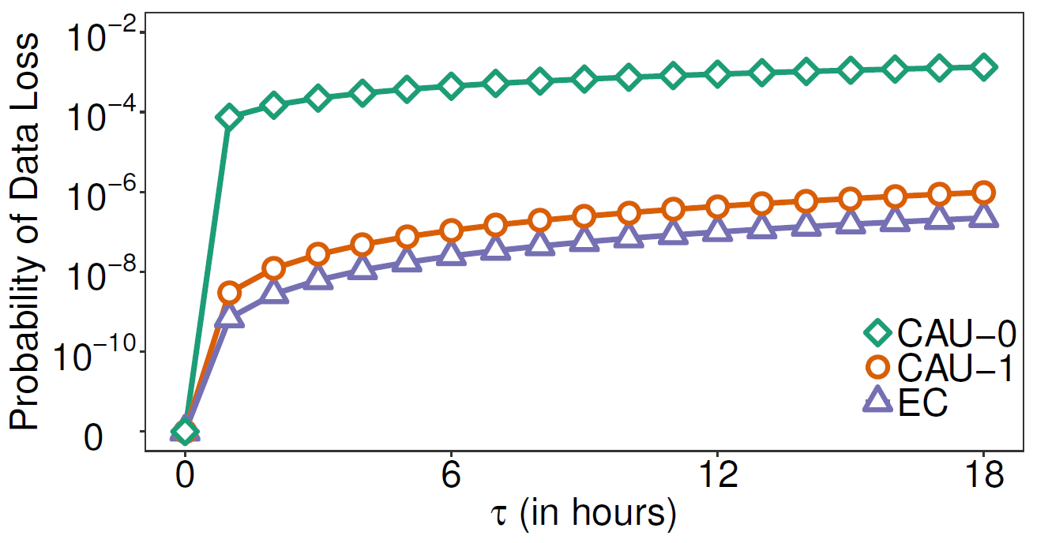
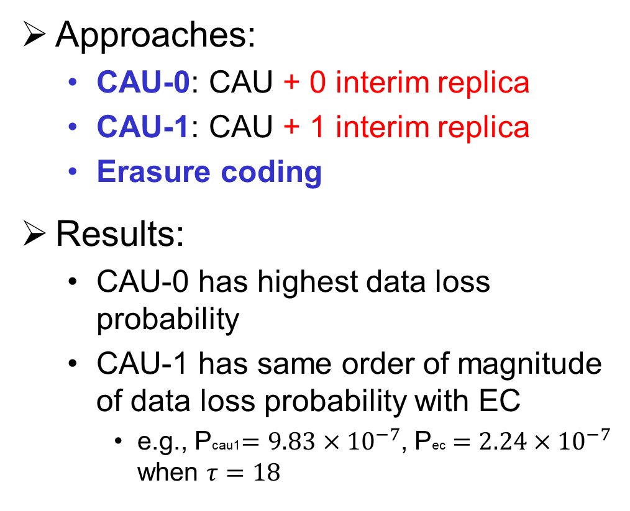
Reliability Analysis
Approaches:
CAU-0: CAU + 0 interim replica
CAU-1: CAU + 1 interim replica
Erasure coding
Results:
CAU-0 has highest data loss probability
CAU-1 has same order of magnitude of data loss probability with EC
e.g., Pcau1 $=9.83×{10}^{−7}$, Pec $=2.24×{10}^{−7}$ when $τ=18$
Data loss probability vs. append phase duration

Slide 16
Prototype Implementation
Appended data chunk
Client
Chunk Metadata
New data chunk
Metadata Server
control flow
data flow
Ack
Replication
Ack
Node
Node
Node
Node
Rack
Rack
Written in C on Linux
Erasure coding is implemented via Jerasure v1.2
Multi-threading to parallelize data transmissions

Slide 17
Evaluation
Trace-driven analysis
Microsoft Cambridge Traces
Grouped by update locality (avg # of stripes updated per 1000 updates)
Local cluster and Amazon EC2 experiments
Compared schemes
Baseline: update all n-k parity chunks immediately for each update
PARIX [ATC’17]: data logging + parity updates (more traffic, fewer disk I/Os)

Slide 18
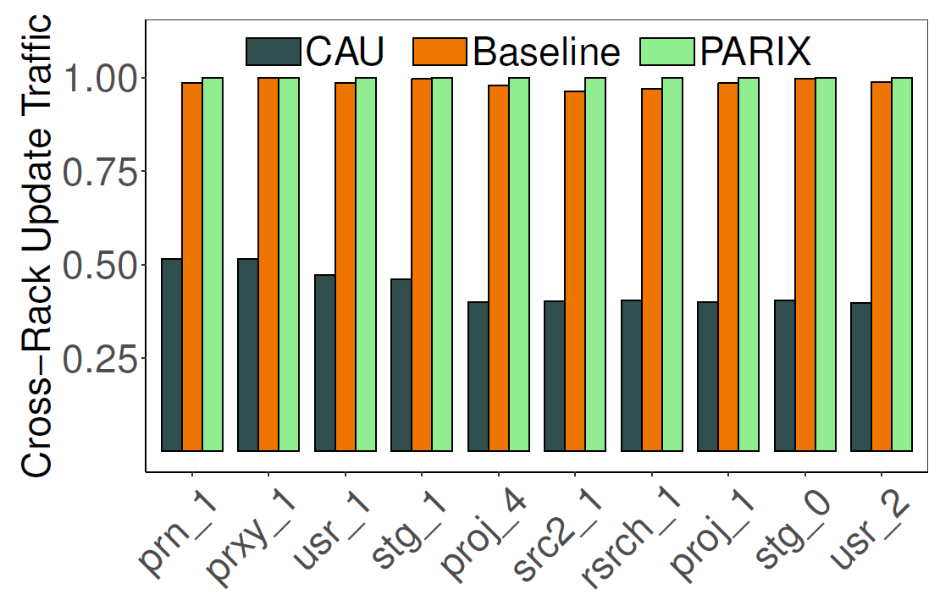
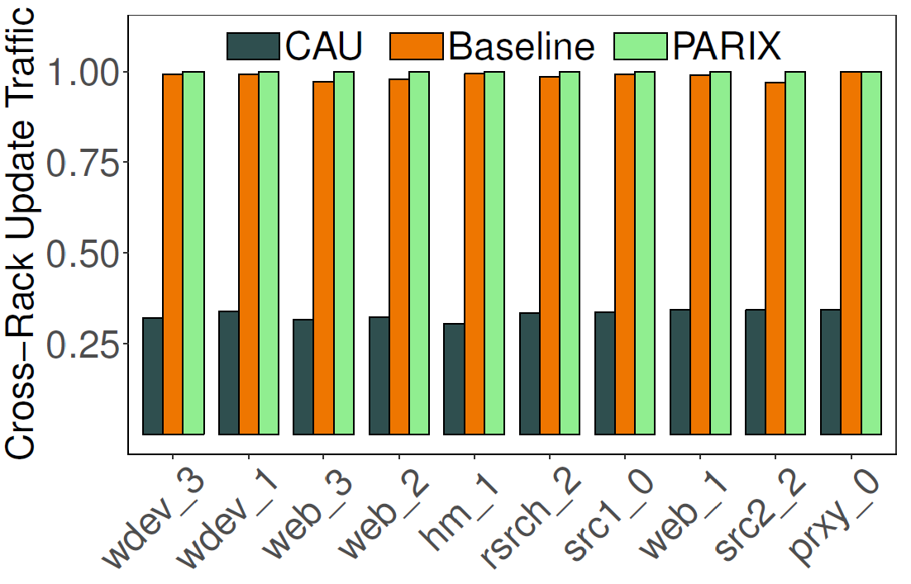
Trace-driven Analysis
Ten traces with low update locality: RS(16,12) with four racks
Ten traces with high update locality: RS(16,12) with four racks
CAU saves 60.9% and 63.4% of cross-rack update traffic compared to the baseline and PARIX, respectively
Higher gains for traces with high update locality

Slide 19
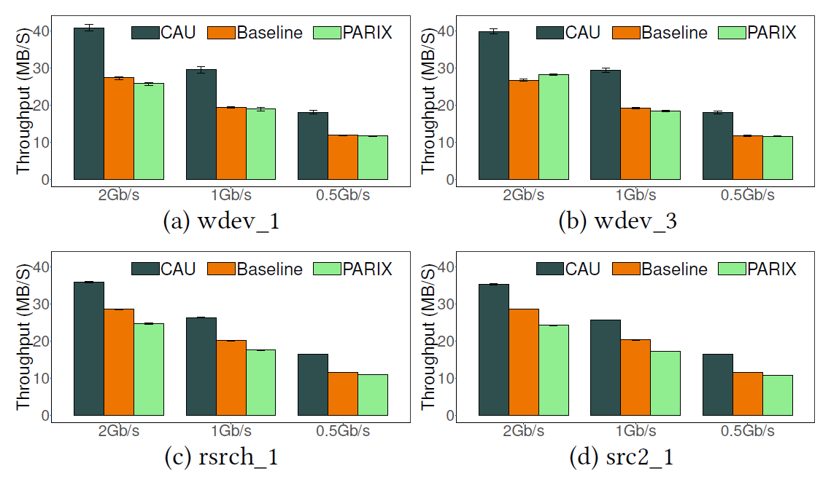
Local Cluster Performance
Higher performance gain by CAU with more limited cross-rack bandwidth
CAU outperforms baseline and PARIX by 41.8% and 51.4%, respectively
Update throughput vs. cross-rack bandwidth for RS(9,6)

Slide 20
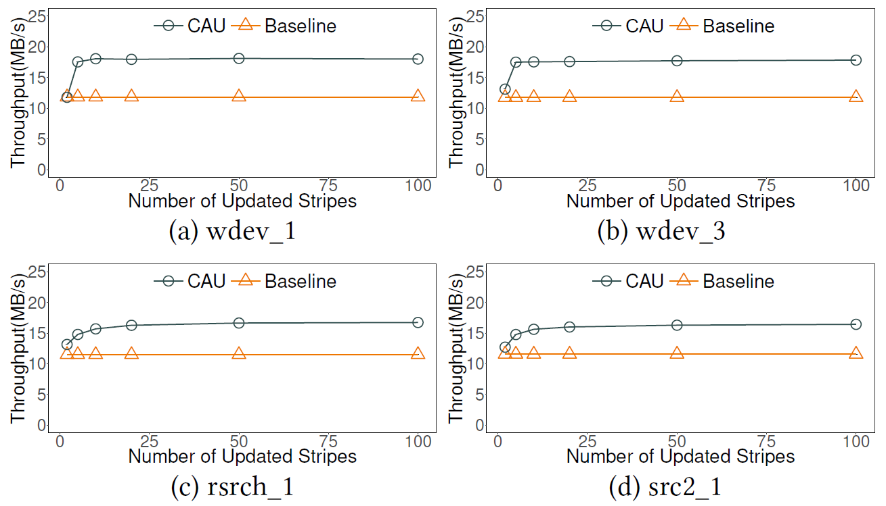
Local Cluster Performance
CAU’s update throughput first increases with the number of updated stripes in append phase, and stabilizes when the number exceeds 10
Update throughput vs. number of updated stripes in appended phase for RS(9,6) and
cross-rack bandwidth = 0.5Gb/s

Slide 21
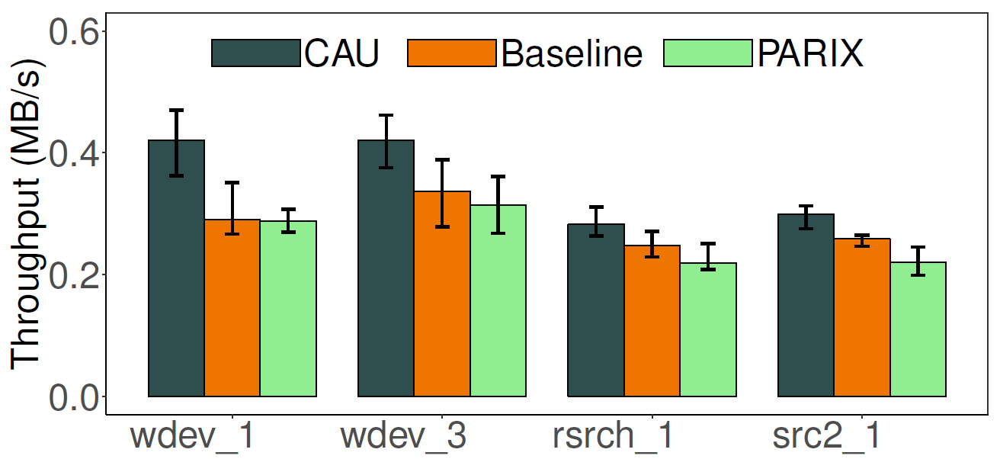
Amazon EC2 Experiments
Geo-distributed deployment
CAU improves update throughput by up to 33.8% (wdev_3) compared to PARIX
Update throughput for (n,k) = (16,12)

Slide 22
Conclusions
CAU is a novel cross-rack-aware update technique that mitigates cross-rack update traffic for erasure-coded data centers
Selective parity updates, data grouping, and interim replication
Reliability analysis
Prototype implementation of CAU
Extensive trace-driven analysis and local cluster and Amazon EC2 experiments
Source code:
http://adslab.cse.cuhk.edu.hk/software/cau

