Slide 1




ClusterSR: Cluster-Aware Scattered Repair in Erasure-Coded Storage
Zhirong Shen, Jiwu Shu, Zhijie Huang, and Yingxun Fu
IEEE IPDPS 2020

Slide 2
Introduction
Failures are prevalent in large-scale storage clusters
Disk failures
Latent sector failures
Erasure coding is a promising redundancy technique
Minimum data redundancy via “data encoding”
Higher reliability with same storage redundancy than replication
Reportedly deployed in Google, Azure, Facebook
e.g., Azure reduces redundancy from 3x (replication) to 1.33x (erasure coding) → PBs saving

Slide 3
Erasure Coding
Encode:
Divide file data to k data chunks
Encode k data chunks to a stripe of n coded chunks
Decode:
Any k out of n coded chunks can recover file data
A
File
A
B
A
=
A+2B
-
2*
B
B
A+B
B
Encode
A+2B
Decode
(n, k) = (4, 2)
I/O amplification: Repairing a chunk needs to retrieve k chunks

Slide 4
Scattered Repair
Scattered repair: store repaired chunks across all the surviving nodes
Repair
Repair
Failed node
Surviving nodes
Performance bottleneck: scale of the storage system

Slide 5
Cluster Storage
Storage systems exhibit bandwidth diversity phenomenon
Cross-cluster bandwidth is scarce
Network Core
Chunk
`
Node
Cluster
Cluster
Cluster
Cluster

Slide 6
Repair in Cluster Storage
Existing study: Intra-cluster aggregation before cross-cluster repair
Transmit three chunks across clusters for repair
Network Core
Failed node
Node with
surviving chunk
Destination node
C₁
C₂
C₃
C₄
Repair in RS(9,6), i.e., reading six surviving chunks (dashed line) for repair

Slide 7
Repair in Cluster Storage
Existing study: Intra-cluster aggregation before cross-cluster repair
Network Core
Failed node
Node with
surviving chunk
Destination node
C₁
C₂
C₃
C₄
Question 1: How to minimize the cross-cluster repair traffic in scattered repair ?
Repair in RS(9,6), i.e., reading six surviving chunks for repair
Repair in RS(9,6), i.e., reading six surviving chunks (dashed line) for repair

Slide 8
Repair in Cluster Storage
Cross-cluster repair traffic is unbalanced in multiple chunks’ repair
Cross-cluster upload traffic
Cross-cluster download traffic
C₁
C₂
C₃
C₄
Repair
solution
Chunk 1
1
1
2
Chunk 2
1
1
2
Upload two chunks across clusters
Download four chunks across clusters
Upload
1
2
1
0
Download
0
0
0
4

Slide 9
Repair in Cluster Storage
Cross-cluster repair traffic are unbalanced
Cross-cluster upload traffic
Cross-cluster download traffic
C₁
C₂
C₃
C₄
Repair
solution
Chunk 1
1
1
2
Chunk 2
1
1
2
Upload
1
2
1
0
Question 2: How to balance the cross-cluster repair traffic in scattered repair ?
Download
0
0
0
4

Slide 10
Our Contribution
ClusterSR, a Cluser-Aware Scattered Repair approach
Selection of clusters and destination node
Substitute repair solutions
Swap repair solution
General design
Applicable for Reed-Solomon codes, regenerating codes, and LRCs
Large-scale simulation, and Alibaba Cloud ECS experiments
Minimize cross-cluster repair traffic
Balancing cross-cluster repair traffic

Slide 11
Minimizing Cross-Cluster Repair Traffic
Step 1: select fewest clusters to collect k surviving chunks
Network Core
Failed node
Node with
surviving chunk
Destination node
C₁
C₂
C₃
C₄
select fewest clusters with at least k chunks (assuming that k=6)

Slide 12
Minimizing Cross-Cluster Repair Traffic
Step 2: select a destination node to perform repair
Network Core
Failed node
Node with
surviving chunk
Destination node
C₁
C₂
C₃
C₄
Selection principle: ensure that the number of chunks of a cluster is no more than n-k after repair

Slide 13
Balancing Cross-Cluster Repair Traffic
Substitution: substitute a repair solution of a chunk
Cross-cluster upload traffic
Cross-cluster download traffic
C₁
C₂
C₃
C₄
C₁
C₂
C₃
C₄
Substitute
H₂’s solution
H₁
2
H₁
2
1
1
1
1
H₂
1
1
1
3
H₂
3
1
1
1
Upload
2
2
1
0
Upload
1
2
1
1
Download
0
0
0
5
Download
3
0
0
2
The most loaded cluster: 5→3

Slide 14
Balancing Cross-Cluster Repair Traffic
Swap: swap two chunks in a repair round
Cross-cluster upload traffic
Cross-cluster download traffic
C₁
C₂
C₃
C₄
C₁
C₂
C₃
C₄
H₁
Swap H2
with H3
H₁
1
1
2
1
1
2
H₂
3
1
1
1
H₃
2
1
1
Upload
1
2
1
1
Upload
1
1
1
1
Download
3
0
0
2
Download
0
2
0
2
The most loaded cluster: 3→2

Slide 15
Repair Round
Partition the whole repair process into repair rounds
In a repair round, select R chunks to be repaired
[Minimize] Selection of clusters and destination node
[Balance] Substitution of repair solutions for the R chunks
[Balance] Swap repair solutions of R chunks with those that are unrepaired yet
Iteratively perform repair rounds until all the failed chunks are repaired

Slide 16
Implementation
Metadata Server
Coordinator
Proxy
Proxy
Proxy
Node
Node
Node
Node
Node
Node
Agent
Agent
Agent
Agent
Agent
Agent
Cluster 1
Cluster 2
Cluster 3
Command
Intra-cluster traffic
Cross-cluster traffic
Written in C++ on Linux as a standalone system
2,700 line-of-codes

Slide 17
Evaluation
Deployment (Alibaba Cloud ECS, Hangzhou Zone)
Type ecs.g6.large (2 vCPUs , 8GB RAM, Ubuntu 14.04)
An instance runs the ClusterSR Coordinator
Remaining 20 instances are organized into four clusters
Each cluster: one ClusterSR proxy and four Cluster Agents
Default configuration
Chunk size: 64MB
Packet size: 4MB
Erasure coding: RS(9,6)
Cross-cluster bandwidth: 0.15 Gb/s
Repair 100 chunks in five repair rounds (20 chunks each round)

Slide 18
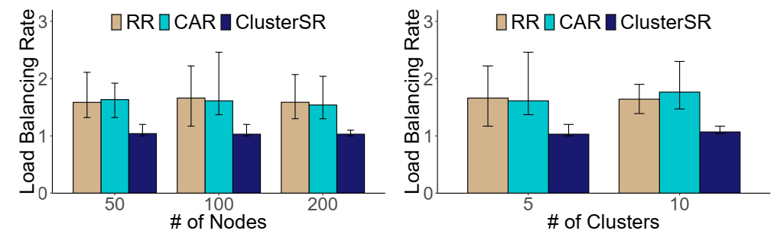
Load Balancing Rate
Varying number of nodes
Varying number of clusters
Ob1: ClusterSR approaches the optimal load balancing rate (i.e., 1)
Ob2: ClusterSR is much more stable

Slide 19
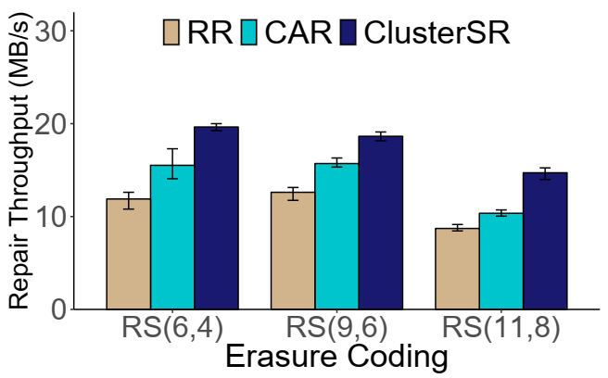
Impact of Erasure Coding
Ob1: The repair throughput of all the three approaches decreases when the value k becomes large
Ob2: ClusterSR can accelerate the repair process by 26.6-68.8%

Slide 20
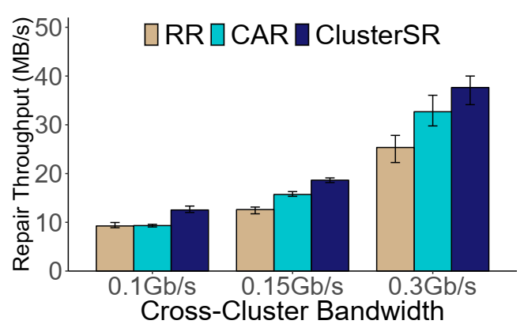
Impact of Cross-Cluster Bandwidth
Ob1: ClusterSR can improve the repair throughput by 15.2-34.3% and 35.4-48.6% when compared with CAR and RR
Ob2: Repair throughput increases with the cross-cluster bandwidth

Slide 21
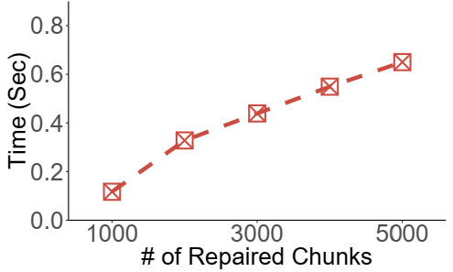
Computation Time
Ob1: ClusterSR is extremely efficient to derive the repair solutions for repairing a large number of failed chunks
0.65 seconds to obtain the repair solutions for repairing 5,000 chunks

Slide 22
Conclusions
CluterSR: a Cluster-aware Scattered Repair approach
Minimize and balance the cross-cluster repair traffic
Analysis, simulation, and experiments
Simulation
Textbed experiments on Alibaba Cloud ECS
Source code of ClusterSR prototype:
https://github.com/shenzr/clustersr

