Slide 1

Fast Predictive Repair in Erasure-Coded Storage
Zhirong Shen, Xiaolu Li, Patrick P. C. Lee
The Chinese University of Hong Kong
IEEE/IFIP DSN 2019
Notes:
Good afternoon, everyone. I am Zhirong Shen from The Chinese University of Hong Kong.
This is a joint work with Xiaolu Li, and Patrick P. C. Lee.
In this work, we design a new approach for fast predictive repair in erasure-coded storage.

Slide 2
Introduction
Failures are prevalent in large-scale storage clusters
Disk failures
Latent sector failures
Erasure coding is a promising redundancy technique
Minimum data redundancy via “data encoding”
Higher reliability with same storage redundancy than replication
Reportedly deployed in Google, Azure, Facebook
e.g., Azure reduces redundancy from 3x (replication) to 1.33x (erasure coding) → PBs saving
Notes:
Failures are becoming prevalent in large-scale storage clusters. For example, disk failures and latent sector failures happen frequently than estimated.
Erasure coding is a promising technique that protects data reliability against failures. It employs data encoding to achieve the minimum data redundancy and it can achieve higher reliability with same storage redundancy than replication.
Erasure coding is now reportedly deployed in modern storage systems, including Google File System, Azure Storage, and Facebook F4 system.

Slide 3
Erasure Coding
Encode:
Divide file data to k data chunks
Encode k data chunks to a stripe of n coded chunks
Decode:
Any k out of n coded chunks can recover file data
A
File
A
B
A
=
A+2B
-
2*
B
B
A+B
B
Encode
A+2B
Decode
(n, k) = (4, 2)
I/O amplification: Repairing a chunk needs to retrieve k chunks
Notes:
At a high level, erasure coding uses two operations to manipulate data. They are encoding and decoding.
In the encoding stage, erasure coding divides file data into k data chunks and encodes them into a stripe of n coded chunks, where n should be larger than k. These n chunks after encoding are distributed to n nodes.
In the decoding stage, erasure coding can reconstruct the file data by retrieving any k out of n coded chunks.
The following example shows the workflow of (4, 2) erasure coding, where n is four and k is two. In this example, we divide file data into two data chunks namely A and B and encode them to four coded chunks.
Suppose that the chunk A fails. We can retrieve any two coded chunks, say B and A+2B to recover the original A and B by linear operations, and finally repair the chunk A.
However, we can also notice one drawback of erasure coding. It amplifies storage and network I/Os in repair, where repairing a chunk needs to read and transfer k chunks. For example, in this case, we need to read two chunks to repair a chunk.

Slide 4
Motivation
Machine learning accurately predicts imminent disk failures
High prediction rate: 98% prediction [Botezatu, KDD’16]
Low false positive rate: as low as 0.03% [Zhu, MSST’13]
Our intuition: Proactively repair soon-to-fail (STF) nodes before they actually fail
Accelerate repair
Reduce window of data vulnerability
Notes:
Erasure coding takes a reactive repair approach and performs repair operations only after data has been lost.
We can notice that machine learning has recently been shown to accurately predict imminent disk failures with high prediction rate and low false alarm rate.
Therefore, our intuition is that we can proactively repair soon-to-fail nodes before they actually fail, so as to accelerate repair process and shorten the window of data vulnerability.

Slide 5
Repair Approach 1: Migration
Read the stored chunks directly from an STF node and relocate them to healthy nodes
Migration
STF node
Healthy node
☺
No extra traffic vs. normal reads
☹
Performance bottlenecked by available bandwidth of the STF node
Notes:
Generally, there are two repair approaches. The first is migration, which reads the stored chunks directly from an STF node and relocates them to healthy nodes.
Migration direct reads the STF node’s data and hence does not introduce any extra traffic compared to normal reads.
However, one of its drawbacks is that its performance is bottlenecked by the available bandwidth of the STF node.

Slide 6
Repair Approach 2: Reconstruction
Retrieve available chunks from healthy nodes to reconstruct the chunks of the STF node
Reconstruction
Reconstruction
STF node
Healthy nodes
☺
High repair parallelism (repair multiple chunks in parallel)
☹
Extra repair traffic
Notes:
The second repair approach is called erasure-coding-based reconstruction. It can exploit the available bandwidth resources of the storage cluster and involve all healthy nodes to participate in the repair of multiple chunks of the STF node in parallel.
This example shows that we can reconstruct two chunks in parallel by accessing all healthy nodes and reading at most one chunk from each healthy node.
We can see that reconstruction can achieve high repair parallelism. It can spread the retrieval across the whole cluster and let all healthy nodes join the repair of multiple chunks. But to repair a chunk, reconstruction needs to transmit k chunks, hence introducing extra repair traffic.

Slide 7
Question: How should we couple migration and reconstruction to maximize repair performance?
Notes:
So our question is how should we couple migration and reconstruction to maximize repair performance?

Slide 8
Our Contributions
FastPR, a Fast Predictive Repair approach
Maximum matching formulation
Finding reconstruction sets
Repair scheduling
General design
Applicable for Reed-Solomon codes, regenerating codes, and LRCs
Applicable for scattered and hot-standby repairs
Mathematical analysis, large-scale simulation, and Amazon EC2 experiments
Exploit more repair parallelism
Schedule migration and reconstruction
Notes:
We propose FastPR, a fast predictive repair approach.
FastPR exploits more repair parallelism by formulating maximum matching problem and finding reconstruction sets.
Based on the reconstruction sets, FastPR then schedules migration and reconstruction by repair scheduling.
FastPR is a general design. It is applicable for Reed-Solomon codes, regenerating codes, and locally repairable codes.
We also evaluate FastPR by mathematical analysis, large-scale simulation, and Amazon EC2 experiments.

Slide 9
Predictive Repair
Selectively migrate chunks and reconstruct remaining chunks of an STF node in parallel
Reconstruction
Time_{Reconstruction}
Migration
Time_{Migration}
STF Node
Time_{Repair} = max(Time_{Migration,} Time_{Reconstruction})
Goal: Minimize total repair time by fully parallelizing migration and reconstruction
Notes:
So let’s first look at the predictive repair
By coupling migration and reconstruction, predictive repair will selectively migrate chunks and reconstruct the remaining chunks of an STF node in parallel.
For example, in this case, we can reconstruct two chunks and migrate the remaining one chunk to repair the STF node.
Therefore, the repair time is the maximum one between the migration time and the reconstruction time.
The goal of predictive repair is to minimize the repair time by fully parallelizing migration and reconstruction. Intuitively, this can be attained when the migration time is equal to the reconstruction time.

Slide 10
Repair Scenario: Scattered Repair
Chunks are repaired to existing healthy nodes
Reconstruction
Reconstruction
Migration
STF node
Healthy nodes
Performance bottleneck: scale of the storage cluster
Notes:
We consider two repair scenarios. The first is scattered repair.
Scattered repair selects existing healthy nodes in the cluster to repair and store the repaired chunks of the STF node.
The cluster scale determines the performance of scattered repair.

Slide 11
Repair Scenario: Hot-Standby Repair
Chunks are repaired to dedicated hot-standby nodes
Reconstruction
Migration
STF node
Hot-Standby nodes
Healthy nodes
Performance bottleneck: number of hot-standby nodes
Notes:
The second repair scenario is called hot-standby repair.
Hot-standby repair deploys one or multiple dedicated hot-standby nodes to store the repaired chunks of the STF node. These hot-standby nodes usually serve as the backup nodes and do not participate in normal application before repair. They will take over the service of the STF node after repair.
Therefore, the number of hot-standby nodes for repair determines the performance of hot-standby repair.

Slide 12
Repair Round
Partition the whole repair process into repair rounds
Question: How to perform both migration and reconstruction in a repair round?
Two key problems
P1: Which chunks to be read for high repair parallelism?
P2: Where to store the repaired chunks to maintain fault tolerance?
We formulate and solve two maximum matching problems
Notes:
For easy manipulation, FastPR partitions the whole repair process into multiple repair rounds.
So our question is how to perform both migration and reconstruction in a repair round? To answer this question, we have to address two problems. The first problem is which chunks to be read for high repair parallelism, and the second is where to store the repaired chunks to maintain fault tolerance after repair.
We address these two problems by formulating and solving maximum matching problems.

Slide 13
Repair Round
Example: repair three chunks of an STF node in a repair round
Stripes
S₁
Reconstruction
S₂
Migration
S₃
STF node
N₁
N₂
N₃
N₄
N₅
N₆
Example: (n, k) = (5, 3), i.e., reconstructing a chunk reads three available chunks
Notes:
We use a toy example to clarify the procedure of a repair round.
Suppose that we want to repair three chunks of an STF node in a repair round. These three chunks are organized into three stripes spanning across seven nodes. Each stripe is generated by (5,3) erasure code, meaning that reconstructing a chunk needs to read three available chunks.
Suppose that FastPR will reconstruct the first two chunks and migrate the third chunk.

Slide 14
Design Overview
FastPR performs migration and reconstruction in parallel (for scattered repair in this example)
For hot-standby repair, evenly distribute the repaired chunks to all hot-standby nodes
Stripes
S₁
Reconstruction
S₂
Migration
S₃
STF Node
N₁
N₂
N₃
N₄
N₅
N₆
Notes:
FastPR performs migration and reconstruction in parallel.
The following is a repair scheduling in a repair round. For example, we can read three chunks from the node one, node two, and node three for reconstruction, and store the reconstructed chunk in the node five. At the same time, we can migrate the third chunk from the STF node to the node one.
The figure shows an example for scattered repair. For hot-standby repair, we can evenly distribute the repaired chunks to all hot-standby nodes for load balancing.

Slide 15
Maximum Matching Formulation
Identify the chunks to be retrieved for reconstruction for both scattered and hot-standby repairs
Objective: Spread the retrieval for high parallelism
Idea: Construct a bipartite graph and find a maximum matching that saturates the chunk vertices (on the right)
N₁
N₁
N₂
N₂
S₁
S₁
Healthy
nodes
N₃
N₃
N₄
N₄
Read three chunks of S₂ from N₄, N₅, and N₆
S₂
N₅
S₂
N₅
N₆
N₆
Notes:
We first identify the chunks to be retrieved for reconstruction.
Our objective is to spread the retrieval across the whole storage cluster for high repair parallelism. We propose to formulate the data retrieval as a bipartite graph.
The vertices on the left denote the healthy nodes and the vertices on the right represent the chunks to be retrieved. If a healthy node can provide a chunk for a given stripe, then we connect it with all the chunk vertices of that stripe. Finally, we can establish a maximum matching that saturates the chunk vertices on the right.
In the following example, suppose that the node six stores a chunk of the stripe two, then we connect node six with the three chunk vertices of the stripe two. After establishing the maximum matching, we can read three chunks of stripe two from the node four, node five, and node six.

Slide 16
Maximum Matching Formulation
Identify the nodes to store the migrated and reconstructed chunks for scattered repair
Objective: Maintain fault tolerance after repair
Idea: Construct a bipartite graph and find a maximum matching that saturates the stripe vertices (on the right)
Store the repaired chunk of S₁ on N₅
N₁
N₁
N₂
S₁
N₂
S₁
Healthy
nodes
N₃
S₂
N₃
S₂
N₄
S₃
N₄
S₃
N₅
N₅
N₆
N₆
Notes:
After determining the chunks that are read for reconstruction, we then have to identify where to store the repaired chunks. Our objective is that we should maintain the fault tolerance after repair. So, for each stripe, we should store its repaired chunk in a node that does not store any chunk of that stripe before repair.
The idea is that we can also construct a bipartite graph. The vertices on the right still are the healthy nodes and the vertices on the left represent the stripes. If a node does not store a chunk of stripe before repair, then we can connect the node vertex with that stripe vertex. We finally establish a maximum matching that saturates the stripe vertices, indicating the nodes to store the repaired chunks.
For example, if the node six does not store any chunk of the stripe one before repair, then we connect the node six to the stripe one. The maximum matching indicates that we can use the node five to store the chunk of stripe one after repair.

Slide 17
Finding Reconstruction Sets
Maximize number of chunks repaired in each repair round to minimize total number of repair rounds
Reconstruction set: chunks of an STF node that can be reconstructed in parallel in a repair round
Idea: Organize as many chunks of the STF node as possible into a reconstruction set
Notes:
Remember that FastPR performs repair by multiple repair rounds. So, to minimize the number of repair rounds, we should maximize the number of chunks repaired in each round.
We partition the chunks to be repaired into multiple reconstruction sets, where each reconstruction set includes the chunks that can be reconstructed in parallel
Therefore, our idea is that we can organize as many chunks of the STF node as possible into a reconstruction set, in order to improve repair parallelism.

Slide 18
Finding Reconstruction Sets
Step 1: Initialize a reconstruction set
Step 2: Optimize a reconstruction set
Replace each selected chunk with every residual chunk
Attempt to enlarge the new reconstruction set
C₁
C₁
A reconstruction
set
C₂
C₂
C₃
C₃
C₄
C₄
STF Node
N₁
N₂
N₃
N₄
N₅
N₆
N₇
N₈
N₉
Notes:
So how to find a reconstruction set? Generally, there are two steps.
In the first step, we initialize a reconstruction set. In this example, the reconstruction set includes two chunks. They are C one and C two. The chunks with dashed lines are retrieved for reconstruction from healthy nodes. We cannot expand the reconstruction set at this moment, otherwise the reconstruction will need to read more than one chunk from some healthy nodes.
In the second step, we attempt to replace each selected chunk in the reconstruction set with every residual chunk, and try to enlarge the reconstruction set. For example, we can replace C two with C three, and we can see that the resulting reconstruction set after replacement can be further enlarged by adding C four. Finally, we can produce a reconstruction set with three chunks.

Slide 19
Repair Scheduling
Schedule migration and reconstruction based on the resulting reconstruction sets
Idea: In each repair round,
reconstruct chunks in large reconstruction sets
migrate chunks in small reconstruction sets
Migration time should be nearly the same as the reconstruction time in each repair round
Notes:
We finally schedule how to perform migration and reconstruction based on the resulting reconstruction sets.
Our observation is that the reconstruction sets with more chunks have better repair parallelism. Therefore, our idea is that we always choose the largest reconstruction set for reconstruction and migrate chunks from the smallest reconstruction sets. To minimize the repair time, we require that the migration time should be near the same as the reconstruction time in a repair round.

Slide 20




Repair Scheduling
number of chunks of an STF node in a reconstruction set
Reconstructed chunks
Migrated chunks
First round
Suppose each round migrates four chunks
R₁
9
R₁
$$\text{R}\text{5}\text{’}$$
1
R₁
9
Second round
R₂
R₆
2
7
R₇
1
R₂
7
R₃
6
$$\text{R}\text{4}\text{’}$$
2
R₄
4
R₂
R₂
7
R₅
2
Third round
R₅
$$\text{R}\text{5}$$
3
R₃
6
R₆
R₃
R₆
R₄
6
2
$$\text{R}\text{4}$$
4
R₃
6
R₇
R₇
R₅
R₄
1
R₅
2
2
R₄
2
Reconstruction sets
Reconstruction sets
Reconstruction sets
Notes:
We show a toy example to clarify the process of the repair scheduling. There are seven reconstruction sets and the values on the right are the number of chunks of an STF node in the corresponding reconstruction sets. We assume that migrating four chunks needs near the same time as the reconstruction.
In the first repair round, as R one is the largest reconstruction set, we reconstruct all the nine chunks in R one. At the same time, we choose four chunks for migration from the three smallest reconstruction sets. For example, we can read all the three chunks in the last two smallest reconstruction sets and read one chunk from the R five. Therefore, we have picked out the chunks to be repaired in the first repair round and then update the remaining reconstruction sets
We iteratively perform repair scheduling on the remaining reconstruction sets and finally repair the chunks by three repair rounds.

Slide 21
Implementation
Control flow
NameNode
Coordinator
Migration
Reconstruction
Agent
Agent
Agent
Agent
Agent
STF Node
DataNode
DataNode
DataNode
DataNode
Written in C++ on Linux as a standalone system
2,400 line-of-codes
Integration with Hadoop 3.1 HDFS with no change to codebase
HDFS automatically recognizes the repair and updates the metadata via periodical heartbeats
Notes:
We implement the prototype of FastPR in C plus plus on Linux.
Our prototype has around 2,400 lines of code.
The prototype comprises a coordinator and multiple agents. The coordinator manages the metadata information for each chunk, including the location of each chunk and the stripe that each chunk belongs to.
When the coordinator detects an STF node, it will issue commands to the involved agents, which tell the agent to start the repair. Upon receiving the commands, the agents resided on the STF node migrates chunks to other healthy nodes, while the agents in the healthy nodes send chunks to other healthy nodes for reconstruction.
We have tested that FastPR can be seamlessly integrated with Hadoop 3.1 HDFS. Because HDFS can automatically update the metadata information through periodically heartbeats communicated between DataNodes and NameNodes. Therefore, the chunks repaired by FastPR can be recognized by HDFS automatically with no change to the codebase.

Slide 22
Evaluation
Evaluation in three aspects
Mathematical analysis
Large-scale simulation
Amazon EC2 experiments
Findings of all three evaluation are consistent
In this talk, we focus on Amazon EC2 experiments
Up to 25 instances (type m5.large)
Ubuntu 14.04.5 LTS, 8 GB RAM
142 MB/s of disk bandwidth (sequential writes)
5Gb/s of network bandwidth (measured by iperf)
Notes:
We carry out extensive evaluation, in terms of mathematical analysis, large-scale simulation, and Amazon EC2 experiments. The findings of all three evaluation are consistent.
In this presentation, we mainly focus on Amazon EC2 experiments to learn the performance of FastPR in a real-world cloud environment. We set up 25 instances of type m5.large. We conduct preliminary measurements and find that each instance achieves 142 Megabyte per second of disk bandwidth and 5 Gigabits per second of network bandwidth.

Slide 23
Evaluation
Deployment
An instance runs the FastPR Coordinator and the HDFS NameNode
Each of 21 instances runs a FastPR Agent and an HDFS DataNode
Three remaining instances are used as hot-standby nodes
Default configuration
Chunk size: 64MB
Packet size: 4MB
Erasure coding: RS(9,6)
Network bandwidth: 5Gb/s
Notes:
We use one instance to run the FastPR coordinator and the HDFS NameNode and employ each of 21 instances to run a FastPR agent and an HDFS DataNode. We reserve three remaining instances for hot-standby repair.
We use the following default configurations. We set the chunk size as 64 Megabytes, and configure the packet size as 4 Megabytes. We select the RS(9,6) code and set the network bandwidth as 5 Gigabits per second.

Slide 24
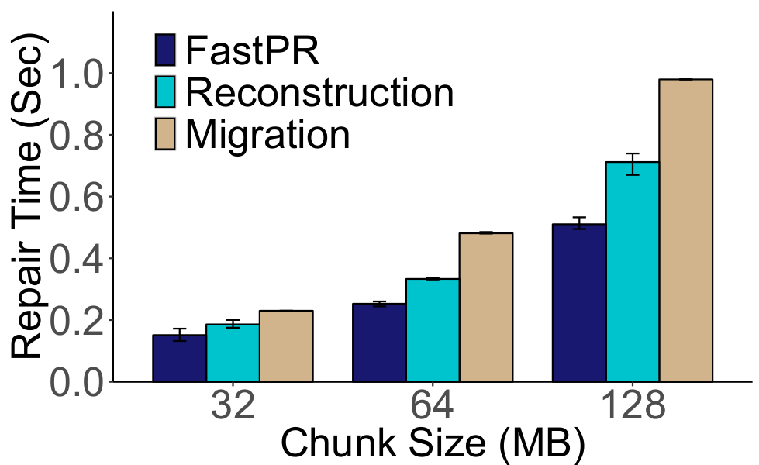
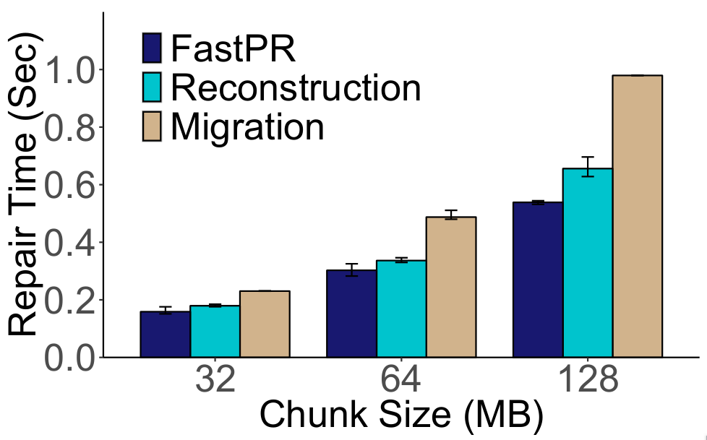
Impact of Chunk Size
Scattered Repair
Hot-standby Repair
FastPR reduces total repair time by 31.1-47.9% for scattered repair and 10.0-28.3% for hot-standby repair
Two repair scenarios have similar performance because the system scale is the bottleneck under this configuration
Notes:
We first evaluate the impact of chunk size, which is varied from 32 megabytes to 128 megabytes.
Our result shows that the repair time increases with the chunk size, yet FastPR still reduces the repair time by up to 47.9% for scattered repair and 28.3% for hot-standby repair.
We can notice that the scattered and hot-standby repair have the close repair time. This is because at this time, the system scale is the bottleneck. In the large-scale simulation, the scattered repair outperforms the hot-standby repair, where the number of hot-standby nodes is the bottleneck for hot-standby repair.

Slide 25
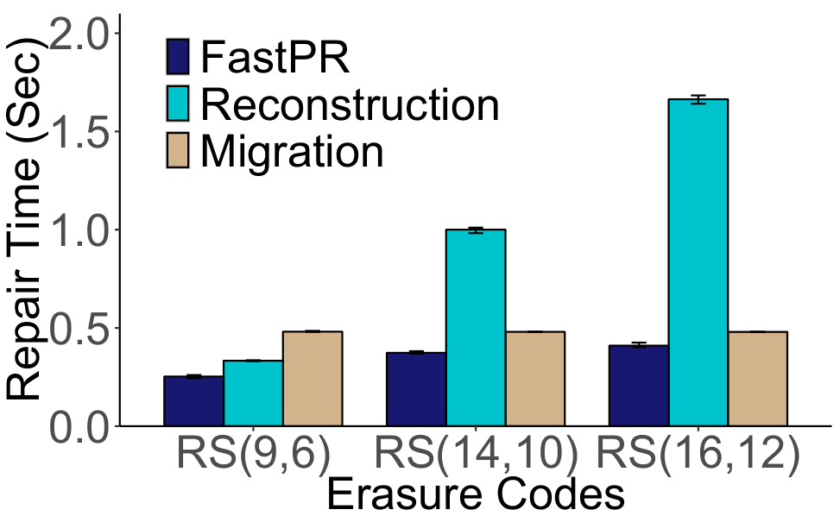
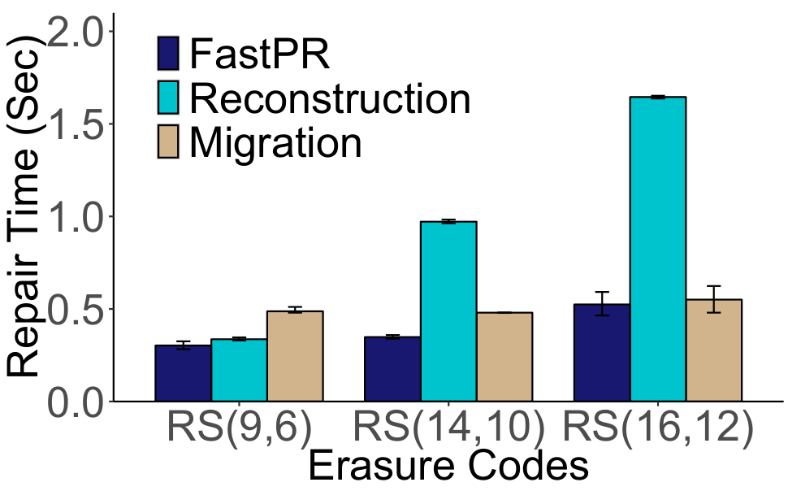
Impact of Erasure Code Parameters
Scattered Repair
Hot-standby Repair
Migration remains unaffected by (n,k), while reconstruction needs more repair time for larger k
Notes:
We then evaluate the repair time per chunk for different erasure codes.
We can observe that the performance of migration remains unaffected by different erasure codes, while the repair time of reconstruction needs more time for larger k. The reason is that a larger k increases the amount of repair traffic in reconstruction.

Slide 26
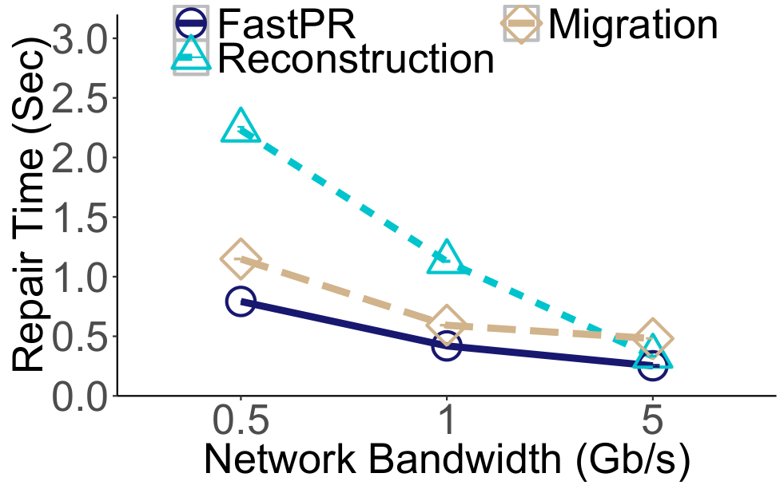
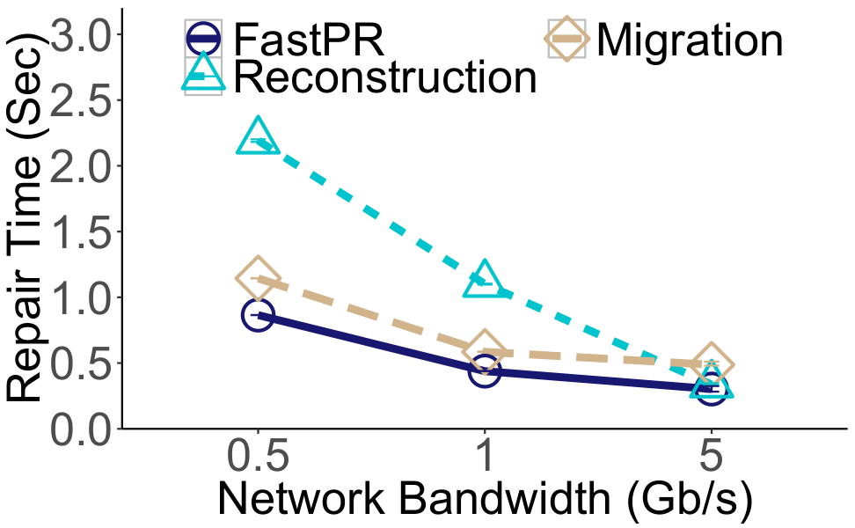
Impact of Network Bandwidth
Scattered Repair
Hot-standby Repair
Repair time of reconstruction significantly increases under limited network bandwidth
Notes:
We finally study how the network bandwidth affects the repair time. The results show that the repair time of reconstruction significantly increases when the network bandwidth is limited. The reason is that reconstruction amplifies repair traffic, making it easily affected by the network bandwidth.

Slide 27
Conclusions
FastPR: a predictive repair approach for erasure-coded storage
Carefully couple migration and reconstruction in parallel fashion
Analysis, simulation, and experiments
More results in the paper (e.g., microbenchmarks on running time of finding reconstruction sets)
Source code of FastPR prototype:
http://adslab.cse.cuhk.edu.hk/software/fastpr
Notes:
To conclude, in this work, we design FastPR, a predictive repair approach that carefully couples migration and reconstruction in parallel fashion.
We conduct mathematical analysis, large-scale simulation, and testbed experiments to validate the performance of FastPR.
Besides, we also carry out microbenchmarks to measure the running time of finding reconstruction sets.
Please refer to our paper for more details.
We release the source code of our FastPR implementation. Any verifications and comments are welcome.

Slide 28
Backup

Slide 29
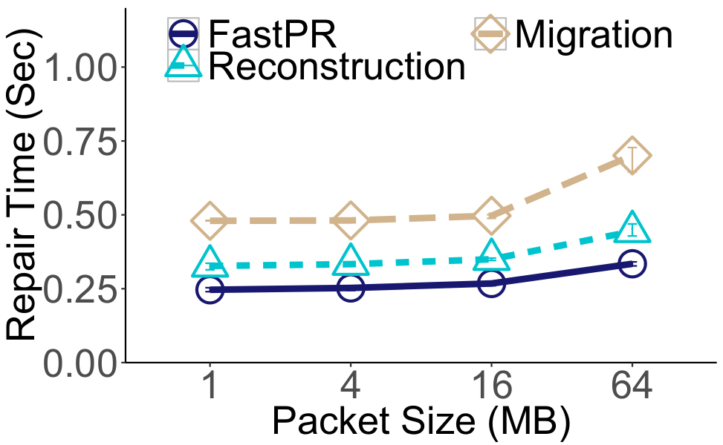
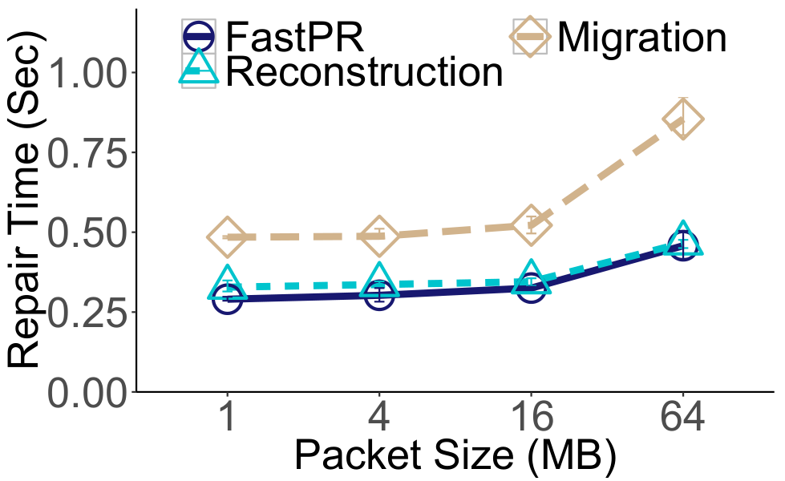
Impact of Packet Size
Scattered Repair
Hot-standby Repair
Repair time reduces for smaller packet sizes
Multi-threading parallelizes different steps of a repair operation

Slide 30
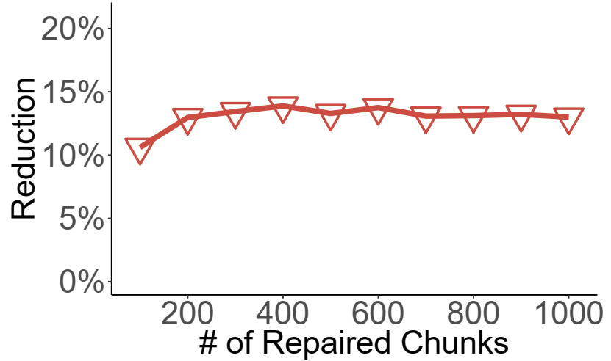
Question
Performance of Finding Reconstruction Set
Optimizing the reconstruction sets can reduce 13% of initial reconstruction sets

Slide 31
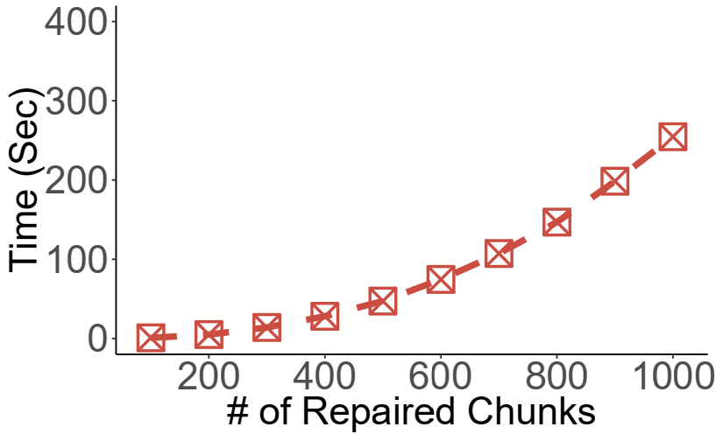
Question
Performance of Finding Reconstruction Set
Suggestion (1): run the algorithm offline for each STF node
Suggestion (2): run the algorithm for small groups

