Slide 1
On the Optimal Repair-Scaling Trade-off in Locally Repairable Codes
Si Wu, Zhirong Shen, and Patrick P. C. Lee
The Chinese University of Hong Kong
INFOCOM 2020

Slide 2
Introduction
Properties of clustered storage systems
Hierarchical architecture, with nodes partitioned into clusters
Cross-cluster network bandwidth is scarce
Failures are commonplace
Cross-cluster bandwidth is the bottleneck!
Network Core
Node
Cluster

Slide 3
Locally Repairable Codes (LRC)
Erasure coding is a promising technique for fault tolerance
Higher reliability with same storage redundancy than replication
Higher repair overhead (network traffic and disk I/Os)
Locally Repairable Codes (LRC) are a new family of erasure codes to mitigate repair overhead
Deployed in Azure, Facebook's data centers
D₀, D₁, D₂, L₀: a local group
D₀
D₁
D₂
D₃
D₄
D₅
G₀
G₁
L₀
L₁
(k, l, g, c) = (6, 2, 2, 3)

Slide 4
Data Repair of LRC
Single-block repair is common
Single-block failures happen more often than multi-block failures
Transient failures trigger repair of temporarily unavailable data blocks
LRC retrieves other available blocks of same local group for repair
Repair cost: average cross-cluster traffic for repairing all data blocks
D₀
D₁
D₂
D₃
D₄
D₅
G₀
G₁
L₀
L₁

Slide 5
Data Scaling of LRC
Requirement in storage systems
Adapt to workload changes by tuning coding parameters to trade between access performance and storage efficiency
LRC adopts two coding parameters for scaling
Fast LRC, e.g., LRC(12, 6, 2)
Compact LRC, e.g., LRC(12, 2, 2)

Slide 6
Upcoding And Downcoding
Upcoding cost and downcoding cost
Amount of cross-cluster traffic for upcoding and downcoding
D₀
D₂
D₄
D₆
D₈
D₁₀
G₀
D₀
D₂
D₄
D₆
D₈
D₁₀
G₀
D₁
D₃
D₅
D₇
D₉
D₁₁
G₁
D₁
D₃
D₅
D₇
D₉
D₁₁
G₁
L₀
L₁
L₂
L₃
L₄
L₅
L’₀
L’₁
L’₀
L’₁
L₀
L₁
L₂
L₃
L₄
L₅
Upcoding, (12, 6, 2, 20) -> (12, 2, 2, 16)
Downcoding, (12, 2, 2, 16) -> (12, 6, 2, 20)

Slide 7
Motivation
LRC’s cluster-aware data placement cannot simultaneously minimize both repair cost and scaling cost
L’₀
L’₁
L’₀
L’₁
L₀
L₁
L₂
L₃
L₄
L₅
D₀
D₁
Core
D₆
D₇
Core
L₀
D₀
D₁
Core
L₃
D₆
D₇
Core
D₂
D₃
D₈
D₉
L₁
D₂
D₃
L₄
D₈
D₉
D₄
D₅
D₁₀
D₁₁
L₂
D₄
D₅
L₅
D₁₀
D₁₁
Minimum upcoding cost
Minimum repair cost

Slide 8
Contributions
Present the optimal repair-scaling trade-off of LRC
Our work is the first formal study on optimal repair-scaling trade-off in erasure-coded storage
Derive data placements that operate along optimal trade-off curve
Conduct testbed experiments to show the efficiency of the placements

Slide 9
Insight
All local parity blocks collocated to minimize upcoding cost
Each local parity block collocated with its encoding data blocks to minimize repair cost
L₀
L₁
L₂
L₃
L₄
L₅
Relocate L1,
L2,
...,
trade scaling for
repair
L₀
D₀
D₁
L₃
D₆
D₇
Data blocks -> other clusters
L₁
D₂
D₃
L₄
D₈
D₉
L₂
D₄
D₅
L₅
D₁₀
D₁₁

Slide 10
Minimizing Upcoding Cost
Collocate relevant local parity blocks in the core
Upcoding cost minimized to 0
L₀
L₁
L₂
Core
L₃
L₄
L₅
Core
L’₀
L’₁
Upcoding within each core

Slide 11
Further Minimizing Repair Cost
Collocate some sets of encoding data blocks also in the core
Other sets of encoding data blocks in other clusters
Repair cost: 0.67
L₀
L₁
L₂
Core
L₃
L₄
L₅
Core
D₀
D₁
Ɛ₀
D₆
D₇
Ɛ₃
Single-cluster fault tolerance
Maximum sets of encoding data blocks in one cluster
D₂
D₃
Ɛ₁
D₈
D₉
Ɛ₄
D₄
D₅
Ɛ₂
D₁₀
D₁₁
Ɛ₅

Slide 12
Trading Upcoding Cost for Repair Cost
Relocate some local parity blocks to each other cluster
Upcoding cost: 1, repair cost: 0.5
Repair cost (0.5) minimized subject to upcoding cost (1)
L₀
L₂
Core
L₃
L₄
L₅
Core
D₀
D₁
Ɛ₀
D₆
D₇
Ɛ₃
L₁
D₂
D₃
Ɛ₁
D₈
D₉
Ɛ₄
D₄
D₅
Ɛ₂
D₁₀
D₁₁
Ɛ₅

Slide 13
Optimality Guarantee
Theorem 1. For any placement subject to single-cluster fault tolerance, if the upcoding cost is u, then the lower bound of the repair cost is 1 - θ/δ- u×θ/l
Repair costs of our placements touch the lower bound
Proof idea: calculate maximum number of data blocks whose repair costs are zero and at least one

Slide 14
Minimizing Repair Cost
Collocate each local parity block with its encoding data blocks
Upcoding cost: 4, repair cost minimized to 0
Core
Core
L₀
D₀
D₁
Ɛ₀
L₃
D₆
D₇
Ɛ₃
L₁
D₂
D₃
Ɛ₁
L₄
D₈
D₉
Ɛ₄
L₂
D₄
D₅
Ɛ₂
L₅
D₁₀
D₁₁
Ɛ₅
Repair within each cluster

Slide 15
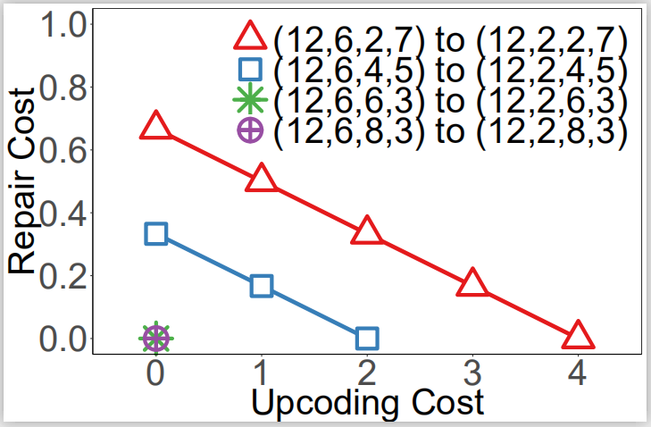
Optimal Trade-off Curve
Upcoding cost increases, repair cost decreases

Slide 16
Evaluation
Implementation
Prototype with a Coordinator and multiple data nodes
Testbed
Local: Multiple 4-core machines over 1 GbE (cross-cluster: 100Mbps)
Comparisons:
Flat: placement with each block in a distinct cluster (e.g., Azure [ATC'12], Xorbas [VLDB'13], HACFS [FAST’15])
Opt-S: placement with minimized upcoding cost
Opt-R: placement with minimized repair cost

Slide 17
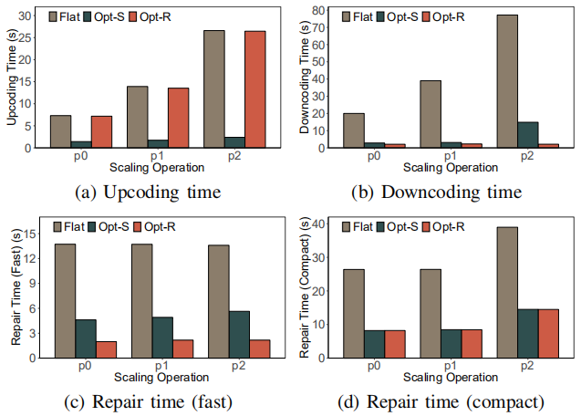
Repair and Scaling Time Performance
Different scaling operations
Findings:
Opt-S has best upcoding performance
Opt-R has best repair performance
Both Opt-S and Opt-R outperform Flat

Slide 18
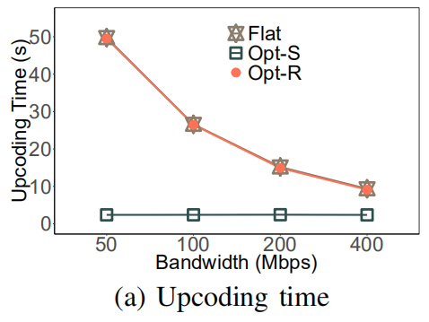
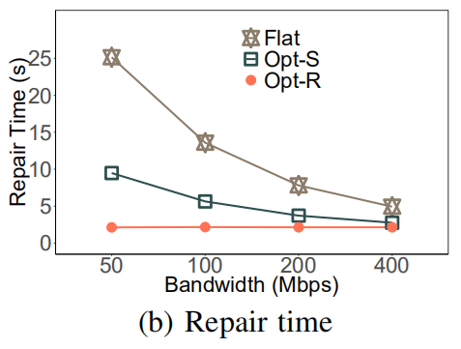
Impact of Cross-cluster Bandwith
Different cross-cluster bandwidth
Findings:
Opt-S and Opt-R have greater improvements over Flat under more scarce cross-cluster bandwidth

Slide 19
Conclusions
Study optimal repair-scaling trade-off of LRC in clustered setting
Design placement strategies to operate along optimal trade-off curve
Conduct testbed experiments to validate efficiency
Source code: http://adslab.cse.cuhk.edu.hk/software/lrctradeoff

