Slide 1

Parity-Only Caching for Robust Straggler Tolerance
Mi Zhang, Qiuping Wang, Zhirong Shen, Patrick P. C. Lee
The Chinese University of Hong Kong
MSST 2019
Notes:
Good afternoon, everyone! I’m Mi Zhang from The Chinese University of Hong Kong. I’m glad to present our work, “parity-only caching for robust straggler tolerance”.

Slide 2
Background
Stragglers exist in large-scale storage systems
Nodes operate with slow performance
Also known as gray failures [Huang, HotOS’17] or fail-slow failures [Gunawi, FAST’16]
Stragglers introduce latency variation [Dean, Comm.’13]
Long tail in latency distribution
Hard to pinpoint stragglers [Huang, HotOS’17; Gunawi, FAST’16]
Varying root causes
Long time to detect
Notes:
-In large-scale storage systems, performance variation is prevalent.
Some nodes remain operational but with slow performance.
We call them as stragglers, which are also known as gray failures or fail-slow failures.
-Stragglers slow down the normal operations, leading to long tails in the latency distribution.
- However, it is not easy to pinpoint stragglers in a large-scale cluster.
There are various factors to degrade the performance, such as resource sharing, background activities, workload spikes.
So given the complexity of detection, it may take a few hours and even several days to figure out the root causes of stragglers.

Slide 3
Background
Caching accessed data to bypass stragglers
Cache space is limited
Only caching popular data inevitably hits stragglers
Selective replication creates more replicas for hot data
High redundancy overhead
Data popularity can change sharply [Huang, HotNets’14]
Notes:
- Caching is a common approach to tolerate stragglers.
It typically caches the data in memory or other storage devices to avoid accessing straggler nodes.
However, the cache space is usually limited. It is impossible to cache all data stored in the whole system.
Given this, caching strategies prefer to cache the frequently-accessed data. But such approaches can still hit stragglers.
-Another approach to bypass stragglers is selective replication. It creates more replicas for hot data.
Actually caching can be regarded as a special selective replication, where the newly-generated replicas are stored in cache.
So we can see that selective replication incurs high redundancy overhead.
And when the data popularity changes sharply, selective replication can not tolerate stragglers effectively.

Slide 4
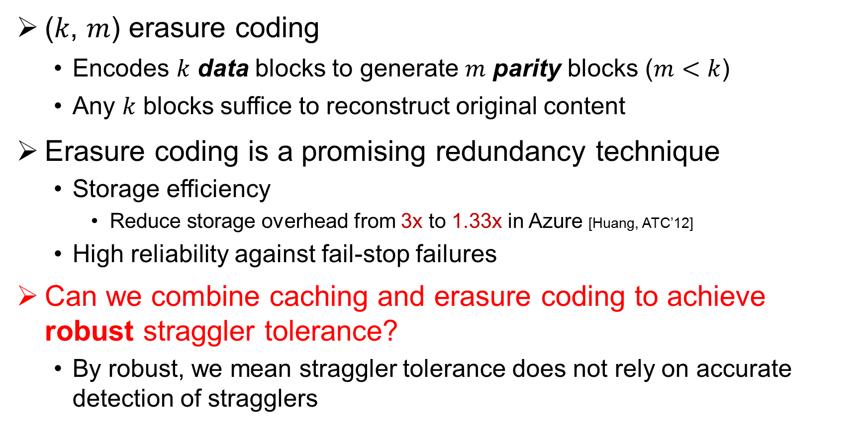
Erasure Coding
(𝑘, 𝑚) erasure coding
Encodes 𝑘 data blocks to generate 𝑚 parity blocks ($m<k$)
Any 𝑘 blocks suffice to reconstruct original content
Erasure coding is a promising redundancy technique
Storage efficiency
Reduce storage overhead from 3x to 1.33x in Azure [Huang, ATC’12]
High reliability against fail-stop failures
Can we combine caching and erasure coding to achieve robust straggler tolerance?
By robust, we mean straggler tolerance does not rely on accurate detection of stragglers
Notes:
Before we go ahead, let’s review another redundancy approach, erasure coding.
Generally, erasure coding has two parameters, k and m. For (k, m) coding, it encodes k data blocks to create m parity blocks. These k data blocks and m parity blocks consist of a stripe.
Compared with conventional replication, erasure coding has lower redundancy ratio. Its redundancy ratio is less than 2 because m is smaller than k.
Erasure coding has been widely employed to tolerate fail-stop failures. When failure happens, any k blocks of a stripe are able to recover the original data.
Erasure coding is a storage-efficient redundancy approach. For example, it can reduce storage overhead from 3x to 1.33x in Azure.
And erasure coding has high reliability. The Mean Time to Failure of erasure coded system is many orders of magnitude higher than that of a system with replication.
Therefore, could we couple caching with erasure coding to avoid the weakness of caching replicas and benefit from erasure coding?
Here we emphasize to tolerate stragglers robustly. By robust, we mean that we can mitigate straggler impact effectively without knowing the exact straggler nodes.

Slide 5
Our Contributions
Conduct mathematical analysis
Design POCache, a parity-only caching scheme for robust straggler tolerance
Mitigate coding overhead via two mechanisms
Straggler-aware cache algorithm
Implement POCache atop Hadoop 3.1 HDFS
Evaluate POCache on a local cluster and Amazon EC2
Compare POCache with hedge reads and selective replication
Notes:
Here comes our contribution.
We first conduct mathematical analysis to show the effectiveness of caching parity blocks.
Then, based on our analysis, we design POCache, a parity-only caching scheme for robust straggler tolerance.
We first mitigate coding overhead to maintain the performance of normal operations.
Then we design a straggle-aware cache algorithm to manage the cache space dedicately.
We implement POCache on the top of Hadoop 3.1 HDFS and conduct extensive evaluation.
We compare it with other straggler-tolerant approaches on both local cluster and Amazon EC2.

Slide 6
Mathematical Analysis
Retrieve data from 𝑘 storage nodes
𝑘 data nodes
𝑐 cache nodes
…
…
client
Assume every node has a probability of 0.5% to become a straggler
What is the probability of hitting a straggler for a read request?
Notes:
So firstly, we conduct a mathematical analysis to compare the effect of caching data and parity blocks in straggler tolerance.
- Assume a client retrieves data form k data nodes. To simplify our analysis, the client downloads one data block from each data node. And we have c cache nodes to cache c blocks to tolerate slow data nodes.
We say that a read request hits a straggler if it retrieves data from at least one straggler node.
If every node has a probability of 0.5% to become a straggler, what is the probability of hitting a straggler for a read request?
High probability of hitting a straggler indicates long tail latencies; otherwise, low probability of hitting a straggler means stable performance.
So what is the probability of hitting a straggler when caching data or parity blocks?

Slide 7
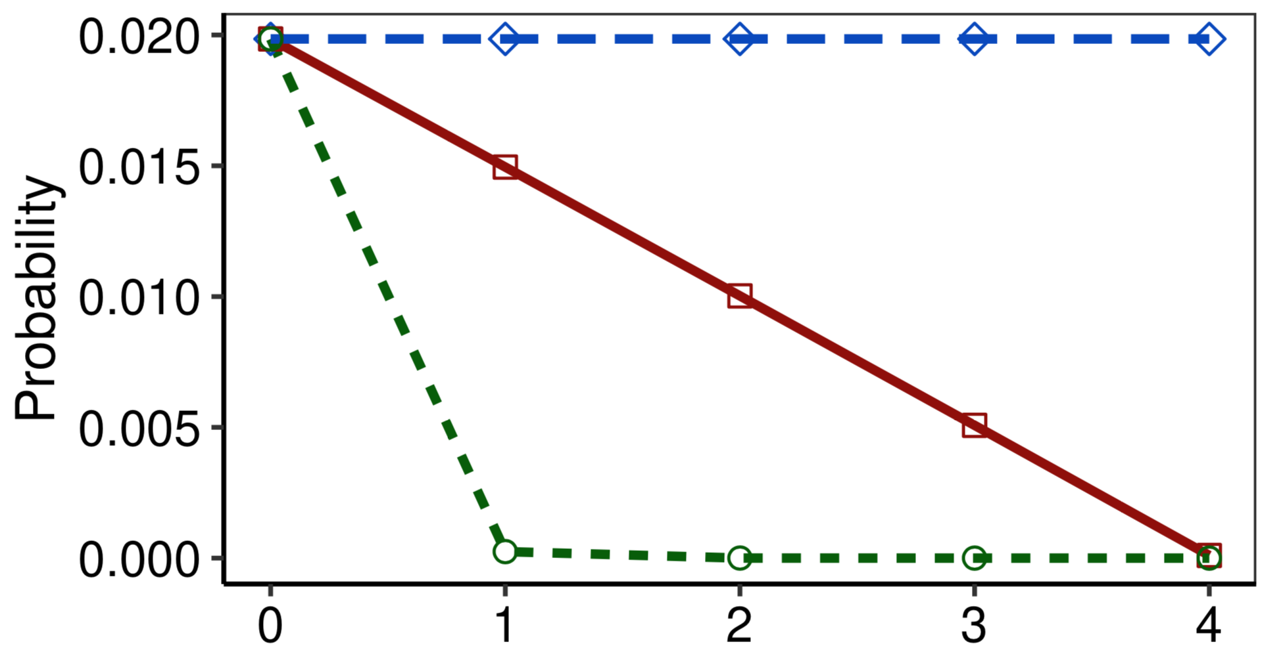
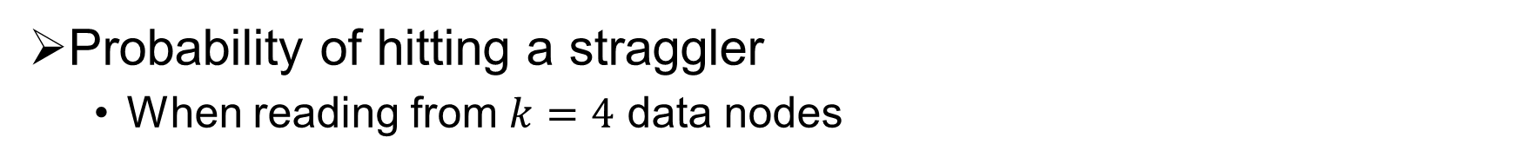
Mathematical Analysis
Probability of hitting a straggler
When reading from $\text{k}=4$ data nodes
No-caching
Caching data
Caching parity
Number of cached blocks
Notes:
We first calculate the probability of hitting stragglers when retrieving data from 4 nodes with different number of cached blocks.
-The y axis is the probability of hitting a straggler.
The x axis is the number of blocks cached, from 0 to 4. Here 0 means no data is cached while 4 indicates that all blocks are cached.
-The blue line indicates the probability of no-caching. The red line is the probability of caching data blocks while the green line is of caching parity blocks.
The probability of hitting a straggler decreases linearly with the number of cached data blocks. We can see that by caching parity blocks, there is a sweet point in the green line. This means that caching only one parity block can keep the probability of hitting a straggler quite low.

Slide 8
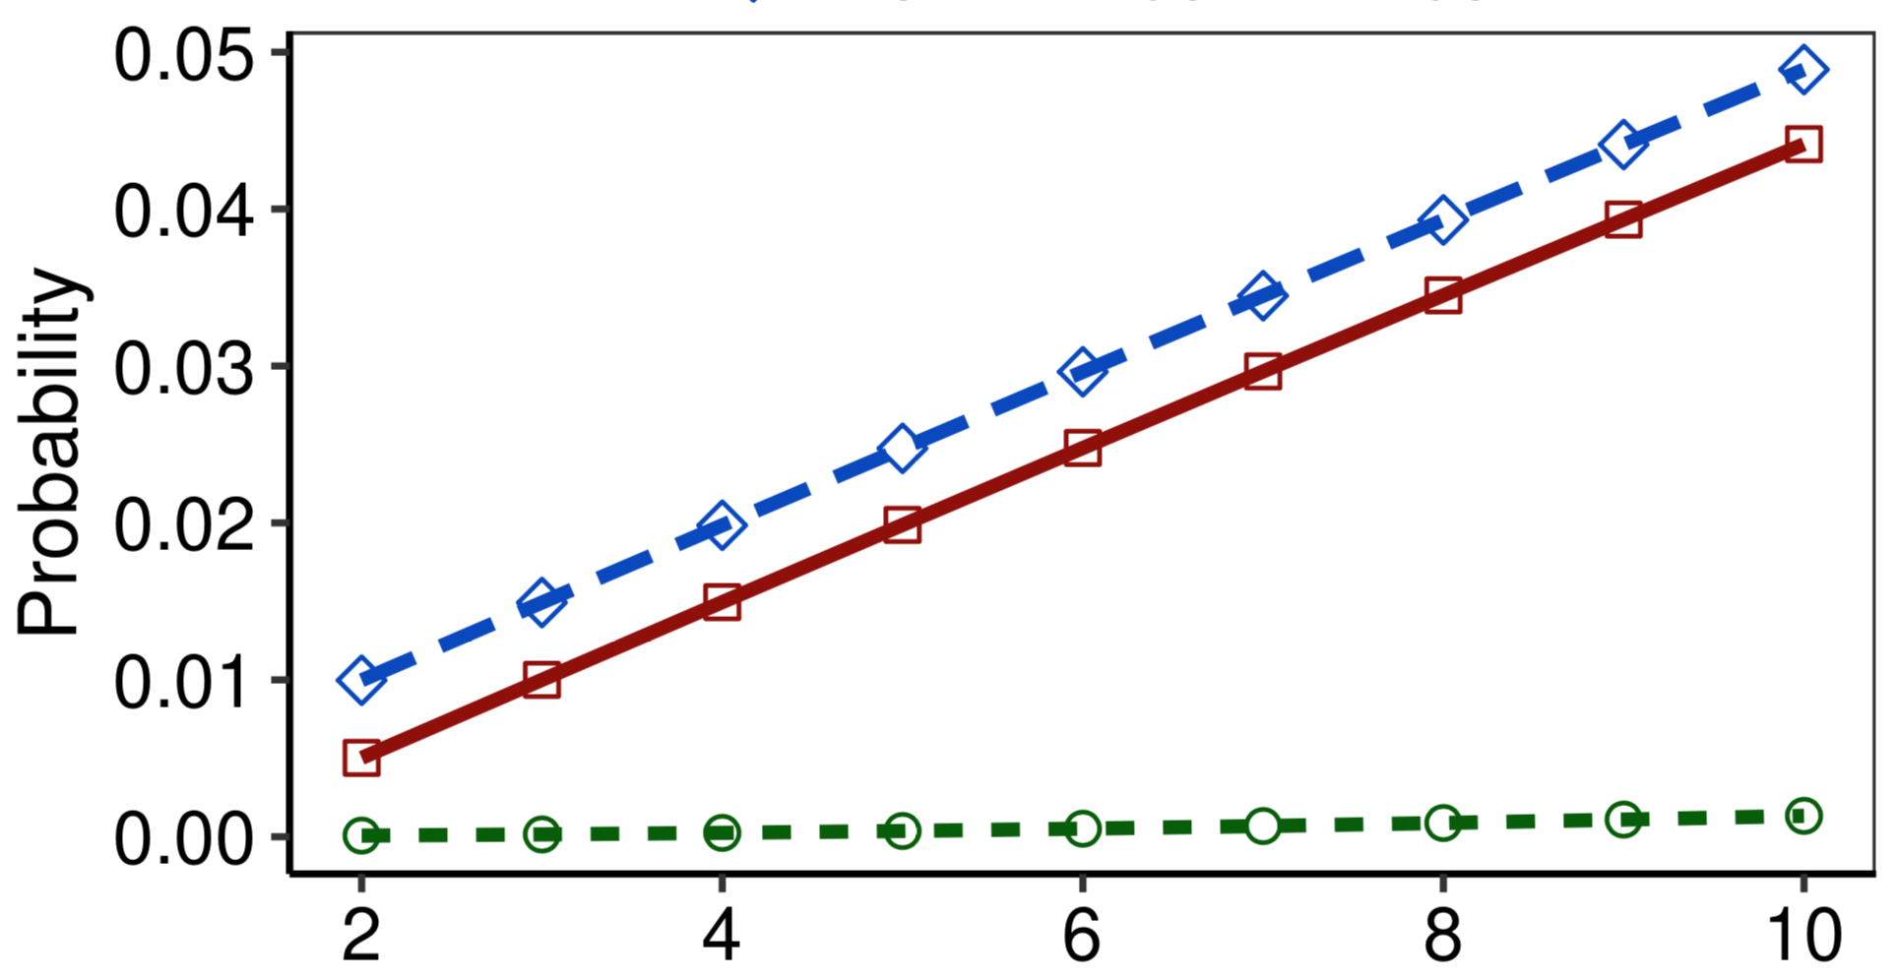
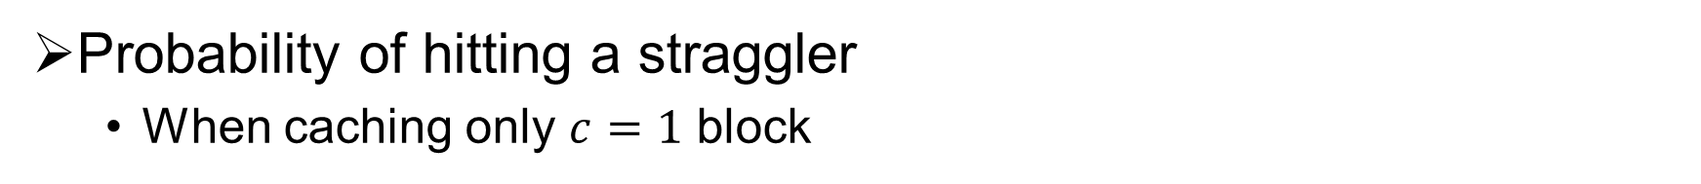
Mathematical Analysis
Probability of hitting a straggler
When caching only $c=1$ block
No-caching
Caching data
Caching parity
Different number of data blocks
Notes:
Then we fix the number of cached blocks as 1 and vary the number of data blocks to read from 2 to 10.
Here the y axis is the probability of hitting a straggler and the x axis is the number of data blocks to read.
For example, when x = 6, it means that we cache 1 block for 6 data blocks.
Without caching, the probability of hitting straggler increases with the number of data blocks to access. That is, for a fan-out request, the higher degree of fan-out implicates the higher probability of hitting a straggler.
The three lines from the top down are non-caching, caching data, and caching parity respectively.
The lower, the better.
Caching data block is better than no-caching, but only achieving limited effect. We can see that the probability of caching 1 parity block remains very low when x varies from 2 to 10.
Even though we only cache 1 parity block for 10 data blocks, the probability of hitting a straggler still reaches to 0, maintaining the straggler tolerance.

Slide 9
Main Findings
Caching parity blocks is more effective than caching data blocks to bypass stragglers
Caching only one parity block can effectively eliminate the impact of stragglers
Even with slowdown of cache nodes, caching parity blocks still maintains straggler tolerance
Notes:
From our analysis, we find that:
First, compared with caching specific data block, caching parity blocks is more effective to mitigate the straggler impact.
And more surprisingly, caching only one parity can effectively tolerate the stragglers.
Furthermore, even though the cache nodes slow down, caching parity block still maintain straggler tolerance.

Slide 10
Challenges
Large encoding/decoding overhead
Decoding time takes about 30% of read time [Rashmi, OSDI ’16]
Degrade normal read/write performance
What parity blocks to cache?
Manage cache space with considering stragglers
Can we support general deployment?
Support general storage systems and protocols
Support upper-layer applications
Notes:
So it seems quite promising to cache parity blocks for straggler tolerance.
However, there are several challenges when applying it in practice:
First, encoding/decoding operations incur large I/O overhead, prolonging the latencies.
For example, it takes about 1/3 of read time to perform decoding.
This means that performing encoding/decoding on the I/O path directly can degrade the I/O performance inevitably.
-Another key problem is how to allocate the cache space.
Which parity blocks should we cache to achieve a lowest probability of hitting a straggler?
-Third, how to design our system for general deployment?
Our design should be independent with underlying storage systems and protocols such that it can support upper-layer applications.

Slide 11
POCache Design
Block slicing
data blocks
parity block
subblock
…
substripe
D₀
D₁
D_{k-1}
C₀
Slice blocks into smaller-size subblocks
Cache parity subblocks rather than the whole block
Parallelize coding across different substripes
Pipeline the process of caching parity blocks
Notes:
Now let me introduce POCache design.
To reduce coding overhead, we slice a large block into smaller-size unit, called subblock.
The subblocks in the same offset of blocks in a stripe consist of a substripe.
Thus, instead of caching the whole parity block, we take the parity subblocks into cache.
This design enables us to parallelize coding operations across different substripes.
And we can pipeline the process of writing parity blocks into cache at the subblock level.
In this way, we can reduce the additional latency of putting parity block into cache.

Slide 12
POCache Design
Incremental encoding
data subblocks
Parity subblock
…
D₀
D₁
D_{k-1}
C₀
C₀’
C₀’’
…
C₀’’’’
C₀
Addition operations are associative in a linear combination
Compute parity subblocks one by one incrementally
Notes:
The second scheme to minimize the coding overhead is incremental encoding.
We observe that a parity block is usually a linear combination of k data blocks.
So we can perform computation when receiving a data block instead of waiting for collecting all k data blocks.
Take the computation of a parity subblock C0 for example.
When the first data subblock D0 comes, we compute an intermediate parity block, c0 prime.
Then, when the second data subblock comes, we update C0 prime with the newly-arrived data and get C0 double prime.
We update the intermediate parity subblocks with new data subblocks.
At last, we get the final parity subblock.

Slide 13
POCache Design
How to minimize straggler hit ratio?
Avoid accessing stragglers
Consider file popularity
Straggler-aware cache algorithm
Admit caching parities for blocks on stragglers
Collect each node’s service rate
Identify stragglers according to three-sigma rule
Compose a straggler list
Evict least-recently-accessed files
75% of re-accesses occur within 6 hours [Chen, VLDB’12]
Details referred to the paper
Notes:
Our goal is to minimize the probability of hitting a straggler, that is, to reduce the straggler hit ratio. We need to pay attention to two perspectives here: the appearance of stragglers and file popularity.
To allocate the cache space dedicatedly for straggler tolerance, we propose a straggler-aware cache algorithm.
The straggler-aware cache algorithm manages the cache space from the aspects of cache admission and eviction.
It prefers to cache parity blocks for the data residing on the straggler nodes.
To determine whether a node is a straggler node, we collect each node’s service rate and regrade the nodes with low service rate as stragglers according to three-sigma rule.
We include the straggler nodes in a straggler list and we update the straggler list periodically.
For eviction, we clear the least-recently-accessed files from the cache because previous study reports that three quarters of re-accesses will occur within few hours.
For the details on the cache algorithm, please refer to our paper.

Slide 14
Implementation
Implement POCache on Hadoop 3.1 HDFS
Use Redis to build cache nodes
Add Manager on NameNode for cache management
Modify HDFS client
Manager
client
NameNode
data
parity
…
…
DataNode
Cache Node
Architecture of POCache
Notes:
We implement POCache atop Hadoop 3.1 HDFS.
We leverage Redis to be the cache.
We add POCache manager on NameNode. POCache manager runs cache algorithms and stores metadata related to the parity blocks in cache.
Moreover, we modify the HDFS client to read with cached parity blocks and perform coding operations.

Slide 15
Evaluation Setup
Local cluster
15 commodity machines
Intel core i5, 16 GiB RAM, 1 TiB SATA disk
10 Gbps Ethernet switch
Employ benchmark tool DFS-Perf
Inject stragglers by running Linux stress
64-MiB block, 256-MiB file (4 blocks) by default
Amazon EC2
30 m5.large instances, 2 m5.2xlarge instances
Magnetic storage
5 Gbps network bandwidth
Notes:
We conduct evaluation on a local cluster and Amazon EC2.
Our local cluster consists of 15 commodity computers, which are connected by 10 Gbps Ethernet switch.
We use benchmark tool DFS-Perf to generate workloads and collect the performance results.
To inject a straggler into the cluster, we run stress on some nodes to exhaust the local I/O resources.
By default, we set the block size as 64 MiB, and the file size as 256 MiB.
On Amazon EC2, we tenant 30 m5.large instances to deploy HDFS and 2 m5.2xlarge instances to be the cache nodes.
The network bandwidth is about 5 Gbps.

Slide 16
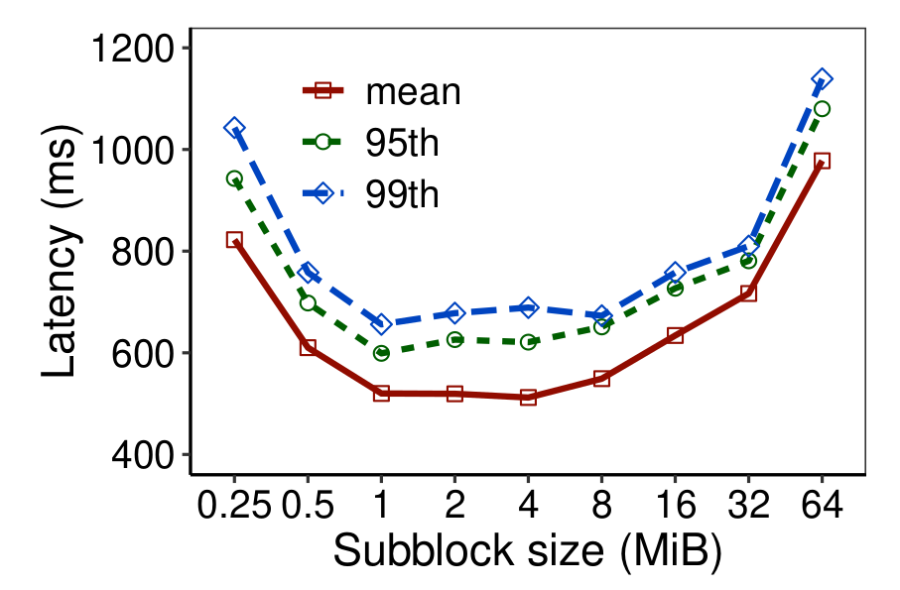
Evaluation Results
Effectiveness of block slicing
Cache one parity block for a file
Lowest latency when subblock is of 1 MiB
Notes:
To show the effectiveness of block slicing, we run experiments with different subblock size.
Here we cache one parity block for a file and vary subblock size from 0.25 MiB to 64 MiB.
The x axis is sublock size and the y axis is latency.
We can see the latency is of a bathtub curve.
When setting the subblock size as 1 MiB, we achieve the lowest mean and tail latency.
Thus, we configure 1 MiB subblock in the following experiments.

Slide 17
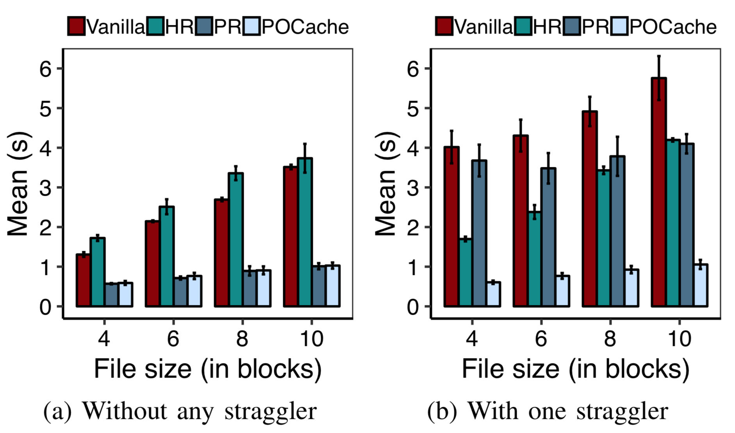
Evaluation Results
Single-client reads
Read mechanisms
Vanilla, read sequentially
HR, hedged read
PR, read blocks in parallel
Evaluate different file sizes
POCache reduces the latency with straggler to the latency in normal case
Notes:
We then evaluate read performance with a single client.
We compare POCache with HDFS vanilla read, hedged read, and parallel read.
The x axis is the file size and the y axis presents the mean latency.
Without any straggler, the latency of POCache equals to that of parallel read. Then we inject one straggler, the read latency prolongs and the standard variation becomes larger.
Here POCache effectively eliminates straggler impact, reducing the latency with straggler almost to the latency without any straggler.

Slide 18
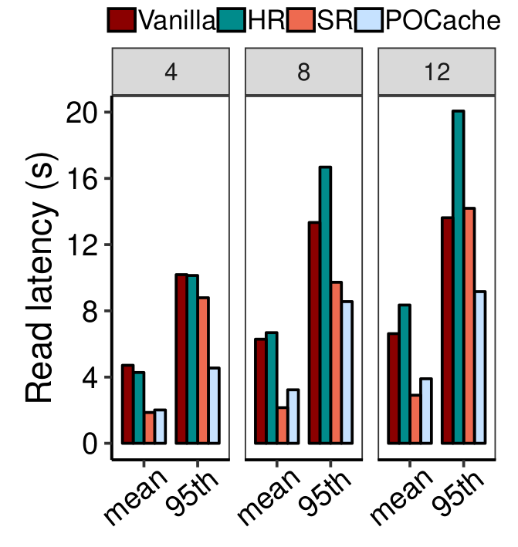
Evaluation Results
Multi-client reads
Read mechanisms in comparison
Vanilla, read blocks sequentially
HR, hedged read
SR, cache popular data blocks
Evaluate with 4, 8, 12 clients
POCache achieves low mean and tail latencies
With one straggler
Notes:
Here we evaluate the read performance with multiple clients.
We deploy 4, 8 and 12 clients in local cluster respectively and compare POCache with vanilla read, hedged read, and selective replication.
In general, the read latencies of all mechanisms increase when more clients issue read requests.
Selective replication has lowest mean latency by caching the popular data but has a much larger tail latencies.
POCache performs well here, achieving low mean and tail latencies.

Slide 19
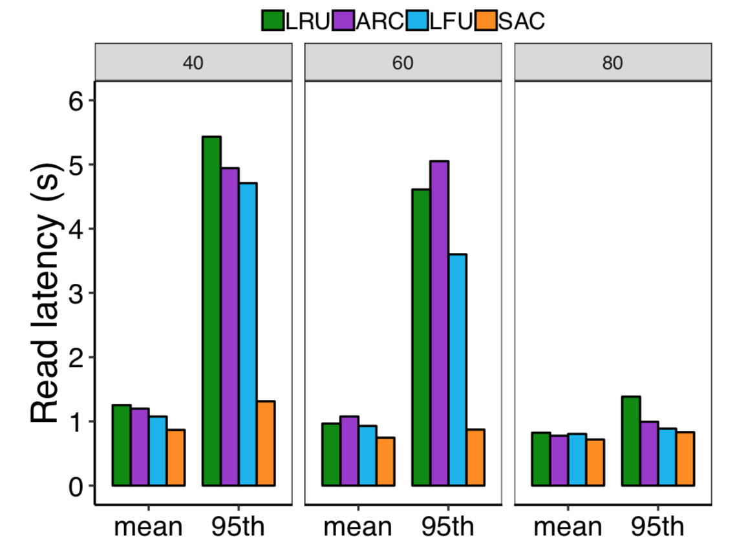
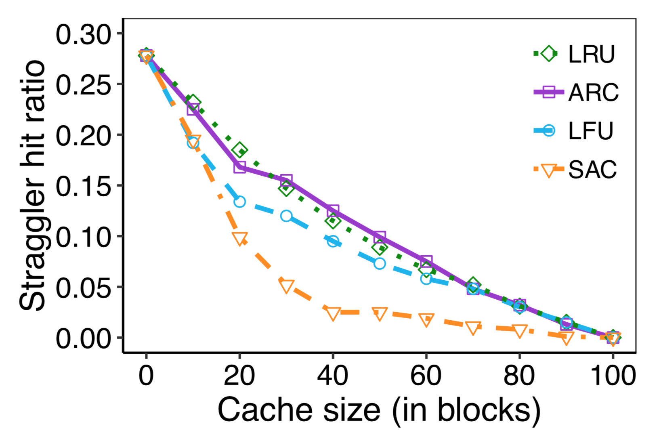
Evaluation Results
Cache efficiency of Straggler-aware cache algorithm (SAC)
Straggler hit ratio under different cache sizes
Latencies under different cache sizes
Notes:
For cache efficiency, we compare straggler-aware cache algorithm with other cache algorithms, including
LRU, LFU, and ARC adaptive replacement cache algorithm.
We write 100 4-block files to HDFS and vary the cache size from 0 to 100 in unit of blocks.
In the left figure, we show the straggler hit ratio versus cache size.
The straggler hit ratio generally decreases when the cache size becomes larger.
Among these four cache algorithms, straggler-aware cache algorithm achieves the smallest straggler hit ratio.
The right figure shows the latencies under different cache sizes.
Accordingly, straggler-aware cache algorithm achieves the lowest latencies, especially when the cache space is limited.
For example, when the cache size is 40, SAC can reduce the straggler hit ratio to only 2.5% and achieve a stable read performance.

Slide 20
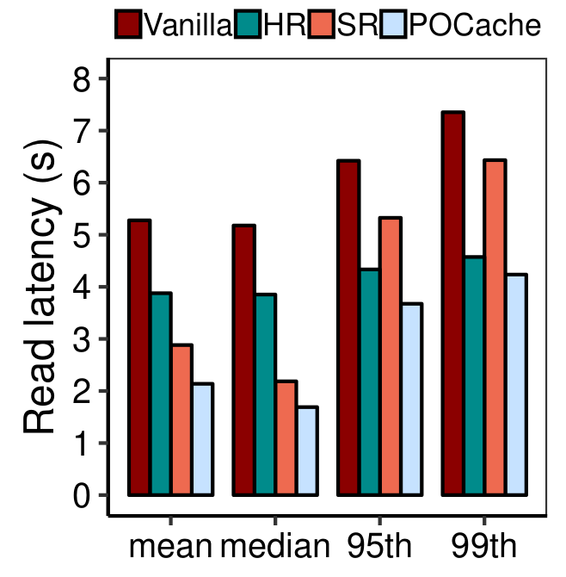
Evaluation Results
Experiments on Amazon EC2
Read mechanisms
Vanilla, read sequentially
HR, hedged read
PR, read blocks in parallel
Stragglers naturally appear in cloud
POCache achieves lowest latency among all four read policies
Notes:
Lastly, we run experiments on Amazon EC2.
In such a shared environment, stragglers naturally exist as the performance variation is quite high.
And straggler estimation is inaccurate as the straggler nodes fluctuate.
POCache still maintains the overall straggler tolerance with cached parity blocks.

Slide 21
Conclusion
Present POCache, a parity-only caching design for robust straggler tolerance
Minimize coding overhead
Straggler-aware cache algorithm
Preserve original workflow and performance
Implement POCache on Hadoop 3.1 HDFS
Conduct experiments on a local cluster and Amazon EC2
Source code
http://adslab.cse.cuhk.edu.hk/software/pocache
Notes:
In conclusion, we design POCache, a parity-only caching for robust straggler tolerance. It eliminates the impact of straggler nodes and achieves stable performance.
We release our source code on the webpage of our lab.

Slide 22
Thank you!
Q&A
Notes:
That's all. Thank you!

Slide 23
Background and Motivation
Stragglers affect both data layouts
Contiguous layout
Striping layout
node₀
node₁
node₂
file
0~2MiB
2~4MiB
4~6MiB
6MiB
Contiguous layout
node₀
node₁
node₂
0~1MiB
1~2MiB
2~3MiB
3~4MiB
4~5MiB
5~6MiB
Striping layout
Notes:
When analyzing the straggler impact, one question is how do we retrieve the k blocks, sequentially or in parallel.
Actually this relates to the underlying data layouts. There are two type of data layouts, named contiguous layout and striping layout.
Contiguous layout divides a file into several blocks and place each block in different node directly.
Striping layout breaks the file into multiple small units and stores the units across different node.
Take a 6-MiB file for example. We place it on three nodes. As illustrated in this figure, contiguous layout partitions the file to 3 2-MiB blocks and places them on 3 three nodes.
For striping layout, the file is broken into 6 1-MiB unit and stored across 3 nodes.
Typically, the client retrieves the data blocks sequentially under contiguous layout while reads data of a file in parallel under striping layout.
Thus, under contiguous layout, the penalty induced by the straggler is added to the overall latency.
And the overall latency under striping layout is equal to the read latency from the straggler node.
Nevertheless, the stragglers affect both data layouts and introduce long latencies.

Slide 24
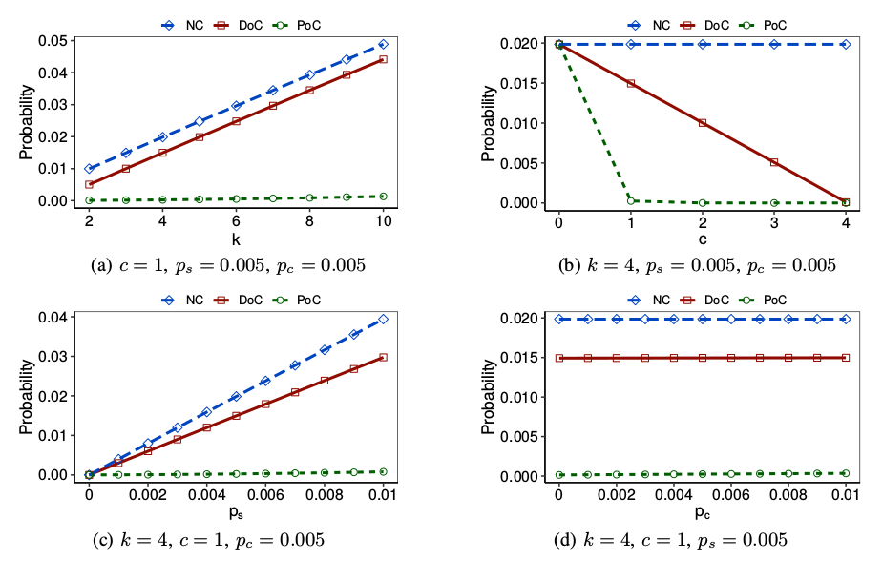
Numerical Analysis
Probability of hitting straggler
Notes:
Once the request hits stragglers, the read latency prolongs.
Now let’s compute the probability of hitting stragglers.
Here we consider three caching mechanisms, no caching, data-only caching, parity-only caching, which are denoted as NC, DoC, PoC in the figures.
The y axis is the probability of hitting stragglers. And in each figure we vary a parameter denoted in x axis to do analysis.
In the first figure, we cache 1 parity block for different number of data blocks. We use k to denote the number of data blocks. For example, we cache 1 parity block for 4 data blocks when k = 4. Varying k from 2 to 10, the probability of hitting stragglers increases under no caching and data-only caching. In contrast, the probability of poc remains quite low.
We vary the number of cached parity blocks. Which are denoted by c. Here we fix k as 4. We can see that there is a sweet point in the line of poc. That means, caching only one parity block can keep the probability of hitting stragglers quite low. But for Doc, it decreases linearly with the number of cached parity blocks.
In the third figure, we vary ps, the probability that each storage node becomes a straggler. We can see that prob of POC keeps at a quite low level while doc and nc increases linearly.
In the last figure, we explore the relation between probability of hitting stragglers and the probability that each cache node becomes a straggler, pc. We can see that p_c has a negligible effect on the probability of hitting stragglers because the line dose not change visibly.

Slide 25
Motivation
Stragglers slow down read request
Read a file f, consisting of k blocks residing on k nodes
Each node behaves abnormally with probability p_{s}
k
data block
storage node
client
Notes:
Now let’s look at an example of reading files.
As shown in this figure, we read file f, which has k blocks residing on k nodes. That is, each block resides on different node.
Here each node can slow down with a probability ps.
We call the slow node as straggler. If the read request hits stragglers, the read latency can be quite long.

Slide 26
Mathematical Analysis
Two caching strategies
Data-only cache
c data blocks out of k data blocks
Parity-only cache
c parity blocks generated from k data blocks
k
…
data block
storage node
cached block
c
…
client
cache node
Notes:
Here we have two caching approaches:
One choice is that we can cache the data block directly. That is, we choose c data blocks out of k data blocks to cache.
Another is that we cache c parity blocks which are encoded from k data blocks.

Slide 27
Implementation
Add Manager on NameNode
Store metadata on cached parities
Support different cache algorithms via two primitives:
Query, return admission decision
Update, update related information and return eviction decision if needed
Manager
client
NameNode
data
parity
…
…
Architecture of POCache

Slide 28
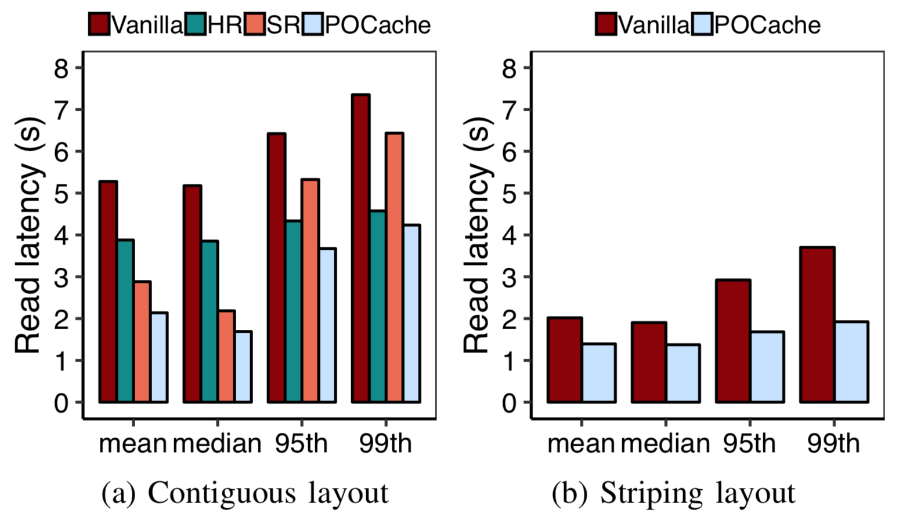
Evaluation Results
Experiments on Amazon EC2 cloud

Slide 29
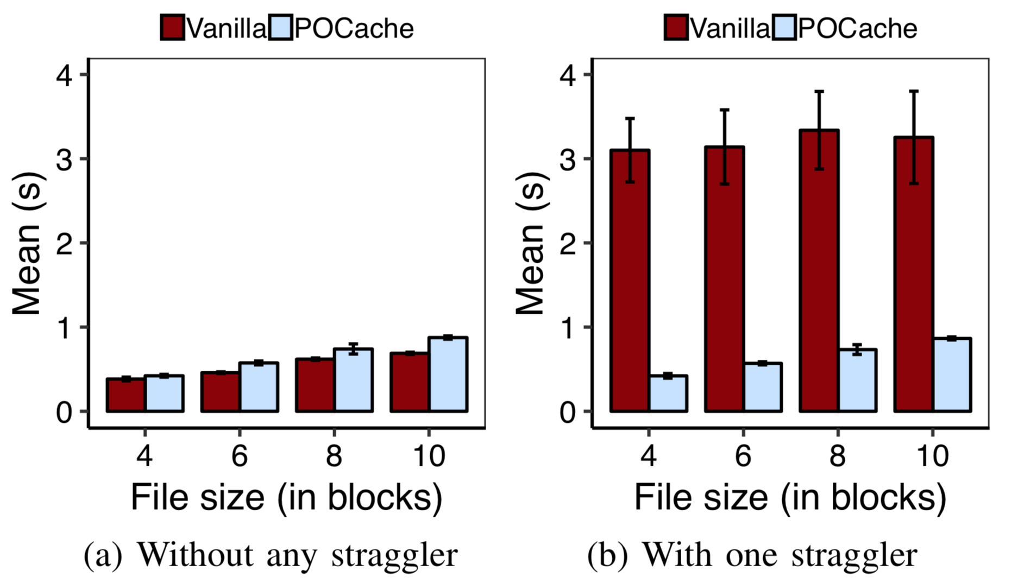
Evaluation Results
Single-client reads under striping layout

