Slide 1
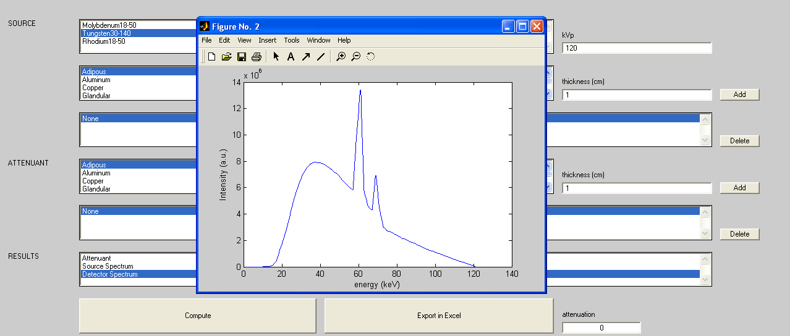
Simulation X

Slide 2
Structures [spectra (Boone data ) and attenuant (NIST data)]
Spectra data (tungsten example) consists in 2 matrix:
SimulationX.data.energiesTungsten=[1:151]; (Sample energies) SimulationX.data.coefTungsten=[coef(i,1),coef(i,2),coef(i,3),coef(i,4)]_{(energy index)}; (Spectra coefs)
➔at the sample energy E_{i},
Sp(E_{i}) = coef(i,1).kVp+ coef(i,2).kVp²+coef(i,3).kVp³+ coef(i,4).kVp⁴
Material attenuation matrix:
SimulationX.data.Aluminum=[Energy(i),LinearAttenuation(i)]_{I}

Slide 3
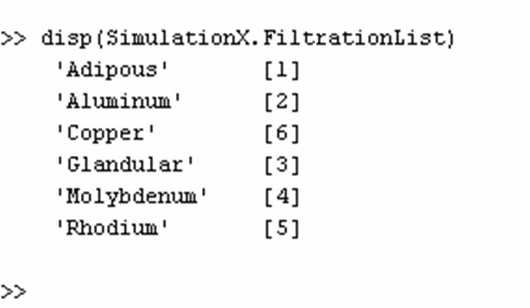
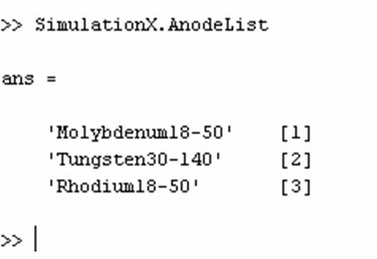
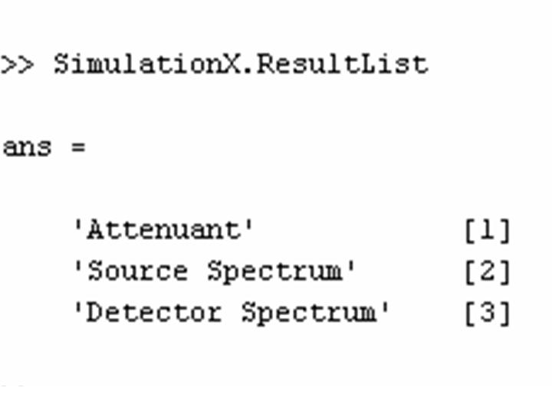
Structures (GUI linked)
Material filtration list: Material anode list:
Display name Material_ID Display name Anode_ID
Computation choise List

Slide 4
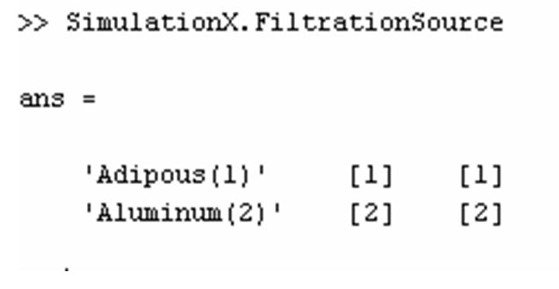
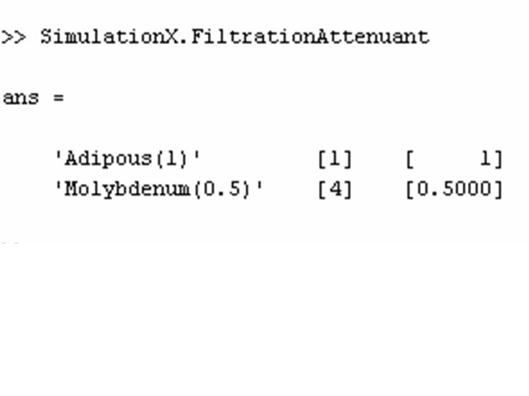
‘Geometry’ description
Source filtration description:
Display Material_ID Thickness
Attenuant filtration description
Display Material_ID Thickness

Slide 5
Outcomes
Energies0
Spectre
Anode spectrum (Molybdenum anode example) computed with
spectre=funcspectre(1,kVp,SimulationX.data.coefMoly,SimulationX.data.energiesMoly);
Spectre1
  Tube spectrum= Anode spectrum + tube filtration; computed with
    Filtration=funcComputeFiltration(SimulationX.numbermaterialSource,SimulationX.FiltrationSource,SimulationX.data,energies0);
    spectre1=spectre0.*exp(-Filtration);
Spectre2
  Detector spectrum = Tube spectrum + object filtration; computed with
  Filtration=funcComputeFiltration(SimulationX.numbermaterialAttenuant,SimulationX.Filtra tionAttenuant,SimulationX.data,energies0);
  spectre2=spectre1.*exp(-Filtration);
Measured attenuation
  attenuation=-log(sum(energies0.*spectre2)./sum(energies0.*spectre1));

