Slide 1


Energy, Sustainability, and AI
Patrick Shepherd

Slide 2
Outline
A little background (20 minutes)
How does the infrastructure of the energy industry work?
How do energy trading markets work?
How does AI work?
Group guided exploration of specific topics (30 minutes)
Whole-room discussion of group topics (20 minutes)
Open discussion (remainder)

Slide 3
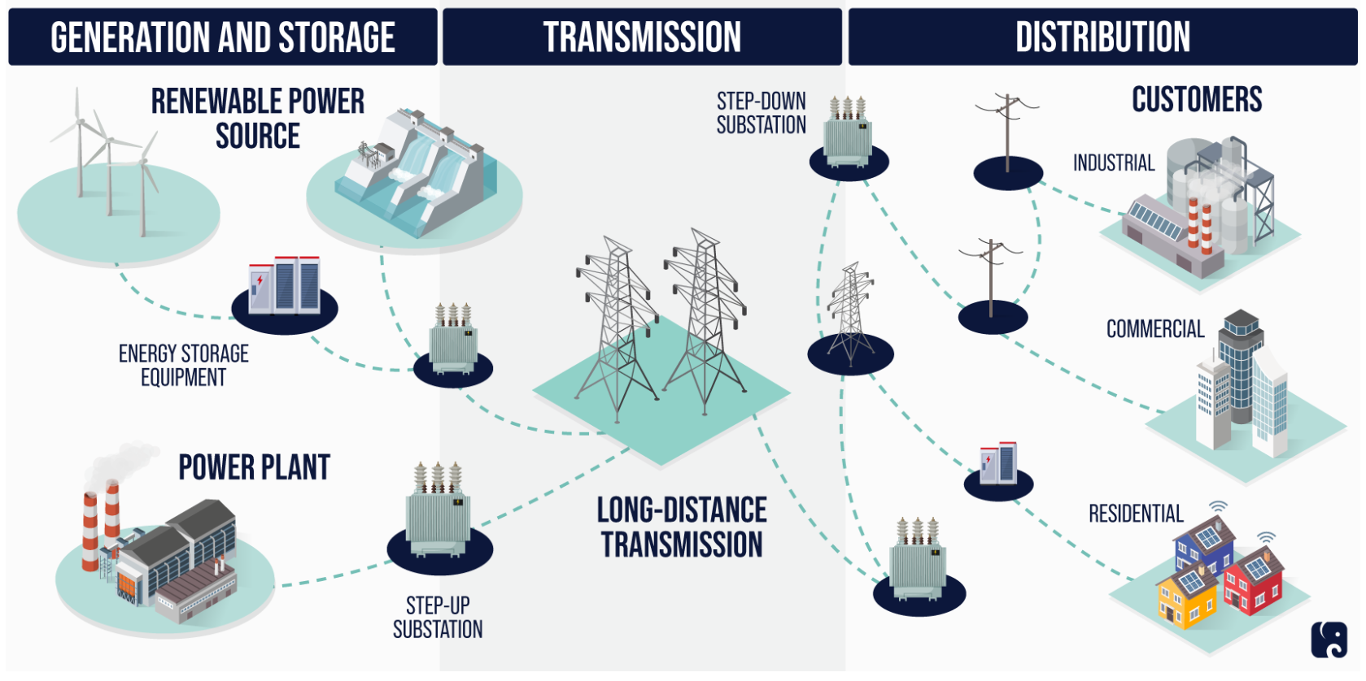
How does the infrastructure of the energy industry work?
https://www.rpc.senate.gov/policy-papers/infrastructure-cybersecurity-the-us-electric-grid

Slide 4
Storage capacity is EXTREMELY limited.
Production and consumption must match exactly in real time, all the time.
Supply Side
Demand Side
https://www.rpc.senate.gov/policy-papers/infrastructure-cybersecurity-the-us-electric-grid

Slide 5
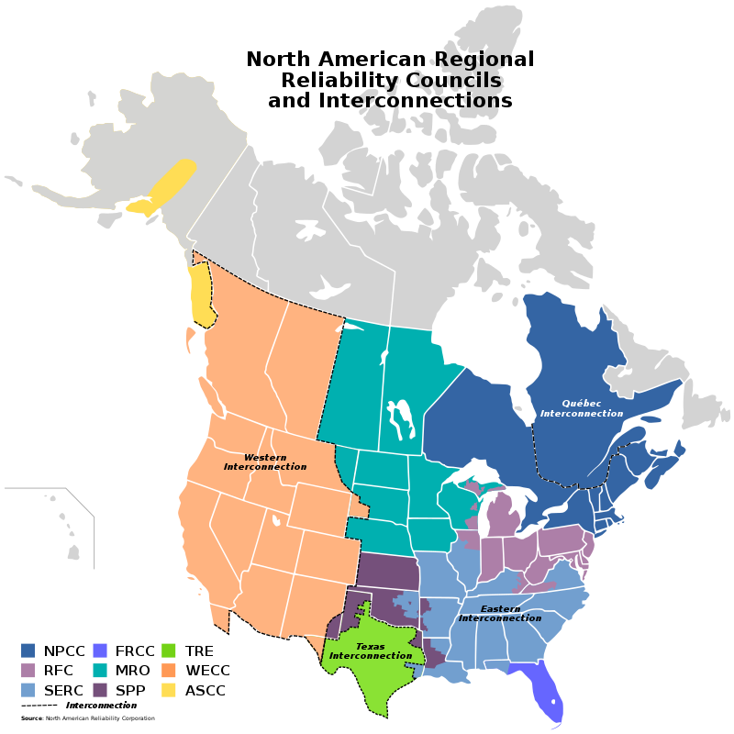
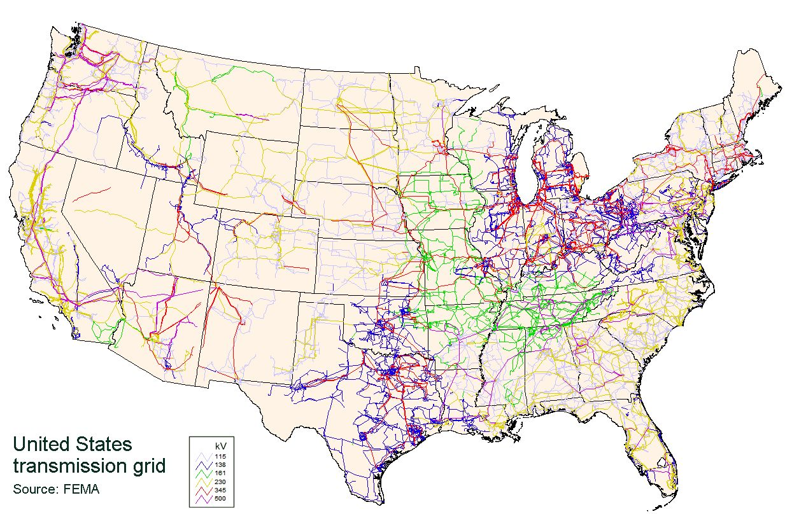
How does the infrastructure of the energy industry work?
https://en.wikipedia.org/wiki/North_American_power_transmission_grid

Slide 6
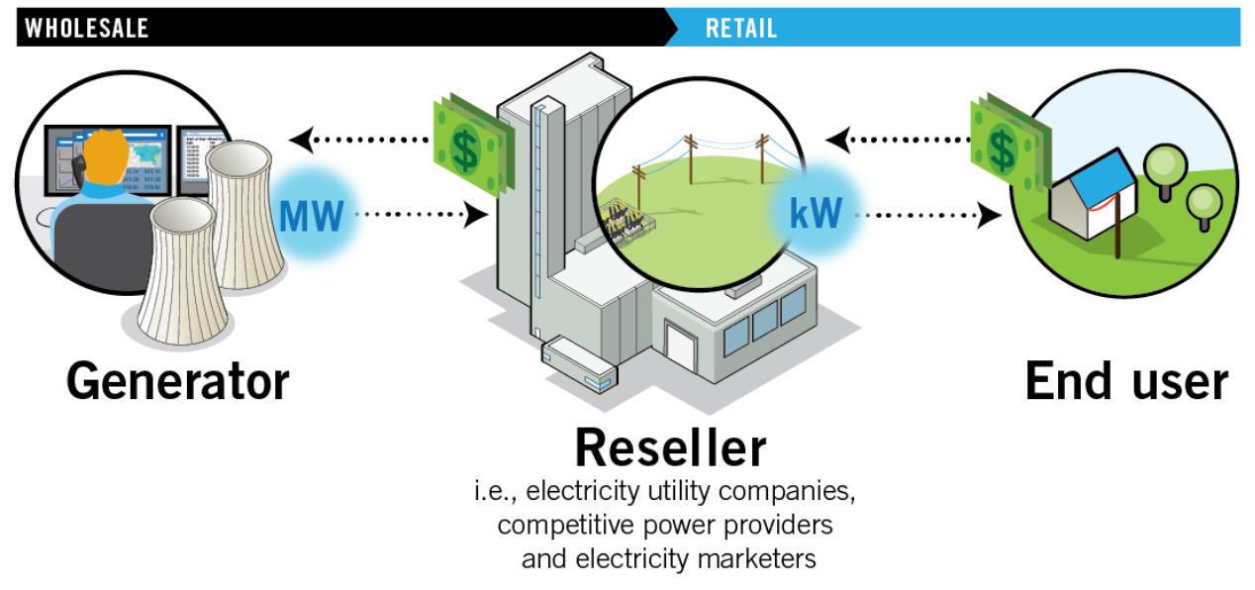
How do the economics of the energy industry work?
https://learn.pjm.com/electricity-basics/market-for-electricity.aspx

Slide 7
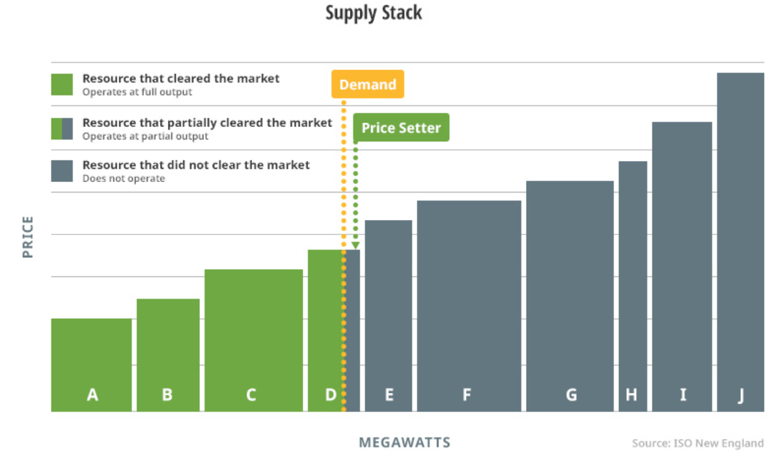
Wholesale energy market
Price paid to A, B, C, and D
https://www.iso-ne.com/about/what-we-do/in-depth/how-resources-are-selected-and-prices-are-set

Slide 8




What is the role of AI?
Predict
Classify
Decide

Slide 9
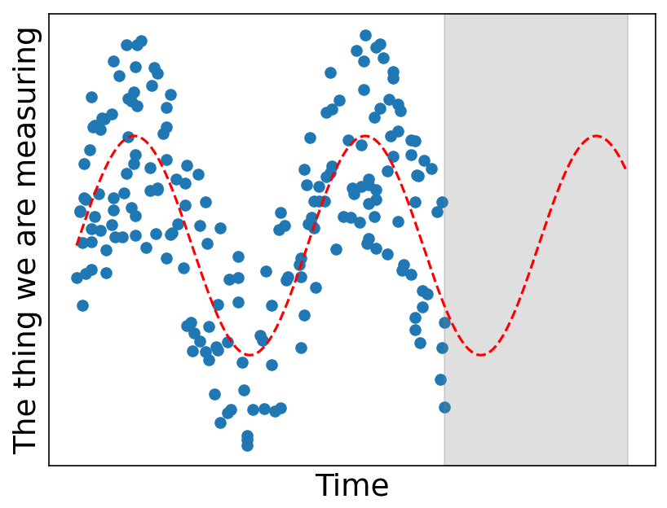
Predicting
What will the data during this time period look like?
Observed data
Predicted data

Slide 10







Classifying
???
THE MODEL
dog
cat
dog
cat
dog
cat
THE MODEL
dog

Slide 11
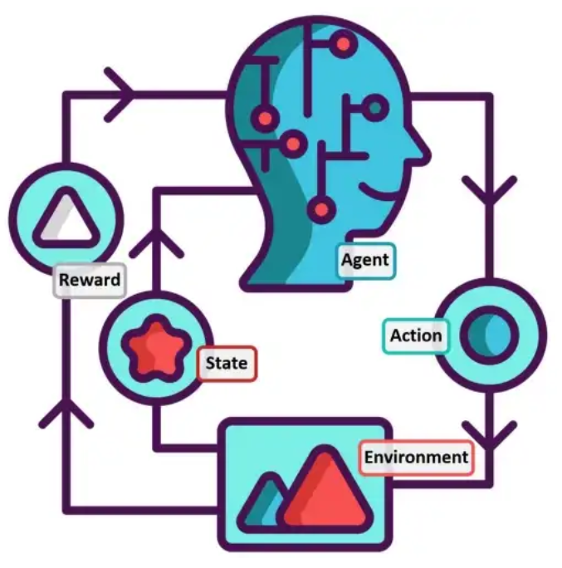
Deciding

Slide 12
Deciding
This is the information the agent needs in order to choose an action. For instance, if the agent is crossing the street, two important pieces of information might be:
Is the walk sign on?
Are there cars coming?

Slide 13
Deciding
This determines what the agent “values” and “fears”. The design of this function informs the kinds of decisions the agent will learn to make.

Slide 14
Outline
A little background (20 minutes)
How does the infrastructure of the energy industry work?
How do energy trading markets work?
How does AI work?
Group guided exploration of specific topics (30 minutes)
Whole-room discussion of group topics (20 minutes)
Open discussion (remainder)

Slide 15
Outline
A little background (20 minutes)
How does the infrastructure of the energy industry work?
How do energy trading markets work?
How does AI work?
Group guided exploration of specific topics (30 minutes)
Whole-room discussion of group topics (20 minutes)
Open discussion (remainder)

Slide 16
Outline
A little background (20 minutes)
How does the infrastructure of the energy industry work?
How do energy trading markets work?
How does AI work?
Group guided exploration of specific topics (30 minutes)
Whole-room discussion of group topics (20 minutes)
Open discussion (remainder)

