Slide 1
Natural Abundance Stripping in PREMISE
Patrick Shepherd

Slide 2
Steps
Version 3.3.0.0 (on Dropbox)
Tools Menu >> Natural Abundance >> From Assignment File
Enter filename(s), molecular formula key, intensity column, isotope count column(s), set ID column (optional)
Click “Correct”

Slide 3
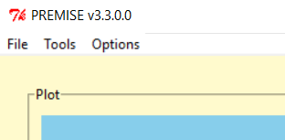
Walkthrough (1)
PREMISE version 3.3.0.0

Slide 4
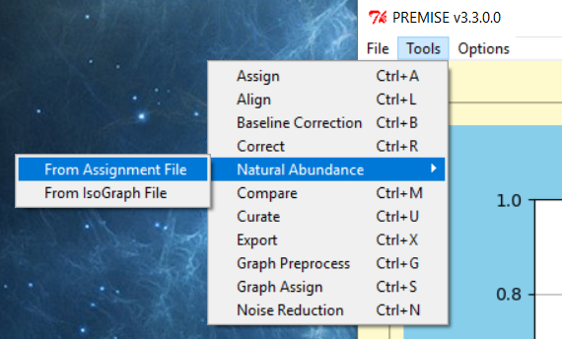
Walkthrough (2)
Pulldown menu

Slide 5
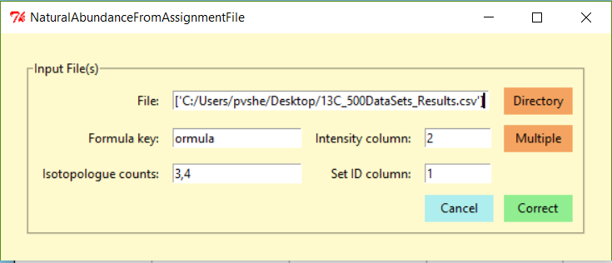
Walkthrough (3)
Correction Window

Slide 6
Walkthrough (4)
Choose files as usual

Slide 7
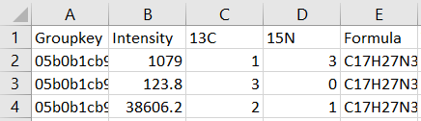
Walkthrough (5)
Formula key; must be partial match to input file header text

Slide 8
Walkthrough (6)
Index of intensity column
1 2 3 4 5

Slide 9
Walkthrough (7)
Index(es) of isotope count column(s) – comma-separated
1 2 3 4 5

Slide 10
Walkthrough (8)
Index of set ID column (optional)
1 2 3 4 5

Slide 11
Walkthrough (9)
NOTE: Isotope count header columns must be “13C”, “15N”, “2H”, or “18O”
1 2 3 4 5

Slide 12
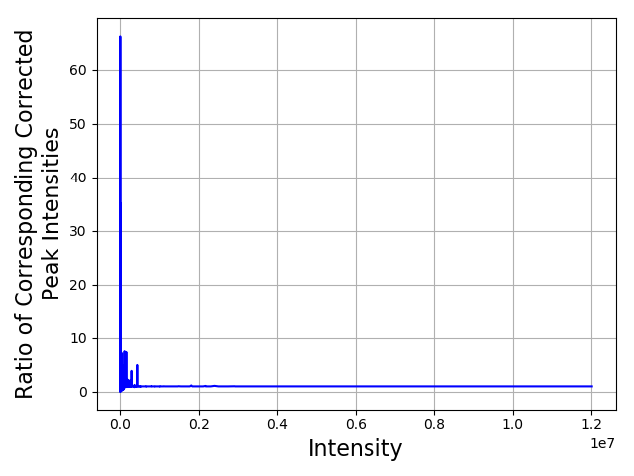
Convergence with Galaxy Implementation
Single label (¹³C)

Slide 13
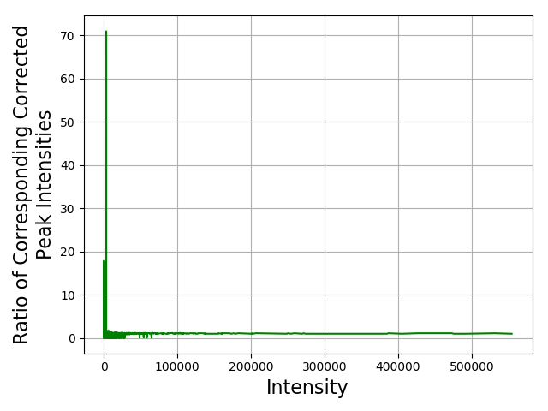
Convergence with Galaxy Implementation
Double label (¹³C, ¹⁵N)

