Slide 1
A Robot’s Story
Robert’s Learn-y Journey

Slide 2
Robert the Robot!

Slide 3


Robert’s Job
Explore the maze
Figure out the best path to get to the reward

Slide 4
The Problem
Robert knows VERY LITTLE
???

Slide 5
The Problem
Robert has a few actions:
Go north
Go south
Go east
Go west
Bounce off walls
Small chance of going wrong direction

Slide 6
The Problem
3
4
5
Robert knows what cell he is in – his “state”
2
6
1
8
7

Slide 7
The Problem
3
4
5
Robert knows the reward or punishment for his current cell (he finds out when he visits it)
0
0
0
0
-10
2
6
0
-100
+100
1
8
7

Slide 8
The Problem
3
4
5
Robert has a table of estimates for the “value” of each state/action pair.
0
0
0
0
-10
 | N | S | E | W
1
2
3
4
5
6
7
8
2
6
0
-100
+100
1
8
7

Slide 9
The Problem
3
4
5
WHAT TO DO???
0
0
0
0
-10
2
6
0
-100
+100
1
8
7

Slide 10
The Problem
3
4
5
WHAT TO DO???
EXPLORE!!!
How about some examples?
0
0
0
0
-10
2
6
0
-100
+100
1
8
7

Slide 11

Exploring
3
4
5
Start in state 1
Choose action North
Land in state 2
Observe reward
0
0
0
0
-10
2
6
0
-100
+100
1
8
7

Slide 12
Exploring
3
4
5
Start in state 1
Choose action North
Land in state 2
Observe reward
Nothing bad happened!
Robert now knows that (State 1, North) can be safe.
0
0
0
0
-10
2
6
0
-100
+100
1
8
7

Slide 13
Exploring
3
4
5
Start in state 6
Choose action South
Land in state 7
Observe reward
0
0
0
0
-10
2
6
0
-100
+100
1
8
7

Slide 14
Exploring
3
4
5
Start in state 6
Choose action South
Land in state 7
Observe reward
Awesome! Robert will remember that!
(State 6, South) is good!
0
0
0
0
-10
2
6
0
-100
+100
1
8
7

Slide 15
Exploring
3
4
5
Start in state 1
Choose action East
Land in state 8
Observe reward
0
0
0
0
-10
2
6
0
-100
+100
1
8
7

Slide 16
Exploring
3
4
5
Start in state 1
Choose action East
Land in state 8
Observe reward
Ouch! Robert will definitely remember that… (State 1, East) is not good!
0
0
0
0
-10
2
6
0
-100
+100
1
8
7

Slide 17
Exploring
3
4
5
Say Robert starts in state 1 again
Choose action North
Accidentally land in state 8
Observe reward
0
0
0
0
-10
2
6
0
-100
+100
1
8
7

Slide 18
Exploring
3
4
5
Say Robert starts in state 1 again
Choose action North
Accidentally land in state 8
Observe reward
Ouch AGAIN! Robert is now quite confused about (State1, North). He needs a way to deal with old AND new knowledge!
0
0
0
0
-10
2
6
0
-100
+100
1
8
7

Slide 19
Exploring
3
4
5
Back to that table…
0
0
0
0
-10
 | N | S | E | W
1
2
3
4
5
6
7
8
2
6
!- - -!
0
-100
+100
1
8
7

Slide 20
Exploring
3
4
5
Back to that table…
0
0
0
0
-10
 | N | S | E | W
1
2
3
4
5
6
7
8
2
6
!- - -!
0
-100
+100
!+ + +!
1
8
7

Slide 21
Exploring
3
4
5
Back to that table…
0
0
0
0
-10
 | N | S | E | W
1
2
3
4
5
6
7
8
2
6
-/!- - -!?
!- - -!
0
-100
+100
!+ + +!
1
8
7

Slide 22
Exploring
3
4
5
We can fill in the whole table this way!
0
0
0
0
-10
 | N | S | E | W
1 | - | - | !- - -! | -
2 | - | - | - | -
3 | - | - | - | -
4 | - | - | - | -
5 | - | !-! | - | -
6 | - | !+ + +! | !-! | !-!
7 | !-! | !+ + +! | !+ + +! | !- - -!
8 | !- - -! | !- - -! | !+ + +! | -
2
6
0
-100
+100
1
8
7

Slide 23
Exploring
3
4
5
We need to care about what we stand to gain in the future.
0
0
0
0
-10
 | N | S | E | W
1 | - | - | !- - -! | -
2 | - | - | - | -
3 | - | - | - | -
4 | - | - | - | -
5 | - | !-! | - | -
6 | - | !+ + +! | !-! | !-!
7 | !-! | !+ + +! | !+ + +! | !- - -!
8 | !- - -! | !- - -! | !+ + +! | -
2
6
0
-100
+100
1
8
7

Slide 24
Learning
Questions to address:
How much do future rewards matter compared to current ones?
How much does new information matter compared to known information?
Once a path is found, do we keep exploring?

Slide 25
Learning
Robert needs one quick trick
$$Q_{t+1}\left(s,a\right)=\left(1−α\right)Q_{t}\left(s,a\right)+α\left[r_{t}+γ\max_{a^{′}}{Q\left(s^{′},a′\right)}\right]$$

Slide 26
Learning
In short:
Old information
New information
$$Q_{t+1}\left(s,a\right)=\left(1−α\right)Q_{t}\left(s,a\right)+α\left[r_{t}+γ\max_{a′}{Q\left(s^{′},a′\right)}\right]$$
Weighted average

Slide 27
Learning
The new estimate is equal to…
$$Q_{t+1}\left(s,a\right)=\left(1−α\right)Q_{t}\left(s,a\right)+α\left[r_{t}+γ\max_{a′}{Q\left(s^{′},a′\right)}\right]$$

Slide 28
Learning
The new estimate is equal to…
the old estimate…
$$Q_{t+1}\left(s,a\right)=\left(1−α\right)Q_{t}\left(s,a\right)+α\left[r_{t}+γ\max_{a′}{Q\left(s^{′},a′\right)}\right]$$

Slide 29
Learning
The new estimate is equal to…
the old estimate…
times how much we care about known information…
$$Q_{t+1}\left(s,a\right)=\left(1−α\right)Q_{t}\left(s,a\right)+α\left[r_{t}+γ\max_{a′}{Q\left(s^{′},a′\right)}\right]$$

Slide 30
Learning
The new estimate is equal to…
the old estimate…
times how much we care about known information…
PLUS
$$Q_{t+1}\left(s,a\right)=\left(1−α\right)Q_{t}\left(s,a\right)+α\left[r_{t}+γ\max_{a′}{Q\left(s^{′},a′\right)}\right]$$

Slide 31
Learning
the reward we get after taking action a in state s and landing in state s’…
The new estimate is equal to…
the old estimate…
times how much we care about known information…
PLUS
$$Q_{t+1}\left(s,a\right)=\left(1−α\right)Q_{t}\left(s,a\right)+α\left[r_{t}+γ\max_{a′}{Q\left(s^{′},a′\right)}\right]$$

Slide 32
Learning
the reward we get after taking action a in state s and landing in state s’…
plus the maximum reward we can get by taking an action in s’…
The new estimate is equal to…
the old estimate…
times how much we care about known information…
PLUS
$$Q_{t+1}\left(s,a\right)=\left(1−α\right)Q_{t}\left(s,a\right)+α\left[r_{t}+γ\max_{a′}{Q\left(s^{′},a′\right)}\right]$$

Slide 33
Learning
the reward we get after taking action a in state s and landing in state s’…
plus the maximum reward we can get by taking an action in s’…
The new estimate is equal to…
the old estimate…
times how much we care about future rewards…
times how much we care about known information…
PLUS
$$Q_{t+1}\left(s,a\right)=\left(1−α\right)Q_{t}\left(s,a\right)+α\left[r_{t}+γ\max_{a′}{Q\left(s^{′},a′\right)}\right]$$

Slide 34
Learning
the reward we get after taking action a in state s and landing in state s’…
plus the maximum reward we can get by taking an action in s’…
The new estimate is equal to…
the old estimate…
times how much we care about future rewards…
times how much we care about known information…
PLUS
$$Q_{t+1}\left(s,a\right)=\left(1−α\right)Q_{t}\left(s,a\right)+α\left[r_{t}+γ\max_{a′}{Q\left(s^{′},a′\right)}\right]$$
all times how much we care about new information.

Slide 35
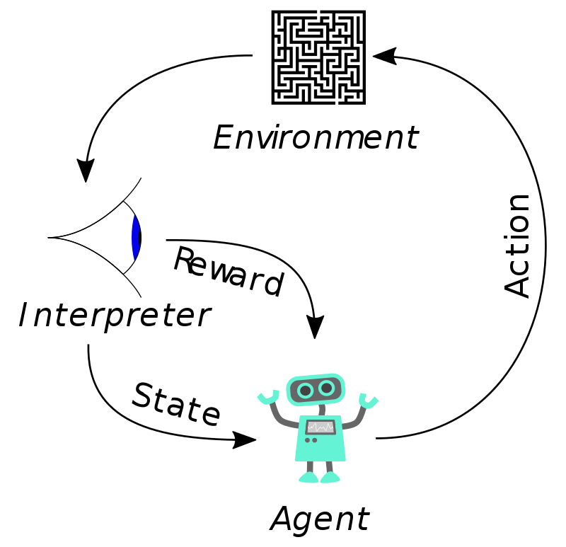
Reinforcement Learning
Image source: https://en.wikipedia.org/wiki/Reinforcement_learning

