Slide 1
Simulating the Interaction of a Renewable Portfolio Standard with Electricity and Carbon Markets

Slide 2
Introduction
Energy Trading Game that incorporates retailers
Now have one group of 7 retailer teams, and one group of 7 GenCo teams
GenCos must comply with carbon cap
Retailers must comply with RPS

Slide 3
Game Setup
GenCos
Retailers
Must provide at least 20% of total electricity from renewables
RECs
Carbon Permits
Must stay under emissions cap
(30% below business as usual emissions)

Slide 4
GenCos
Same portfolios as in previous games (Big Coal, Fossil Light, etc.)
GenCos must keep emissions under carbon cap
Pay penalty of $500/ton of emissions not covered by allowances
May purchase unlimited renewable generators at a fixed cost per time period
New renewables facilities provide GenCos with RECs – GenCos sell RECs to retailers
Permit trading allowed

Slide 5
Retailers
Retailers have to comply with an RPS
Certain percentage of power distributed must be supplied by renewable sources
Accomplished by buying sufficient RECs from GenCos
Pay $350/MWh not covered by RECs
Sell purchased electricity at $100/MWh (fixed end-user price)

Slide 6
Retailers
Can sign forward contracts with GenCos
Protects against price uncertainty
Any unsatisfied demand must be met on the spot market
Call in critical peak pricing rebate (CPP-R)
Idea: Rebate for end-customers to reduce usage
Effect: shift demand curve in by ~20%
Retailer must pay $100/MWh reduction

Slide 7
The Games
Two pairs of simultaneous games (2A/2B, 3A/3B)
In each pair, teams would play a GenCo in one game and retailer in the other
4 simulated days, 4 hours each
Different conditions for each pair of games

Slide 8
The Games
2A/2B
3A/3B
Carbon allowances free and evenly distributed
Played over one or two class periods
All carbon allowances distributed by auction
Played over two weeks

Slide 9
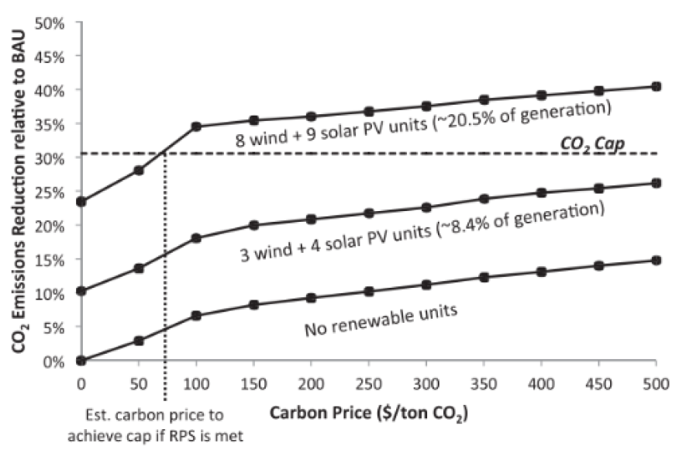
Estimated Carbon Price to Achieve Cap

Slide 10
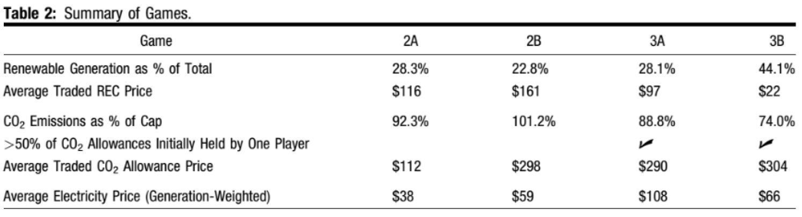
Assorted Results

Slide 11
Assorted Results

Slide 12
Assorted Results

Slide 13
Assorted Results

Slide 14
Assorted Results

Slide 15
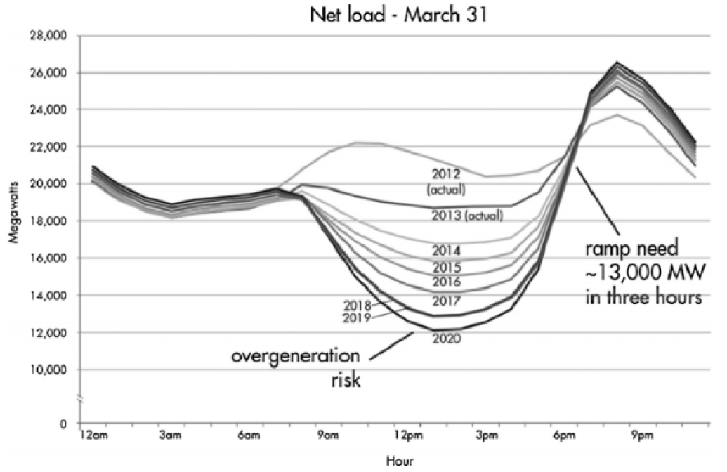
The Duck Curve

Slide 16
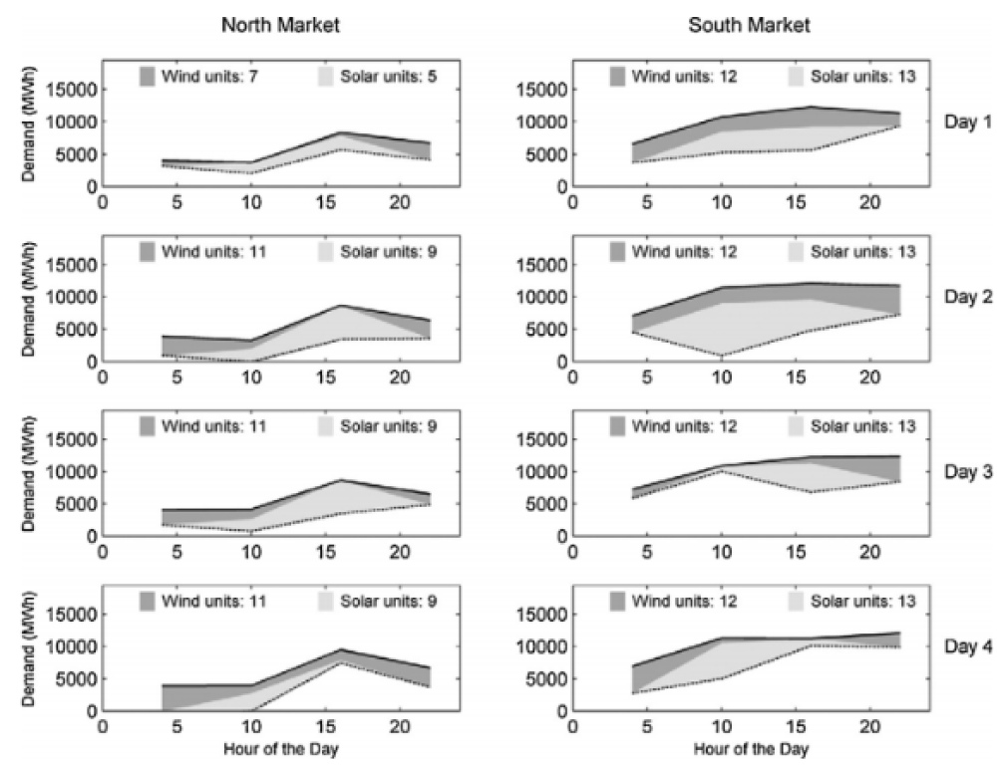
3B – High wind and solar

Slide 17
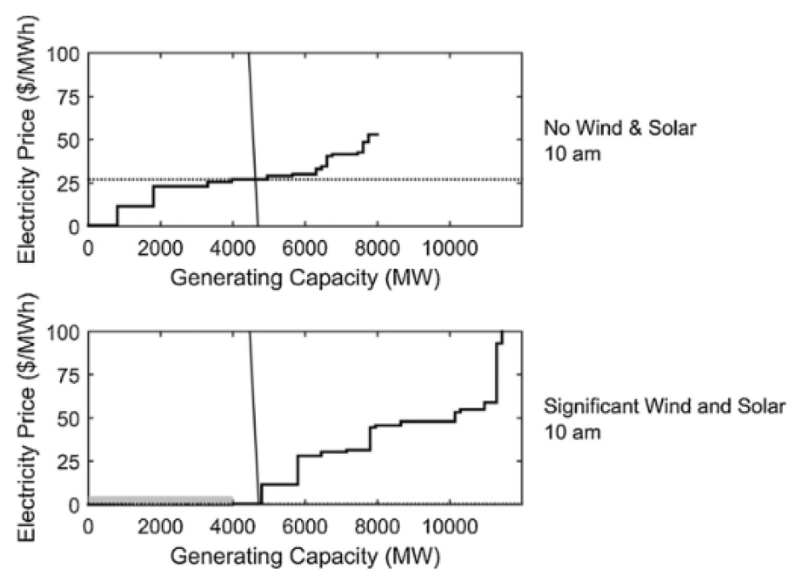
Price Pressure
Teams couldn’t easily bid up the price, especially with high renewable generation, so bid in at marginal cost.
Wind and Solar Generation

Slide 18
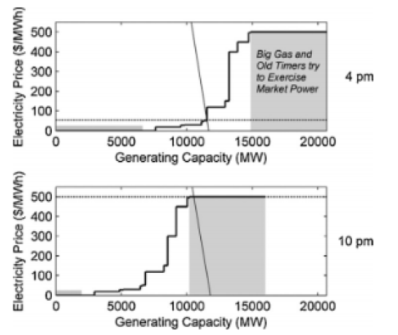
Market Manipulation
Big Gas and Old Timers attempt to game the market price at 4pm
Renewables generation too high, no generators operate
Try again at 10pm, but bid themselves almost entirely out
Capped out the market price

Slide 19
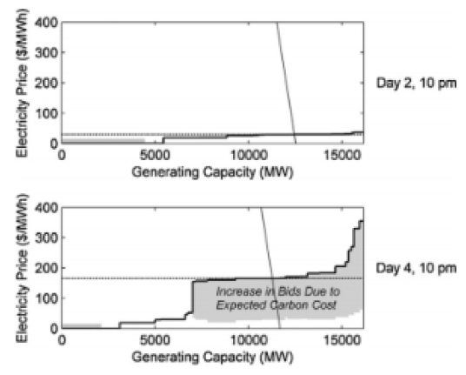
Expected Carbon Prices
Day 2
Renewable generation is high
Carbon cap is satisfied
Low expected carbon price
Firms bid marginal cost to compensate for renewables

Slide 20
Expected Carbon Prices
Day 4
Teams realize one GenCo has a monopoly on permits
Suspect high carbon prices
Factor prices into bid
Higher market price

Slide 21
High Renewables Investment
GenCos stood to benefit from higher carbon costs
More renewable sources means less ability to control price with traditional units
Also depresses wholesale price overall
Lower wholesale price means less ability to fund the fixed costs of renewables plants
Why invest at all?

Slide 22
High Renewables Investment
New renewables plants could be “up and running” by the next time period. This is not the case in real life
RPS was stringent, so GenCos expected the REC market to be profitable
There was even early over-investment into renewables in an attempt to acquire monopoly power in the REC market
Extra investment by one party can’t be controlled by others
Over-supply of renewables drives down the price of RECs

Slide 23
REC and Allowance Markets
REC
Allowance
Expectations:
If the retail market is falling short of 20% RPS requirement, demand for RECs will increase
REC market price increase incentivizes more investment in renewables
Expectations:
If the generation market is getting close to its cap, then demand for emissions allowances will go up
Increased expected carbon prices lead to higher prices in the market

Slide 24
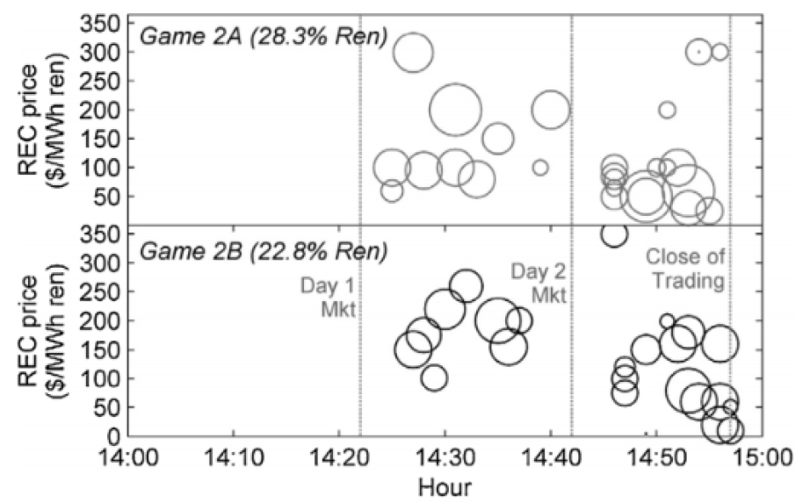
REC Market (2A/2B)
Relatively low renewables investment
Closer to missing RPS requirement

Slide 25
REC Market (2A/2B)
Fewer RECs to go around
Higher market price
More liquidity

Slide 26
REC Market (2A/2B)
Additional supply later in game helped drive prices down, but holders could still command a markup

Slide 27
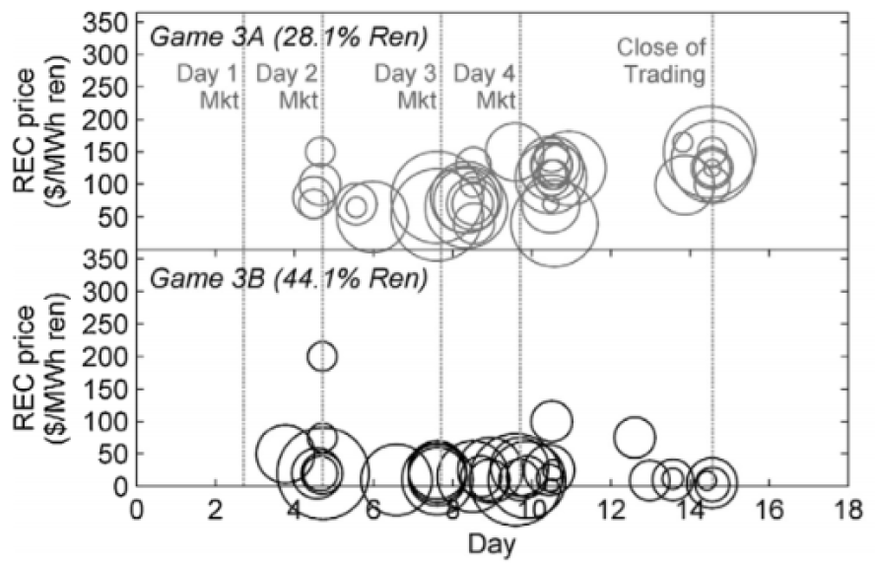
REC Market (3A/3B)
3A had fewer renewables than 3B
Higher REC price overall

Slide 28
REC Market (3A/3B)
Relatively liquid markets, lots of trades
Lower supply = higher price

Slide 29
REC Market (3A/3B)
Big Coal held RECs until the end, then sold for a profit
Oversupply of RECs prevented that strategy

Slide 30
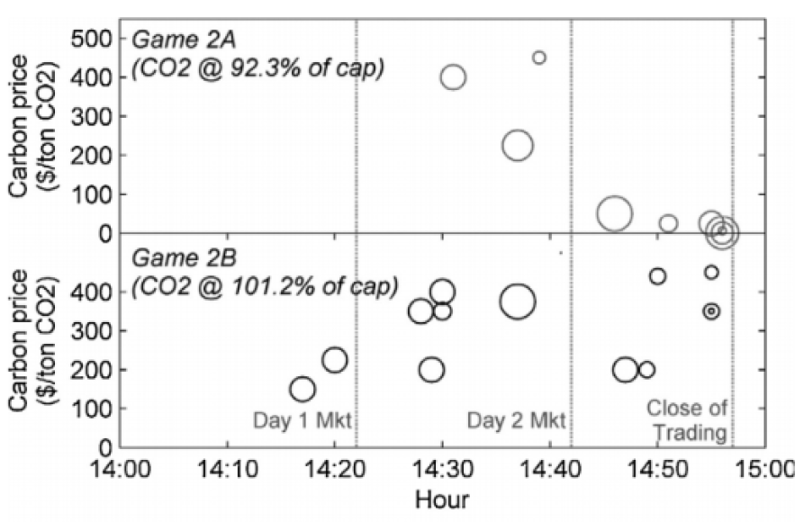
Carbon Market (2A/2B)
Allowances distributed equally
When carbon emissions started looking good, allowance prices went to zero

Slide 31
Carbon Market (2A/2B)
Tighter market produced higher prices

Slide 32
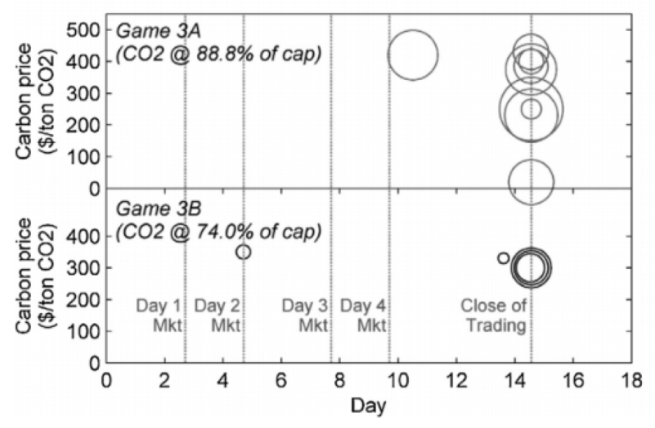
Carbon Market (3A/3B)
Allowances auctioned at beginning
>50% controlled by a single GenCo in both games
Very little liquidity in the market

Slide 33
Carbon Market (3A/3B)
One GenCo ended up will almost all surplus allowances
Commanded high prices despite coming in under the cap

Slide 34
Carbon Market (3A/3B)
Again one GenCo ended up will almost all surplus allowances. Buyers were also able to exercise power over the seller

