Slide 1
Regression: Beyond Linear

Slide 2
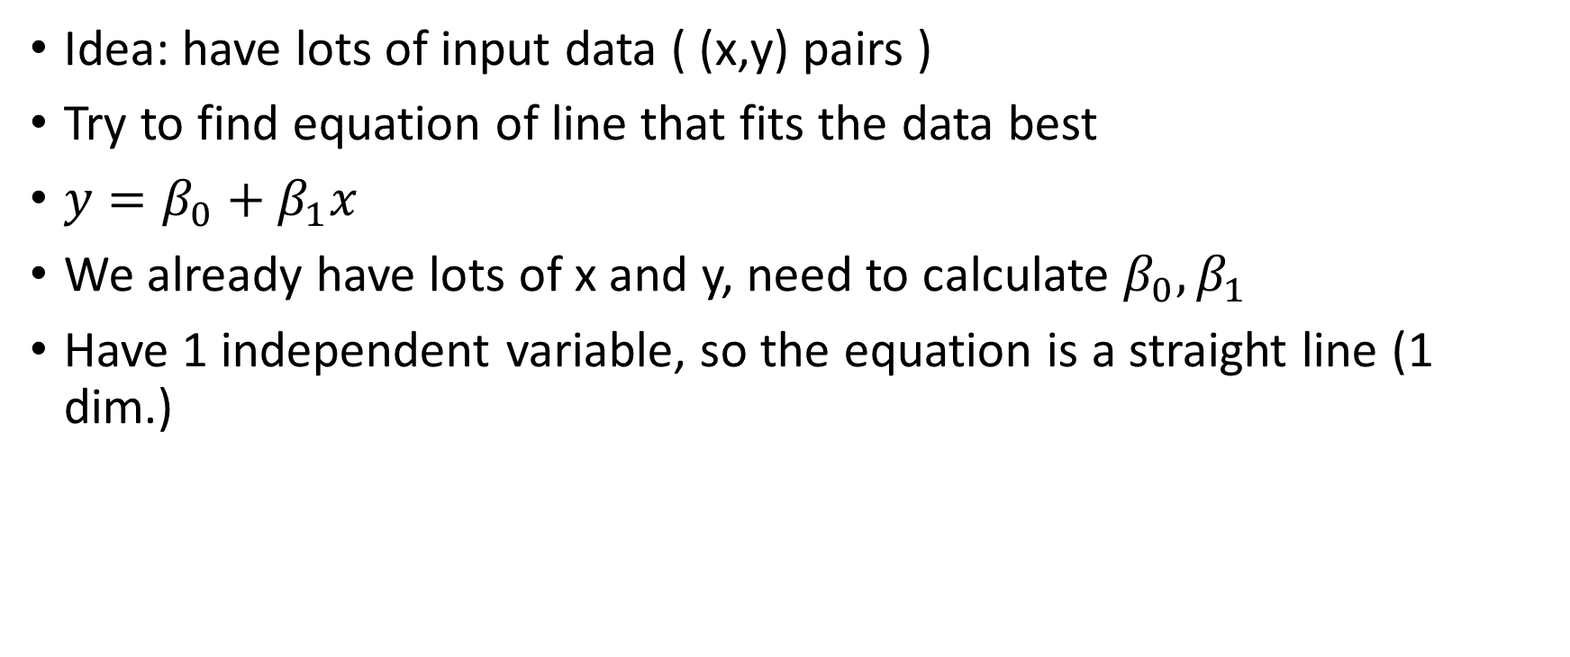
Basic Linear Regression
Idea: have lots of input data ( (x,y) pairs )
Try to find equation of line that fits the data best
$y=β_{0}+β_{1}x$
We already have lots of x and y, need to calculate $β_{0}, β_{1}$
Have 1 independent variable, so the equation is a straight line (1 dim.)

Slide 3
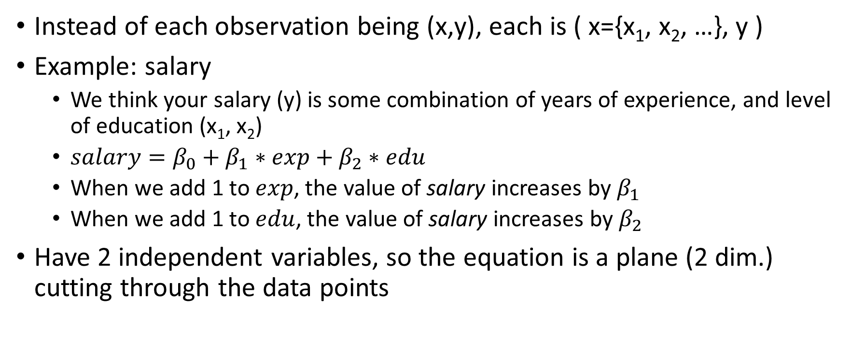
Multiple Regression
Instead of each observation being (x,y), each is ( x={x₁, x₂, …}, y )
Example: salary
We think your salary (y) is some combination of years of experience, and level of education (x₁, x₂)
$salary=β_{0}+β_{1}∗exp+β_{2}∗edu$
When we add 1 to $exp$, the value of salary increases by $β_{1}$
When we add 1 to $edu$, the value of salary increases by $β_{2}$
Have 2 independent variables, so the equation is a plane (2 dim.) cutting through the data points

Slide 4
Multiple Regression
In general, regression on n independent variables creates an n-dimensional plane cutting through the data
ASSUMES LINEAR RELATIONSHIP BETWEEN INDEPENDENT AND DEPENDENT VARIABLES
What if the relationship isn’t linear?

Slide 5
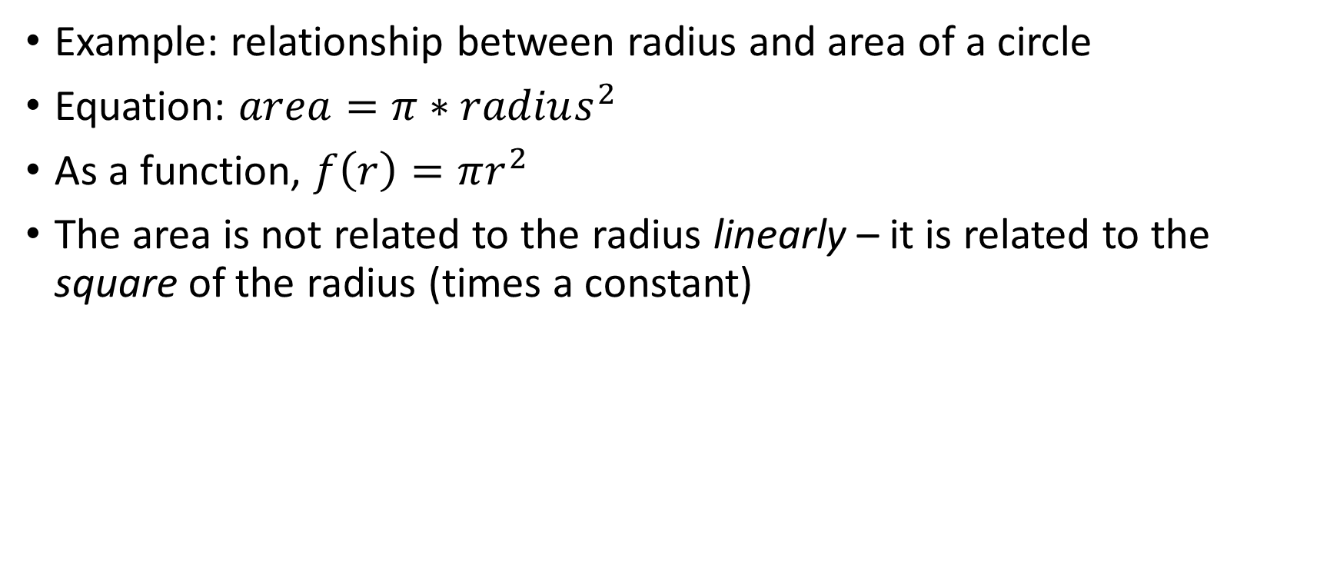
Nonlinear Relationships
Example: relationship between radius and area of a circle
Equation: $area=π∗radius^{2}$
As a function, $f\left(r\right)=πr^{2}$
The area is not related to the radius linearly – it is related to the square of the radius (times a constant)

Slide 6
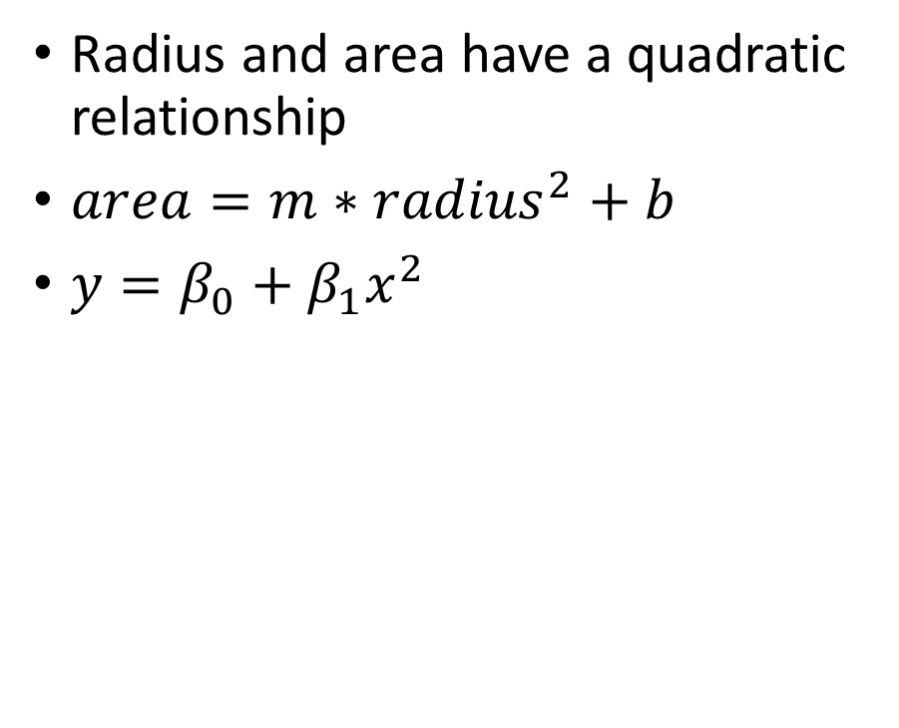
Nonlinear Relationships
Radius and area have a quadratic relationship
$area=m∗{radius}^{2}+b$
$y=β_{0}+β_{1}x^{2}$

Slide 7

Nonlinear Relationships
What if we used linear regression on these data?
$area=β_{0}+β_{1}radius$
Not a good fit

Slide 8

Polynomial Regression
Need a better equation
$y=β_{0}+β_{1}x+β_{2}x^{2}$

Slide 9
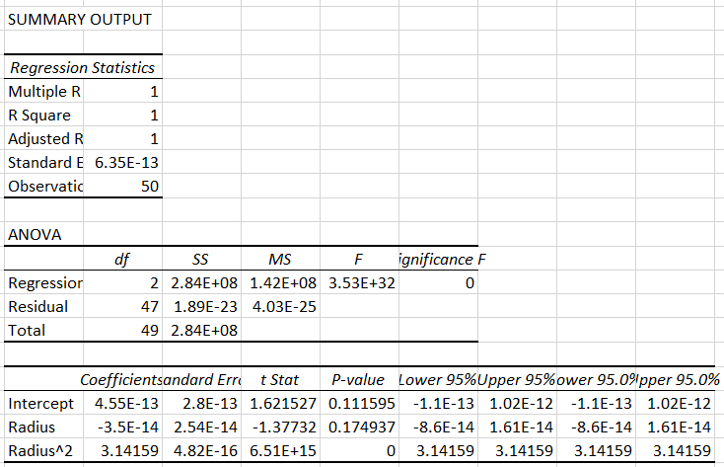
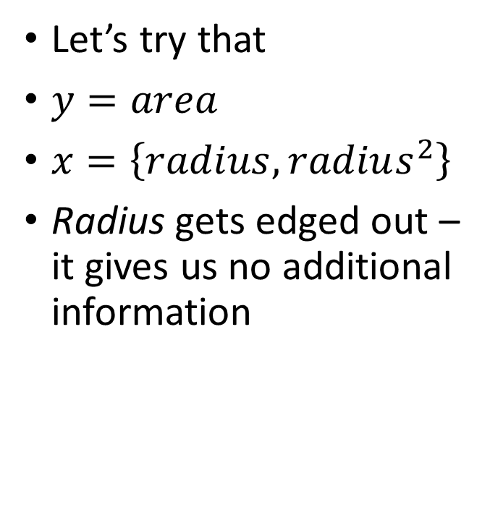
Polynomial Regression
Let’s try that
$y=area$
$x=\left\{radius, radius^{2}\right\}$
Radius gets edged out – it gives us no additional information

Slide 10
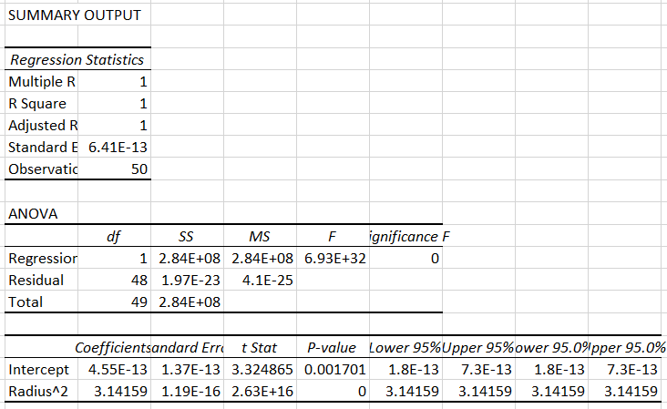

Polynomial Regression
$y=β_{0}+β_{2}x^{2}$
$y=area$
$x=radius^{2}$

Slide 11
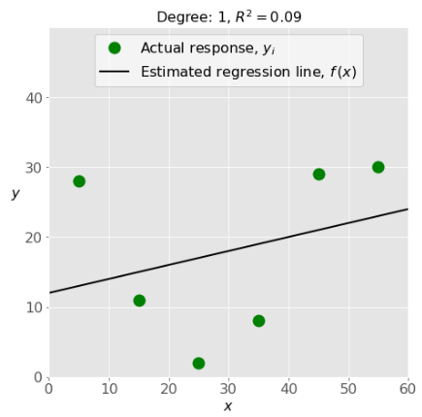
Limitations
What if we don’t know what degree polynomial to use?
Degree too small → underfitting
Don’t capture dependencies
Poor predictions

Slide 12
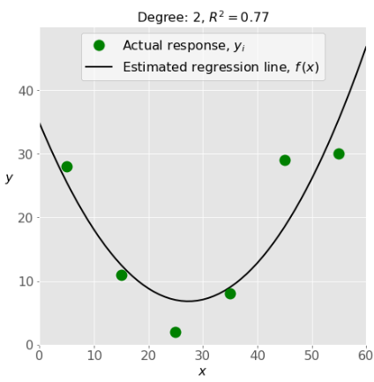
Limitations
Degree just right
Predicts well, high R²
Matches existing data nicely

Slide 13
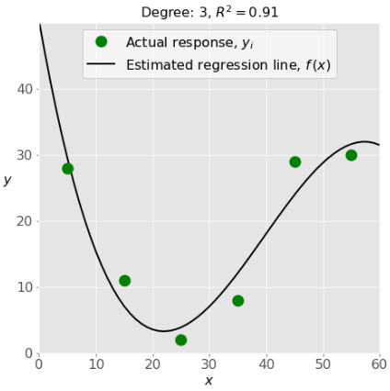
Limitations
Degree maybe too high?
Higher R²
Matches existing data very nicely – maybe too nicely…
May miss greater trends due to additional focus on the known data

Slide 14
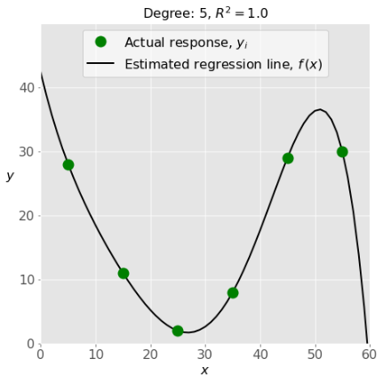
Limitations
Fits the data perfectly
What are the odds that every new piece of data will fit this line exactly?
No empirical evidence that y values drop to 0 for input values around 60

Slide 15
Logistic Regression
Sometimes we want to know a probability instead of a value
We have some output variable y that can only have two values: true (1) and false (0)
We have input values x that we think can predict the state of the output

Slide 16

Logistic Regression
$\ln\left(y\right)=\ln\left(\frac{p}{1−p}\right)=β_{0}+β_{1}x_{1}+β_{2}x_{2}+…$
p is the probability that the value of y is “true” given the independent variables
Start with series of observations, and y values for each of 1 or 0

Slide 17
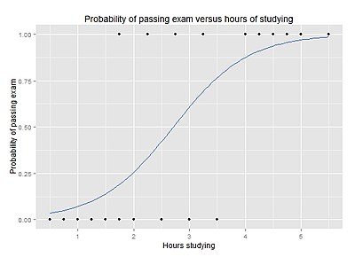
Logistic Regression
Example: probability of passing an exam given a certain number of study hours
Each dot is an observation (Did they pass? How many hours did they study?)
Line is called a “sigmoid”, goes from 0 to 1

Slide 18

Exponential Regression
Now we are assuming the equation $y=β_{0}\left(β_{1}^{x}\right)$, where $β_{0}$ is some initial value and $β_{1}$ is a growth or decay rate
Shows exponential relationships (e.g. world population over time)

