Slide 1
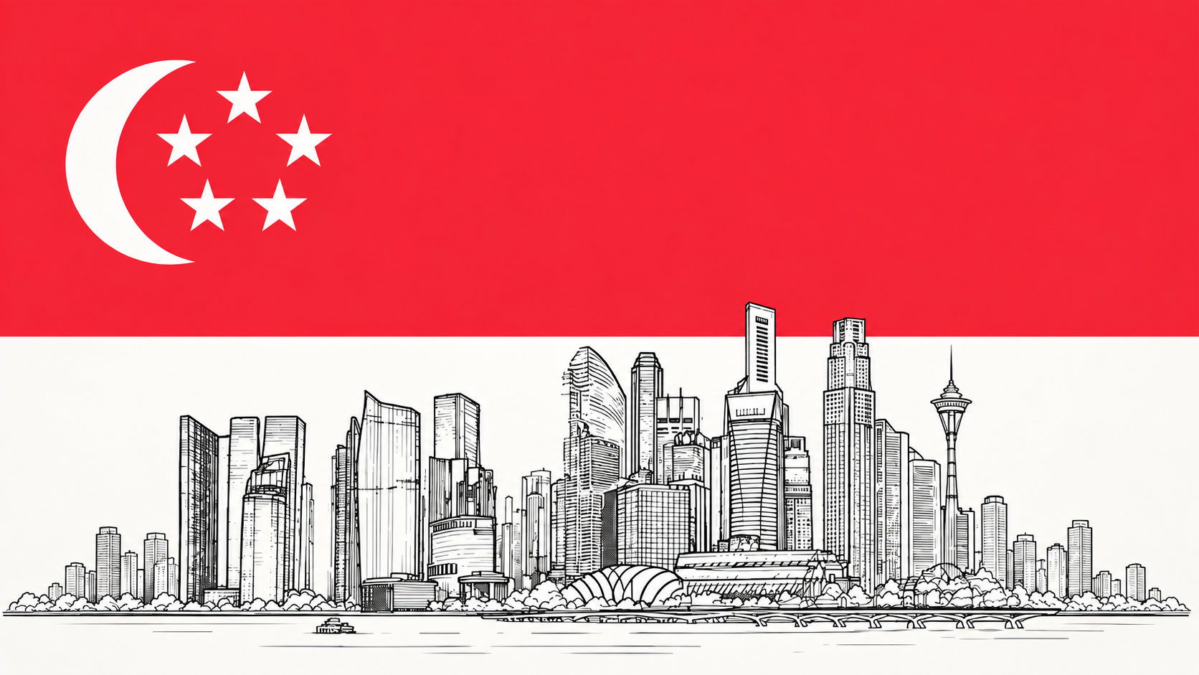
Can Singapore’s Development Model Be Reproduced?
A comparative study of whether Singapore’s ideas and institutions can work outside Singapore.
MICHAEL SHEPHERD | SODA 308

Slide 2
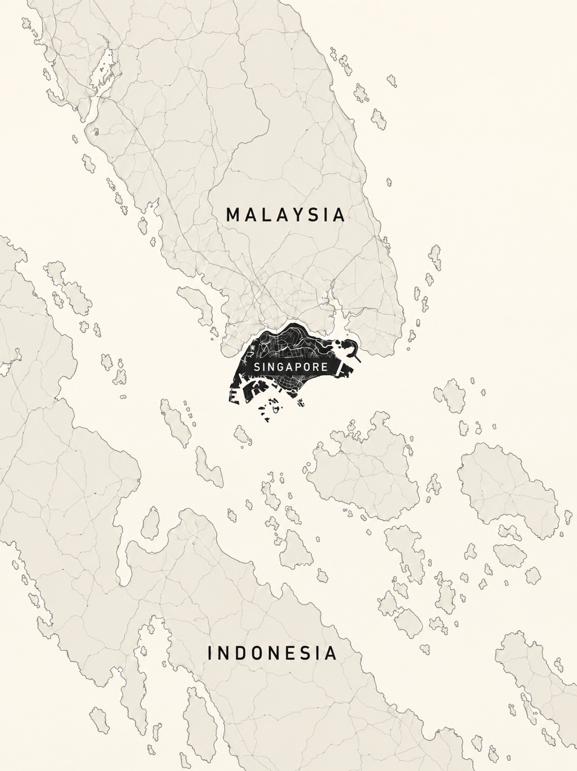
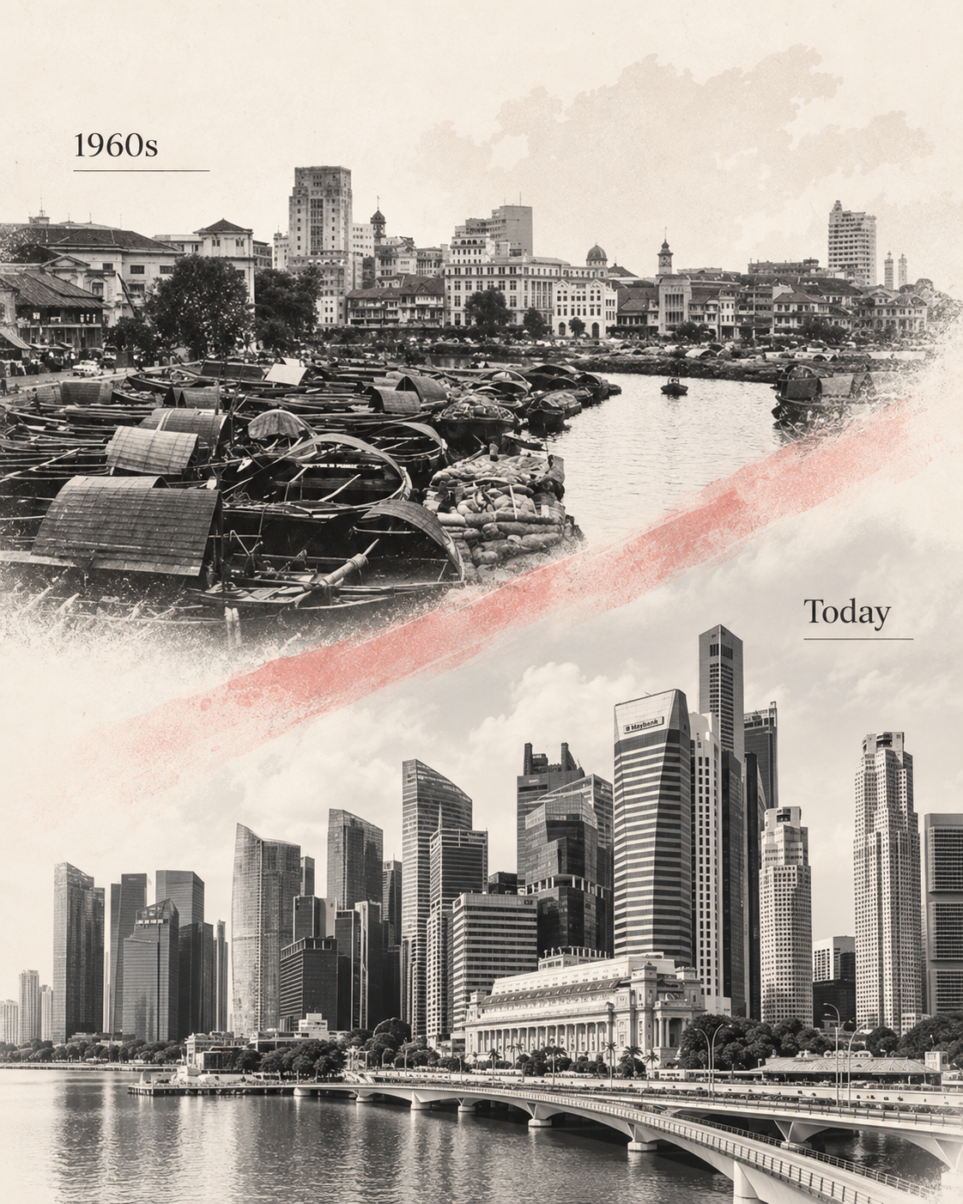
Why Singapore?
A small city state with a remarkable transformation.
A dramatic development story
Since independence in 1965, Singapore transformed from a relatively poor, vulnerable city-state into one of the world’s wealthiest and most developed economies.
A government led model
The state played a major role in housing, education, infrastructure, trade, foreign investment, and long term planning.
The key question
Was Singapore’s success driven by policies and ideas that other countries can copy, or by conditions that were unique to Singapore?
Singapore is useful because it is both a development success story and a difficult case to reproduce.

Slide 3

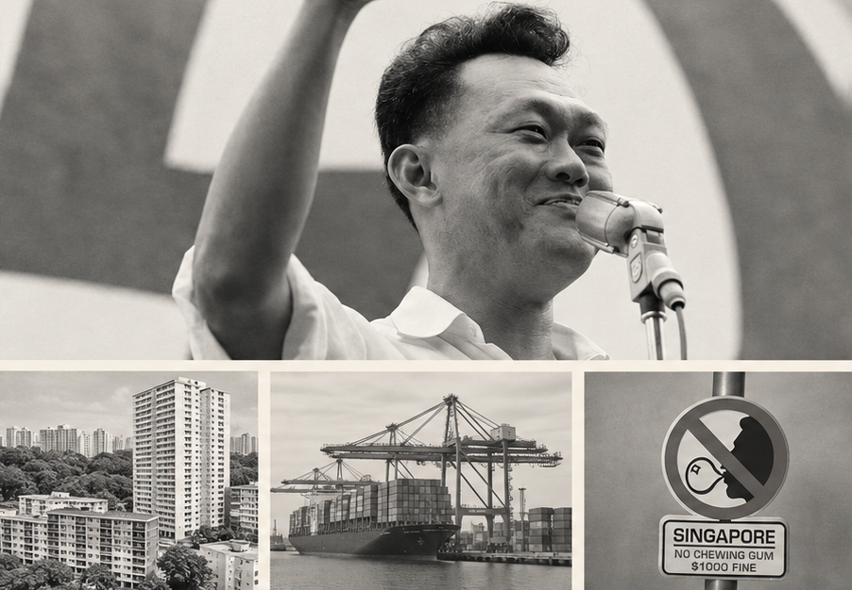



What Is The Singapore Model?
A development strategy shaped by strong state directions.
Educate
Investment in schools, skills, and workforce development.
Build
Public housing, infrastructure, and urban planning.
Open
Trade, foreign investment, and global integration.
Control
Social order, strict regulation, and disciplined governance.
Singapore’s model combined economic openness with unusually strong state direction.

Slide 4
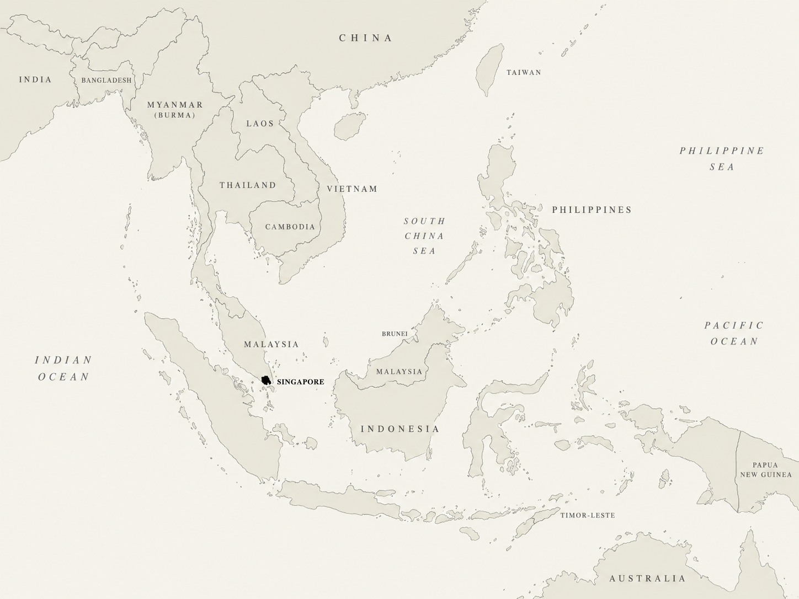
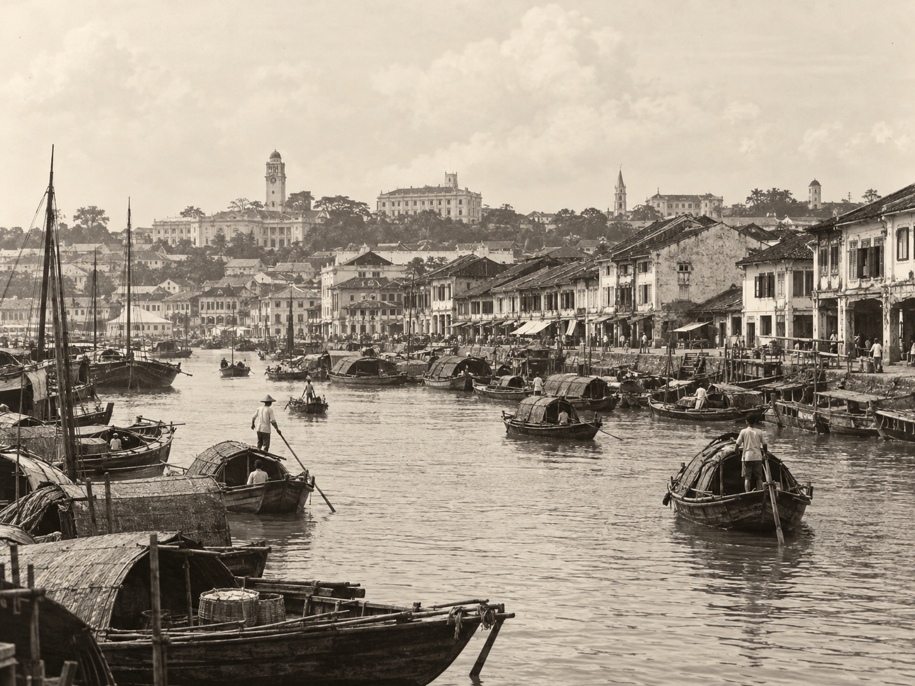
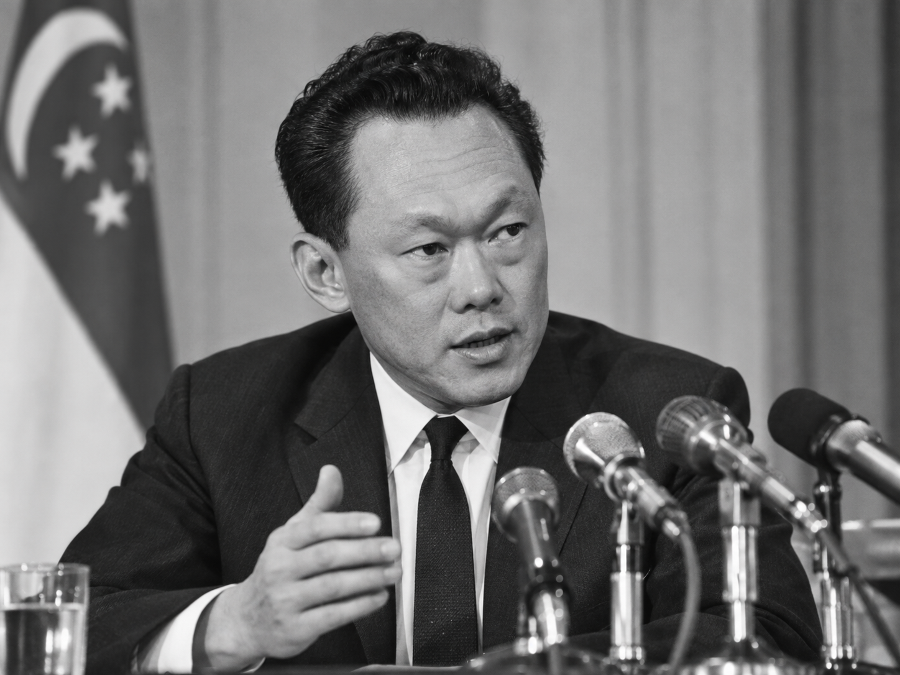
Ideas or Unique Conditions?
Why Singapore was not an obvious success story.
1
2
3
1963–1965: Merger and Separation
Singapore joined Malaysia in 1963, but political conflict quickly weakened the union. In August 1965, Singapore became independent.
A Vulnerable Starting Point
At independence, Singapore had few natural resources, a small domestic market, high unemployment, and an uncertain economic future.
Strong, Continuous Leadership
Lee Kuan Yew and the PAP governed with unusually concentrated authority and long political continuity, allowing long-term policies to be planned and maintained.
Singapore’s success may reflect both its development ideas and the unusual conditions under which those ideas were implemented.

Slide 5
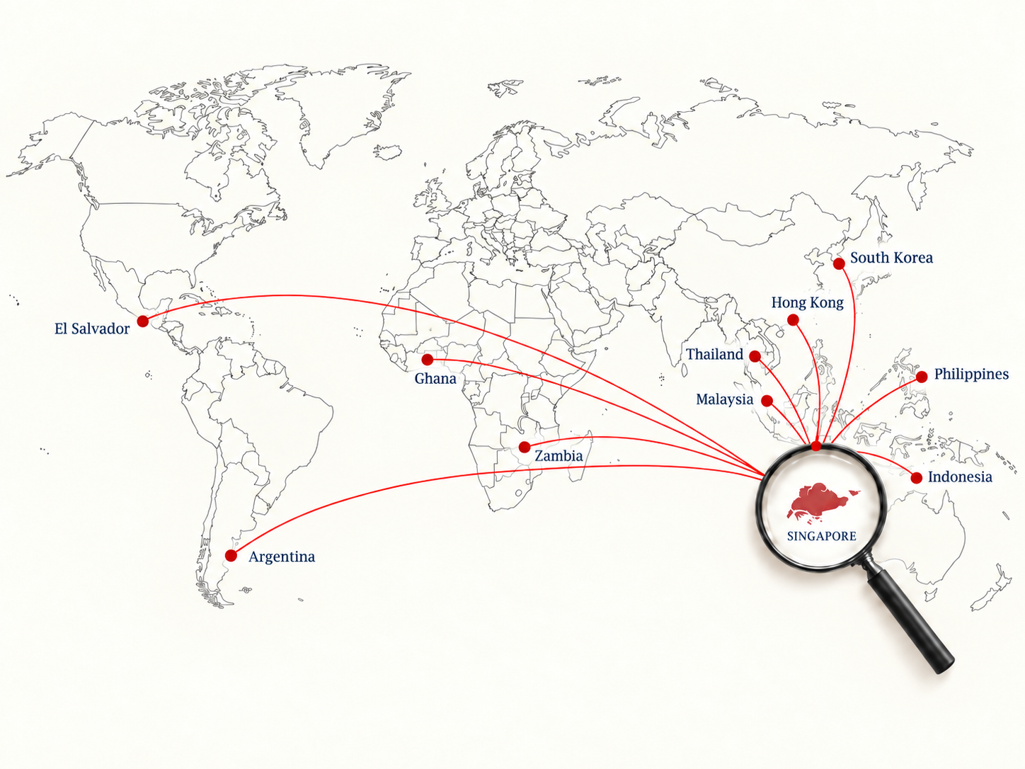
Research Question & Expectations
Each country helps test if Singapore’s ideas can work elsewhere.
H1 - Conditional Model
Singapore style policies are most likely to work when governments have strong institutions, capable bureaucracies, and enough political stability to implement and sustain them over time.
H2 - Context Matters
Singapore’s size, geography, history, and political structure may make its success unusually difficult to reproduce.
H3 - Success Has Multiple Dimensions
Economic development does not automatically mean equal success in political freedom, social well-being, or quality of life.
The project is not only asking whether Singapore succeeded, but why it succeeded, what the costs were, and which parts of that model can travel.

Slide 6
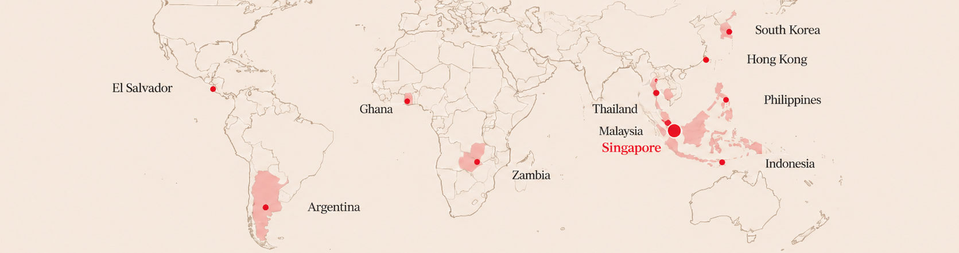
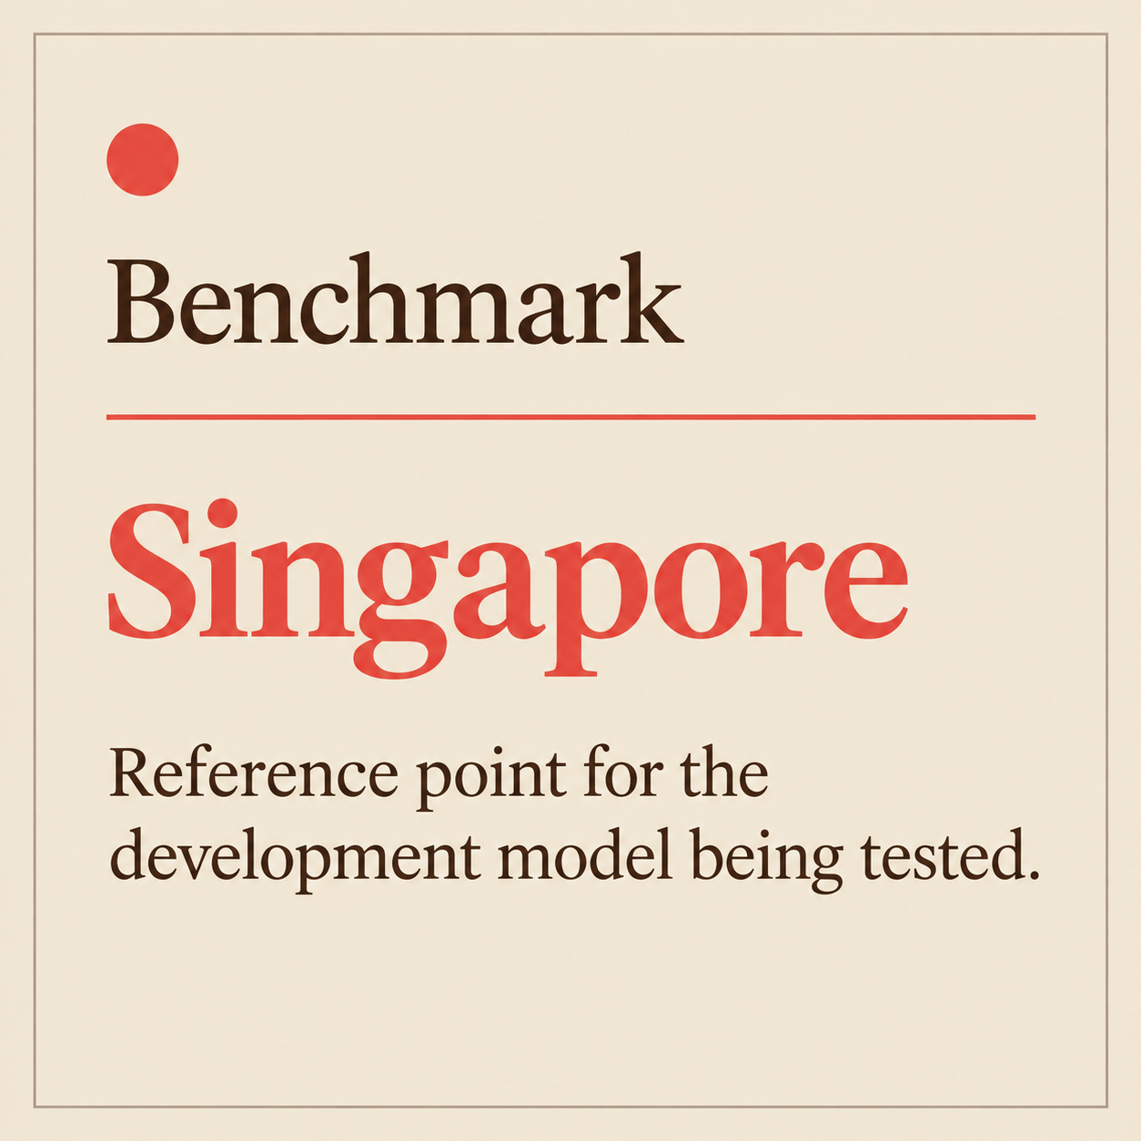
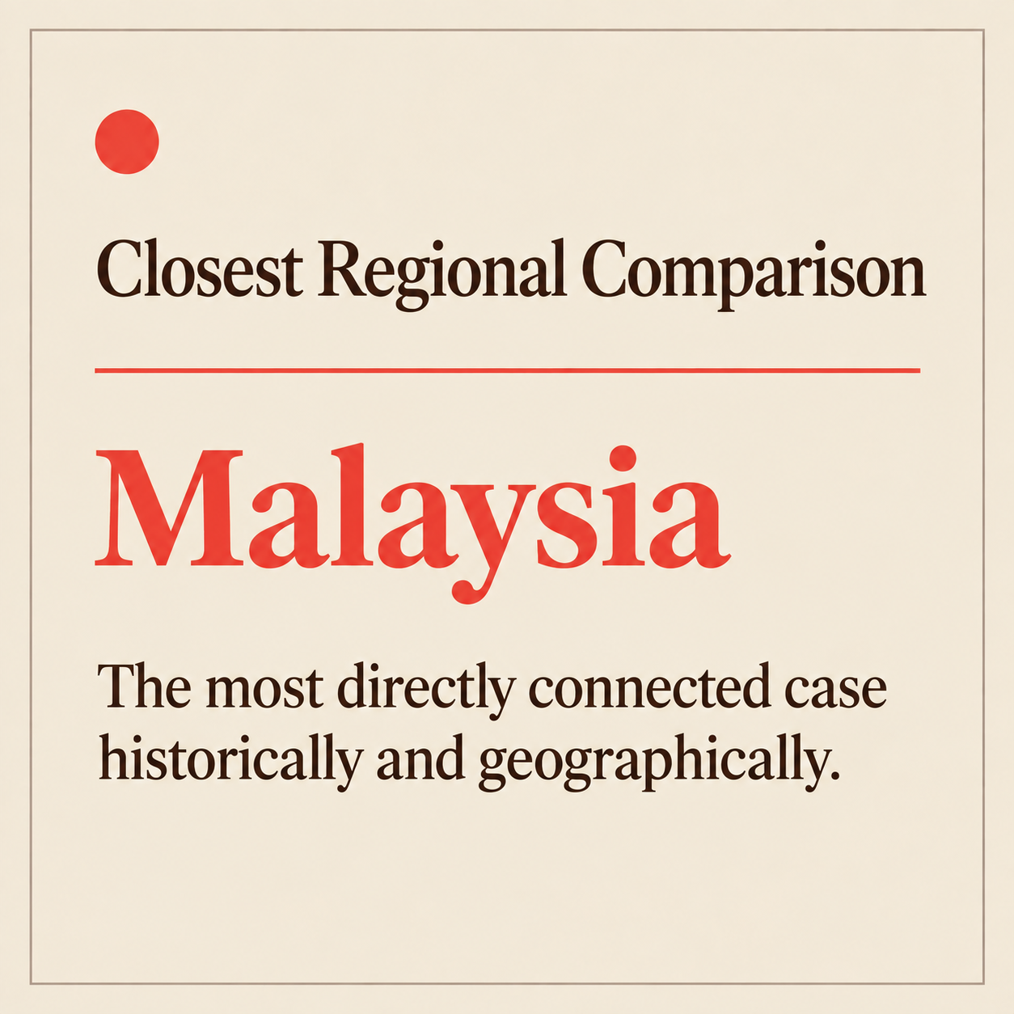
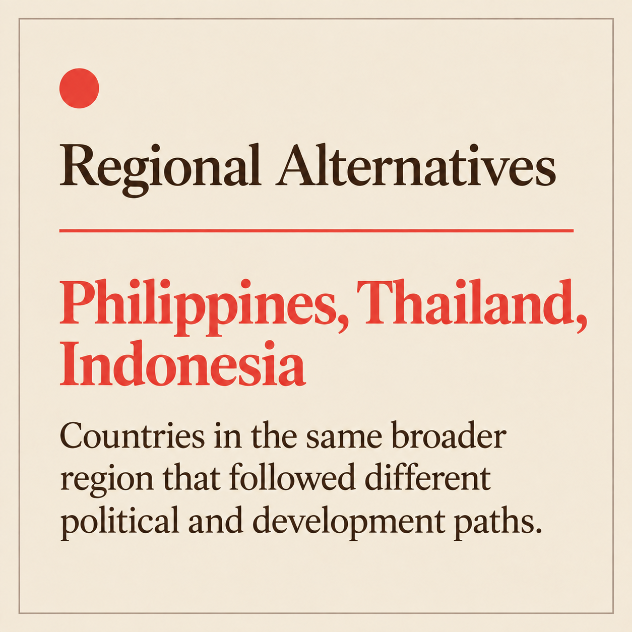
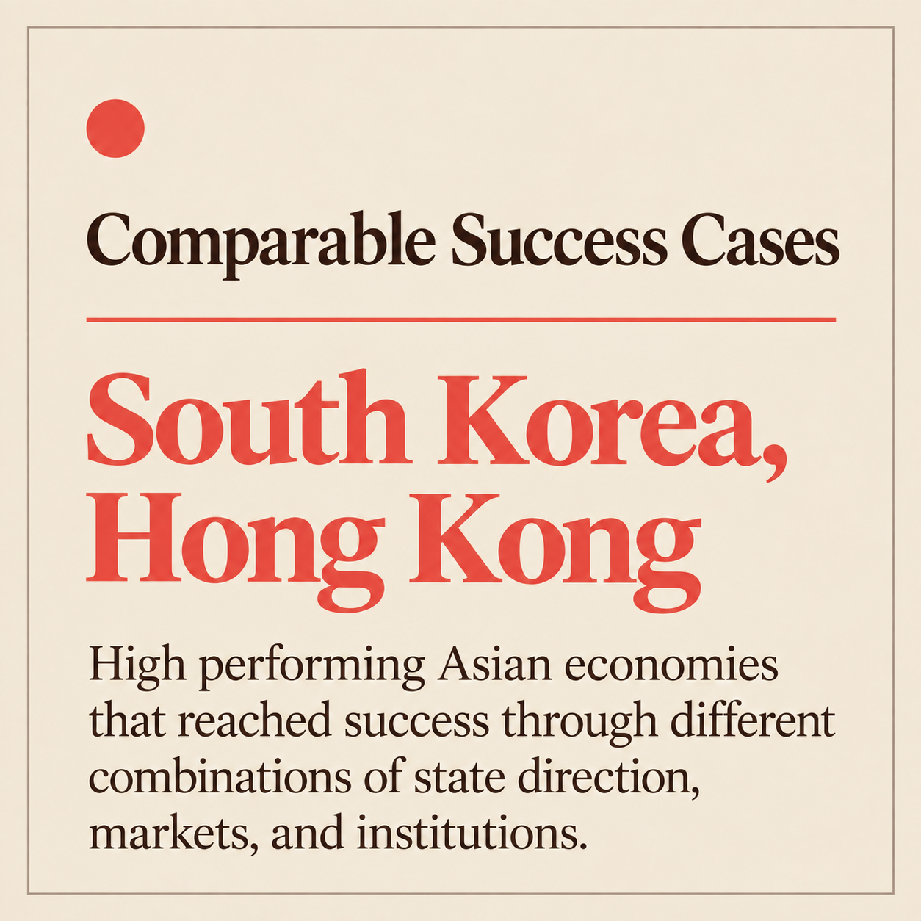
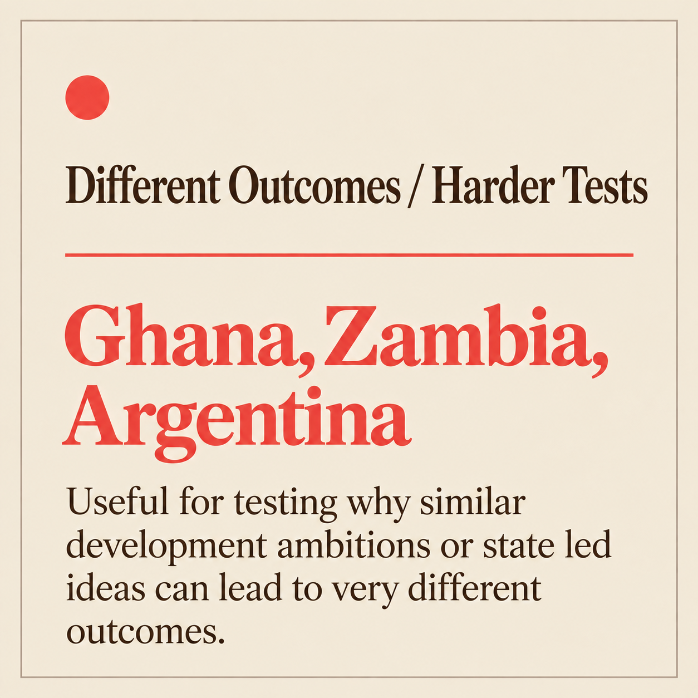
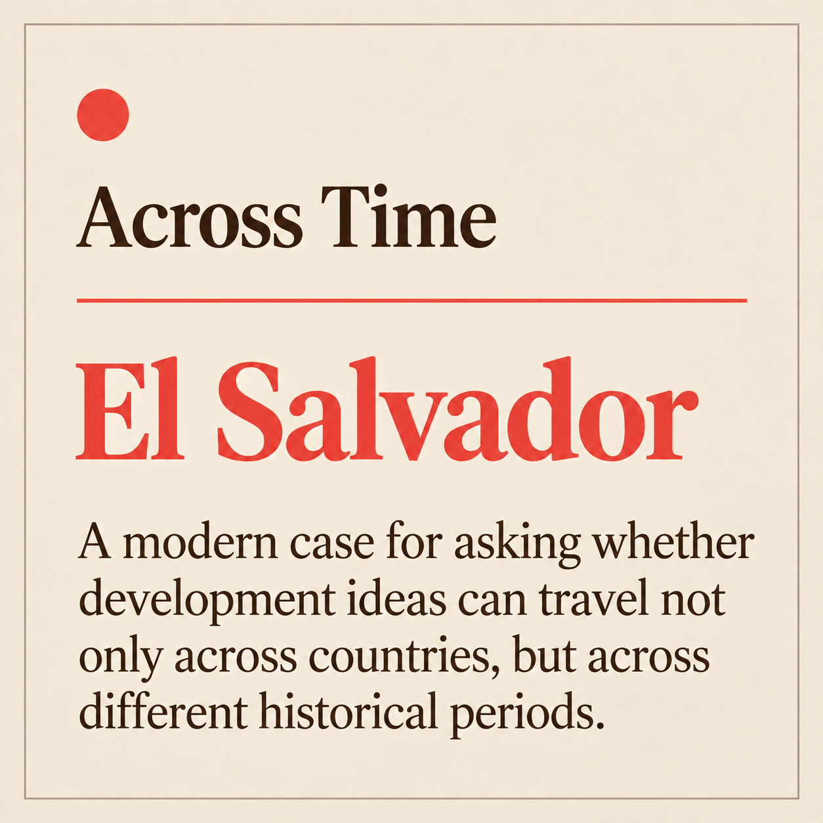
Why These Countries?
Do Singapore’s ideas work, and can they be reproduced elsewhere?
H1 - Conditional Model
Each case is meant to isolate a different explanation for Singapore’s success.

Slide 7
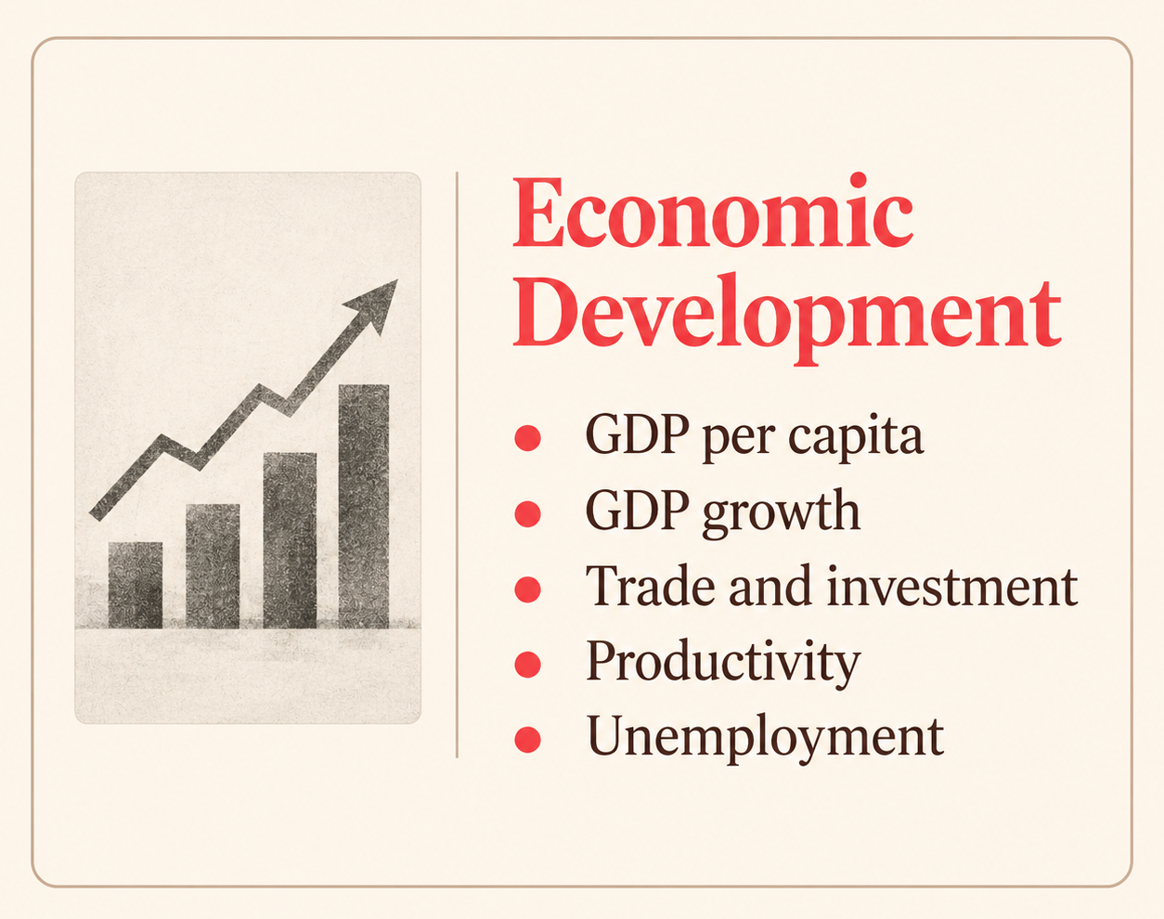

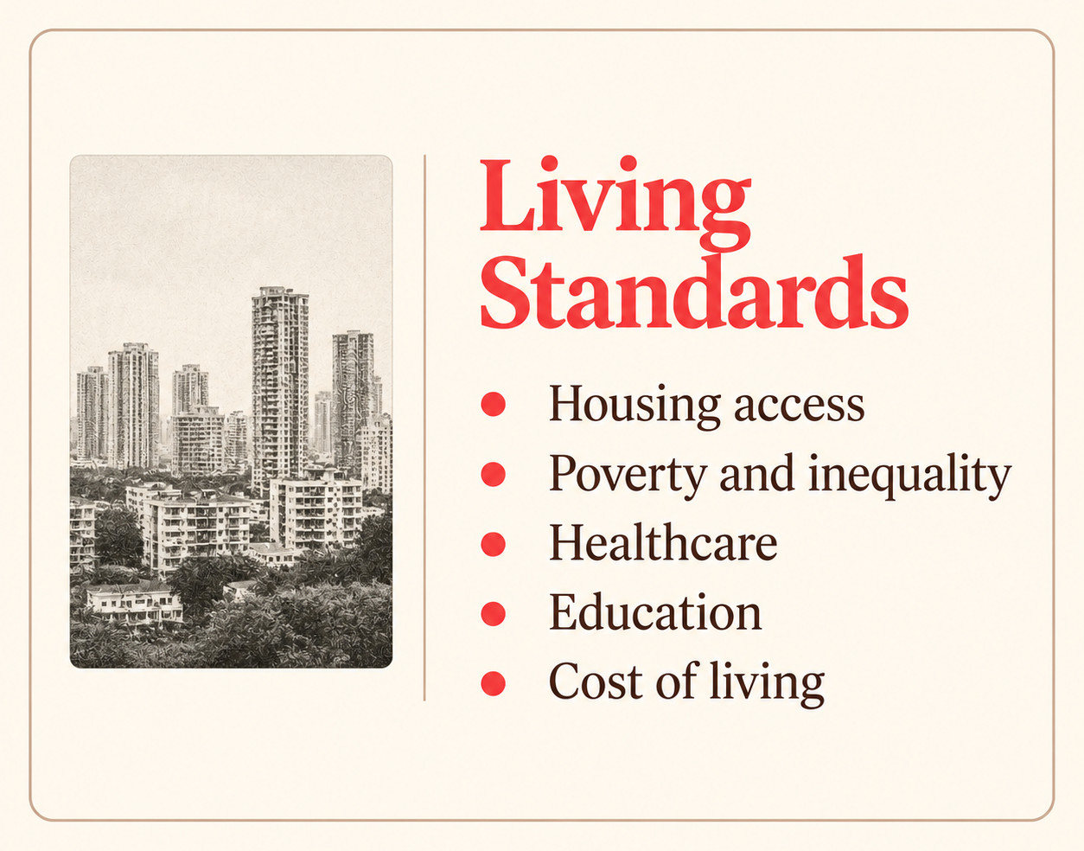

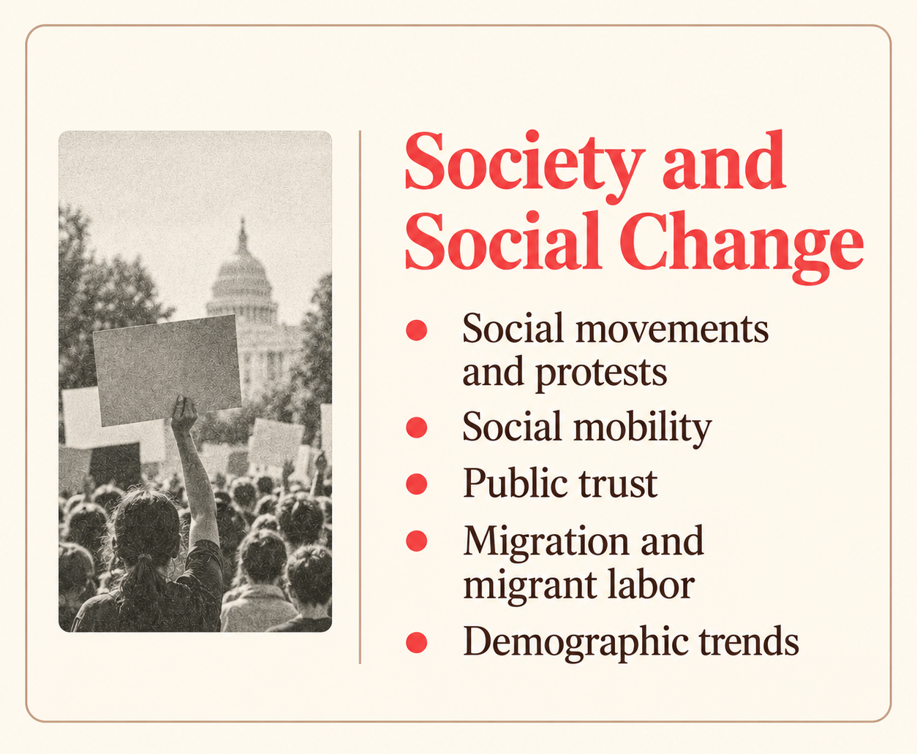
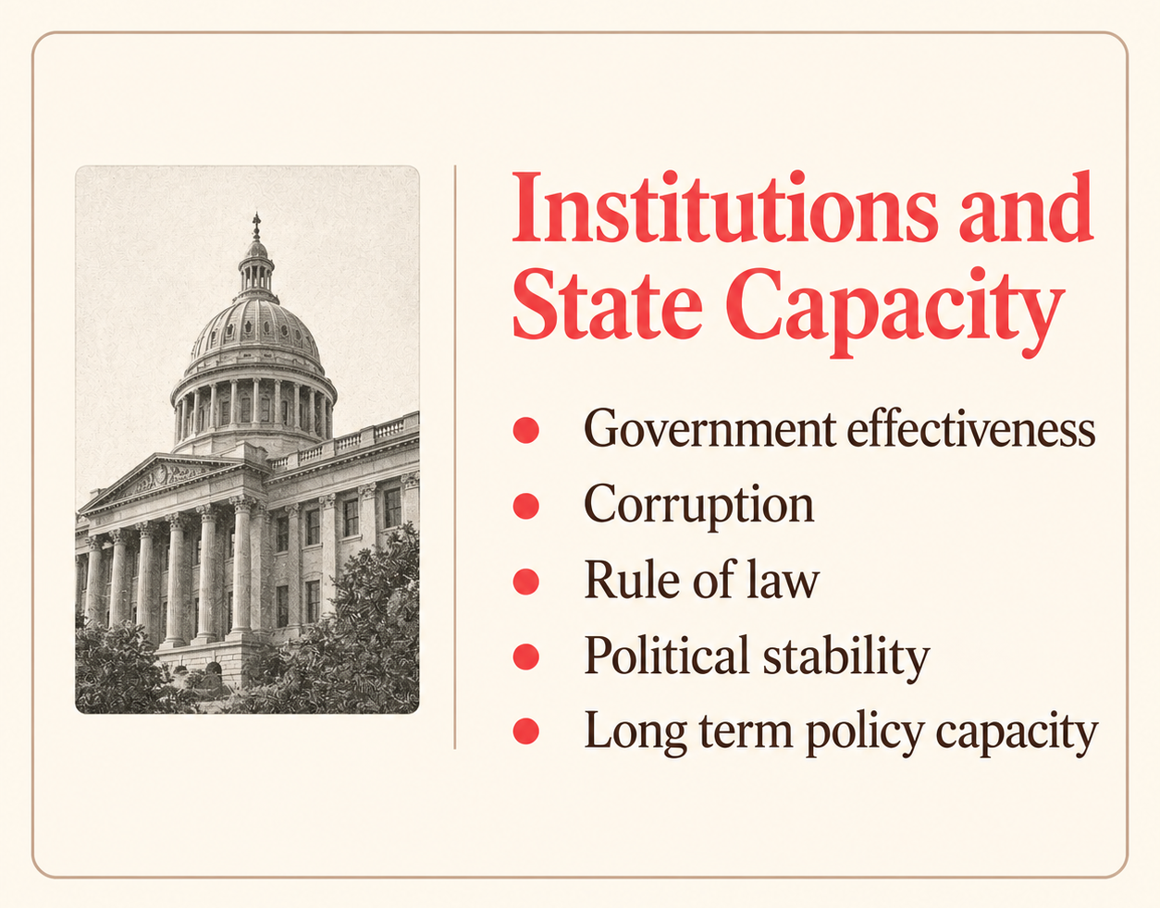
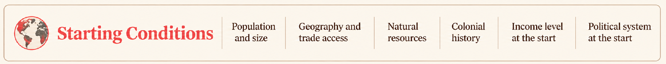
What I Will Compare
How will I judge whether the model works?
Succes is more than economic growth. I will compare material development, well being, freedom, institutes, and broader social outcomes.

Slide 8
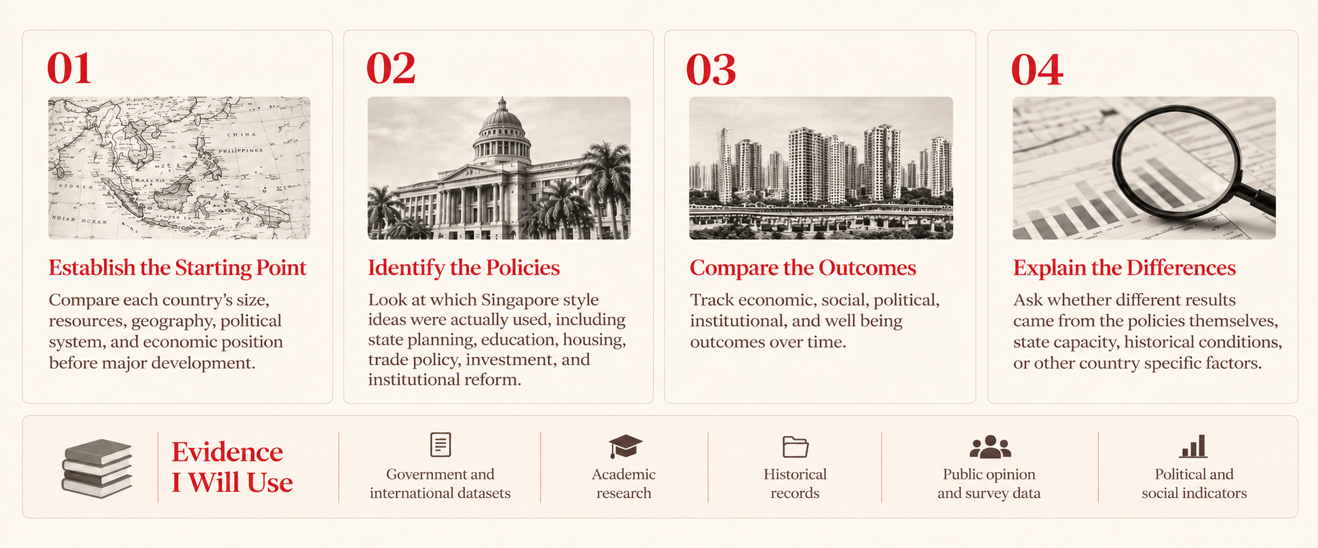
How I Will Study It
A comparative case study across countries and time.
The goal is not to rank countries. It is to understand when similar development ideas produce similar results and when they do not.

Slide 9
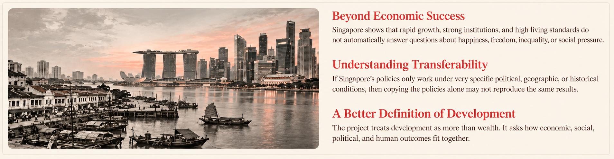
Why This Matters
Is Singapore a model to copy, or a case to understand?
The goal is to understand not just whether Singapore succeeded, but what produced that success, what it cost, and what other countries can realistically learn from it.
Can Singapore's success be reproduced or was Singapore itself the key ingredient.

