Slide 1
SHERIN S
Final Project
3/21/2024 Annual Review

Slide 2
GANs for Data Augmentation in Image Classification
3/21/2024 Annual Review

Slide 3


AGENDA
Understanding the Problem
Literature Review
Data Collection
GAN Model Selection and Training
Image Generation and Augmentation
Model Training
Evaluation
Iteration
Documentation and Presentation:
3/21/2024 Annual Review

Slide 4

PROBLEM STATEMENT
In the field of image classification, obtaining a large and diverse dataset is crucial for training robust machine learning models. However, real-world datasets are often limited, imbalanced, and lack the variety needed to train models effectively. This project aims to address the challenge of dataset limitations by leveraging Generative Adversarial Networks (GANs) to augment existing image datasets. The goal is to generate synthetic images that are indistinguishable from real images, thereby enhancing the dataset’s size and diversity. This augmentation is expected to improve the accuracy and generalization ability of image classification models, especially in scenarios with limited or imbalanced data. The project will explore the effectiveness of GAN-generated images in augmenting datasets and their impact on the performance of classification algorithms. The ultimate objective is to develop a methodology that can be applied to various image classification tasks, ensuring models are trained on datasets that better represent the complexity of real-world visual data
3/21/2024 Annual Review

Slide 5

PROJECT OVERVIEW
The project aims to bolster image classification models by using Generative Adversarial Networks (GANs) to generate synthetic images, thereby enriching training datasets. This approach seeks to mitigate the challenges posed by limited and imbalanced real-world datasets, enhancing the models’ accuracy and generalization capabilities. By integrating GAN-generated images into the training process, the project endeavors to create a scalable methodology for various image classification tasks, reflecting the complexity of real-world visual data.
3/21/2024 Annual Review

Slide 6

WHO ARE THE END USERS?
The end users of this project are likely to be professionals and organizations involved in fields where image classification plays a crucial role. This includes sectors like healthcare for medical imaging analysis, autonomous vehicle companies for object detection and navigation, agricultural sectors for crop and pest monitoring, security and surveillance systems, and any other industry that relies on visual data for machine learning and AI applications. Essentially, any domain that benefits from improved accuracy in image classification could be an end user of the technology developed in this project.
3/21/2024 Annual Review

Slide 7
YOUR SOLUTION AND ITS VALUE PROPOSITION
The value proposition lies in the ability to generate synthetic yet realistic images that expand and diversify training datasets, leading to more accurate and robust image classification models.
Value Proposition:
Enhanced Data Quality: GANs can create high-quality images that closely mimic real-world data, improving the training process.
Increased Dataset Size: Synthetic images augment datasets, especially beneficial where data collection is challenging or expensive.
Improved Model Performance: With richer datasets, models can achieve better accuracy and generalization, reducing overfitting.
Cost-Effectiveness: Reduces the need for extensive data collection, saving time and resources.
Scalability: The methodology can be applied across various domains, making it a versatile tool for many industries.
3/21/2024 Annual Review

Slide 8

THE WOW IN YOUR SOLUTION
Innovative use of Generative Adversarial Networks (GANs) to fundamentally transform the landscape of image classification. By generating synthetic images that are virtually indistinguishable from real ones, the project not only solves the problem of data scarcity and imbalance but also paves the way for advancements in AI that were previously hindered by dataset limitations. This breakthrough has the potential to revolutionize industries by enabling the development of more accurate and reliable image classification systems, which can be particularly impactful in areas such as medical diagnostics, environmental monitoring, and autonomous navigation. The project’s approach is a testament to the power of AI in overcoming some of the most challenging obstacles in machine learning.
3/21/2024 Annual Review
‹#›

Slide 9
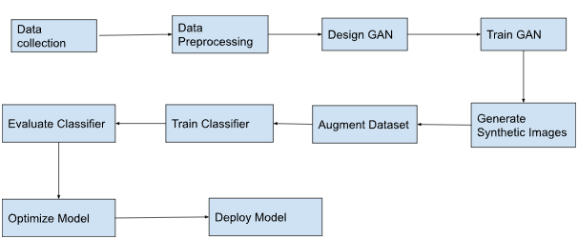
MODELLING
‹#›

Slide 10
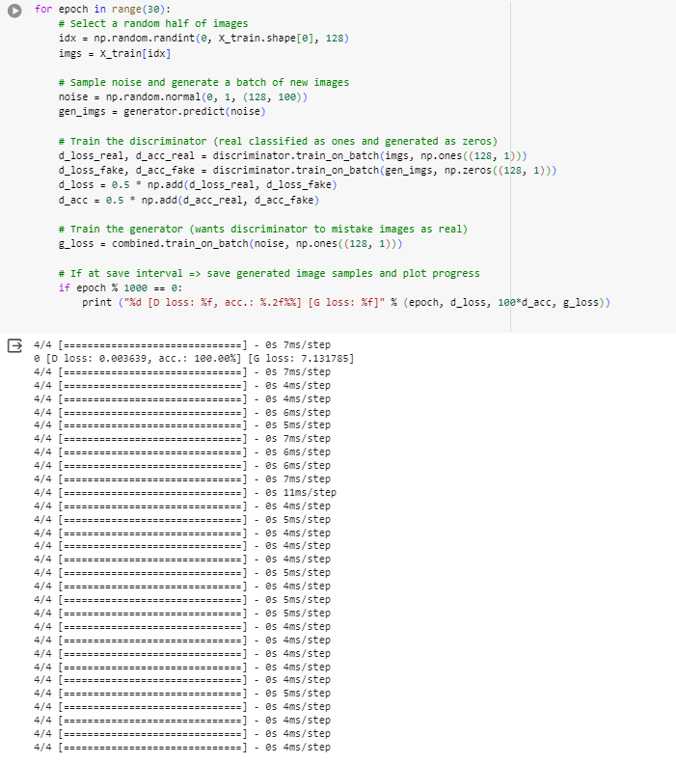
RESULTS
Demo Link
‹#›

