Slide 1
Survival analysis of tcga
Sharon Yedidia

Slide 2
feature selection and cleaning the data
The methods below were implemented in order to normalize and select the features.
Log transformation to mirna and exp files
Remove samples with negative ‘last_contact_days_to’
Removing duplicates
Removing features with std == 0
Normalization (scaling) of features
Calculate mutual information and remove insignificant features relatively to the event the duration
Correlation between all remaining features and remove highly correlated features (>0.9)

Slide 3
For each cancer type - model based on each omic and on the merged omics
The Cox Proportional Hazard
lasso
Ridge
Elastic net
Neural Network
Gradient Boosting Survival Tree
No Regularization
Dropout
Subsample
Learning rate
Random Survival Forest

Slide 4


Task 1 concept
Compare between two kind of models:
1
Build a predictor based on the concatenated omics.
2
Build 3 predictors, one for each omic. Combine the predictors into one model.

Slide 5
First implementation - neural network
# net = torch.nn.Sequential(
# torch.nn.Linear(in_features, x),
# torch.nn.ReLU(),
# torch.nn.BatchNorm1d(y),
# torch.nn.Dropout(z),
# torch.nn.Linear(s, s),
# torch.nn.ReLU(),
# torch.nn.BatchNorm1d(r),
# torch.nn.Dropout(w),
# torch.nn.Linear(k, out_features)
# )
Notes:
The NN was implemented using pytorch and was wrapped by the LogisticHazard model of the library Pycox. The Logistic-Hazard method parametrizes the discrete hazards and optimizes the survival likelihood. I tried a few variations of layers and eventually I used a NN using pytorch containing 9 layers and checked a range of each of the hyper parameters: 32<= x,y,s,k<=40 in jumps of 4 nodes and 0.1<w,z<0.3 in jumps of 0.1.

Slide 6
First implementation - neural network
output
Survival
Survival
Survival
input
Methylation
mRNA
Gene Expression

Slide 7
Check the assumption - is the multi view better
Survival
output
input
Methylation
mRNA
Gene Expression

Slide 8
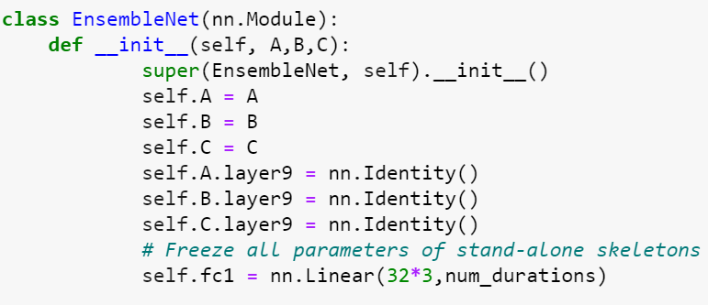
Abstract code of the MULTI VIEW net

Slide 9
Good results - maybe too good to be true
feature selection wasn’t according the folds - fixed.
Still high concordance index…
Label was inside the baseline NN as a feature Concordance index went to 0.492

Slide 10
Trying to improve the baseline nn
I tested again the hyperparameters tuning using cross validation and got no change in the results. I checked different kinds of models other than the logisticHazard:
- PMP: The PMF method parametrizes the probability mass function (PMF) and optimizes the survival likelihood. It is the foundation of methods such as DeepHit and MTLR. - DeepHit: DeepHit is a deep neural network that learns the distribution of survival times directly. This means that this model does not make any assumptions about an underlying stochastic process, so both the parameters of the model as well as the form of the stochastic process depend on the covariates of the specific dataset used for survival analysis. - MLTR: The (Neural) Multi-Task Logistic Regression is a PMF methods
MLTR gave the best results - using the folds with cross validation the averaged concordance index over all the cancer types was 0.529.
Notes:
The Logistic-Hazard method parametrizes the discrete hazards and optimizes the survival likelihood

Slide 11
Second implementation - gradient boosting survival tree
Single model - concatenated omics as input
The chosen baseline model combined few regularizations and got an optimal averaged concordance index of 0.816 using 80 estimators, learning rate of 0.8, subsample of 0.5 in each iteration and dropout rate of 0.1.

Slide 12
Multi view Gradient Boosting Survival Tree
Cox output
Final Survival
Gradient boosting output = Cox input
Hazard
Hazard
Hazard
Gradient Boosting input
Methylation
mRNA
Gene Expression
Notes:
I built a Gradient Boosting Survival Tree for each omic. In order to combine these models, I built a Cox model that gets as an input the predictions out of each baseline model and predicts the hazard out of it.

Slide 13
Concatenated omics Gradient boosting survival tree vs.Multi view Gradient Boosting Survival Tree
I compared the 2 models using the folds with cross validation, the averaged concordance index over all the cancer types of the Multi view model was 0.843> 0.816. The baseline model of Gene expression got an averaged concordance index of 0.65, The baseline model of mRna got an averaged concordance index of 0.672, The baseline model of Methyl got an averaged concordance index of 0.641

Slide 14
Task 2
Build a predictor that gets as input the gene expression and predicts the predictions of methyl and mRna of the baseline models.
Cox output
Final Survival
Gradient boosting output = Cox input
Hazard
Hazard
Hazard
Gradient Boosting input
Methylation
mRNA
Gene Expression

Slide 15
Task 2 model
Cox output
Final Survival
Gradient boosting output = Cox input
Hazard
Hazard
Hazard
Gradient Boosting input
Methylation
mRNA
Gene Expression

Slide 16
Choosing the predictor
NN - 5 layer NN using pytorch of python
Random forest - I used the Random Forest model of scikit library with the default values of hyperparameters.
Linear regression - I used the linear regression model of scikit library- 2 predictors, one for mRna predictions and one for Methyl predictions.
I compared between the multi view model that gets all the omics (concordance index 0.843) to these models. Using the folds with cross validation, the averaged concordance index over all the cancer types the of the model using the NN predictor was 0.531, the model using the Random forest predictor was 0.677, and the model using linear regression model was 0.829 (even better than the concatenated omics gradient boosting model).

Slide 17
Task 2 model
Cox output
Final Survival
Gradient boosting output = Cox input
Hazard
Hazard
Hazard
Linear regression
Linear regression
Gradient Boosting input
Methylation
mRNA
Gene Expression

Slide 18
Task 3

Slide 19
Task 3
Final Survival
Cox model
Hazard
Hazard
Hazard
Hazard
Hazard
Hazard
Hazard
Hazard
Hazard
Methyl
mRNA
Gene Expression
Methyl
mRNA
Gene Expression
Methyl
mRNA
Gene Expression
Notes:
For each omic for each cancer type I build a gradient boosting survival tree (each triangle). All the predictions from the models are the input for Cox model that will give the final prediction.

Slide 20
Predict the hazard of the cancer type in training using the omic of the tested cancer type
I built a linear regression model for each omic for each cancer type using the omic of the cancer type that is available in the testing.
Final Survival
Cox model
Hazard
Hazard
Hazard
Hazard
Hazard
Hazard
Hazard
Hazard
Hazard
Methyl
mRNA
Gene Expression
Methyl
mRNA
Gene Expression
Methyl
mRNA
Gene Expression

Slide 21
Task 3 results

Slide 22
questions?

