Slide 1

PNEUMONIA DETECTION USING DEEP LEARNING
Department of Computer Science and Engineering
University College of Engineering Kakinada(A)
Jawaharlal Nehru Technological University Kakinada
2021-2025
Presented by:
SK.SHER ALI (21021A0505)
B.NAVANEETHA (21021A0522)
M.DIVYA SRI DURGA(22025A0561)
Under the Supervision of:
Dr. K.V Ramana
Professor of CSE and Rector of JNTUK
UCEK(A), JNTU Kakinada

Slide 2
Contents
Abstract
Introduction
Problem Statement
Literature Review
Existing system
Proposed system
Implementation and Workflow
Architecture of Model
Results and Outputs
Conclusion and Future scope
References

Slide 3
Abstract
Pneumonia is a potentially life-threatening respiratory infection that primarily affects the lungs and remains a major global health concern, especially in children and the elderly. Early and accurate detection is critical for timely treatment and reducing mortality rates. Chest X-ray imaging is a widely used diagnostic tool for identifying pneumonia, but manual interpretation can be time-consuming and prone to human error. In recent years, deep learning techniques have shown great promise in medical image analysis due to their ability to learn complex patterns from large datasets.

Slide 4
This project explores the application of deep learning for automated pneumonia detection using chest X-ray images. By leveraging convolutional neural networks, the system is trained to distinguish between normal and pneumonia-infected lungs with high accuracy. The goal is to support healthcare professionals by providing a fast, accurate, and consistent diagnostic aid, potentially improving outcomes in clinical and remote healthcare settings.

Slide 5
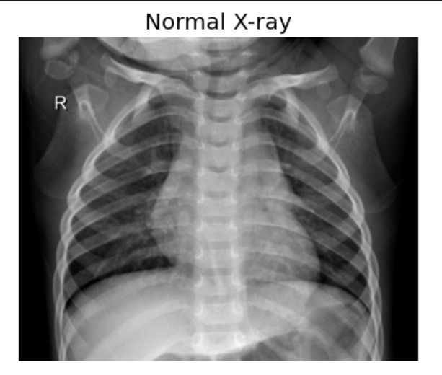
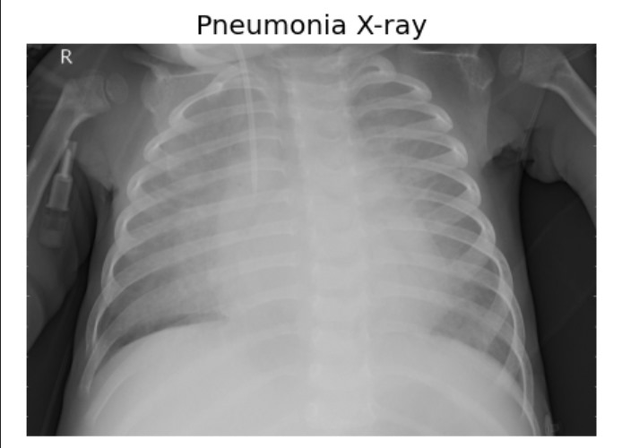
Introduction
Pneumonia is a lung infection that can be identified using chest X-ray images. X-rays help doctors detect lung inflammation, but manual analysis can be time-consuming and error-prone. Deep learning offers a way to automatically and accurately detect pneumonia from X-rays.
Difference in x-ray images in Normal and abnormal cases

Slide 6
Problem statement
Project aims to develop a deep learning-based model for Automated Pneumonia detection from chest X-ray images. By leveraging Convolutional Neural Networks (CNNs), the model will classify images as either Normal or Pneumonia, improving diagnostic accuracy and efficiency while reducing human error.

Slide 7
Literature Review
Sr. no | Paper Allocation | Author | Methods
1 | Bayesian convolutional neural network estimation for paediatric pneumonia detection and diagnosis | Vandecia Fernandes et al. | Bayesian convolutional neural network
2 | Transfer Learning from Pneumonia to COVID-19 | Hongen Lu et al. | Transfer Learning
3 | Pneumonia and COVID-19 Detection using Convolutional Neural Networks | Sammy V. Militante et al. | Convolutional Neural Networks
4 | Pneumonia Detection through Adaptive Deep Learning Models of Convolutional Neural Networks | Nanette V. Dionisio et al. | Deep Learning Models

Slide 8
Existing system
The existing system for pneumonia detection is built using a custom Convolutional Neural Network (CNN) architecture.
This model comprises:
Three convolutional layers followed by ReLU activation and feature mapping.
Two fully connected (dense) layers.
A SoftMax activation layer for final classification.

Slide 9
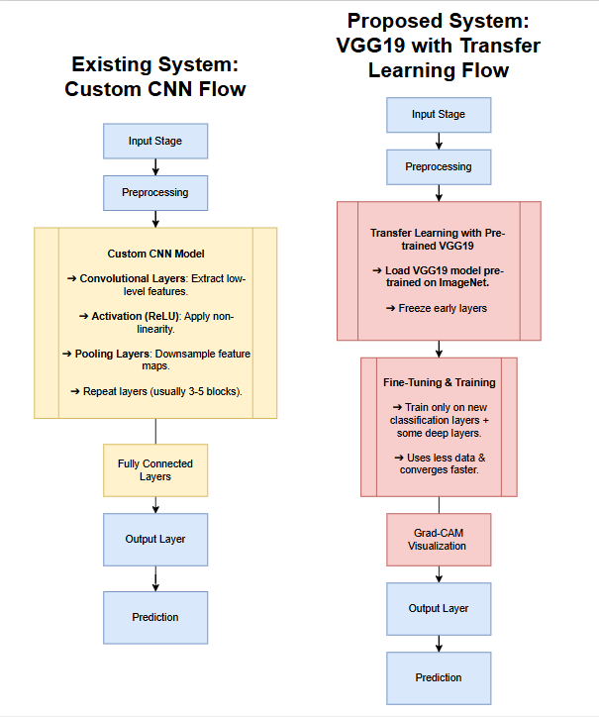
Existing System: Custom CNN Flow

Slide 10
Drawbacks of the Existing System
Limited Feature Extraction: With only three convolutional layers, the model may not effectively capture the complex and hierarchical features present in medical images.
Overfitting Risk: Due to the smaller architecture and training from scratch on a relatively small medical dataset, the model is prone to overfitting.
Longer Training Time with Suboptimal Accuracy: Since it lacks pre-trained weights, training takes longer and may not achieve optimal generalization.
No Transfer Learning Utilization: It does not leverage the power of large-scale pre-trained models that have learned generalized features from large datasets like ImageNet

Slide 11
Proposed System
The proposed system is designed for image classification using a deep learning approach, leveraging the VGG19 convolutional neural network (CNN) architecture as the core model. VGG19 is a well-established deep CNN that consists of 19 layers, known for its simplicity and effectiveness in extracting image features.
It is pre-trained on large datasets such as ImageNet, enabling it to generalize well on various image recognition tasks. To enhance model interpretability and provide visual explanations for the classification decisions, the system incorporates Gradient-weighted Class Activation Mapping (Grad-CAM).
Grad-CAM helps in identifying the important regions in the input image that influenced the model's predictions.

Slide 12
Proposed System : VGG 19 with Transfer Learning

Slide 13
Dataset Description
Chest X-Ray Images (Pneumonia): This dataset, curated by Paul Timothy Mooney and available on Kaggle, comprises 5,863 chest X-ray images categorized into two classes: Pneumonia and Normal.
Dataset Structure:
Training Set: Contains images used to train the deep learning model.
Validation Set: Used to fine-tune model parameters and prevent overfitting.
Test Set: Employed to evaluate the final model's performance on unseen data.
Image Format: All images are in JPEG format, ensuring compatibility with standard image processing libraries.

Slide 14
Libraries Used
TensorFlow & Keras — for model building and training.
Matplotlib & Seaborn — for analyzing and visualizing performance.
Flask — for deployment and building a user-friendly interface.
OpenCV — for preprocessing and preparing the X-ray images before prediction.
Programming Language
Python

Slide 15
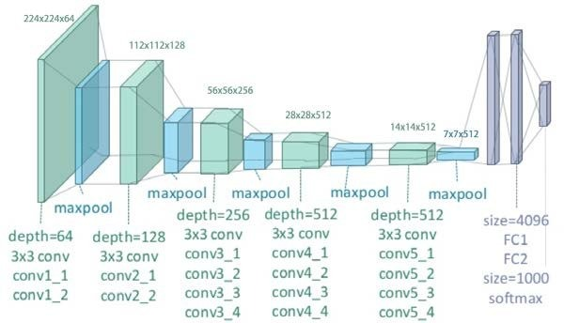
Architecture of VGG19 Model

Slide 16
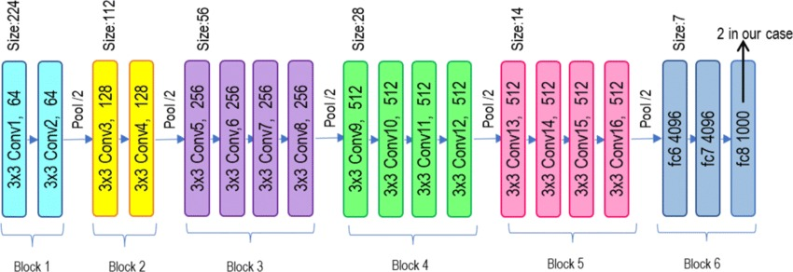
Block based structure of VGG19 MODEL

Slide 17
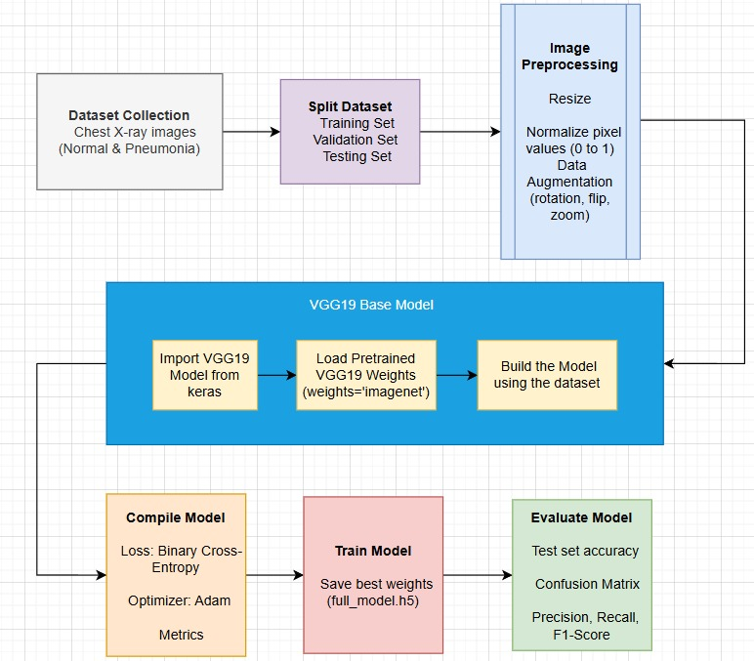
Workflow

Slide 18
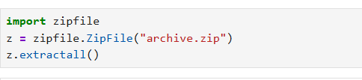
Implementation
Extract Dataset
we extract the compressed dataset file archive.zip. The extracted data contains chest X-ray images categorized into folders such as train, test, and validation. These images will be used to train, validate, and evaluate our pneumonia detection model.
2. Loading and Preprocessing X-ray Images
we load the chest X-ray images from the dataset folders (train, test, val) and preprocess them:
We read images in grayscale using OpenCV for simplicity.
All images are resized to a standard size of 128x128 pixels for consistent input to the model.
Pixel values are normalized between 0 and 1 by dividing by 255.0, which helps improve model performance.
Labels are assigned: 0 for Pneumonia and 1 for Normal.
Any non-image or unreadable files are skipped to avoid errors.

Slide 19
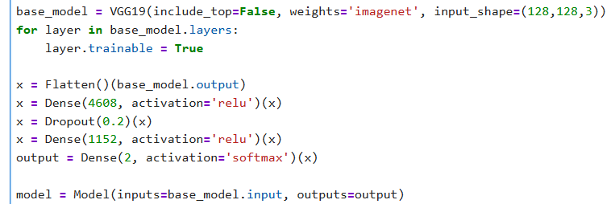
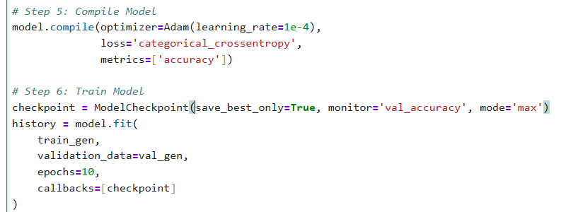
3. Build the Model (Using VGG19 Base)
VGG19 Base Model is loaded without its top layers and added custom layers.
4. Compile and Train the Model

Slide 20
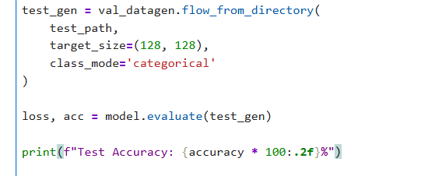
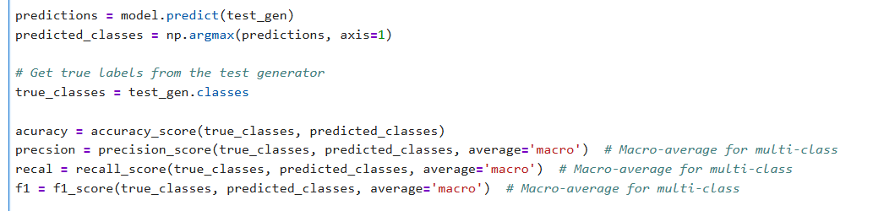
5.Test evaluation
6.Evaluation Metrics

Slide 21
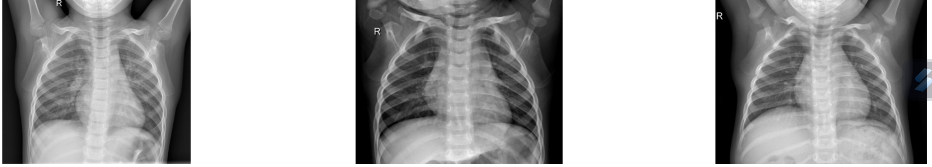
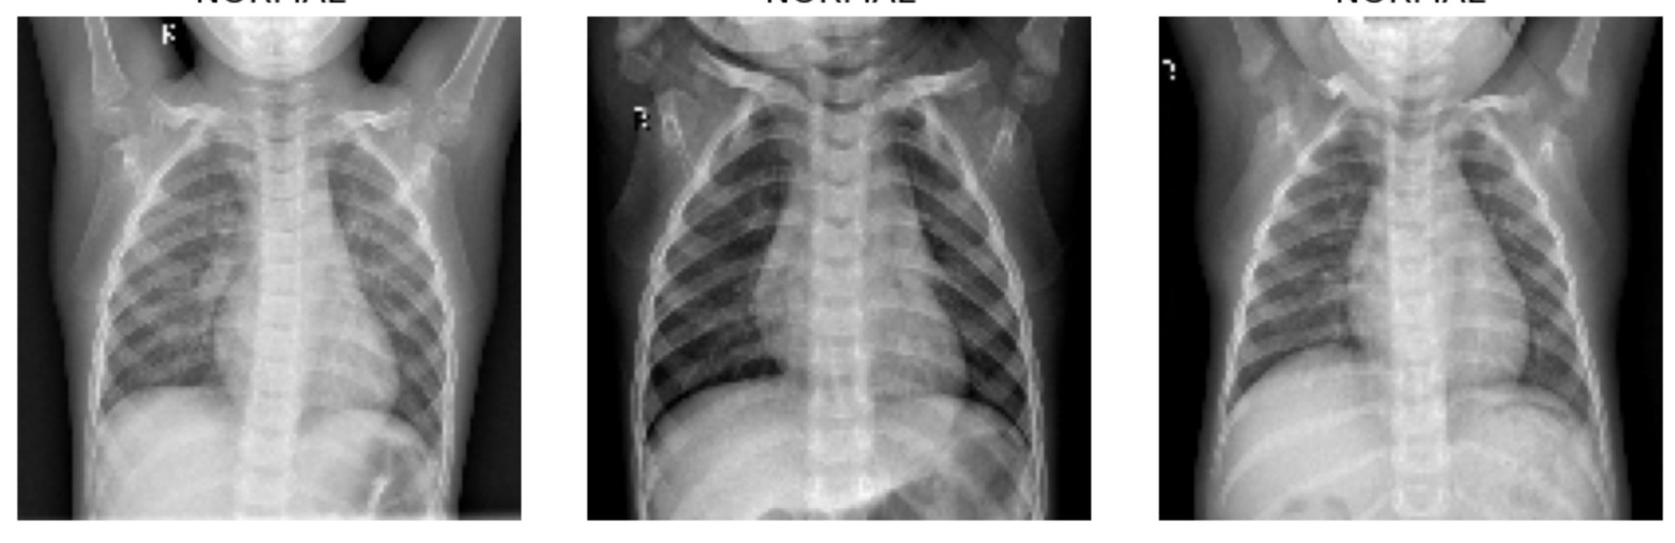
Results and Outputs:
Images before resizing:
Images after resizing:

Slide 22
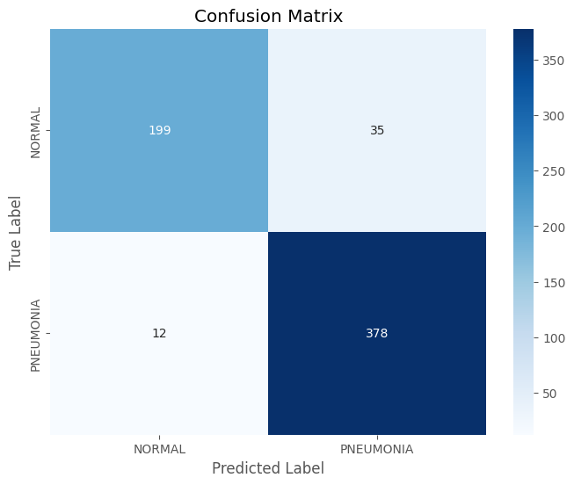
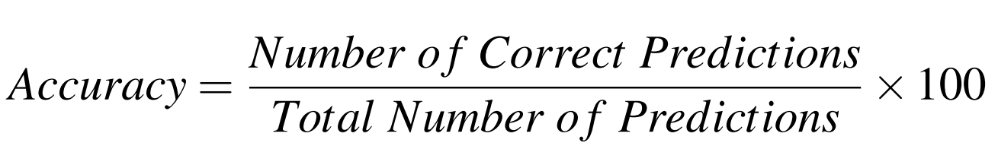
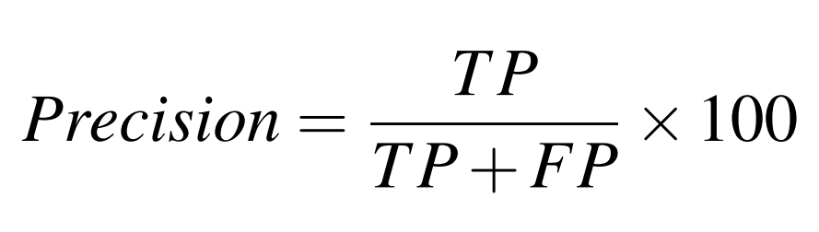
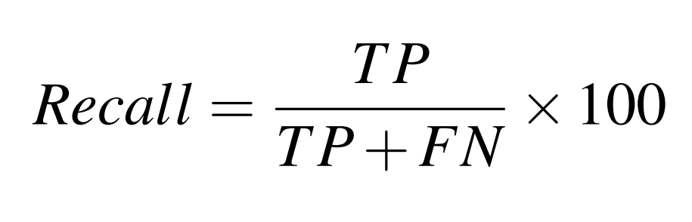
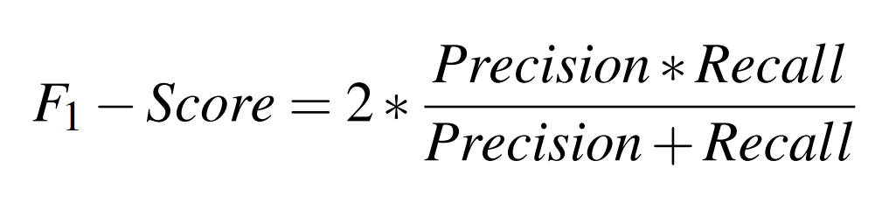
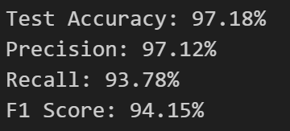
CONFUSION MATRIX:
PERFORMANCE METRICS:

Slide 23
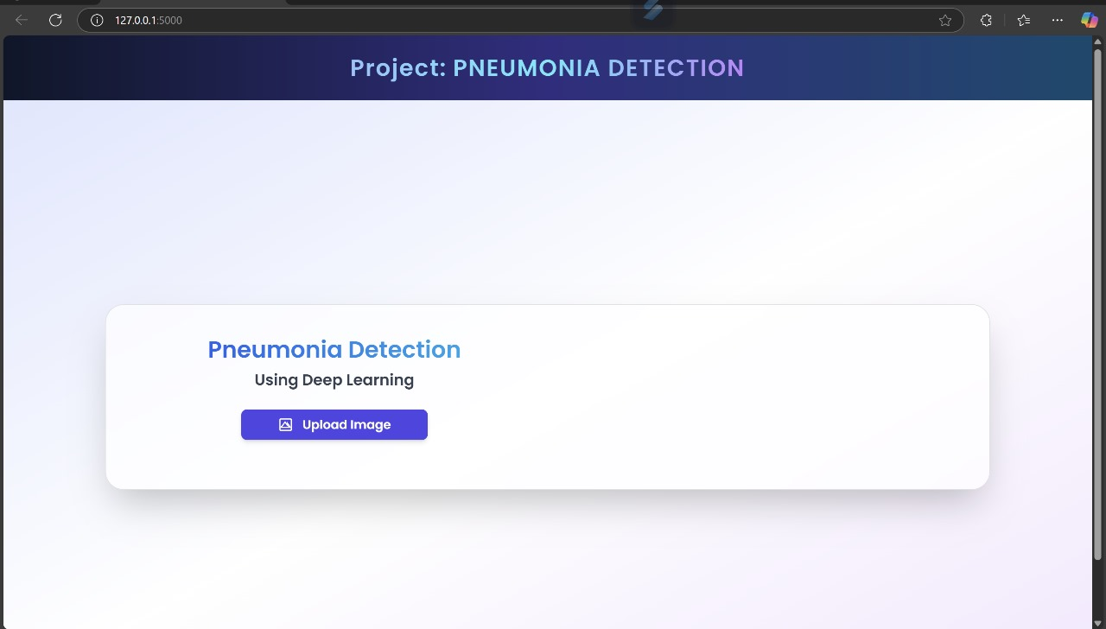
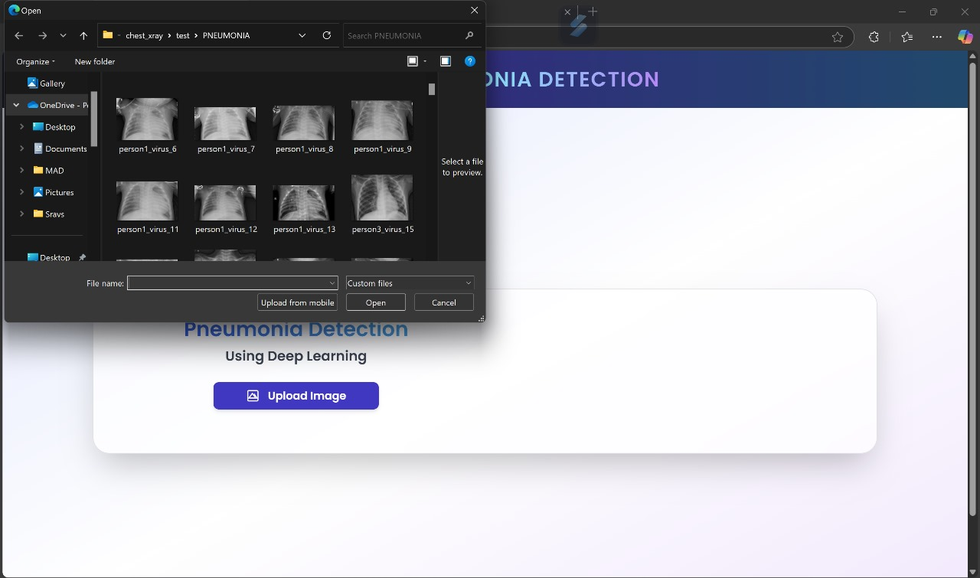
Home Page (Upload Interface):The page displays an upload button for users to submit chest X-ray images. When an image is uploaded,It is sent via a POST request to the Flask backend (app.py).The image is preprocessed (resized, normalized). The preprocessed image is passed into the VGG19 model for prediction
Output:

Slide 24
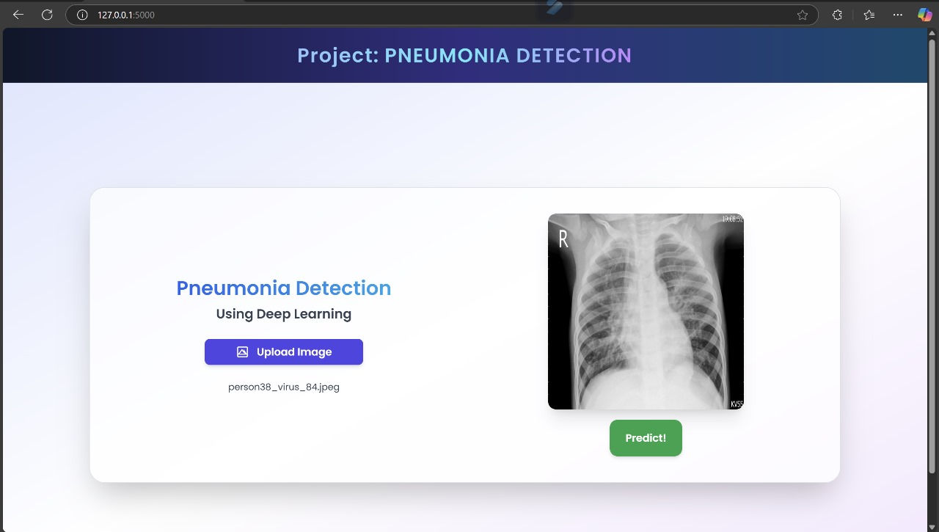
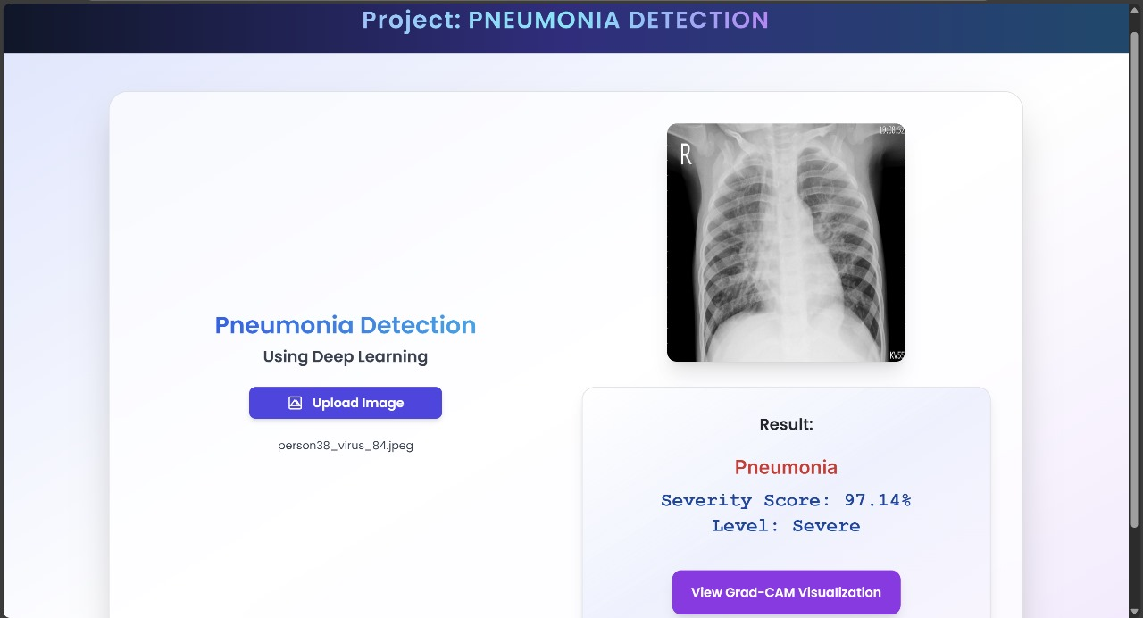
The user sees a label: either “Pneumonia Detected” or “Normal”.A severity score also be shown .
Backend Working,After passing through the CNN:The model outputs probabilities for the classes (Pneumonia or Normal).The class with the highest probability is shown as the final result.

Slide 25
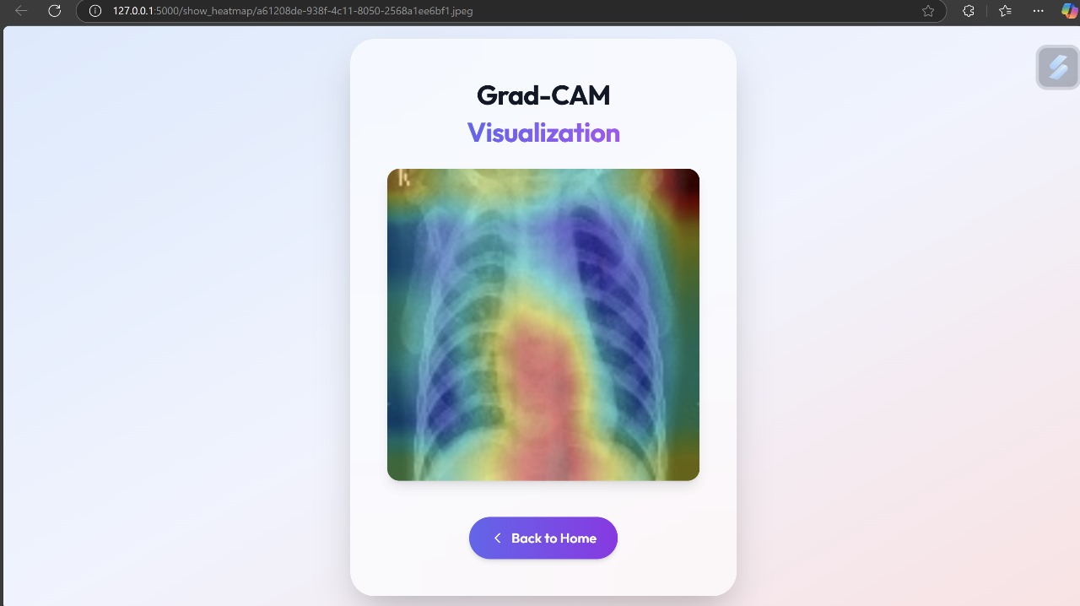
A heatmap is overlaid on the original X-ray image.It shows regions in red/yellow, indicating areas the model focused on to make its prediction.
Grad-CAM uses the final convolutional layer of VGG19.It computes the gradient of the output class score with respect to feature maps.Provides model explainability – crucial for trust in healthcare AI.

Slide 26
Conclusion
The project focuses on detecting pneumonia from chest X-ray images using deep learning, specifically the VGG19 model through transfer learning. The model was trained on a labeled dataset and achieved a high accuracy of approximately 97%, with precision and recall also around 93-94%, ensuring reliable performance. Preprocessing steps such as resizing, grayscale conversion, and normalization were applied to improve model input quality. Data augmentation techniques helped reduce overfitting and improve generalization. One of the key features of the system is the integration of Grad-CAM, which visually highlights the regions of the X-ray that influenced the model’s decision, enhancing interpretability. The trained model was saved and deployed through a Flask-based web application, allowing users to upload images and get real-time predictions. The interface is simple, effective, and accessible, making it suitable for practical use. Evaluation metrics such as confusion matrix, precision, recall, and F1-score provide a comprehensive performance overview. The model demonstrates strong potential for aiding radiologists in clinical diagnosis. Overall, the system is accurate, explainable, and ready for real-world application.

Slide 27
Future scope
Enhanced Explainability Techniques: Grad-CAM is already integrated, which is excellent for visualization. In the future, using tools like LIME or SHAP can provide more granular, pixel-level explanation or model-agnostic interpretability to further increase clinical trust.
Model Ensembling for Robust Predictions: Combining multiple pre-trained models (e.g., VGG19, ResNet, EfficientNet) using ensembling techniques can improve classification robustness and handle edge cases better, particularly when dealing with subtle pneumonia manifestations.
Cloud and API Services: Hosting the model as a cloud-based API would allow third-party healthcare platforms, making the tool scalable and accessible to developers and institutions globally.

Slide 28
3. User-Friendly Enhancements: Adding features like multilingual support, voice-guided interactions, and patient history tracking can make the system more accessible to diverse users, especially in telemedicine settings.
4. Real-Time and Edge Deployment: Future versions can be optimized and deployed on edge devices like smartphones or Raspberry Pi, allowing offline diagnosis in low-resource or rural settings without relying on internet connectivity or powerful servers.

Slide 29
References
[1] K. I. Zheng, G. Feng, W.-Y. Liu, G. Targher, C. Byrne, M.-H. Zheng, Extra-pulmonary complications of covid-19: a multi-system disease?, Journal of Medical Virology.
[2] Wang X et al (2017) Hospital-scale chest x-ray database and benchmarks on weaklysupervised classification and localization of common thorax diseases. IEEE CVPR.
[3] A. Karargyris, J. Siegelman, D. Tzortzis, S. Jaeger, S. Candemir, Z. Xue, K. Santosh, S. Vajda, S. Antani, L. Folio, et al., Combination of texture and shape features to detect pulmonary abnormalities in digital chest x-rays, International journal of computer assisted radiology and surgery 11 (1) (2016) 99–106.
[4] A.Reddy Kandula, S. D. Gangiredla, K. P. Tirukkovalluri, S. Yallamilli, N. Tummalapalli and S. Talluri, "X-Ray Image Analysis using Deep Learning Techniques to Identify Pneumonia," 2023 Second International Conference on Augmented Intelligence and Sustainable Systems (ICAISS), Trichy, India, 2023, pp. 674-679, doi: 10.1109/ICAISS58487.2023.10250543.
[5] Jaiswal, A.K.; Tiwari, P.; Kumar, S.; Gupta, D.; Khanna, A.; Rodrigues, J.J. Identifying pneumonia in chest X-rays: A deep learning approach. Measurement 2019, 145, 511–518.

Slide 30
THANK YOU!

