Slide 1
MSc DISSERTATION · VIVA VOCE
Does a language model earn its cost
in a multi-agent travel planner?
Four architectures measured on the same task, with retrieval as the only variable.
Student 25182589 · CMP7200 — Individual Master's Project
Notes:
Fifteen minutes. The argument is one sentence: a model is worth its cost where a step needs judgement, and costs without adding anything where it does not. I built four architectures that differ only in how data is retrieved, measured all four, and the retrieval layer is where the money goes.

Slide 2
THE PROBLEM
Agents are given tools by default
21
2
15x
model requests per trip when six agents each decide
model requests per trip when plain Python fetches
the tokens, for the same finished itinerary
Fetching a fare for a known route on a known date needs no judgement.
A reasoning loop is charged for it anyway — every step re-sends every tool schema.
Notes:
The literature treats tool-use as the thing that makes agents useful. Nobody asks which steps deserve one. Interpreting "leaving on the fifteenth for two adults" is a judgement. Calling a flight API with a date is not. The naive arm spent 20.6 model requests per trip against 2.0 for the shipped design, and the tokens differ by about 15 times, because each loop step re-sends the whole tool schema set.

Slide 3
Where does a language model
earn its cost,
and where is it just expensive?
Design Science Research · four-arm ablation · retrieval is the only variable
Notes:
Everything else is held constant: same task, same prompts where they overlap, same tool server, same message protocol, same model. Only the retrieval layer changes between arms. That is what makes the comparison attributable.

Slide 4
THE FOUR APPROACHES
One variable: who fetches the data
 | Architecture | Who retrieves | Why it is in the design
A | One model call, no tools | nothing | Floor. Shows what fluency alone produces
B | Six agents, as first built | each agent decides | The proposal, untuned. The honest baseline
C | Six agents, tuned | each agent decides | Separates tuning from architecture
D | Three agents | plain Python | What ships. The claim under test
C exists so nobody can say D only won because B was badly configured.
Notes:
C is the arm that makes the result defensible. Tuning alone cut tokens by 89% without changing the architecture — so a comparison of B against D would have conflated two different effects. A is the control: it produces a fluent itinerary from nothing, and its price groundedness of 1.7% is the number that shows why retrieval matters at all.

Slide 5
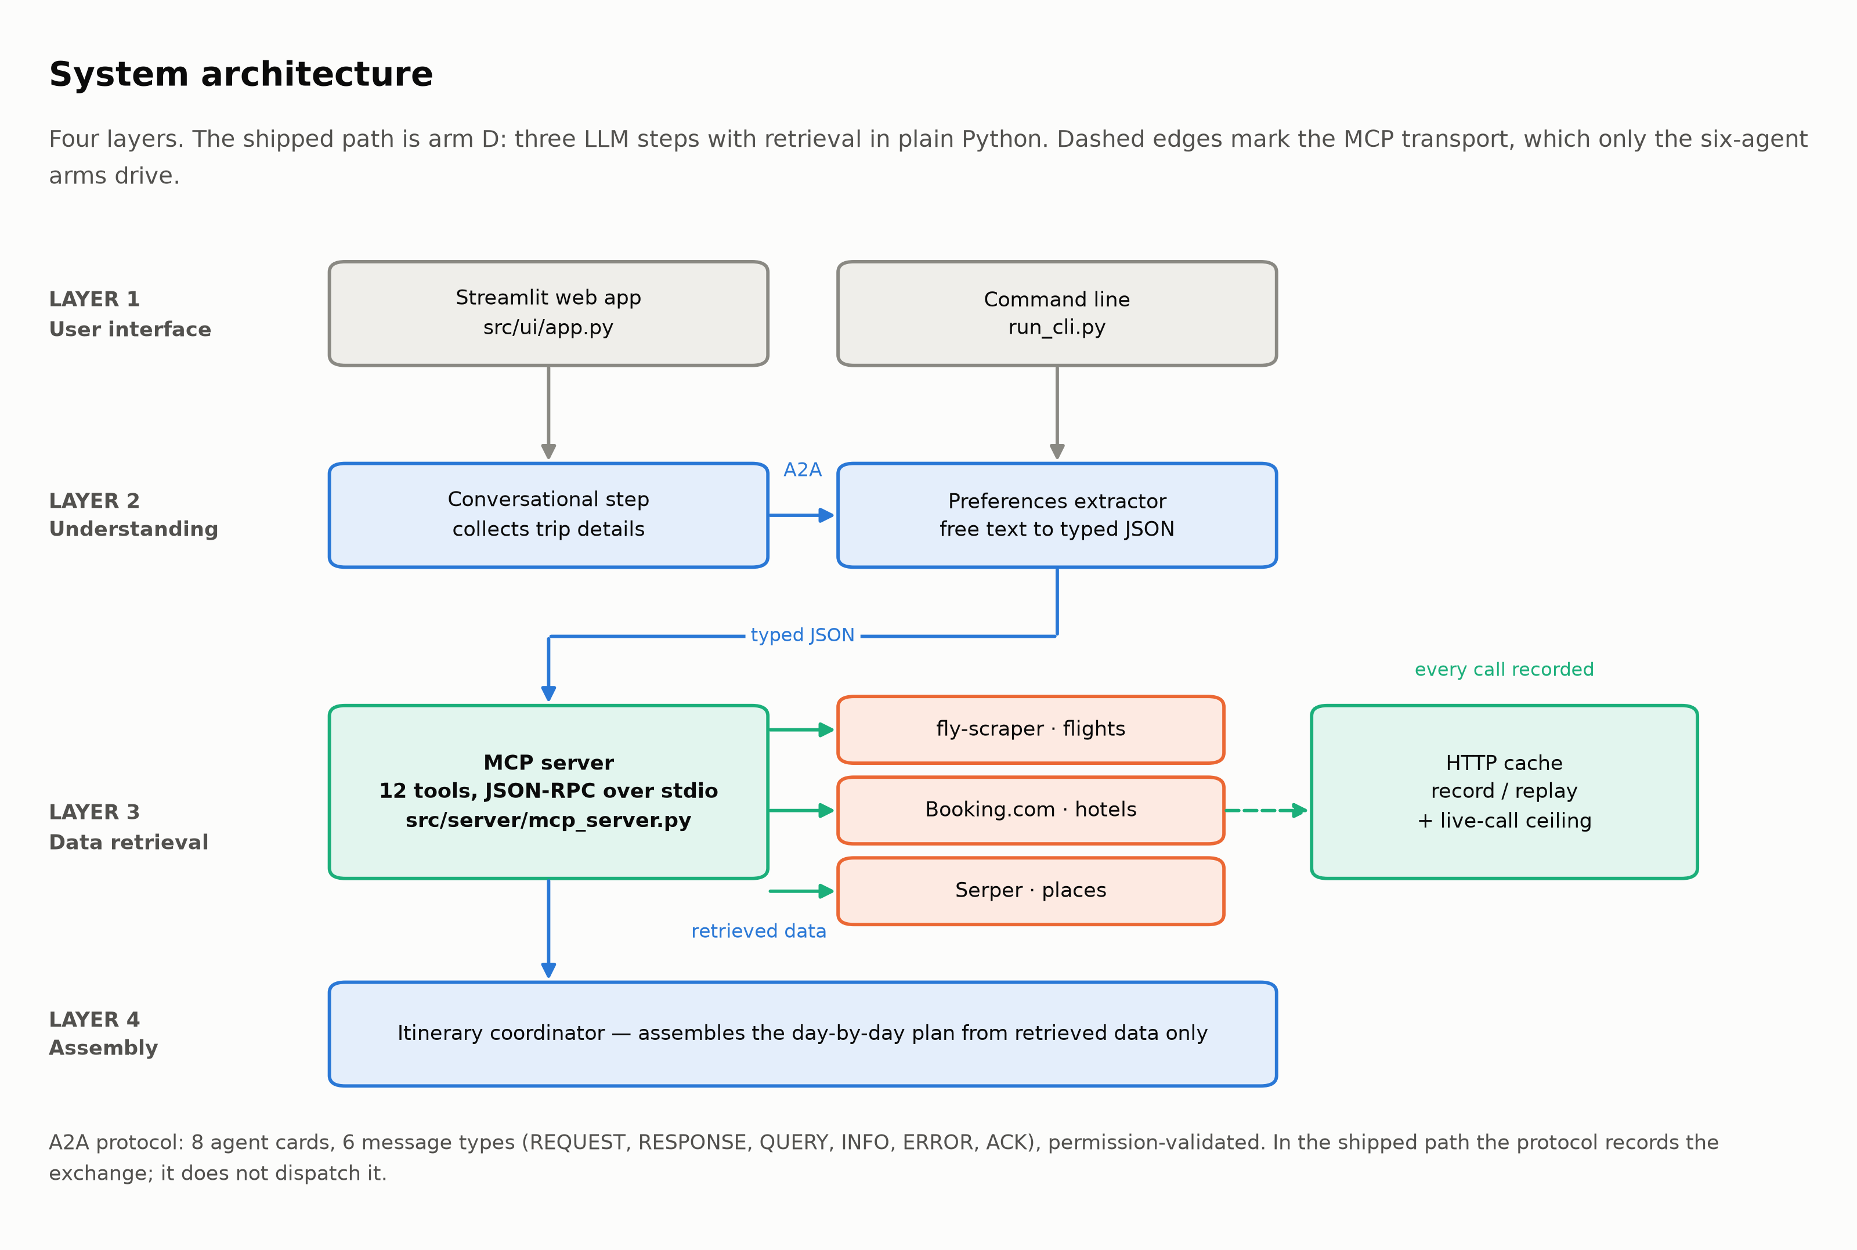
ARCHITECTURE
Four layers; only layer three changes
Notes:
Layer one takes the request, two turns free text into typed fields, three retrieves, four assembles. The research question lives entirely in layer three. Note the honest detail: the shipped path imports the tool functions in process. The JSON-RPC transport is exercised by the six-agent arms, and Section 7.2 of the dissertation says so rather than implying otherwise.

Slide 6
THE AGENTS
Three use the model. Four steps do not
Step | Who | Model? | Why
1 | Conversational agent | yes | Reads a request written however a person writes it
2 | Preferences extractor | yes | Free text to typed fields, then the budget is checked
3 | Flights · hotels · attractions · restaurants | no | One correct call each. An if statement decides, not a model
4 | Itinerary coordinator | yes | Arranges retrieved options into a sensible day-by-day plan
The test applied to every step: does this need a judgement that cannot be written as code?
Two steps do. Four do not. That is the whole design.
Notes:
Six agents became three because the instrumentation showed most requests were spent on deterministic retrieval. The three that remain each fail the "write it as code" test — you cannot write a rule that interprets arbitrary phrasing, and you cannot write a rule that sequences a pleasant day.

Slide 7
HOW IT WAS MEASURED
Repeats, intervals, and no credentials
5
1/20
30
393
runs per arm, so every figure has an interval
scenarios for the cost comparison — quota-bound
recorded API responses, committed and replayable
tests, no keys and no network
Model requests counted from provider callbacks, never by hand.
Coverage is stated on every chart rather than smoothed over.
Notes:
The honest weakness first: 1 of 20 scenarios for the cost comparison, because the free tiers allow thirty flight and fifty hotel searches a month. What that bought instead: two questions that need no quota — protocol conformance and the feasibility gate — evaluated across all twenty, and both produced negative findings. Never hand-count model requests: a reasoning loop issues far more than there are tasks.

Slide 8
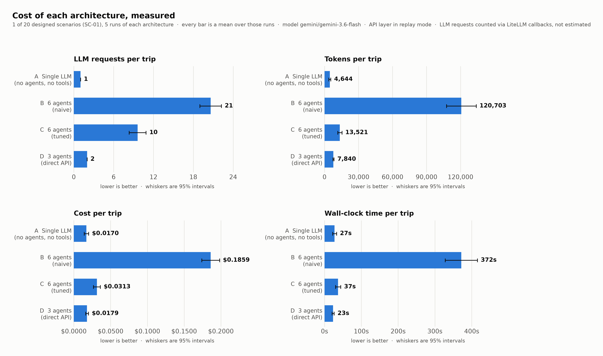
RESULT · COST
The retrieval layer is where the money goes
B 120,703 tokens → D 7,840. Same task, same data, same model.
Notes:
Naive six agents: 120,703 tokens and 20.6 model requests per trip. Three agents with Python retrieval: 7,840 tokens and 2.0 requests. The intervals do not overlap, which is why this is reported as a difference rather than as noise. Latency follows the same shape.

Slide 9
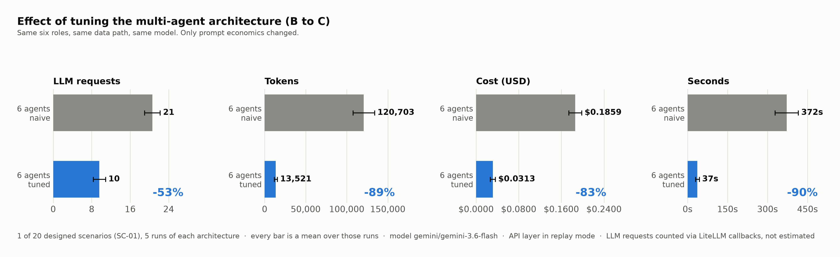
RESULT · TUNING VS ARCHITECTURE
Configuration is not the same as design
Tuning alone: 89% fewer tokens. Changing the architecture: 94%.
Notes:
This slide is the answer to the obvious objection. Cutting each agent's tool list from twenty slots to four, and its step budget down, took 89% of the tokens out without touching the architecture. So most of B's cost was configuration. The remainder — the part only the architecture change reaches — is the contribution being claimed.

Slide 10
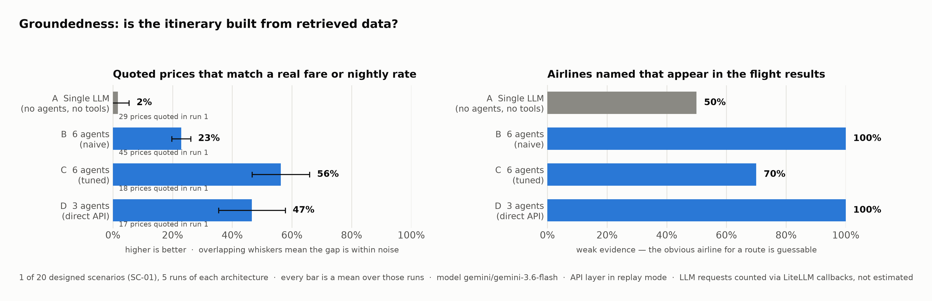
RESULT · GROUNDEDNESS
Cheaper, and no less real
Prices traceable to retrieved data — A 1.7% · B 22.9% · C 56.3% · D 46.6%
Notes:
The cost saving would be worthless if the plan got vaguer. A is the control and scores 1.7% — a fluent itinerary invented from nothing, which is exactly the failure this metric exists to detect. It caught a real one: the first end-to-end run produced a confident plan while every tool call was silently failing.

Slide 11
FINDINGS THAT WERE NOT FLATTERING
Two things I built do not do what I claimed
3/9
0.643
protocol conformance checks pass. Priority is declared, never honoured
Cohen's kappa on the budget gate. Moderate, not good
Both are reported rather than quietly fixed.
The gate misses 1 of 2 impossible budgets — recall 0.5, precision 1.0.
Notes:
6 of 9 conformance checks fail: message priority is declared and never honoured, and inbound permissions are never enforced. On the gate, precision is 1.0 and recall 0.5 — it never wrongly refuses a workable trip, and it misses half the impossible ones. Kappa 0.643 is moderate agreement. Saying so is the point; an evaluation that only confirms its author is not an evaluation.

Slide 12
RISK
The binding constraint was never difficulty
30
50
30
flight searches a month. One search costs two
hotel searches a month. Free tier, no top-up
responses recorded once, replayed for ever
Exhausting the quota is not a delay. It is a month-long stop.
Record-and-replay plus a hard live-call ceiling protected reproducibility — not breadth.
Notes:
Both allowances were fully spent during development. The controls were built before the arms were, and they worked: 30 committed responses mean a marker with no API keys can reproduce every number. What they could not do is create requests that were never made, so coverage of the cost comparison stayed at 1 of 20. Appendix N has the full register — three of the eight risks occurred, including the model being withdrawn mid-project.

Slide 13
THE ARTEFACT
A working planner, not only an experiment
8,591
393
12
2
lines in the system
tests, all passing
schema-validated tools
interfaces — terminal and browser
It refuses a trip it cannot afford, and says what would work.
Where a route has been recorded it uses the fare really quoted; where it has not, it says the figure is estimated.
Notes:
The feasibility gate is the part a user would notice. Ask for six nights in London on three thousand dollars and it declines, names the shortfall, and offers a shorter trip or a nearer city. It also distinguishes a measured price from an estimated one, because the price table was 52% below a real fare on the one route where both were known.

Slide 14
WHAT I WOULD DO DIFFERENTLY
The ordering mistake, and what it cost
Measurement last was the wrong order.
Six agents became three because instrumentation showed where the requests went. That evidence arrived after the architecture was built, so the pivot cost a rebuild.
Build the counter first, then the thing being counted.
Notes:
Honest answer to the likely question. The tool server came first because nothing works without it, then the message layer, then the agents, and the measurement infrastructure last. That ordering is why the first end-to-end run silently produced an ungrounded itinerary and nothing noticed. Reversed, the six-to-three pivot would have been a design decision rather than a rewrite.

Slide 15
CONCLUSION
A model earns its cost where a step
needs a judgement you cannot write as code.
Everywhere else it is a bill.
15x fewer tokens, no loss of groundedness, on 1 scenario measured 5 times.
Breadth is the gap. Everything needed to close it is committed and runs without credentials.
Notes:
Land on the claim and its limit in the same breath. The effect is large and the sample is narrow, and both are stated in the abstract. The cache, the harness and the scenarios are all committed, so the next person — or I, next month, when the quota resets — can widen it without rebuilding anything.

