Slide 1
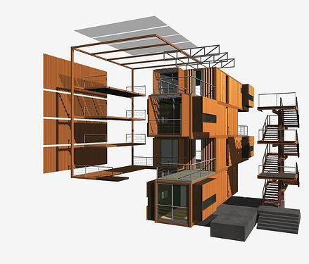

MODULAR CONSTRUCTION DEVELOPMENT OPPORTUNITIES

Slide 2
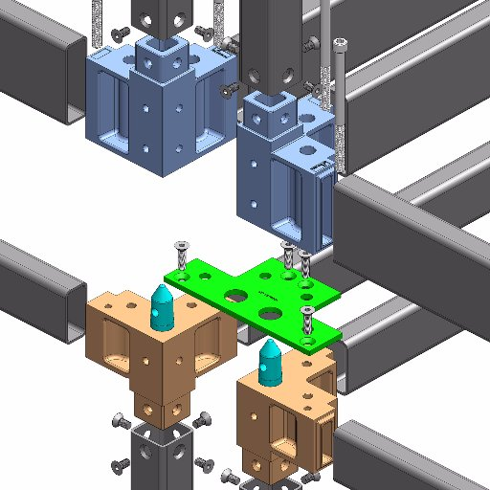
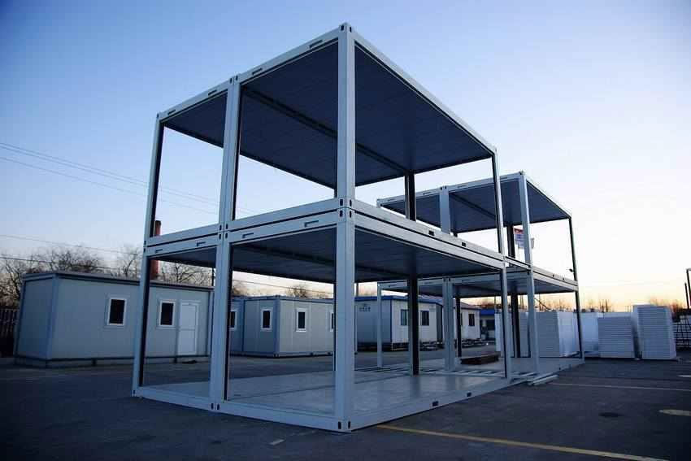
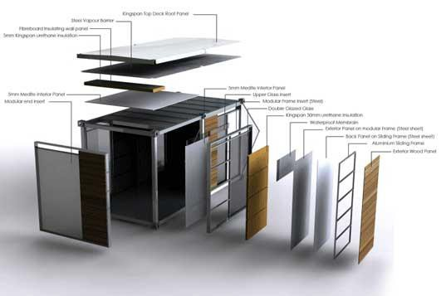
Core Structure
Exhibium has developed a core methodology applications that significantly improve
ROI and construction schedules.
Modular construction can deliver projects 20% to 50% faster than traditional methods. Exhibium has identified the following 2 fabrication and erection systems as viable alternatives for the projects being undertaken. A project’s specific requirements will determine the choice of modular system.
Existing Container structures
Pre-fabricated steel module cores
Custom fabricated structures w/ modular connectors
Modular Construction Apps
Copyright © 2017 Exhibium Group. All rights reserved.

Slide 3
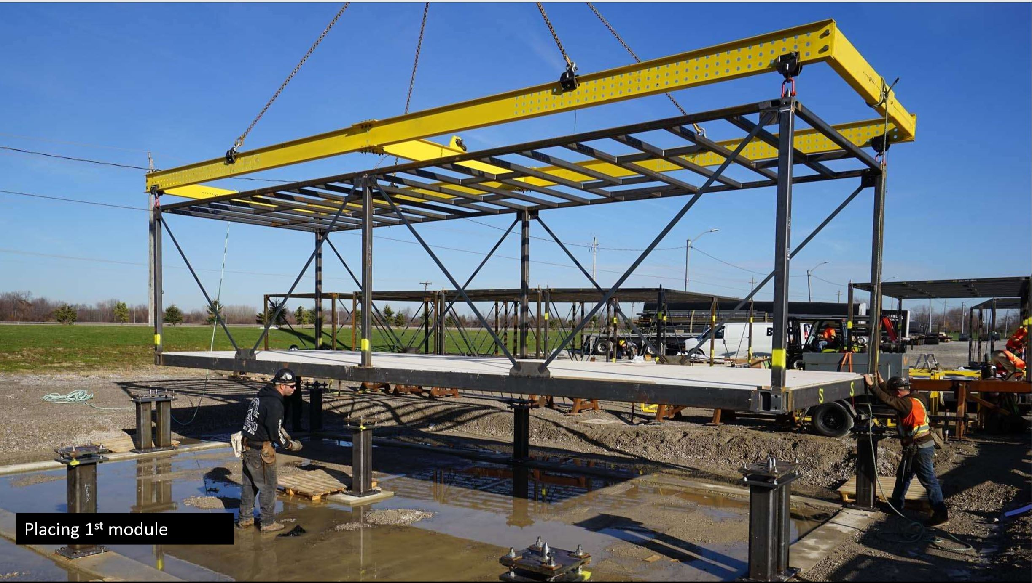
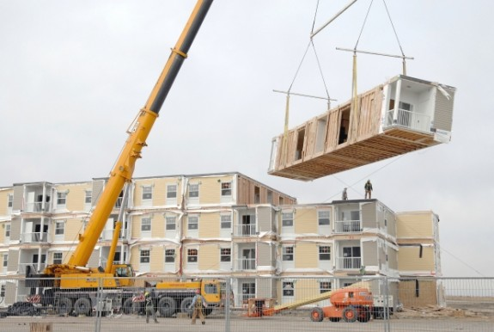
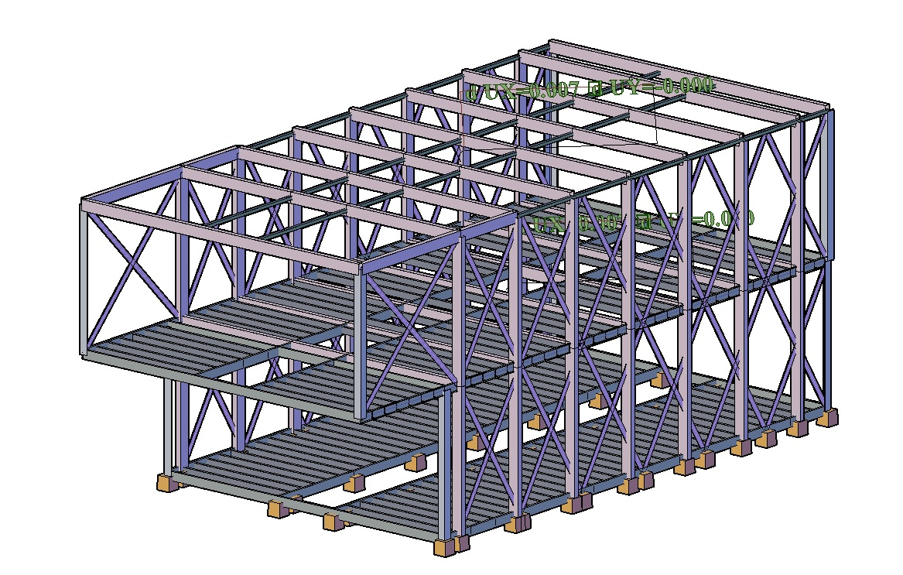
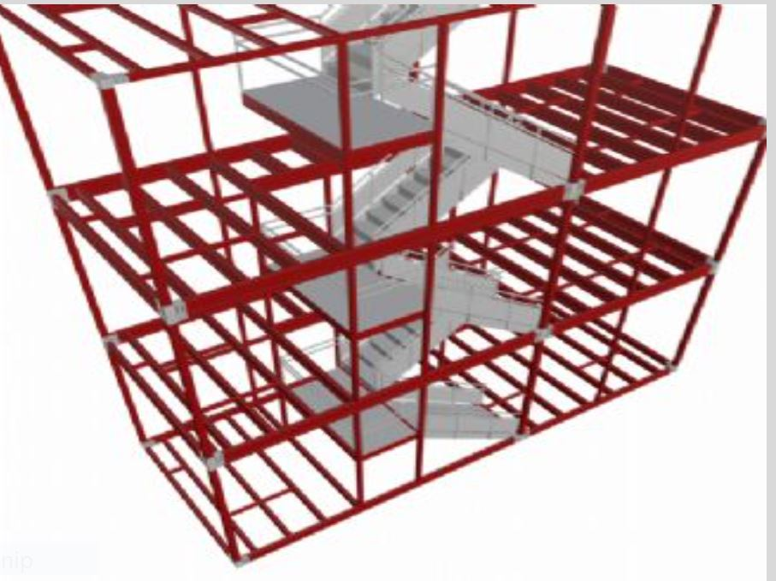
Erectors
Modular Construction Apps
Copyright © 2017 Exhibium Group. All rights reserved.

Slide 4
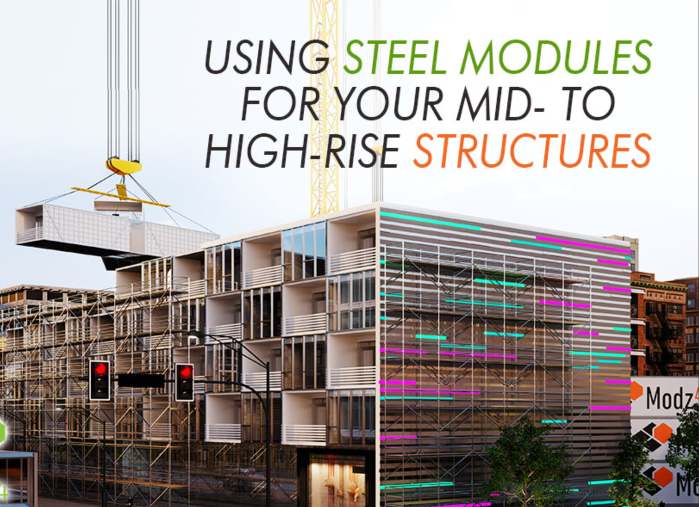
Current examples of MODULAR CONSTRUCTION projects

Slide 5
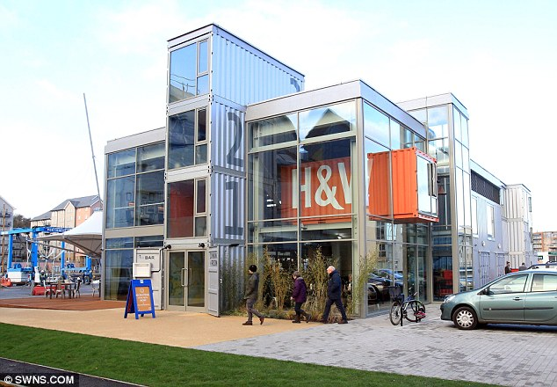
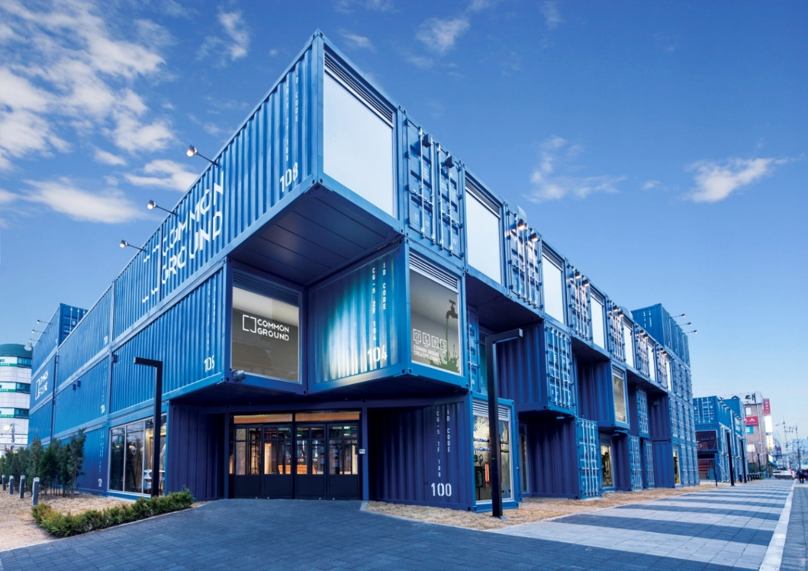
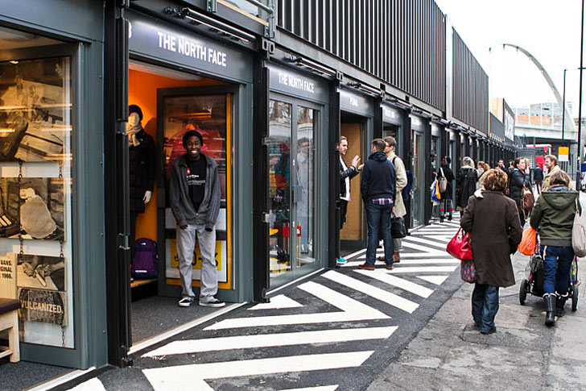
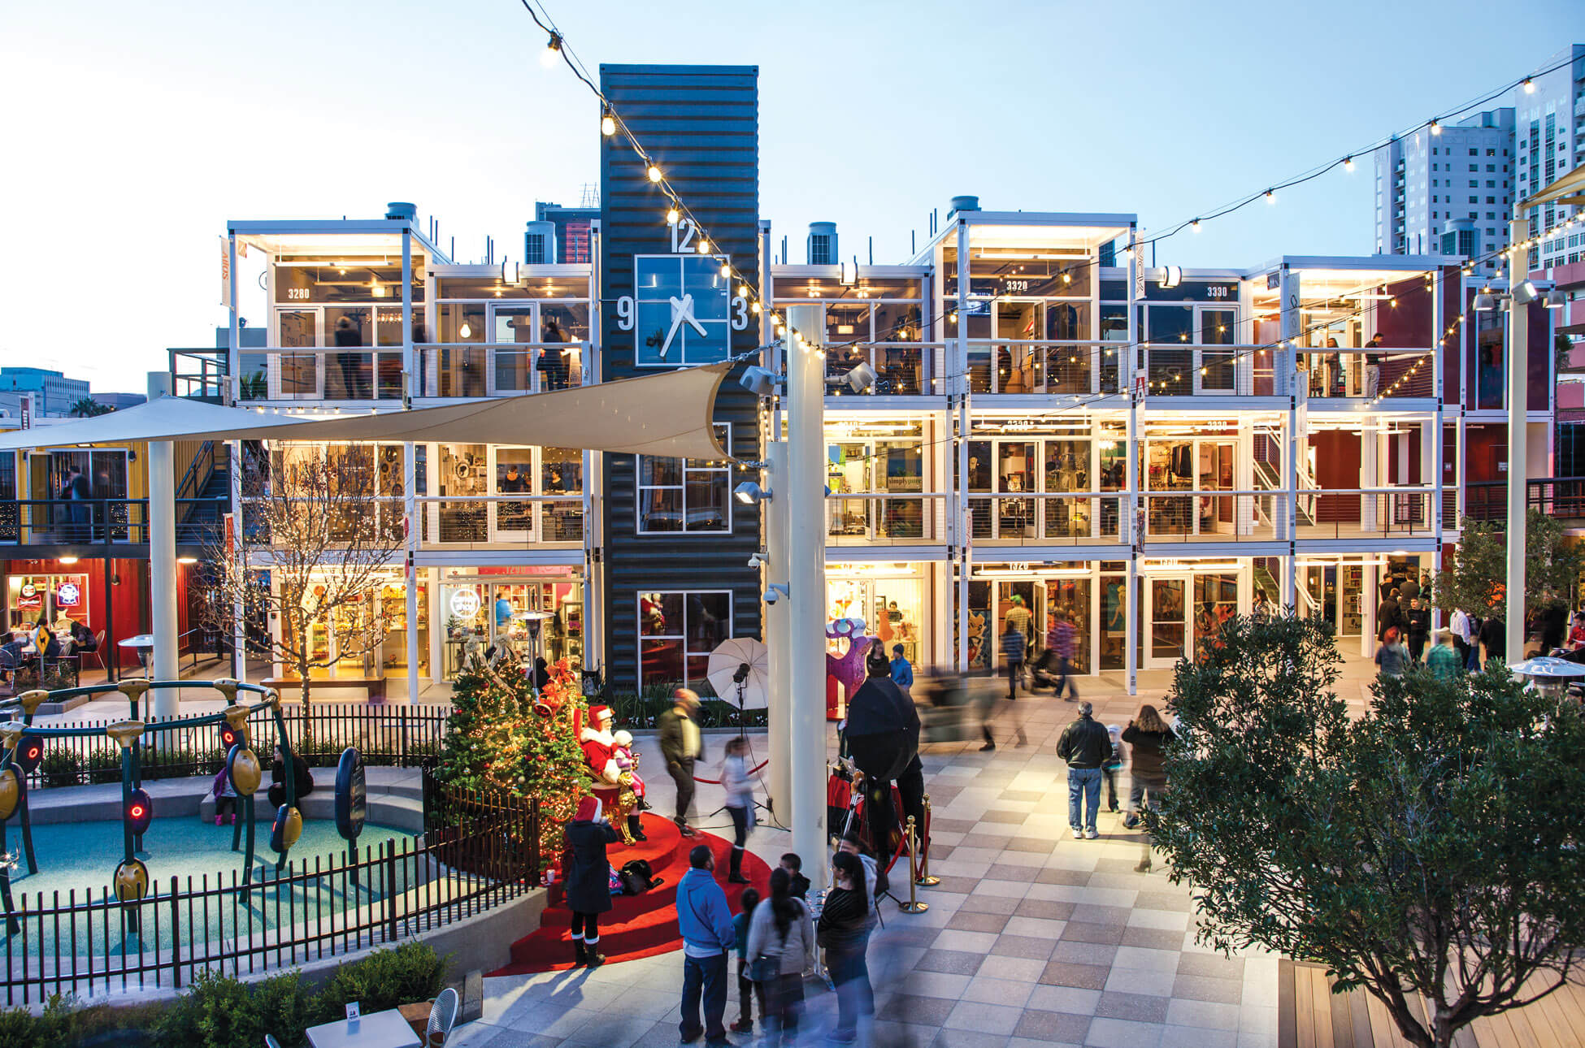
Strip Centers
Copyright © 2017 Exhibium Group. All rights reserved.

Slide 6
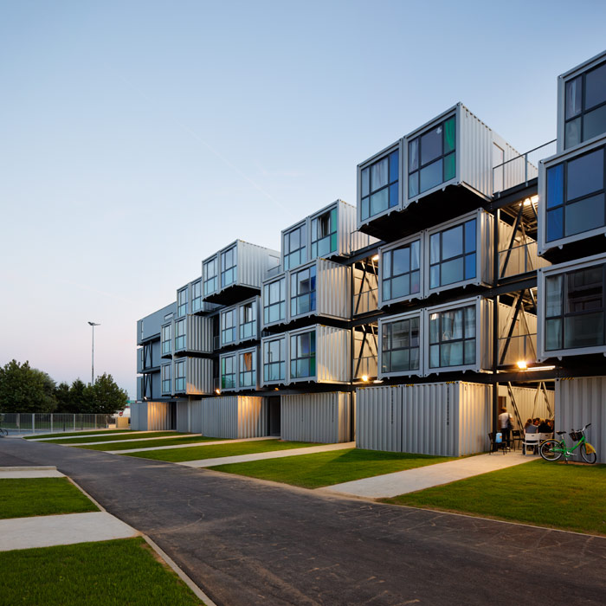
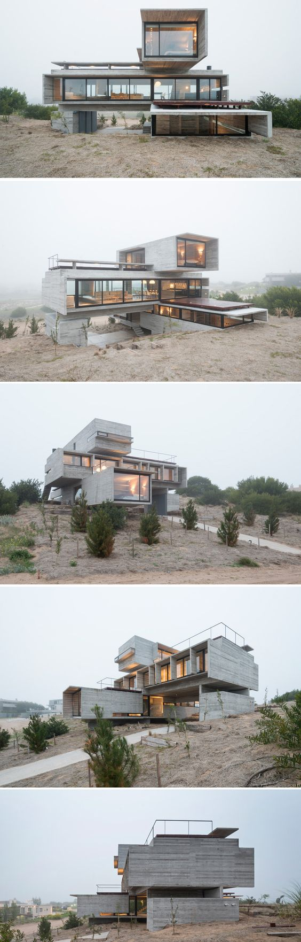
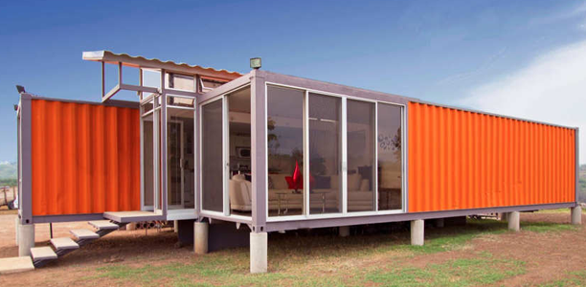
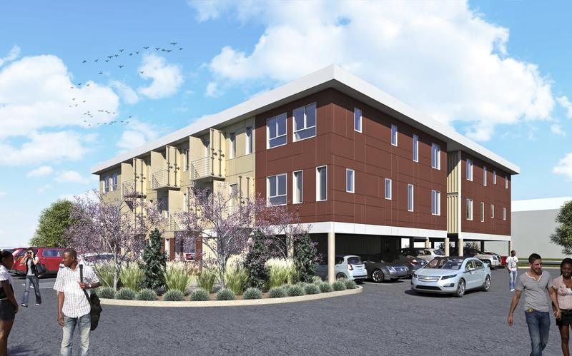
Housing
Multi Unit and Single family
Modular Construction Apps
Copyright © 2017 Exhibium Group. All rights reserved.

Slide 7
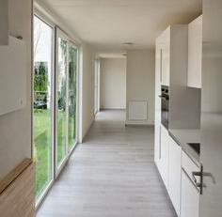
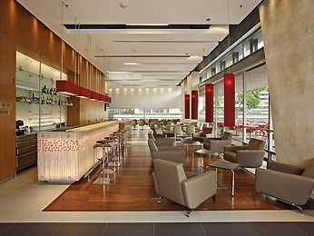
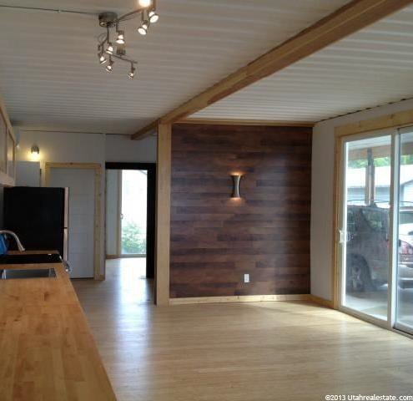
Interior Finishes

Slide 8
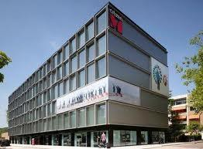
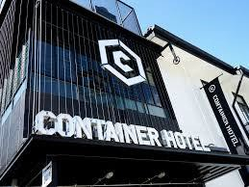
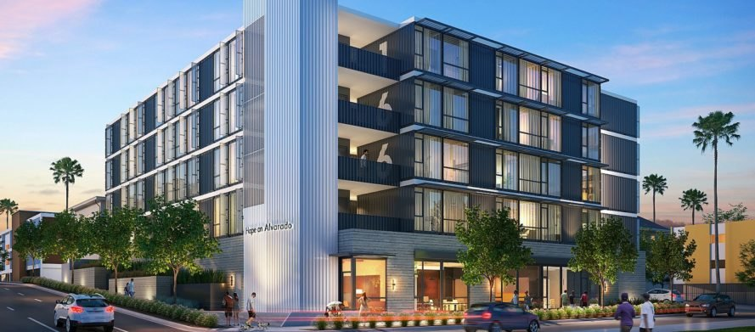
Commercial Hotel and Storage
Modular Construction Apps
Copyright © 2017 Exhibium Group. All rights reserved.

Slide 9
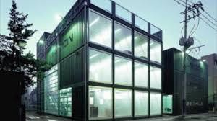
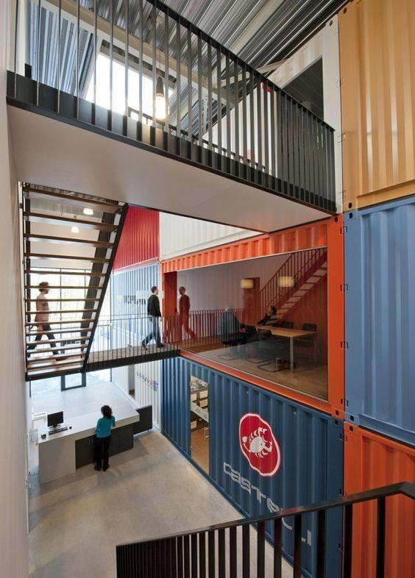
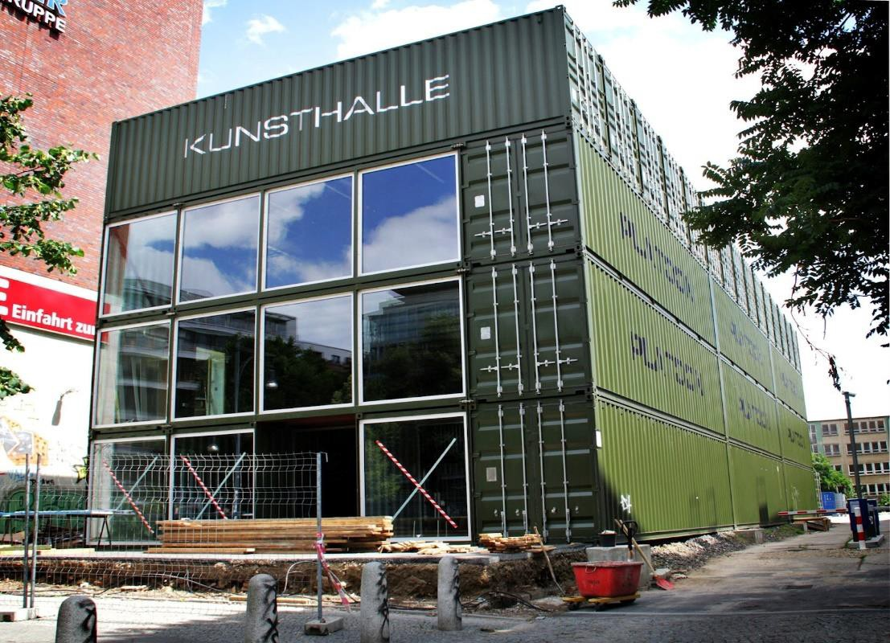
Office Parks
Modular Construction Apps
Page 9
Copyright © 2017 Exhibium Group. All rights reserve₉d.

Slide 10
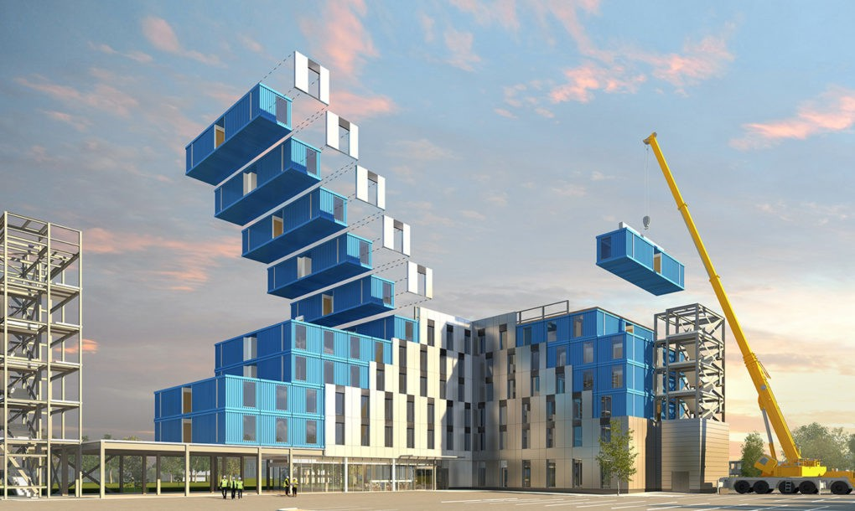
EXHIBIUM DESIGNS for MODULAR CONSTRUCTION projects.

Slide 11
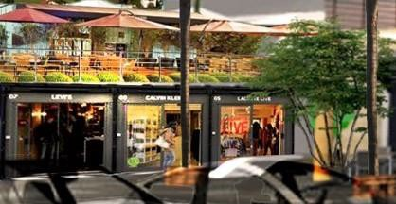
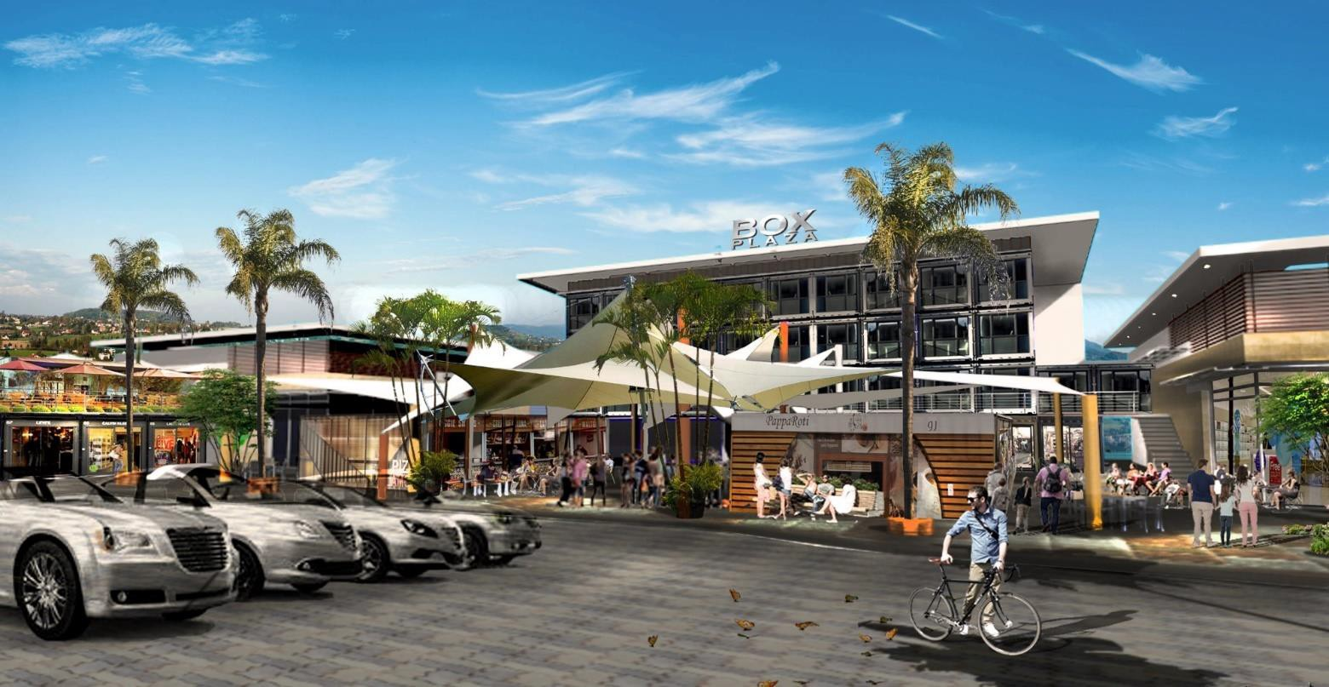
Exhibium DESIGN PROTOTYPES
USING MODULAR CORE STRUCTURES
Strip Centers
Page 11
Copyright © 2017 Exhibium Group. All rights reserved.

Slide 12
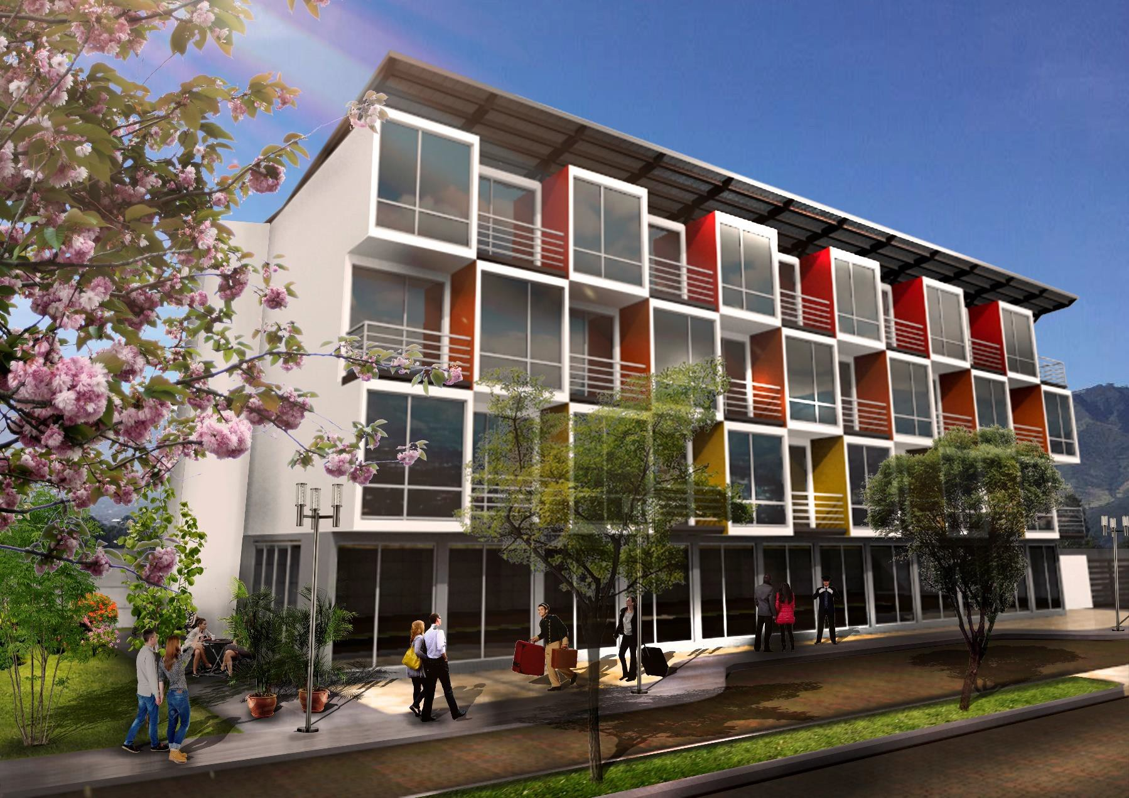
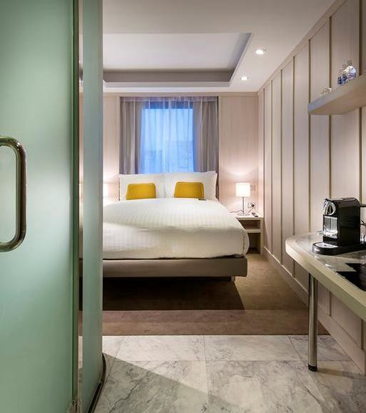
Exhibium DESIGN PROTOTYPES
USING MODULAR CORE STRUCTURES
Hotel and Student Dorms
Page 12
Copyright © 2017 Exhibium Group. All rights reserved.

Slide 13
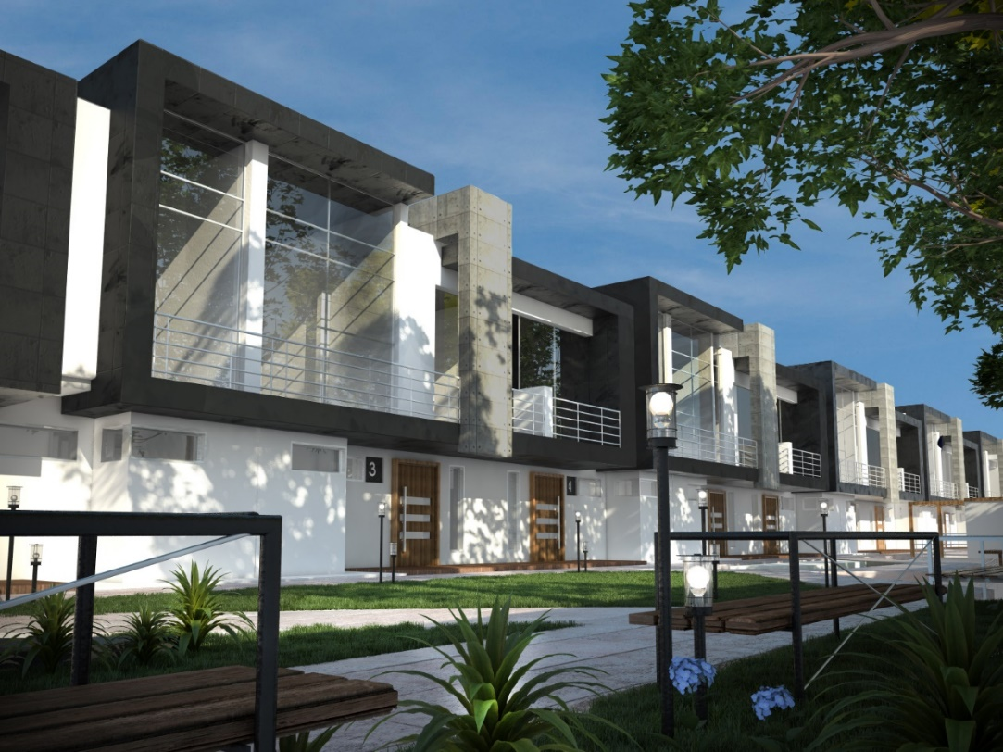
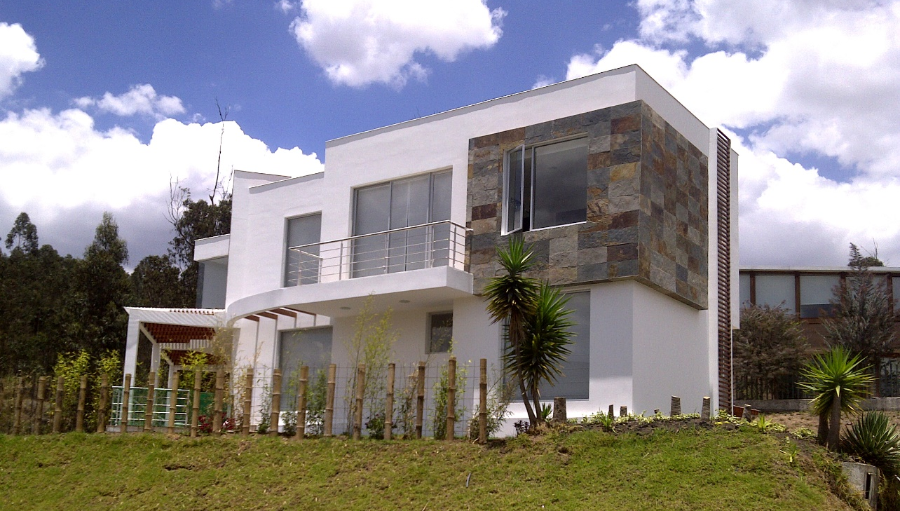
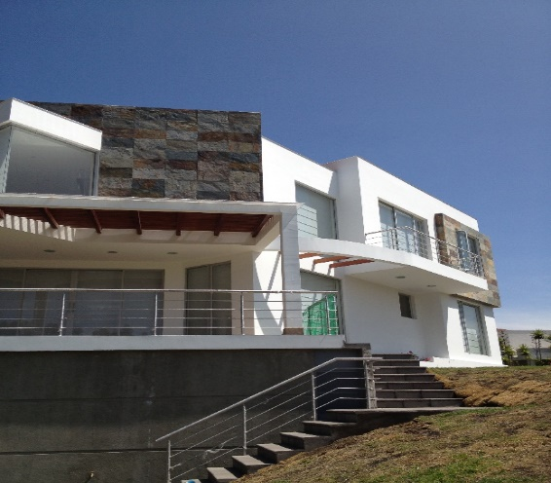
Exhibium DESIGN PROTOTYPES
USING MODULAR CORE STRUCTURES
Housing
Page 13
Copyright © 2017 Exhibium Group. All rights reserved.

Slide 14
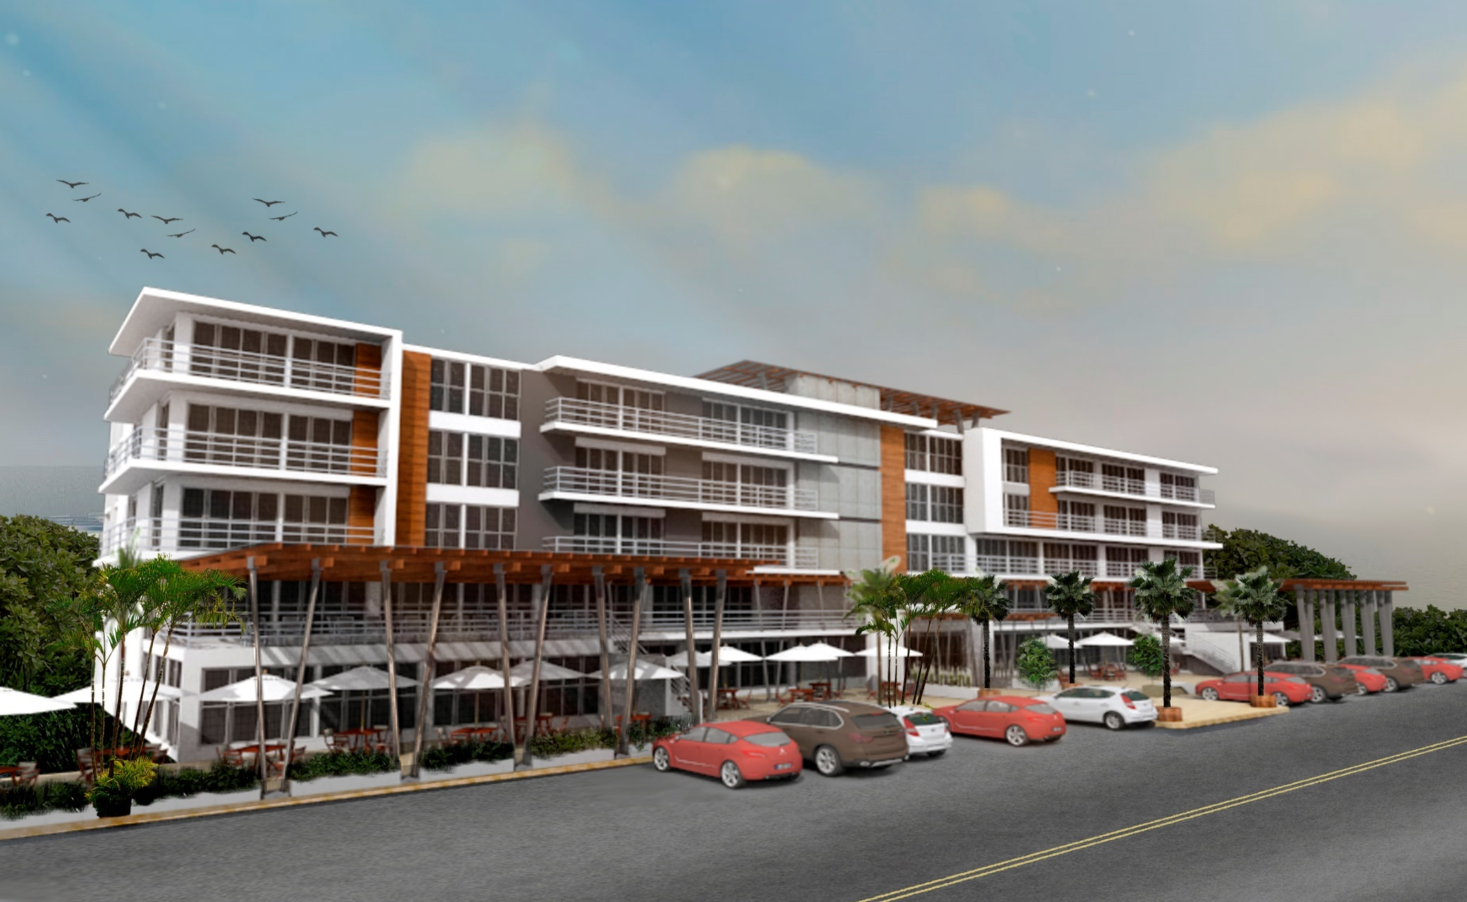
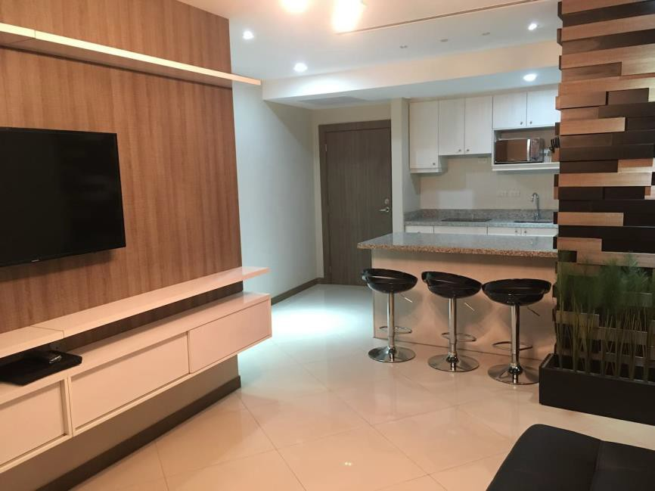
Exhibium DESIGN PROTOTYPES
USING MODULAR CORE STRUCTURES
Residential Condos
Page 14
Copyright © 2017 Exhibium Group. All rights reserved.

Slide 15
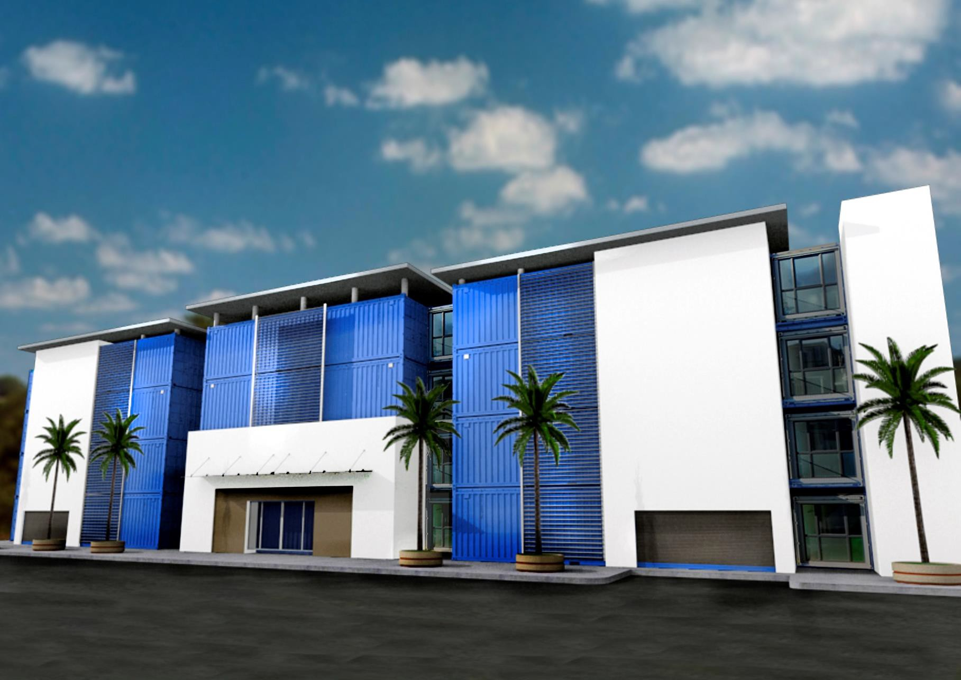
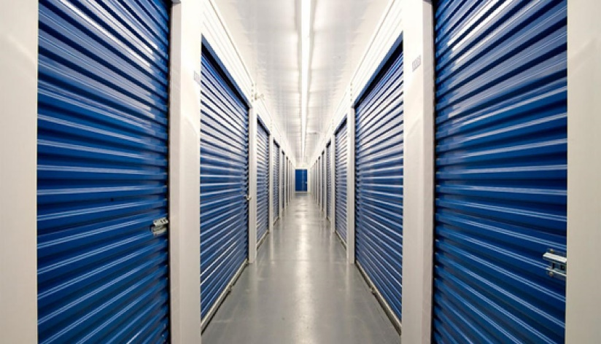
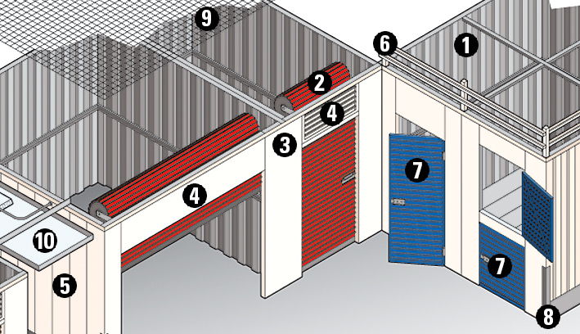
Exhibium DESIGN PROTOTYPES
USING MODULAR CORE STRUCTURES
Self Storage
Page 15
Copyright © 2017 Exhibium Group. All rights reserved.

Slide 16
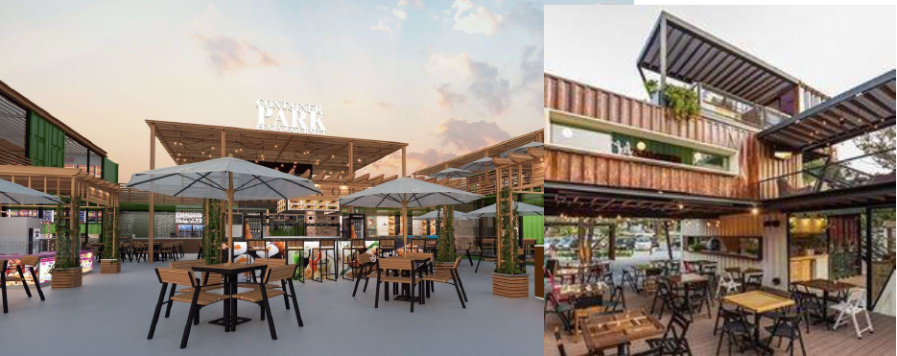
Exhibium DESIGN PROTOTYPES
USING MODULAR CORE STRUCTURES
Food Plaza
Page 16
Copyright © 2017 Exhibium Group. All rights reserved.

Slide 17
EXHIBIUM
LETS TALK

