Slide 1
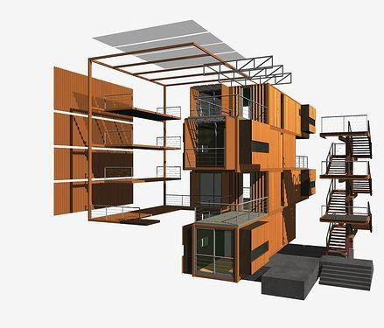
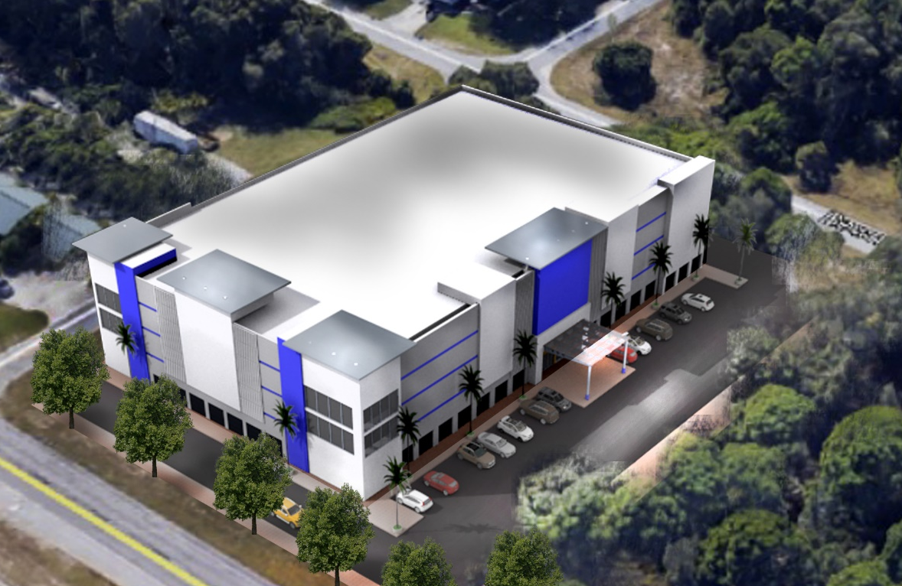


The better way to build…….
CFS Development Division Self Storage Experience

Slide 2
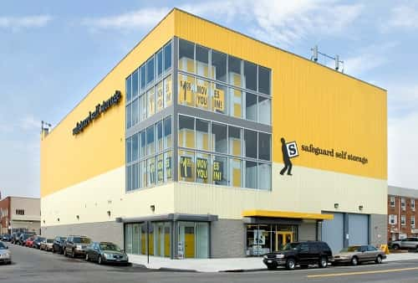
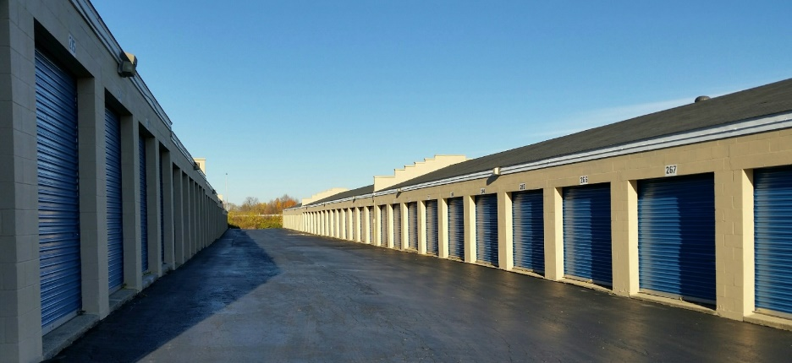
The Self Storage Business
As commercial property goes, self-storage has none of the sex appeal of a gleaming office building or a ritzy shopping mall. There are more than 50,000 self-storage facilities in the U.S.
But even though self-storage is about as unassuming an industry as you can get, it turns out to be a pretty solid investment, often better than other kinds of real estate.
Why? It is recession-resistant.
Secured rental income 90% Occupancy
Strong REIT involvement due to high yields
Strong demographic indicators for growth
Low capital outlay operation expenses
High ROI
New trends example
Old Style

Slide 3
References
Exhibium experience with Self Storage
CFS system built applications
Consulting Services
Proprietary Development projects

Slide 4
Brief…Cold Formed Steel (CFS)
CFS frame elements for building construction has become the biggest construction trend globally.........
The BETTER WAY to build. Major characteristics of the CFS method
Strength and ductility of structural cold-formed steel (CFS) framing, along with the holding power of CFS connections, make it the ideal material for construction in high wind speed and seismic zones.
Characteristics such as non-combustibility, dimensional stability can lower construction and home ownership costs.
CFS frames are eco friendly and 100% recyclable
Design/Manufacturing /Construction solutions
Overall construction time reduction for better ROI performance to investors.
Applications and Territories under development
USA - Self Storage and Multi Family Developments
Latam - Self Storage and Residential developments
Modular Construction Apps
Copyright © 2018 Exhibium Group. All rights reserved.

Slide 5
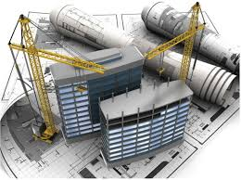
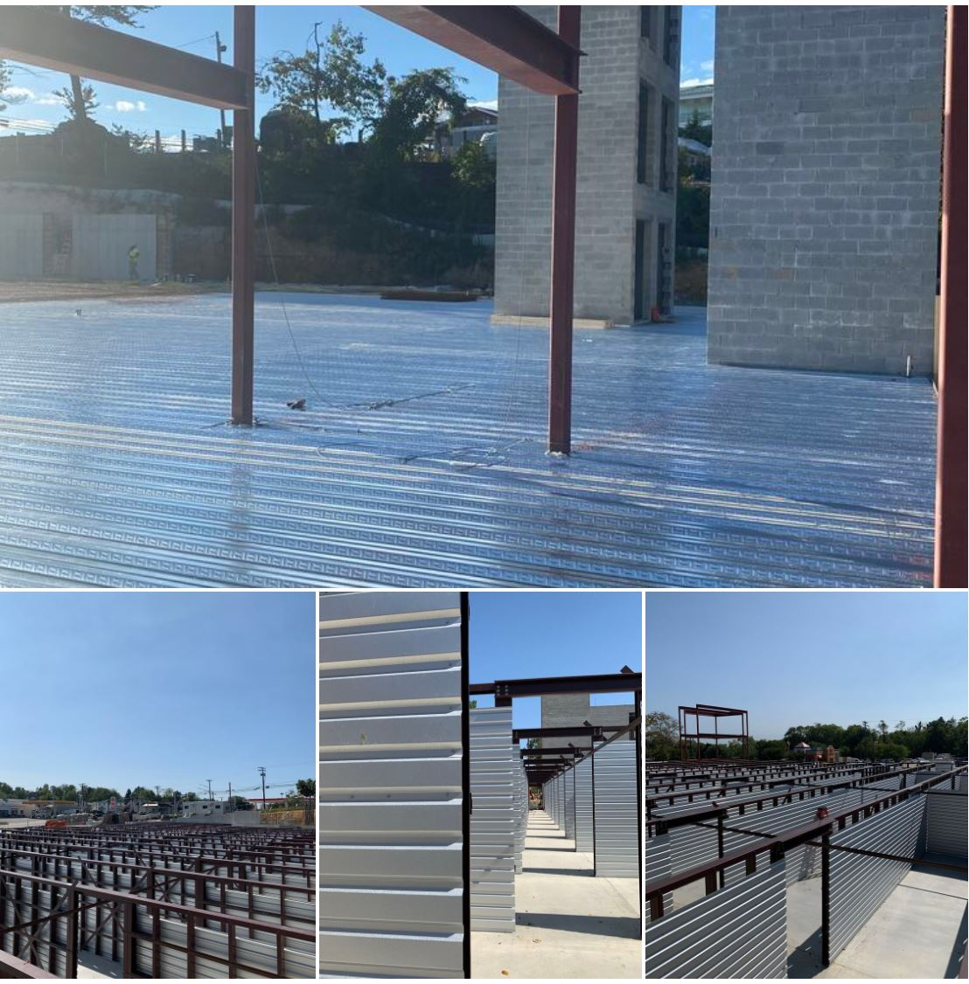
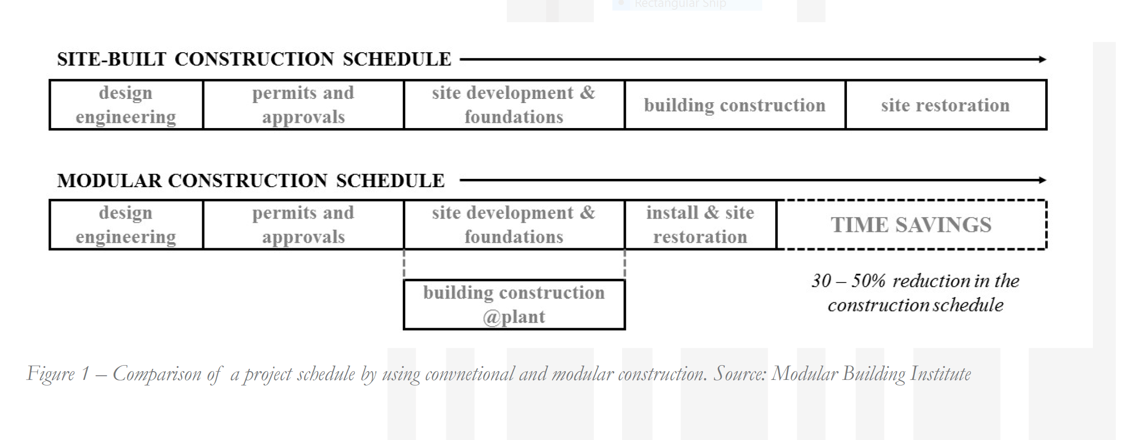
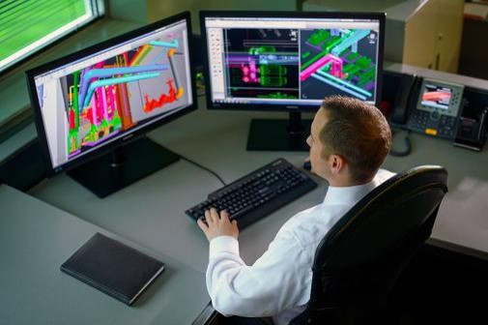
CFS BENEFITS
Project execution time savings.
Innovators in new green construction techniques:
Construction Cost savings.- Off site development
ROI focused sustainable development
Bim Modeling
Framing and MEP

Slide 6
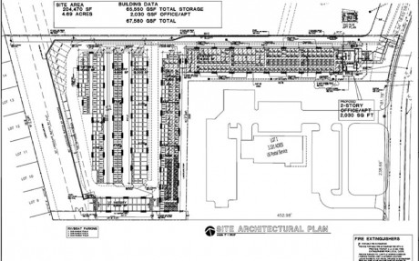
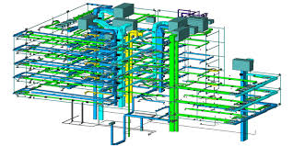
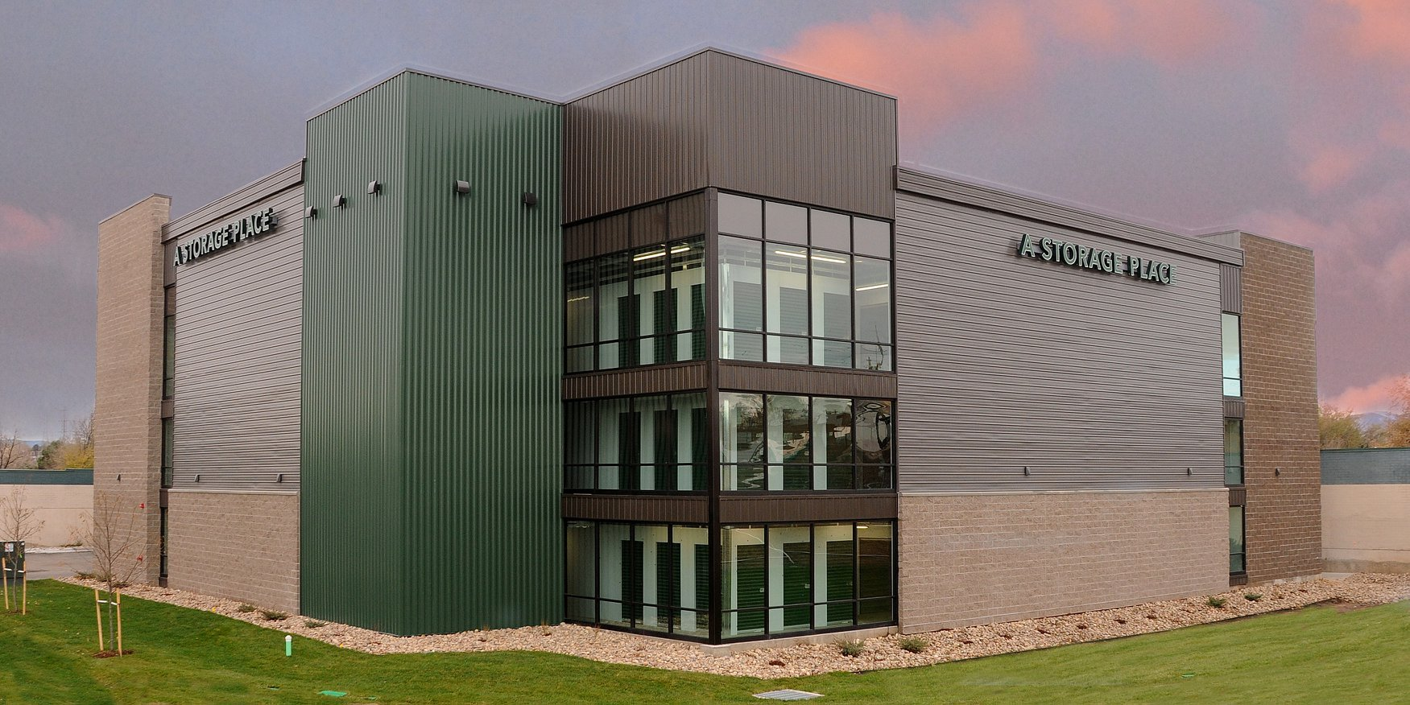
Consulting Services
Services provided in an advisory capacity
Concept Planning and Design
CFS system Built Applications
Pre- Construction Planning
Bim Modeling Services
Site Planning
Clients served:
USA consultancies
www.proselfstorage.com
www.thestorageacquisitiongroup.com
www.bmsgrp.com
LATAM consultancies
www.blueboxstorage.com.ar
www.patio.cl

Slide 7
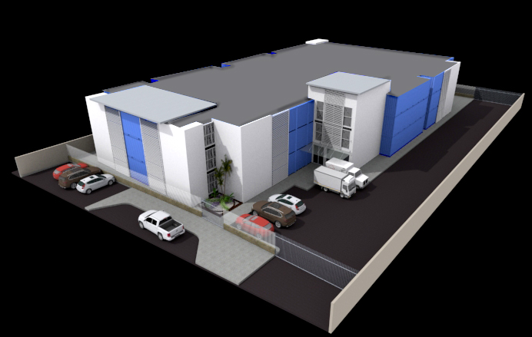
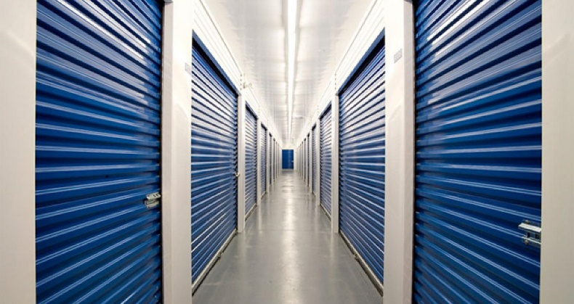
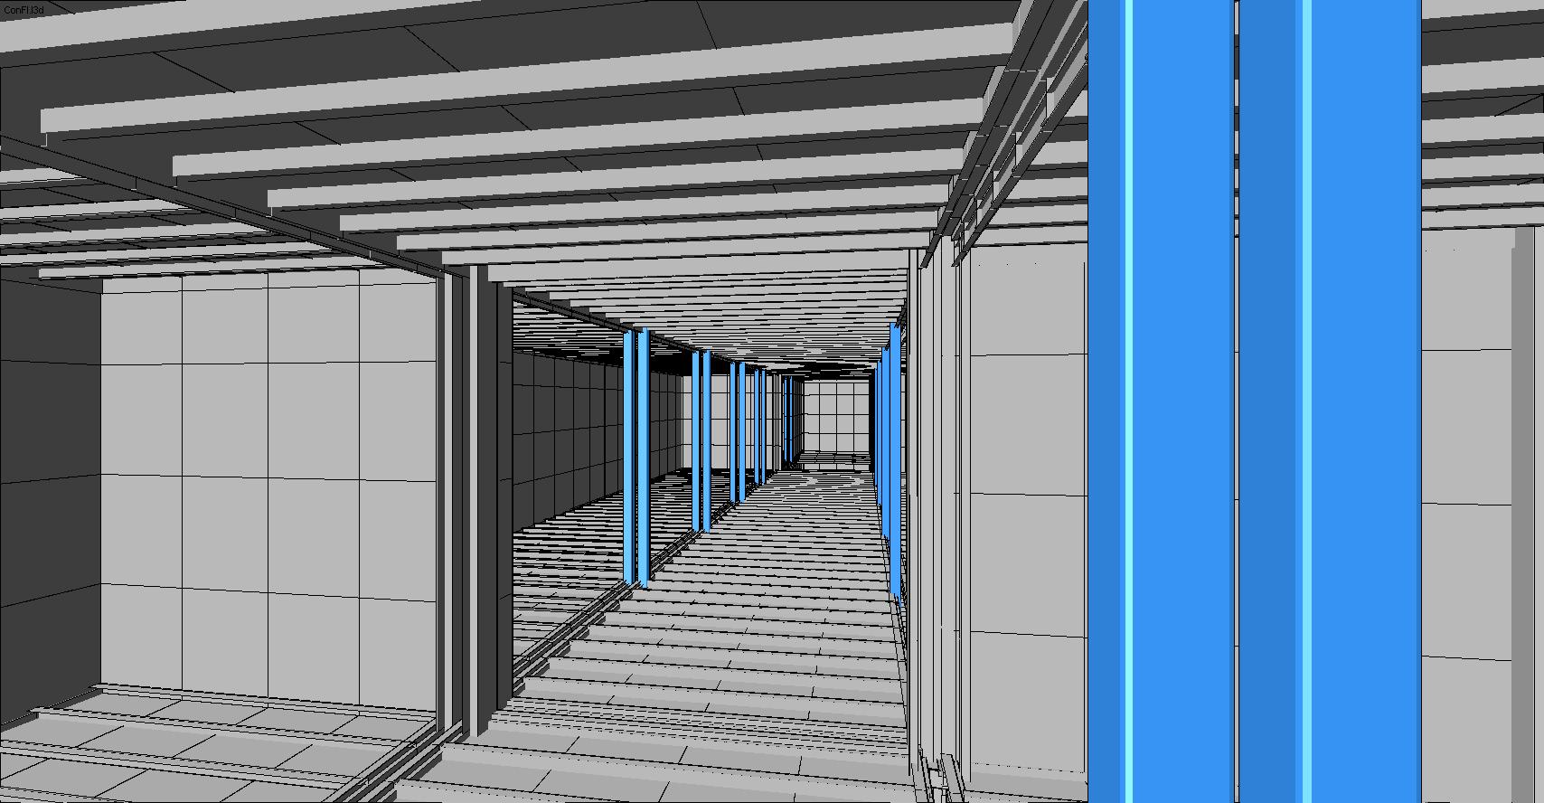
Exhibium Proprietary Development Services
Services provided :
Feasibility Studies
Site Planning
Environmental Studies
Plan Approvals
Architectural Design
Engineering services
Project Management services
Financials analysis
Equity Funding sourcing
Concept Planning and Design
CFS system Built Applications
Construction Documents
Construction Oversight services

Slide 8
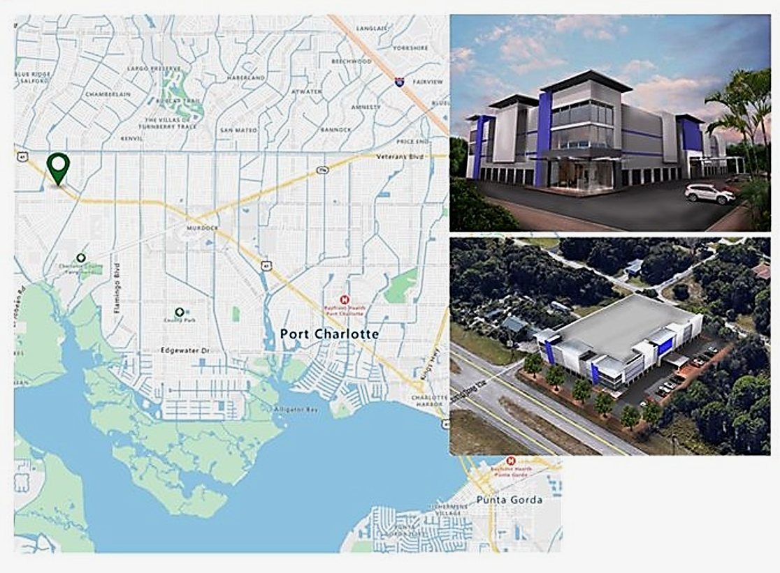
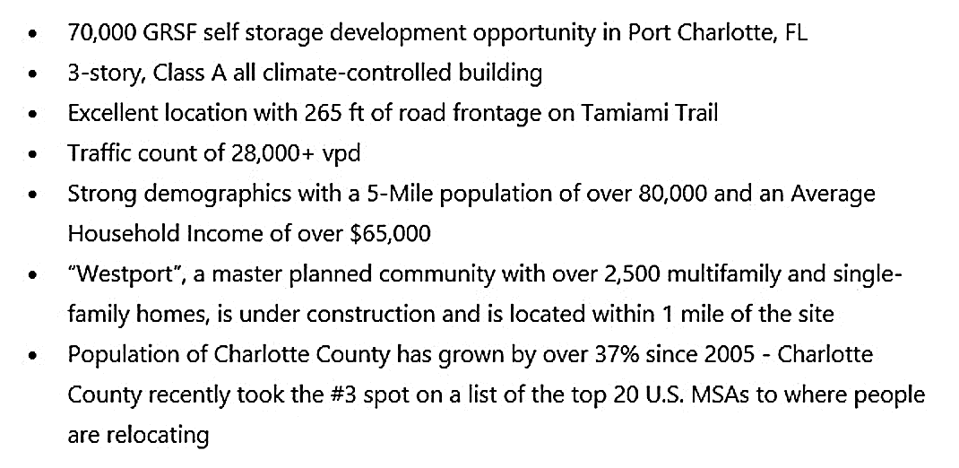
Current Exhibium Proprietary Florida Development

Slide 9
