Slide 1
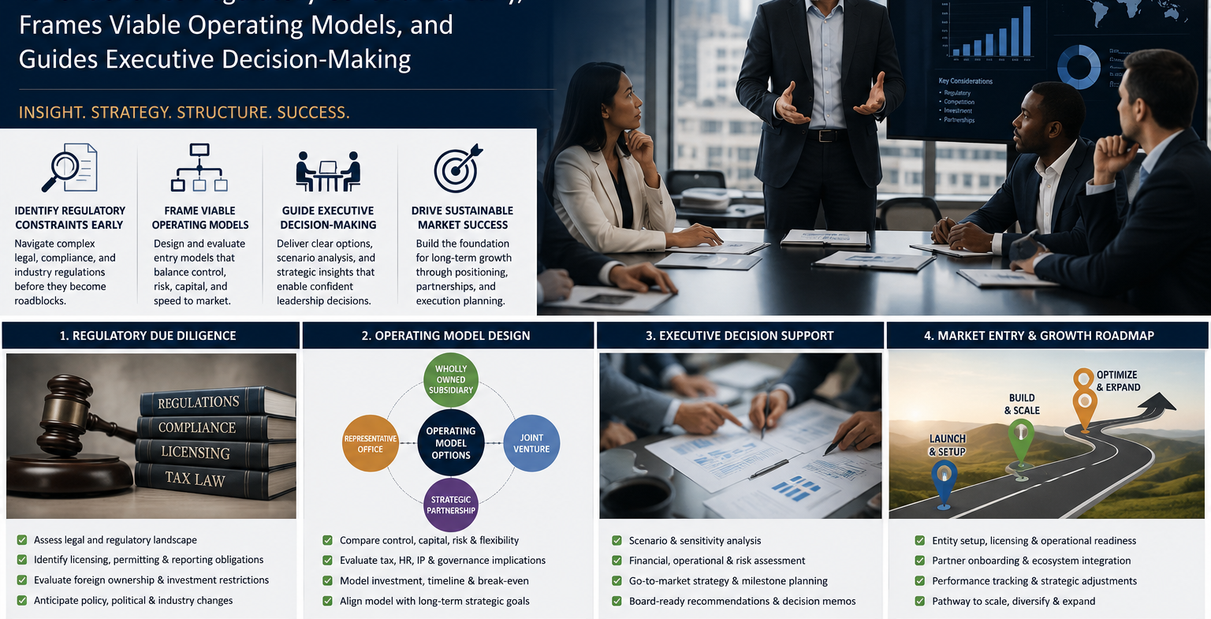

Slide 2

MARKETS/CLIENTS SERVED
USA and International based clients wishing to enter the USA, Latin America and the Middle East markets.
Retailers, developers, strategic advisory partners, self-storage, specialty building materials manufacturers, Non-profit foundations
LATIN AMERICA based clients and others wishing to enter USA markets and or expansion within Latin America
Retailers, Exporters
MIDDLE EAST based clients and others wishing to enter USA markets and Latin America.
Retailers, Investors
KEY OFFERINGS INCLUDE
SWOT analysis reporting
Marketing and Business Development Services
Brand positioning and promotional strategy
Creation of an initial business plan strategy for implementation of roadmaps
Introduction of potential business leads and partners
A/E/C services

