Slide 1
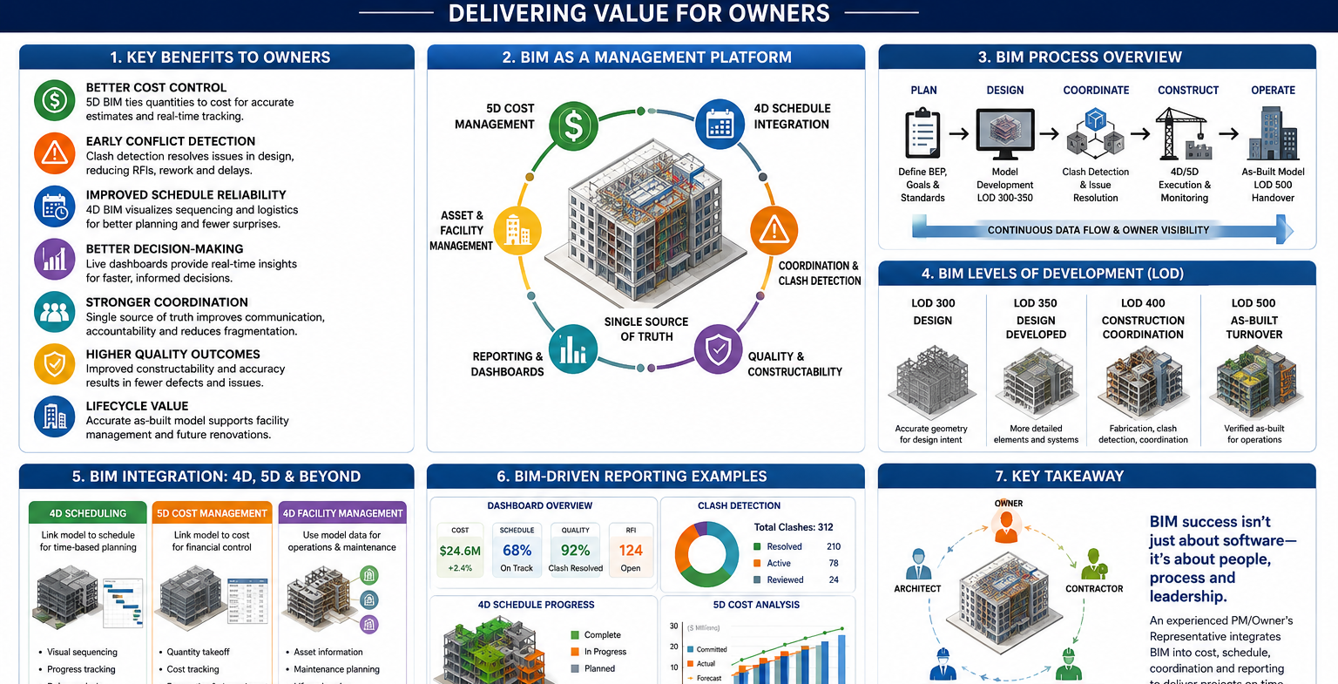

Slide 2
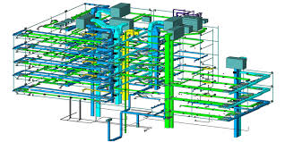
Critical Distinction: True BIM-Driven Management vs. “Using BIM”
The document emphasizes that many firms claim BIM capability without actually operating a BIM-driven management process.
Key Questions Owners Should Ask:
Who manages the BIM Execution Plan (BEP)?
Is 4D scheduling actively managed from the model?
Are quantities tied directly into cost tracking (5D)?
Who owns and controls the federated model?
Are BIM-driven reports issued directly to ownership?
Important Position:
The project management or owner’s representative team—not solely the architect or contractor—should maintain ownership and control of the integrated project model.

Slide 3
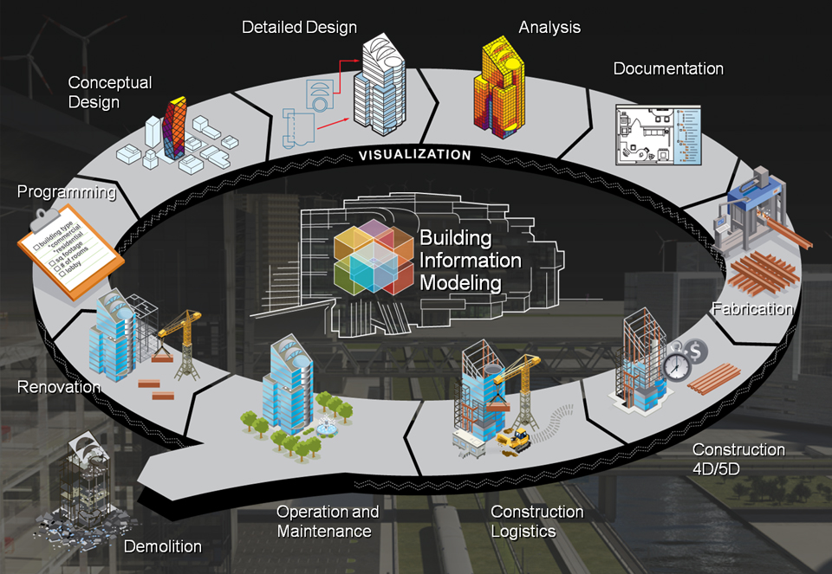
Executive Summary Highlights
BIM/VDC-Driven Project Management Services Prepared for PM Firms, Owner’s Representatives, and General Contractors
This document outlines the strategic and operational advantages of implementing a BIM/VDC-driven project management system where BIM serves as the core platform for project controls, coordination, scheduling, cost management, and owner reporting—not merely as a design visualization tool.
Key Strategic Benefits to Owners
1. Improved Cost Control & Reduced Financial Risk
Real-time quantity tracking and model-based estimating (5D BIM)
Better budget forecasting and visibility into scope changes
Significant reduction in change orders caused by coordination issues
Lower contingency exposure and fewer budget surprises
Owner Value:
More predictable project costs and tighter financial control throughout the project lifecycle.

Slide 4
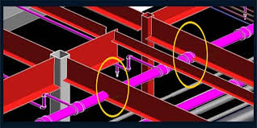
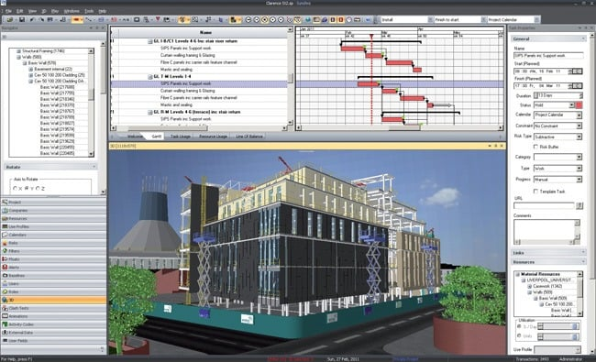
2. Early Detection of Design & Coordination Conflicts
BIM clash detection identifies conflicts before construction begins
Structural, architectural, and MEP issues resolved digitally rather than in the field
Reduction in RFIs, rework, delays, and field disruptions
Owner Value:
Major reduction in costly rework and schedule disruption.
3. Enhanced Schedule Reliability Through 4D BIM
Integration of project schedules directly into BIM models
Visualization of sequencing, logistics, phasing, and critical path activities
Ability to simulate delays and recovery strategies
Owner Value:
More predictable delivery timelines and proactive schedule management.

Slide 5

4. Real-Time Data & Decision-Making
Live project dashboards tied to cost, schedule, and progress
Scenario modeling for informed owner decision-making
Continuous project visibility instead of static reporting
Owner Value:
Faster and more informed executive decisions.
5. Centralized Coordination & Accountability
BIM becomes the “single source of truth” across all stakeholders
Improved communication among architects, engineers, contractors, and owners
Greater accountability and transparency in project execution
Owner Value:
Reduced fragmentation and smoother project delivery.

Slide 6

6. Higher Construction Quality
Digital coordination improves constructability and detailing
Reduced field errors and installation conflicts
More consistent project execution and quality assurance
Owner Value:
Lower defect rates and fewer post-construction issues.
7. Long-Term Lifecycle Asset Value
Delivery of accurate as-built BIM models (LOD 500)
Supports facilities management and future renovations
Asset-tagged equipment data enhances operations readiness
Owner Value:
Operational efficiencies extend well beyond construction completion.

