Slide 1
Usability Issues in Web Applications
Usability Engineering

Slide 2
Usability
Usability can be defined as “the extent to which a product can be used by specified users within a specified usage context to achieve specified goals effectively, efficiently, and satisfactorily”.
So one has to consider:
  Who are the product’s users?
  What are the product’s goals?
  In what context is the product used?
  Can the goals be achieved effectively (i.e., completely and exactly), efficiently (at a justifiable cost relative to the achievement), and satisfactorily?

Slide 3
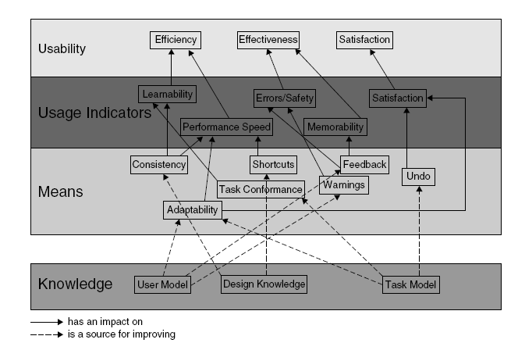
Layered Usability Model

Slide 4
Usability of Web Applications - Issues
Perception
  Layout of different elements should correspond to the mechanisms of human perception
Memory
  Capacity of human beings to remember is limited
  While surfing the Web, user needs to remember a lot of information
  With animations, banners and a lot of links it becomes difficult for the user to focus on the main task
Attention
  High level of animation/multimedia content is a source of distraction for the users

Slide 5
Design Guidelines
Response Times
  To ensure the feel of interactivity and active flow control the system must respond efficiently
  a system response time of 0.1 second is felt as a direct response
  waiting times of up to 3 seconds are acceptable without affecting the thinking process
  longer waiting times are perceived consciously (and normally unpleasantly).
    Response time of up to 3 secs is considered normal for Web Apps

Slide 6
Design Guidelines ..
Response Times
  Design ‘slim’ pages to reduce response time
  Reduce the no of images or use low-size formats for multimedia content (use thumbnails, or ALT text for images)
Interaction Efficiency
  The time user spends on navigation and input (form filling etc) is also important
  Minimise the distances to clickable elements
  Size of these elements should be good enough so that users can accurately click these items

Slide 7
Design Guidelines ..
Colours
  Avoid excessive use of colours
  roughly five colours are believed to represent the upper limit.
  Extreme hues, such as flashy or highly saturated colours, should be avoided.
Text Layout
  Reading on screen is not efficient
  Avoid fixed text layouts ( problems with resize of browser windows and font sizes)
  Avoid structures or patterns in the Web page backgrounds

Slide 8
Design Guidelines ..
Page Structure
  Avoid horizontal browsing
  menus and navigation elements, are best arranged on the left and upper page margins.

Slide 9
Design Guidelines ..
Navigation Structure
  The “getting lost in hyperspace syndrome” due to non-linear navigation has to be avoided at any cost.
  Provide a clear and logical basic structure, supported by a sitemap, constant feedback on the current position within the structure (“Where am I?”)
  Provide clear information about the content on the current page (“What can I do or find here?”)
  Give information about the items reachable in the next interaction step (“Where can I go?”)

Slide 10
Few more Practical Guidelines
Have a Consistent and Standardized UI
  keep it constant for all pages
  Be consistent, whether it’s
color scheme or
layout and order of elements
or anything else

Slide 11
2. Guide the user
The worst thing to a user is having to guess what to do next.

Slide 12
Guide the User
The worst thing to a user is having to guess what to do next.
Make it clear where to click to progress
Make the button or action area prominently displayed [if one action is more important than other]

Slide 13
3. Make (Call-to-Action) Interactive Objects Obvious
Make click and tap targets as large as possible
make the interactive objects big and obvious

Slide 14

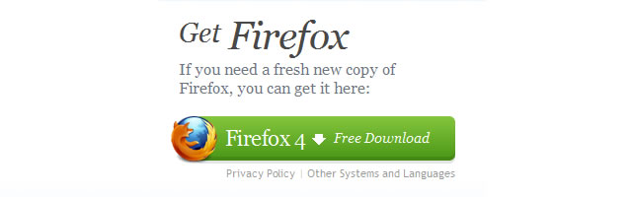

Slide 15
4. Give Feedback – Both for User’s Interacting and Progressing
Worst thing that can happen in a web app:
not knowing if your click or tap went through
Give visual feedback when a user is interacting, as well as the user’s progress if applicable.

Slide 16
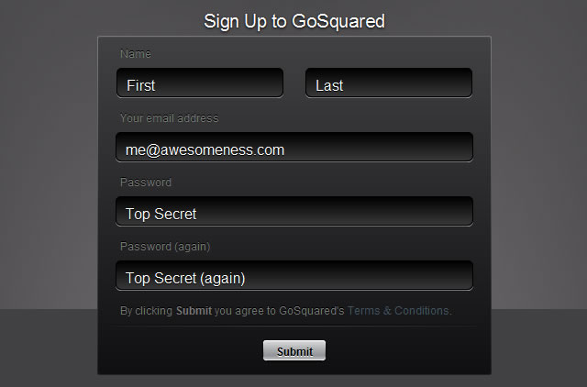
5. Never Have Users Repeat Anything & Keep Signup Info to a Minimum
Ask for any info only once
Avoid: Asking user to fill in lots of text-fields during sign up
  maximum of five or six fields

Slide 17
6. Always Have Default Values in Fields and Forms
Having a simple default value in a text field will push the user in the right direction
  “First name”, “Last name”, “Email address”, “Password”, “Country”, and so forth.

Slide 18
7. Explain How the Input Info Will Be Used
Make it as clear, comfortable and affirming as possible for your users by clearly explaining how any input info will be used
“Your email will be your login username”
“Your location will be used to deliver the info about events in your area”

Slide 19
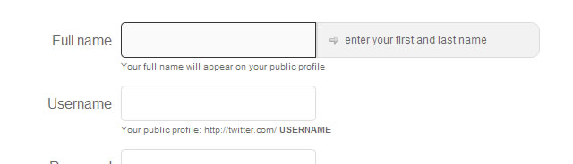
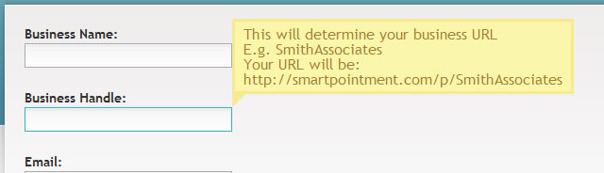

Slide 20
8. Don’t Have any Reset or Mass-Delete Buttons
A user never requires to delete all data and start again
    User will only fix one or few values
Avoid the accidental deletion/reset by not even giving users the option.

Slide 21


9. Have Clear and Explanatory Error & Success Messages
Related to tip #7
puts the user at peace and comfort with your web app
“Oops, something went wrong”
“Our database which holds your account info is temporarily inaccessible and will be back shortly”

Slide 22
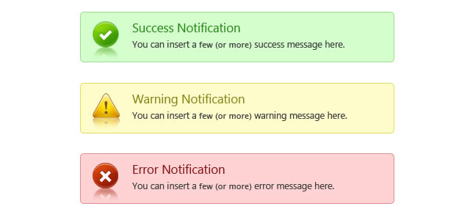

Slide 23
10. Include a Clear Visual Hierarchy and Navigation (Breadcrumbs)
make sure your layout and navigation is very clear
This gives the user a sense of where they are in your web app
Have clear ‘breadcrumbs’ at the top of the page which includes the visual hierarchy of where the user is navigation-wise
“*Main menu* > *sub-menu* > *settings*”

Slide 24
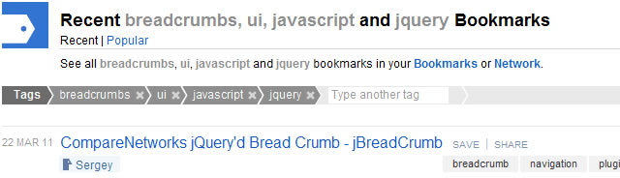

Slide 25
Methods to ensure Visibility of System Status in UI

Slide 26
4 Ways To Communicate the Visibility of System Status in UI
Visual feedback that shows user location or progress:
Visual feedback that confirms user action
Visual feedback that shows system status
Triggered events
https://uxplanet.org/4-ways-to-communicate-the-visibility-of-system-status-in-ui-14ff2351c8e8

Slide 27
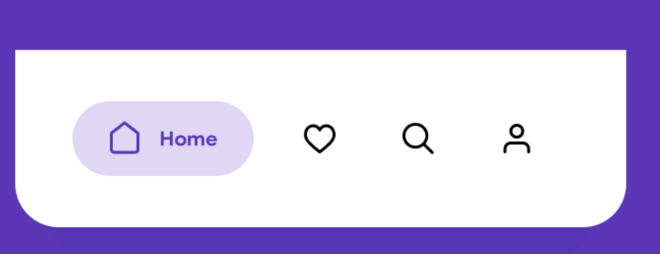
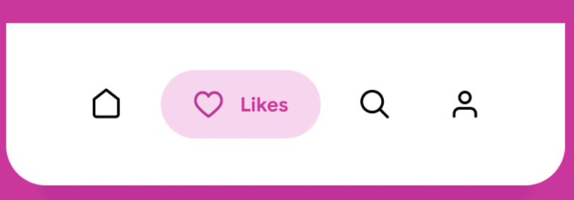
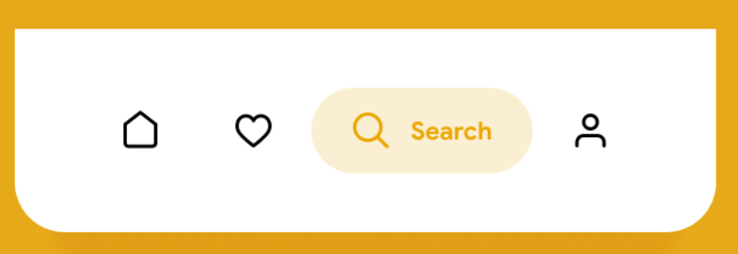
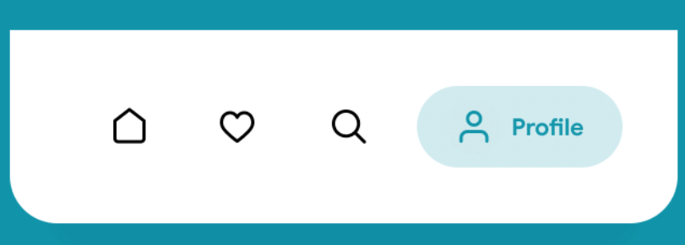
Visual feedback that shows user location or progress:
4 Ways To Communicate the Visibility of System Status in UI:POINT 1
Where I am
No one likes to be lost, but it happens both in real and digital worlds. Making users aware of where they are in the app is essential for creating good navigation experience. Both apps and websites should highlight the currently selected navigation option to help users understand their current location.

Slide 28
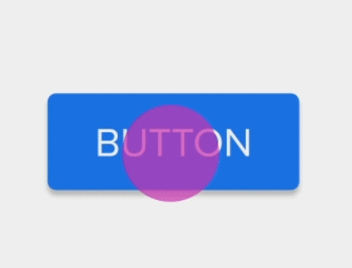
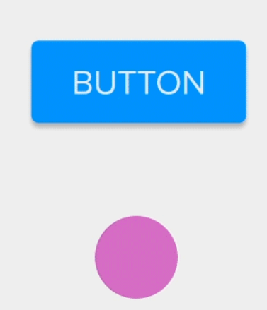
Visual feedback that confirms user action
4 Ways To Communicate the Visibility of System Status in UI:POINT 2
It’s vital to providing immediate feedback for all interactive events. Immediate visual feedback will acknowledge that the app has received a user’s action, reinforce the sense of direct manipulation, and prevent a user from making errors (such as tapping the same button twice).
In its basic form, it’s vital to show that the system actually caught the tap/click.

Slide 29



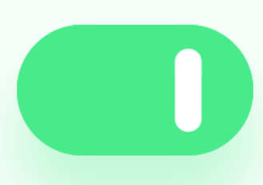
EXAMPLE 2:Turning something ON/OFF. The change in the color of the button gives users a signal about the current state of the object.
4 Ways To Communicate the Visibility of System Status in UI:POINT 2
EXAMPLE 1:Clicking on the Like button.

Slide 30
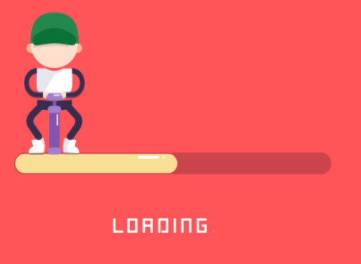

3.Visual feedback that shows system status
4 Ways To Communicate the Visibility of System Status in UI:POINT 3
Show the system is busy doing something by using progress bars
These indicators communicate that the system is working and reduce the level of uncertainty.

Slide 31


4.TRIGGERED EVENTS
4 Ways To Communicate the Visibility of System Status in UI:POINT 4
Example 1:Notifications/Indicators
The purpose of effective notification is to direct user attention to the fact of a new event. It’s recommended to use subtle animations for notifications because animated effects naturally capture user attention — the human eye is hardwired to focus on moving objects.

Slide 32
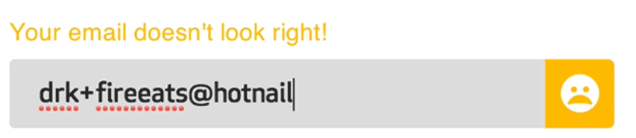
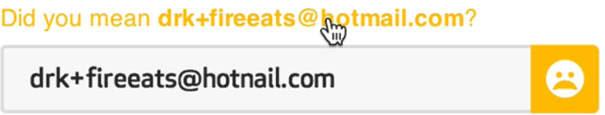
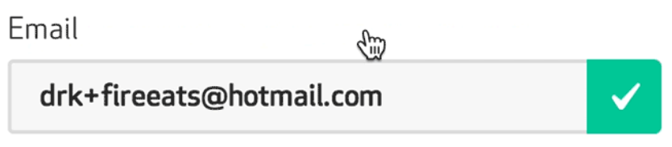
4.TRIGGERED EVENTS
4 Ways To Communicate the Visibility of System Status in UI:POINT 4
Example 2: Request for user actions
There are a lot of cases when a system might request data for user action. For example, when users fill out a form with invalid data. For example, a user creates a password and it’s not good in terms of complexity, provides an invalid email address, etc. It’s always better to tell users about the problem upfront, using appropriate visual feedback.

Slide 33
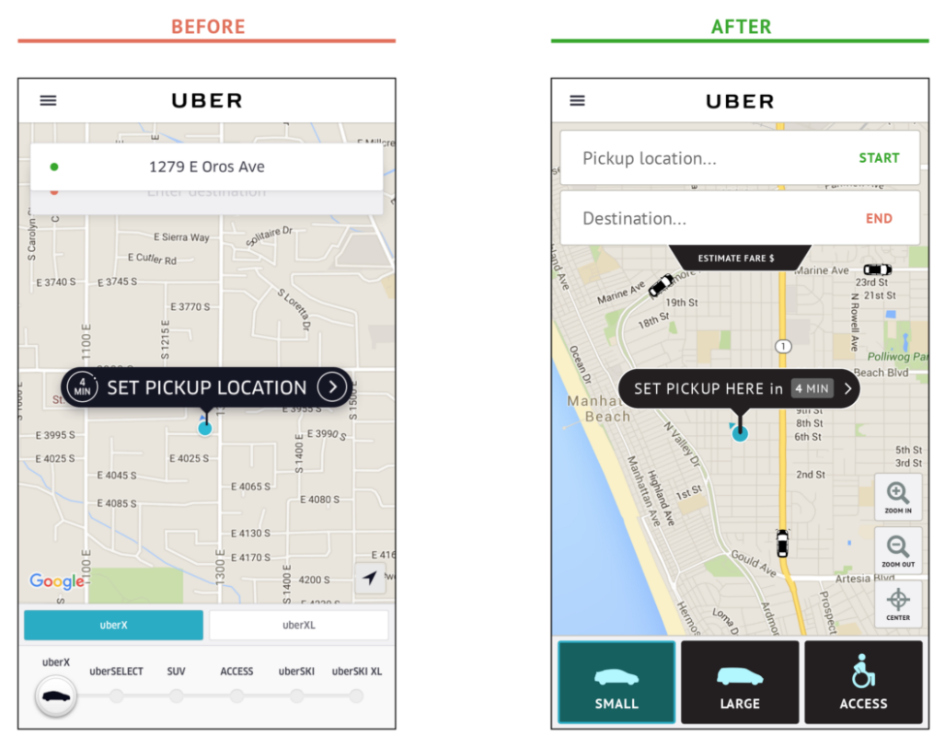
Uber for Seniors and Poor Visibility
https://blog.prototypr.io/uber-for-seniors-and-poor-visibility-dbaadca12a2a

Slide 34
ISSUES WITH THE UBER INTERFACE
As there are hundreds-of-thousands of people with poor vision, limited finger dexterity, or even just new users with a limited understanding of Uber’s complex business?
ISSUES:
Not respecting link color/convention
Ambiguous buttons
Extremely small font sizes
Overly dynamic interfaces (e.g. Destination input field)
Poor labelling

Slide 35
UBER INTERFACE ISSUES DISCUSSION
The destination input field is hidden, floating ambiguously behind the pickup location field, this UI makes no sense.
Gestural controls for zooming the map are difficult for people with poor finger dexterity. Let’s add zoom and center buttons with labels, so people know what they do.
Seniors are automatically price conscious, so they don’t need to know the difference between uberX and uberXL and the myriad other options, just give them the cheapest option. Make it simple.

Slide 36
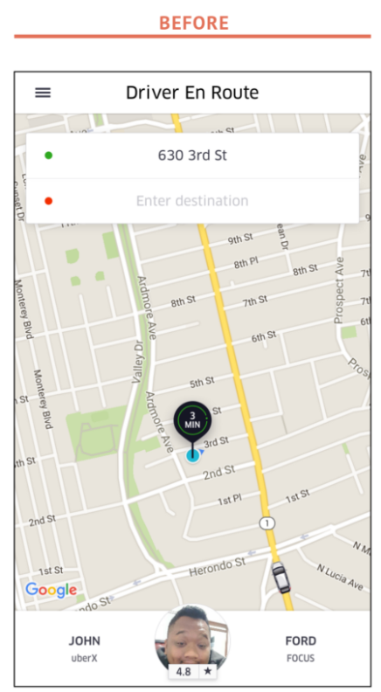
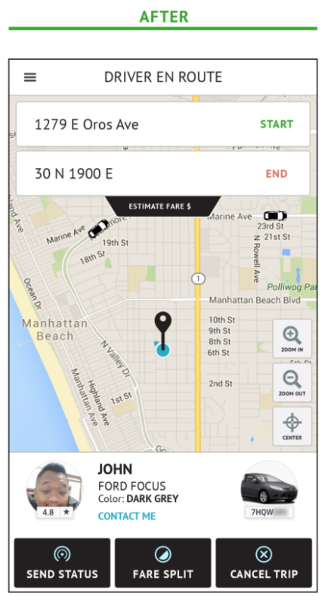
ENSURING VISIBILITY OF SYSTEM STATUS

Slide 37
Reference and Further Reading
Chapter 11
http://speckyboy.com/2011/03/31/10-essential-web-application-usability-guidelines/
http://www.uie.com/articles/usability_challenges_of_web_apps

