Slide 1


Slide 2
Word of Wisdom
Never Give up.

Slide 3
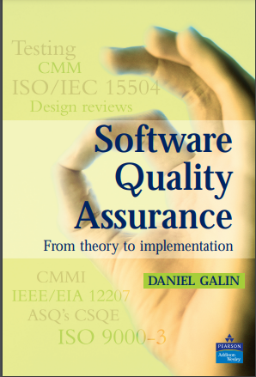
sOftware Quality Assurance
By:
Saira Hameed
Lecturer
Bahria University, Islamabad

Slide 4
Software Quality Assurance
LECTURE 11

Slide 5
Lecture 10 Revision
Why Test Software?
What Do we test?
Testing Factors
The V-Model Of Software Testing
The Test Plan
Testing Is A Process
Test Plan Terminology
Type of Software Tests

Slide 6
Test Design
Test design is a process that defines how testing has to be done.
It involves the process of identifying the testing techniques, test scenarios, test cases, test data, and expected test results.
Also, testers need to be specific about the test cases they create, such as providing specific inputs, steps, and test data for each test case.

Slide 7
Purpose of Test Design
Software testing, like all processes, is an investment and is considered successful when it provides an ROI.
To calculate the Return on Investment (ROI) of test automation, one must compare the benefits and costs of test automation over a period of time and express it as a percentage or a ratio. One of the most common and simple formulas to do this is ROI = (Benefits - Costs) / Costs * 100%.
To ensure, we are getting the ROI; it has to be tracked too.
One factor that will create an impact on the ROI, is the effectiveness of the test strategy.
An effective test design will largely dictate the effectiveness of the testing strategy, thus the ROI from the software testing process.

Slide 8
When to Create a Test Design
Test design should be created once the test conditions are defined, and adequate information is available to create the test cases of both high and low levels.

Slide 9
Why is Test Design Important for Test Automation?
Just as Test Design is important for an effective test strategy, a well-defined test design plays an important role in the success of test automation too.
It is a crucial activity that helps determine the effectiveness of automated test cases in identifying bugs and is highly essential for quality control and testing.
For the effectiveness of test automation, you also need to have a test automation tool that supports your goals. Thus, choosing the right test automation tool is vital, as also stated by a report that said: 26% of companies consider finding the right tools for automation testing as their biggest challenge.

Slide 10
How Is Test Design Done?
Test design is done using several test design techniques. The following is a list of some of the top design techniques,
  Equivalence Class Testing
  State Transition
  Exploratory Testing
  Boundary value analysis
  Pairwise test design
  Error guessing test design

Slide 11
Test Design Techniques
1. Equivalence Class Testing
Equivalence class testing, also known as equivalence class partitioning, is a test design technique that lets you partition your test data into equivalent classes or sections.
It aims to reduce the number of test cases required to test a product by dividing the input domain into a set of equivalence classes. You can use this whenever an input field has a range like age.
Example:
Consider a gaming website has a form that requires users to enter their age. And the form specifies that the age has to be between 18 and 60. Now, using the equivalence class partitioning technique, you can divide the input range into three partitions, as follows,
1 to 17 (invalid)
18 to 60 (valid)
>60 (invalid)
By partitioning the input range into equal partitions, you can create test cases that cover all possible scenarios. This way, you can easily make sure that your form is working correctly without testing every possible number between 18 and 60.

Slide 12
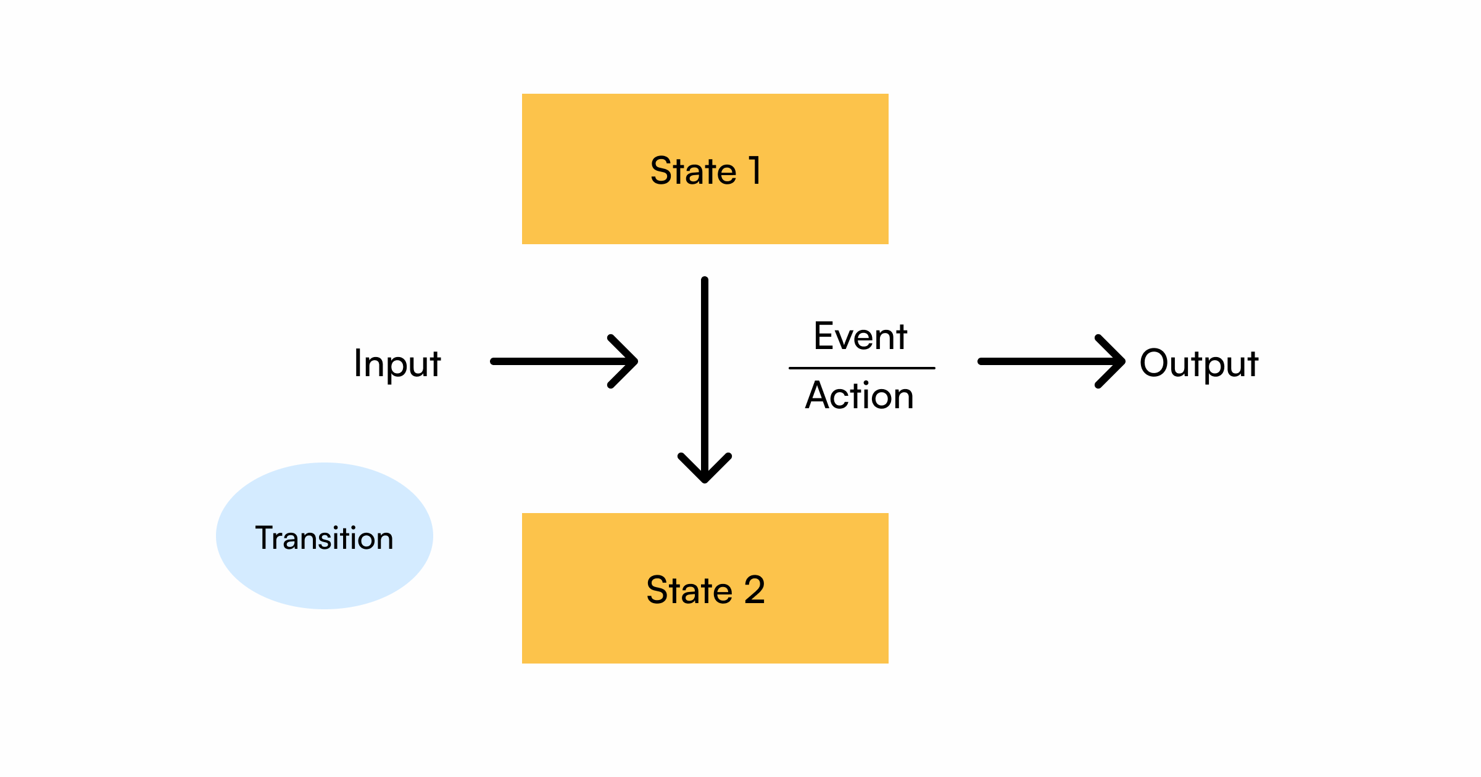
Test Design Techniques
2. State Transitioning
It is a type of black box testing that is performed to check the change in the application’s state under various inputs.
This testing is used where different system transitions have to be tested.

Slide 13
Test Design Techniques
2. State Transitioning
State Transition Diagram Above is a state transition diagram that needs to be tested, it depicts how a system’s state changes on specific inputs. The four main components for a state transition diagram are as follows:
  States
  Transition
  Events
  Actions
State transition testing helps understand the system’s behavior and covers all the conditions. Let’s try to understand this with an example.

Slide 14
Test Design Techniques
2. State Transitioning
Example:
Consider a bank application that allows users to log in with valid credentials.
But, if the user doesn’t remember the credentials, the application allows them to retry with up to three attempts.
If they provide valid credentials within those three attempts, it will lead to a successful login.
In case of three unsuccessful attempts, the application will have to block the account.

Slide 15
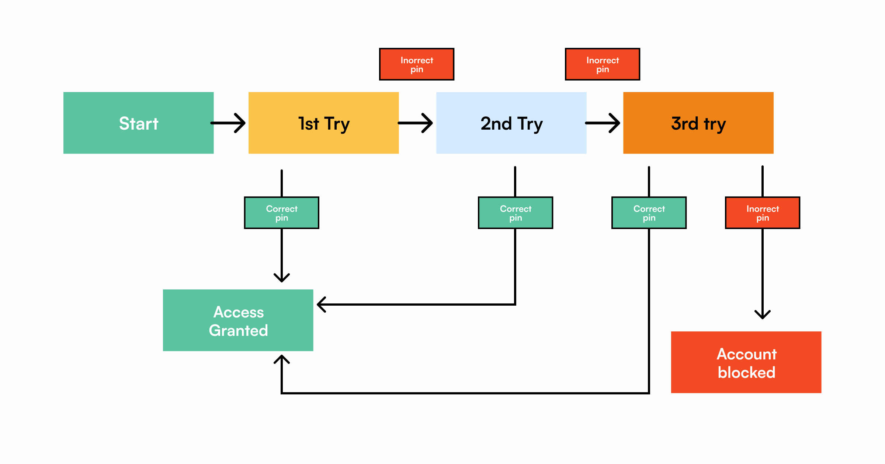
Test Design Techniques
2. State Transitioning
The below image will explain this scenario in a clear way.

Slide 16
Test Design Techniques
3. Exploratory Testing
Exploratory testing is primarily used in Agile methods and involves outside-the-box thinking.
This process does not follow pre-defined test cases but instead involves testers using their knowledge, skills, and creativity to identify issues that may not have been expected by developers.
During exploratory testing, the tester will explore the software application in an unstructured way, creating and executing tests on the fly.
The goal of this testing is to uncover bugs that may have been missed by other traditional testing methods.

Slide 17
Test Design Concepts
As a software tester, there are several test design concepts that you must be familiar with to create effective test cases.
Here are some of the most important test design concepts,
Test Automation Pyramid
Test Automation Pyramid is a testing framework that helps developers and testers to build high-quality products. It emphasizes the importance of automation at each level. The pyramid consists of three levels, each representing a different type of testing as follows,
  Unit Tests
  Integration Tests
  End-to-End Tests

Slide 18
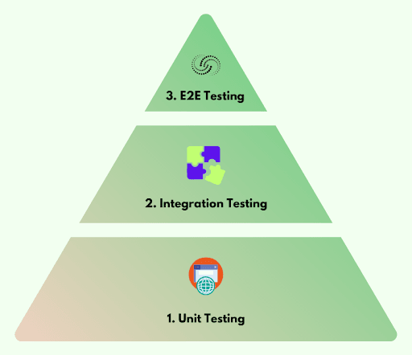
Test Design Concepts
Test Automation Pyramid

Slide 19
Test Design Concepts
Unit testing: Here, testing is done on individual units or software modules.
Each unit is tested separately to ensure that it behaves as intended and meets its requirements.
Integration testing: It helps verify that different modules of a software application are working as intended when they are integrated together.
End-to-End testing: It involves evaluating the entire software application, from start to finish, to ensure that all components work together as expected and meet the requirements and business objectives.
Also, it enables quick feedback cycles and helps developers fix bugs in a short time.
It helps save time, reduce costs, and improve the overall quality of an application.

Slide 20
Test Design Concepts
In system testing, the entire software or application is tested at a time.
In end-to-end testing, the behavioral flow of the application is tested.
Validates specific software systems.

Slide 21
Lecture 11 Summary
Test Design
Purpose of Test Design
When to Create a Test Design
Why is Test Design Important for Test Automation?
How Is Test Design Done?
Test Design Techniques
Test Design Concepts

Slide 22


