Slide 1
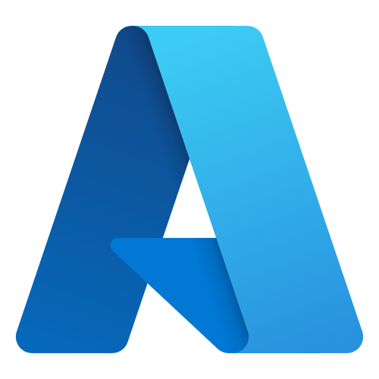


DATA ENGINEERING CASE STUDY • 2026
AMN Healthcare Data Platform
End-to-end enterprise lakehouse automating ingestion, validation, warehousing, and real-time analytics for healthcare workforce staffing.
1–3 Min SLA
Near Real-Time Processing
1.1M+ Rows
6 Multi-Source Entities
12 Pipelines
Event + Watermark Sync
Zero-Trust RBAC
Key Vault & PII Masking
Microsoft Azure
ADF Ingestion · ADLS Gen2 · Logic Apps Alerts
Snowflake Data Warehouse
RAW → CURATED → MARTS ·
Owner-Rights SPs
Power BI DirectQuery
4-Page Live Executive Analytics · Zero Staging
PRESENTED BY SYED SHOAIB SHERAZI • DATA ENGINEER

Slide 2
Problem Overview and Solution Approach
Why this project exists, and how the modern data platform solves healthcare staffing bottlenecks.
THE PROBLEM
OUR SOLUTION
!
Siloed Healthcare & Staffing Feeds
HR systems, candidate applications, and hospital demand lived in isolated silos, preventing unified staffing demand forecasting.
✓
Unified Cloud Lakehouse Platform
Integrated ADLS Gen2 with Snowflake Medallion architecture, consolidating 1.1M+ records.
!
Fragile & Unmonitored Pipelines
Data movement relied on manual exports with zero automated retry policies, missing audit trails, and no pipeline failure detection.
✓
12 Automated ADF Pipelines & Alerts
Implemented event-driven batch loads and 5-min incremental watermark syncs with real-time Logic App Gmail failure alerts.
!
High Infrastructure Costs
Expensive legacy infrastructure and maintenance increased operational costs.
✓
Cost-Efficient Cloud Platform
Cloud-based data infrastructure reduced infrastructure and operational costs
!
Stale Reports & High Latency
Analytics suffered from multi-hour latency with no live visibility into critical placement fill rates, overtime spend, or SLA breaches.
✓
Live DirectQuery Power BI Intelligence
Built a 4-page interactive executive suite refreshing in sub-minute latency with strict RBAC security and PII masking.
AMN Healthcare Data Platform: Azure · Snowflake · Power BI
2

Slide 3



Core Tools at a Glance
Key technologies powering ingestion, transformation, storage, security, and visualization.
Azure Data Factory
Orchestrates 12 full and incremental pipelines with storage event triggers, metadata routing, parameterization, and automated error handling.
Snowflake Data Warehouse
Multi-cluster data warehouse hosting RAW, CURATED, and MARTS schemas with owner-rights stored procedures and atomic MERGE logic.
Azure Data Lake Storage Gen2
Enterprise hierarchical namespace data lake providing partitioned landing, staging, and archive storage for healthcare feeds.
Azure Logic Apps
Serverless workflow executing instant Gmail failure alerts with pipeline name, run ID, and error diagnostics within seconds.
Power BI DirectQuery
Interactive 4-page executive suite delivering live workforce, recruitment, staffing fill rate, and payroll intelligence.
Terraform & Azure Key Vault
100% declarative Infrastructure as Code provisioning coupled with centralized Key Vault encryption for credentials and webhooks.
AMN Healthcare Data Platform: Azure · Snowflake · Power BI
4

Slide 4
Data Sourcing, Volumes & Load Strategies
How 1.1M+ healthcare staffing records across 6 entities are generated, partitioned, and ingested.
SOURCE OBJECTS & RECORD VOLUMES
Python Synthetic Data Generator
• Generator Script: generate_amn_hr_data.py
• Referential Integrity: Enforced across Candidates, Hospitals, Shifts & Payroll
• Total Generated Scale: 1,107,500+ valid records output to UTF-8 CSVs
Object | Source System | Rows | Load Strategy
Hospitals | Reference DB | 7,500 | Full Load
Staffing Requests | Azure SQL | 75,000 | Full + Incremental
Candidates | Azure SQL (HR) | 150,000 | Full + Incremental
Employees | Azure SQL (HR) | 50,000 | Full Load
Schedules | Azure SQL (HR) | 525,000 | Full + Incremental
Payroll | Azure SQL (HR) | 300,000 | Full + Incremental
TOTAL DATASET | All Feeds | 1,107,500+ | Mixed Architecture
Incremental Sync & Delta Watermarking
• Watermark Storage: CONTROL.WATERMARK table tracks last extracted, updated_at
• Execution Frequency: 5-minute scheduled ADF polling interval
• Merge Engine: Automated atomic UPSERT via Snowflake Stored Procedures
Event-Driven Batch File Drops
• Trigger Mechanism: Storage Event trigger on ADLS Gen2 file drop
• Manifest Protocol: AMN_BATCH_READY.json validates file completeness
• Execution Auditing: Every run recorded to CONTROL.PIPELINE_RUN_LOG
AMN Healthcare Data Platform Azure · Snowflake · Power BI
6

Slide 5
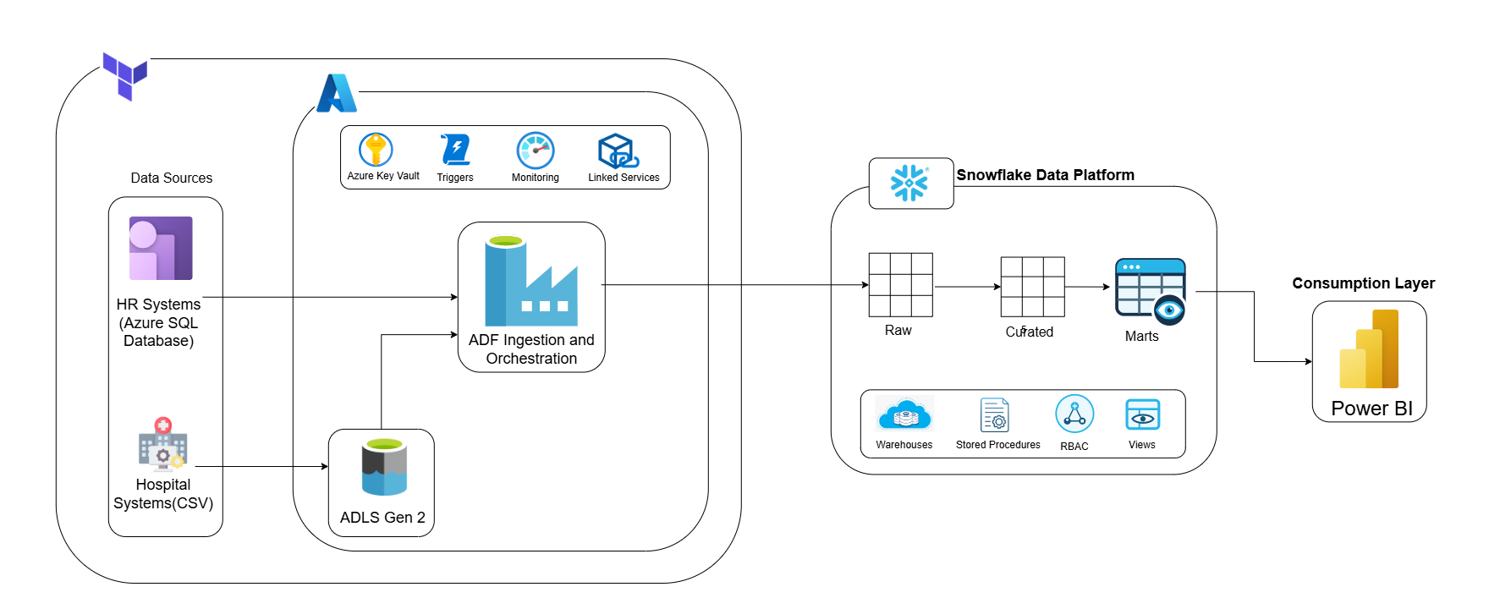
End-to-End Pipeline Architecture
System architecture: Azure SQL & hospital sources → ADLS Gen2 → ADF → Snowflake → Power BI.
AMN Healthcare Data Platform: Azure · Snowflake · Power BI
5

