Slide 1



Air Quality & Weather Data Pipeline
Correlating real-time weather with historical air quality — the same data product built three times, on Google Cloud, Microsoft Azure and AWS.
BUILT ON ALL THREE MAJOR CLOUDS
Microsoft Azure
Amazon Web Services
PRESENTED BY SYED SHOAIB SHERAZI

Slide 2
Problem Overview and Solution Approach
Why this project exists, and how the pipeline answers it.
THE PROBLEM
OUR SOLUTION
!
Air quality and weather data live in separate silos, so it's hard to see how conditions like wind or rain actually affect pollution.
✓
A unified data platform joins historical air-quality data with real-time weather data, enabling correlation and cross-domain analysis.
!
Historical air-quality records are scattered across raw API responses, not organized into a clean, queryable dataset.
✓
An automated batch pipeline ingests OpenAQ history via dltHub, transforms it with Spark, and lands it through a governed bronze → silver → gold layering.
!
There is no live, at-a-glance view of current conditions and what they mean for air quality right now.
✓
A Kafka-powered streaming pipeline continuously ingests live OpenWeather data and powers a real-time Streamlit dashboard.
BUILT ON ALL THREE MAJOR CLOUDS
Microsoft Azure
Amazon Web Services
Air Quality & Weather Data Pipeline
2

Slide 3
What I Learned Across 3 Clouds
The same data product exposed very different cloud-native tradeoffs.
Microsoft Azure
Amazon Web Services
GCS · Spark · BigQuery · Bruin
ADLS Gen2 · Databricks · Delta Lake
S3 · Glue · Iceberg · Athena
BigQuery is the warehouse itself — serverless and pay-per-query, with no cluster to size or shut down.
Databricks is compute and warehouse at once — Bronze, Silver and Gold are managed Delta tables, not lake files.
Athena and Glue cost nothing while idle — you pay per query scanned, not per running cluster.
GCS holds the lake; Spark reads and writes the bronze and silver prefixes through the GCS connector.
ADLS Gen2 needs the hierarchical namespace switched on, and here it only ever lands raw data.
S3 is only storage; the Glue Data Catalog is what turns those objects into queryable tables.
One service-account key plus IAM roles is the entire auth story, shared across every container.
Delta Lake adds ACID transactions and time travel on top of plain object storage.
Apache Iceberg gives the bronze, silver and gold tables schema evolution and snapshot history.
Connector versions bite: the Maven-resolved GCS jar clashed with the Guava already on Spark's classpath.
SQL Warehouse auto-stop is the real cost guard — an idle cluster is the expensive mistake.
IAM policies only — there are no managed identities, so every service's access is written out by hand.
Air Quality & Weather Data Pipeline — built three times over
3

Slide 4




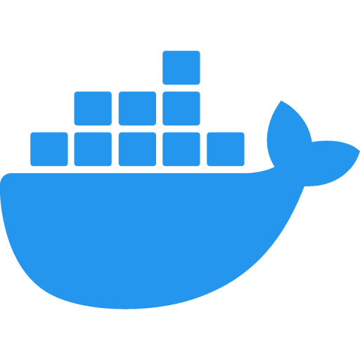

Core Tools at a Glance
The layer that stays identical no matter which cloud is underneath.
Apache Kafka
dltHub
Decouples the OpenWeather producer from the storage consumer, so streaming ingestion works the same against GCS, ADLS Gen2 or S3.
A declarative ingestion framework that extracts, normalizes and loads the historical API data into the raw layer of whichever lake the project targets.
dbt
Kestra
The SQL transformation layer building staging views and analytics marts with tests — repointed at BigQuery, Databricks SQL or Athena by profile alone.
The workflow orchestrator running the same batch chain on all three clouds: ingest → transform → load → dbt.
Docker
Streamlit
Every service ships as its own container with Compose, so the pipeline behaves identically on a laptop and against any of the three clouds.
The dashboard layer reading the gold marts — the same app, pointed at each cloud's warehouse with only a connection change.
Air Quality & Weather Data Pipeline — cloud-agnostic layer
4

Slide 5
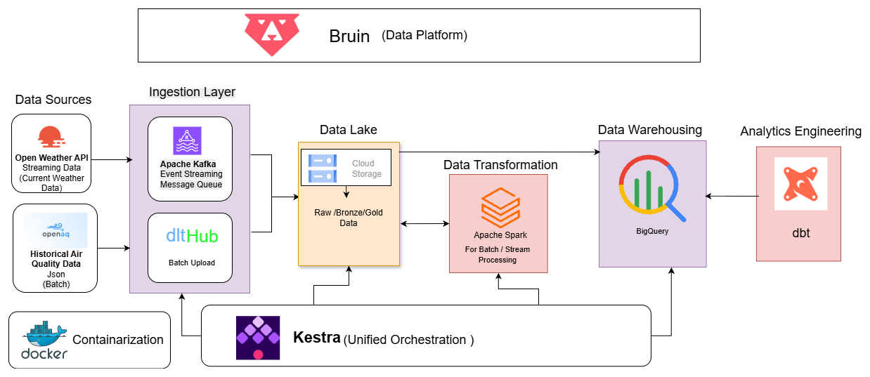
End-to-End Pipeline on Google Cloud
System architecture · 1 of 3
Air Quality & Weather Data Pipeline — GCS · BigQuery · Spark
5

Slide 6
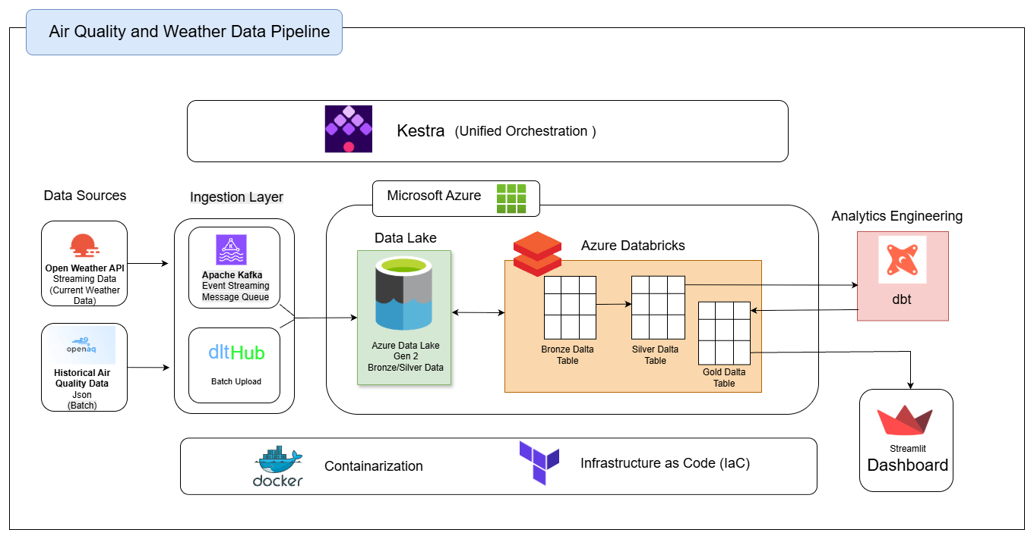
End-to-End Pipeline on Microsoft Azure
System architecture · 2 of 3
Air Quality & Weather Data Pipeline — ADLS Gen2 · Databricks · Delta Lake
6

Slide 7
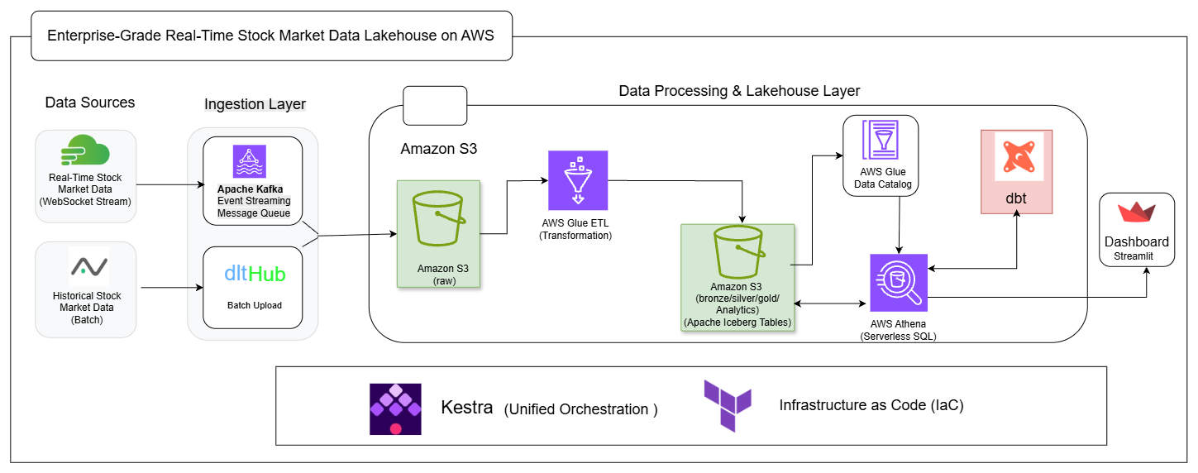
End-to-End Lakehouse on AWS
System architecture · 3 of 3
Real-Time Stock Market Data Lakehouse — S3 · Glue · Iceberg · Athena
7

Slide 8
Demo Videos
Recorded walkthroughs of each cloud implementation — ingestion, orchestration, warehouse and dashboard.
One video per cloud. Same pipeline, three platforms.
GCP Implementation — Demo
Watch
↗
→ paste your demo video link here
Azure Implementation — Demo
Watch
↗
→ paste your demo video link here
AWS Implementation — Demo
Watch
↗
→ paste your demo video link here
Replace each placeholder above with your recorded walkthrough URL.
Air Quality & Weather Data Pipeline
8

