Slide 1



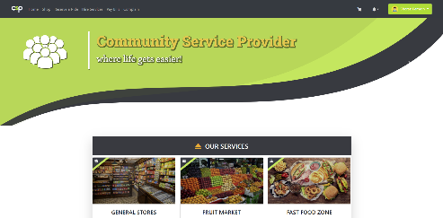


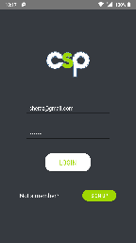
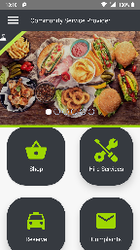
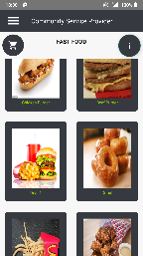


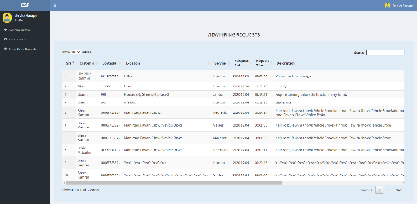

^{COMMUNITY SERVICE PROVIDER} ^{Final Year Project (2017-2021)} ^{Department of Computer Science} COMSATS University Islamabad, Attock Campus
Introduction
Life is getting busier and busier day by day. Managing daily life needs has become quite a painful thing. The time factor gets tighter and tighter every day which can cause serious issues in a person’s life. It can also affect his health too.
Nowadays, there is a growing trend of building Town Communities in Pakistan. Even though, a town has a lot of privileges for its members, still it fails to provide these facilities in an easy and time-saving manner.
The main aim of Community Service Provider is to provide a specific town’s members the fast and easy access of its privileges (shopping, town bills, services, reserving a ride and putting complaints online).
Motivations
Provide easy and fast access of daily life services.
Provide a sophisticated yet a user-friendly management system.
Create job and business opportunities.
System Background
Community Service Provider is a cross platform application that is developed and customized for a specific town to provide daily life services to its users in one application. It’s a targeted ecommerce application specific for a town that provides its user with the services of,
Online Booking
Online Shopping
Online Service Hiring
Online Billing
Online Complaints
Architecture
Results
User End Website
Conclusion
Community Service Provider is a cross platform full fledge application that provide daily life services and service management services under a single platform. Some of these services include online shopping, booking, service hiring, paying bills etc. It is targeted towards Communities and towns and saves a lot of time and cost of its users. Advanced and latest tools and technologies are adopted to design and develop the project of such sale as well as a lot of effort and passion. The system is tested continuously to make it a reliable and quality product. The aim is to provide convenience to the users and managers alike in their daily life affairs and businesses, respectively.
User
Manager
Desktop
Mobile
Desktop
User End Android App
Internet
Internet
Future Directions
To modify and introduce new features in the system.
To make it available on all OS platforms.
To introduce digitalized solutions for other problems tackled traditionally in a community.
Manager End Web Portal
Server
Objectives
Online reservation.
Availing (renting) vehicles.
Ordering a meal or fast food online.
Online hiring of services of the town.
Online payment of bills.
Online Complaints of any sort.
Reduce unnecessary cost and time spent on going to market.
Learning and development of efficiently working software.
Availing the Business opportunity.
Group Members
SHERAZ KAMRAN UBAID UR REHMAN M. USAMA MALIK
shiraz.kamran729@gmail.com ubaidkhan3081@gmail.com 46usama@gmail.com
Supervisor: Mr. Muhammad Kamran

