Slide 1
Non-profit organization Food collection centers
A project to identify neighborhoods in east of Toronto

Slide 2
Overview
None profit organization is looking to setup its food collection centers.
Excessive food collection from restaurants.
Ideal locations are with 20 or more restaurants in radius of 1000 meters.
Setup 3-4 collection centers

Slide 3
Data acquisition
Tap on to postal codes data for the city of Toronto that is available on Wikipedia website for free.
Data scrapping using the BeautifulSoup library.
Pull location coordinates details from a CSV file.
Location information is critical to determine number of restaurants within 1000-meter radius.
Foursquare API to pull restaurants data.

Slide 4
Data Cleaning and filtration
Toronto east (Scarborough) data was extracted.
Neighborhoods with 20 or more restaurants were identified.
 | PostalCode | Borough | Neighbourhood | Latitude | Longitude
0 | M1B | Scarborough | Rouge, Malvern | 43.806686 | -79.194353
1 | M1C | Scarborough | Highland Creek, Rouge Hill, Port Union | 43.784535 | -79.160497
2 | M1E | Scarborough | Guildwood, Morningside, West Hill | 43.763573 | -79.188711
3 | M1G | Scarborough | Woburn | 43.770992 | -79.216917
4 | M1H | Scarborough | Cedarbrae | 43.773136 | -79.239476
5 | M1J | Scarborough | Scarborough Village | 43.744734 | -79.239476
6 | M1K | Scarborough | East Birchmount Park, Ionview, Kennedy Park | 43.727929 | -79.262029
7 | M1L | Scarborough | Clairlea, Golden Mile, Oakridge | 43.711112 | -79.284577
8 | M1M | Scarborough | Cliffcrest, Cliffside, Scarborough Village West | 43.716316 | -79.239476
9 | M1N | Scarborough | Birch Cliff, Cliffside West | 43.692657 | -79.264848
10 | M1P | Scarborough | Dorset Park, Scarborough Town Centre, Wexford ... | 43.757410 | -79.273304

Slide 5
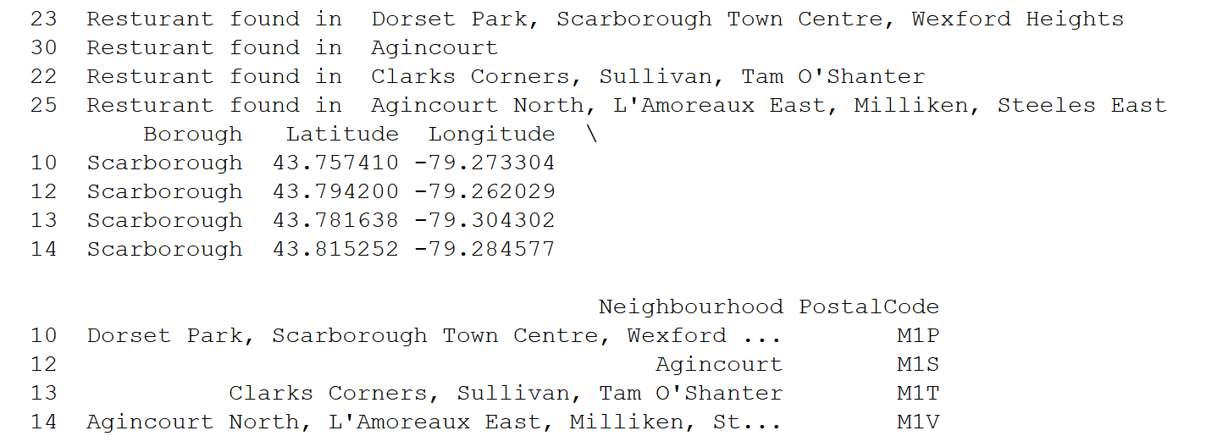
Resulting data

Slide 6
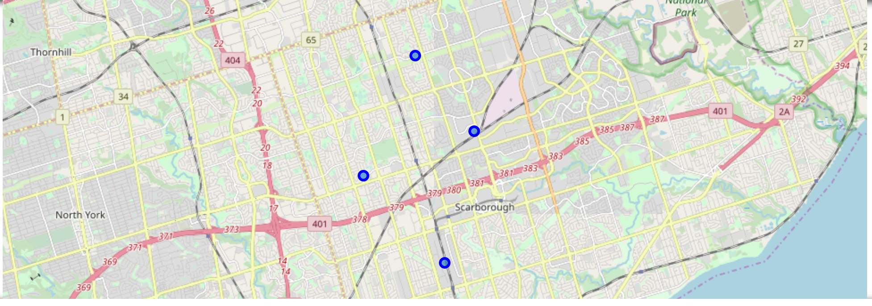
Data visualization

Slide 7
Conclusion
Easy implementation yet extremely useful insight
Based on factual data
Public domain data can used for real decision-making
Small businesses and non-profit organizations benefits

