Slide 1

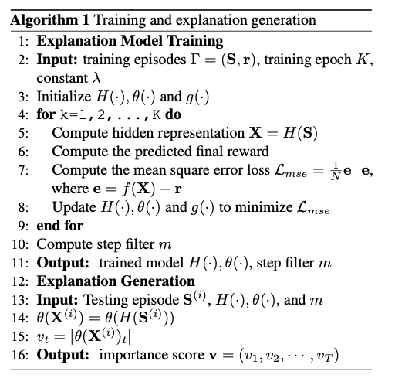
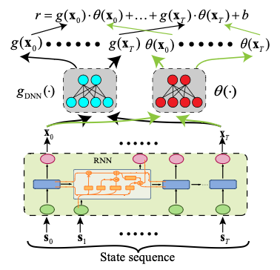
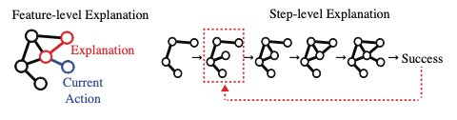
Explainable Deep Reinforcement Learning in Security Applications
Jiahao Yu, Xinyu Xing
Department of Computer Science and Learning Science, Northwestern University
Research Questions
Proposed Methods
Deep reinforcement learning models have a powerful capacity, however, due to the black-box nature of the deep neural network, it is hard to trust the decision-making process of DRL agents, especially in security domains.
None of existing work try to give the step-level explanation for DRL-based security agents
Above: Comparison between feature-level explanation and step-level explanation
Limitations of Existing Works
Most existing works focus on the feature-level explanation, which are not suitable for application debugging and expert analysis[1,2,3,4].
Other explanation methods utilize value functions of the target agent to assess state importance [5,6]. These methods cannot work when the value functions are not available.
Some explanation focus on the coarse-grained explanation[7]. The explanation results are too generic to debug individual runs of the DRL agent
Explanation methods for security applications have higher expectations not only for the explanation fidelity but also for explanation stability and efficiency[8], which are not the main focus of existing works.
Above: Framework of our proposed method
We first use a RNN to extract the temporal information from the observations.
Then we use one network to further process the transformation and one network to predict the importance score.
Finally, we use the importance score to rank the steps and generate the explanation.
Research Questions
Expected Results
Thus, we believe that there is a need to develop a method to explain the DRL-based security applications in the step level. The explanation should have the high fidelity, efficiency and utilities. Once the explanation model is obtained, we can use it for policy debugging, application debugging and agent understanding.
We will compare our method with other baseline method in four DRL-based applications: selfish mining[9], network lateral movement, safe driving and malware mutation[10].
We will show the utilities of our explanation. For example, we will show how to utilize our explanation to understand the agent behavior and patch the policy errors.
References
[1] Simonyan, Karen, Andrea Vedaldi, and Andrew Zisserman. "Deep inside convolutional networks: Visualising image classification models and saliency maps." arXiv preprint arXiv:1312.6034 (2013).
[2] Zeiler, Matthew D., and Rob Fergus. "Visualizing and understanding convolutional networks." European conference on computer vision. Springer, Cham, 2014.
[3] Shrikumar, Avanti, et al. "Not just a black box: Learning important features through propagating activation differences." arXiv preprint arXiv:1605.01713 (2016).
[4] Springenberg, Jost Tobias, et al. "Striving for simplicity: The all convolutional net." arXiv preprint arXiv:1412.6806 (2014).
[5] Huang, Sandy H., et al. "Establishing appropriate trust via critical states." 2018 IEEE/RSJ International Conference on Intelligent Robots and Systems (IROS). IEEE, 2018.
[6] Amir, Dan, and Ofra Amir. "Highlights: Summarizing agent behavior to people." Proceedings of the 17th International Conference on Autonomous Agents and MultiAgent Systems. 2018.
[7] Guo, Wenbo, et al. "Edge: Explaining deep reinforcement learning policies." Advances in Neural Information Processing Systems 34 (2021): 12222-12236.
[8] Warnecke, Alexander, et al. "Evaluating explanation methods for deep learning in security." 2020 IEEE european symposium on security and privacy (EuroS&P). IEEE, 2020.
[9] Hou, Charlie, et al. "SquirRL: Automating attack analysis on blockchain incentive mechanisms with deep reinforcement learning." arXiv preprint arXiv:1912.01798 (2019).
[10] Zhao, Kaifa, et al. "Structural attack against graph based android malware detection." Proceedings of the 2021 ACM SIGSAC Conference on Computer and Communications Security. 2021.

