Slide 1
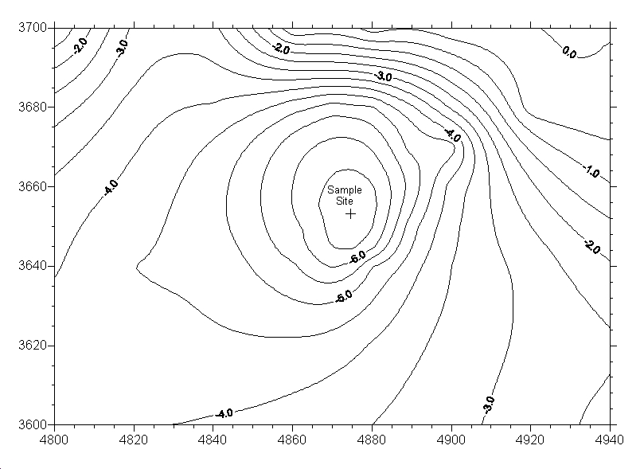
Notes:
Figure 1. Bathymetry of Organic Lake 9 November 2008

Slide 2
Notes:
Figure 2. Physical and chemical profiles of Organic Lake on 9 November 2008.

Slide 3
Notes:
Figure 3a. Epifluorescence microscopy image of Organic Lake biota from December 2006. Lake water was filtered onto 0.01 um polycarbonate membrane and stained with SYBR gold.

Slide 4
Notes:
Figure 3b. Epifluorescence microscopy image of Organic Lake biota from December 2008. Lake water was filtered onto 0.01 um polycarbonate membrane and stained with SYBR gold. From left to right, samples are: a) whole water, b) water coming off the 3.0 μm filter and c) water coming off the 0.8 μm filter.

Slide 5
Notes:
Figure 4. Counts of reads matching to 16S gene sequence normalized to the average number of reads obtained from each filter (403, 577 average reads). Assignment of reads to phylum (>75% bootstrap value) by RDP classifier.

Slide 6
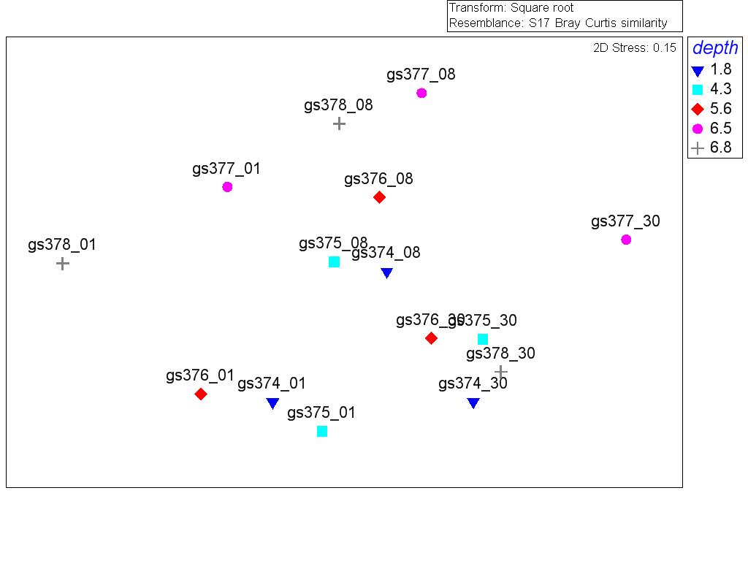
Notes:
Figure 5. MDS plot of relative 16 S gene abundances from the November 2008 Organic Lake depth profile. 16 S read counts were aggregated to the genus level and relative abundances were square root transformed.

Slide 7
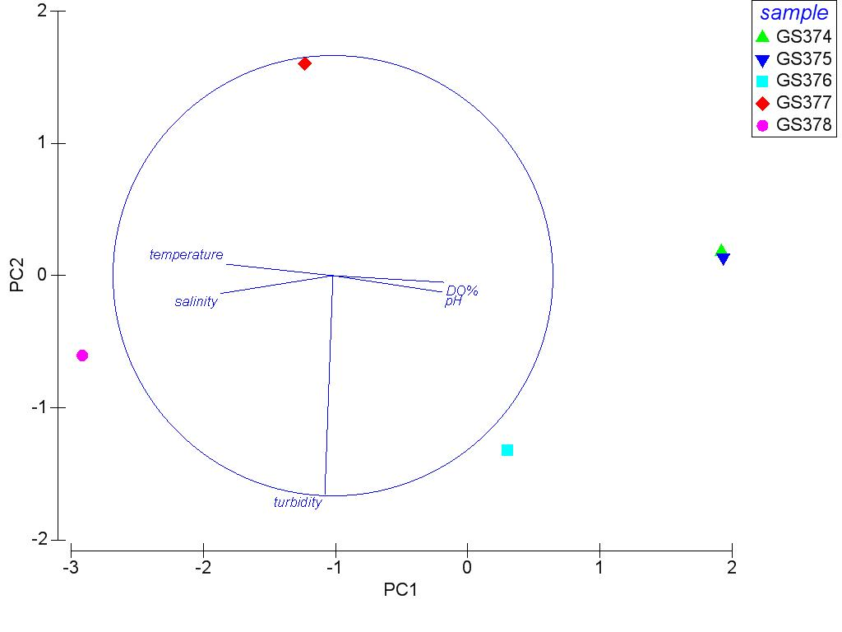
Notes:
Figure S1: PCA analysis of environmental parameters: temperature, percentage dissolved oxygen saturation (DO_%), turbidity, salinity and pH measured during November 2008 from the depths in the lake from which microbial biomass was sampled.

Slide 8
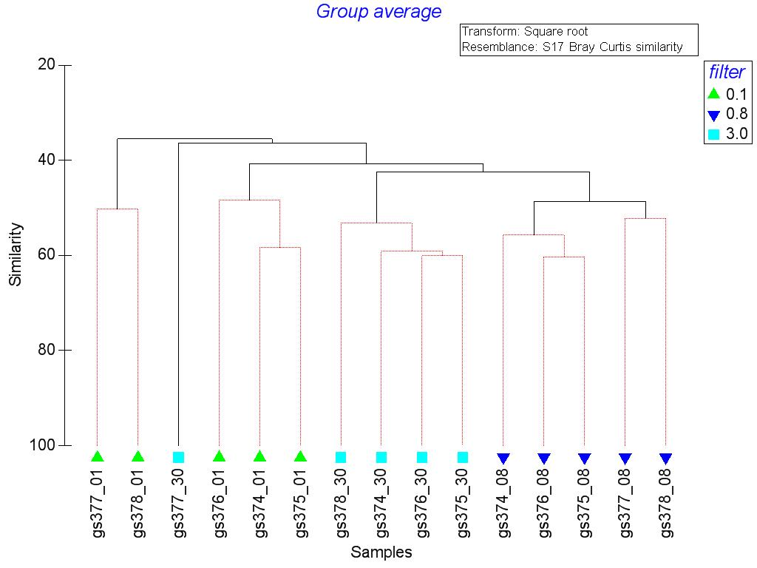
Notes:
Figure S2. Dendogram of cluster analysis of the November 2008 bacterial community composition (based on 16S rRNA gene). Statistically significant clusters are shown in the dendogram with black branches while branches that cannot be distinguished as statistically different are coloured red. Y-axis shows percent Bray Curtis similarity.

Slide 9
Notes:
Figure S3. Comparison of turbidity and 16S hit rate counts from metagenomic reads.

Slide 10
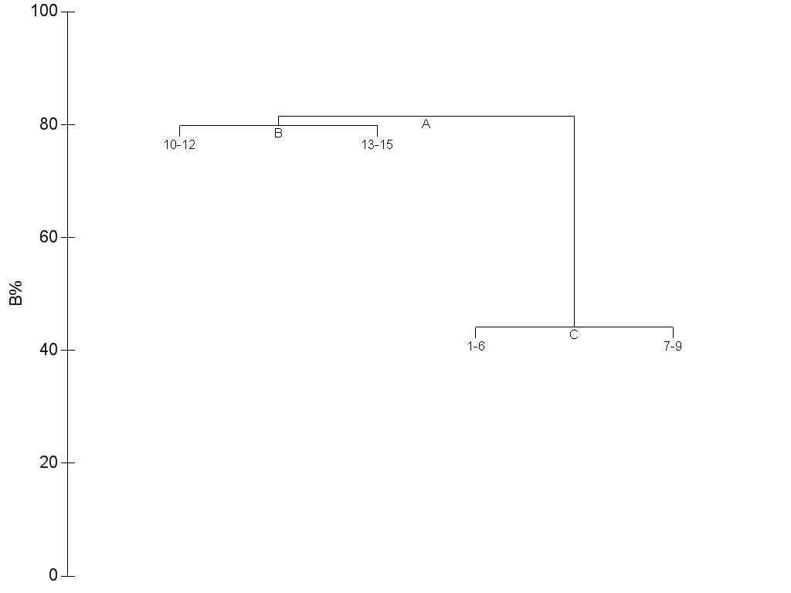
Notes:
Figure S4. Link tree analysis of 16S rRNA gene frequencies and abiotic parameters: temperature, turbidity, pH and dissolved oxygen.

Slide 11
Notes:
Figure SX: November temperature profiles of Organic Lake indicating lake temperatures have in general fallen principally in the mixolimnion but also in the monimolimnion since earlier surveys. Temperature values obtained from the Australian Antarctic Data Centre (data.aad.gov.au) except 9 November 2008 values which are from this study.

Slide 12
Notes:
Figure SX.November practical salinity profiles of Organic Lake indicating the halocline has shifted deeper in the water column since 1991. Values were calculated from in situ conductivity and pressure data obtained from the Australian Antarctic Data Centre (data.aad.gov.au) except 9 November 2008 data are from this study.

Slide 13
Notes:
Figure SX. Counts of reads matching to 16S gene sequence normalized to the average number of reads obtained from each filter that were not classified to a phylum level (<75% bootstrap value) by RDP classifier. Closest RDP assignment is listed in the legend.

