Slide 1


Analytics Project
Leveraging data to transform rail transportation insights
Notes:
AI-generated content may be incorrect. ---

Slide 2
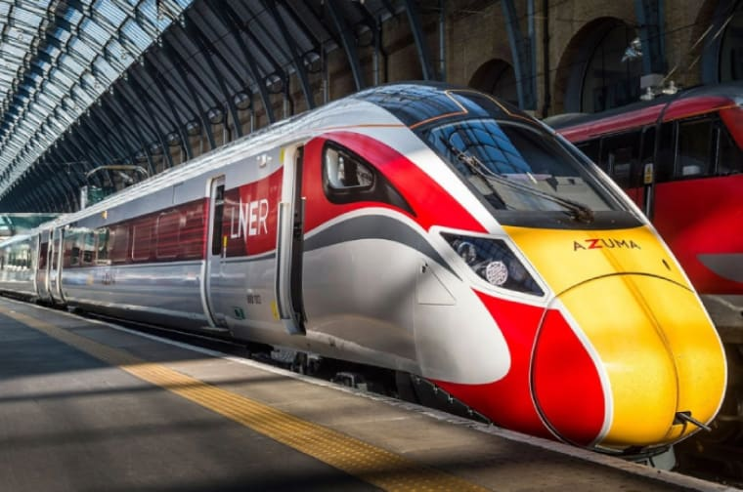


UK National Rail Analytics Project
Data Analysis Team
Rimon Ezzat Habeeb
Shereen Talaat Saad
Basma Atef Abd-Elghafour
Mona Mohammed Hussein
Instructor
Eng. Kareem Bakli
Notes:
--- The UK Rail Analytics Project aims to establish a verifiable correlation between operational performance metrics, specifically service delays, and their commercial outcomes such as revenue generation. The final deliverable is a five-page interactive Power BI dashboard that spans descriptive analysis to predictive modeling. Additionally, the project incorporates smart alerts using Power Automate to notify stakeholders of critical risk metrics like 'Revenue at Risk'. These objectives ensure that the project delivers actionable insights and supports strategic decision-making across various operational domains. Image source: Microsoft 365 content library

Slide 3
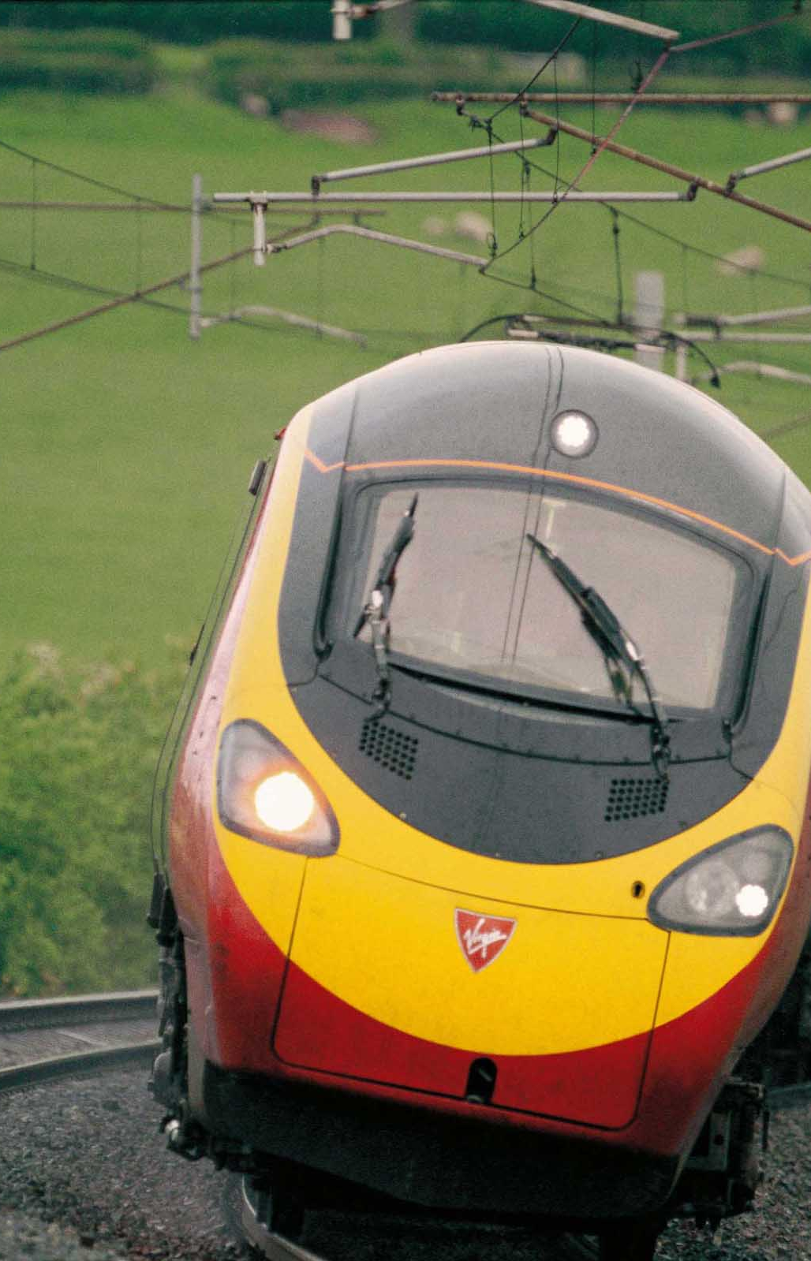
Content
Project Overview
Dataset Description
Key Diagnostic Questions
Data Cleaning & Preparation
Data Enrichment & Dimension Tables
Exploratory Data Analysis (EDA)
Data Modeling
DAX Measures Overview
Dashboard Walkthrough
Key Insights & Findings
Conclusions
Recommendations / Actions
Forecasts
Notes:
--- The UK Rail Analytics Project aims to establish a verifiable correlation between operational performance metrics, specifically service delays, and their commercial outcomes such as revenue generation. The final deliverable is a five-page interactive Power BI dashboard that spans descriptive analysis to predictive modeling. Additionally, the project incorporates smart alerts using Power Automate to notify stakeholders of critical risk metrics like 'Revenue at Risk'. These objectives ensure that the project delivers actionable insights and supports strategic decision-making across various operational domains. Image source: Microsoft 365 content library

Slide 4

Project Overview
This project focuses on analyzing UK National Rail journeys to uncover patterns in passenger behavior, ticket purchasing, travel performance, and operational efficiency. Using a cleaned dataset of train ride transactions, the analysis aims to identify key trends related to ticket types, pricing, travel timings, delays, and refund requests.
The insights generated help demonstrate practical data-analysis skills, including data preparation, dashboard design, and the extraction of meaningful conclusions from real-world transport data.
Notes:
--- The UK Rail Analytics Project aims to establish a verifiable correlation between operational performance metrics, specifically service delays, and their commercial outcomes such as revenue generation. The final deliverable is a five-page interactive Power BI dashboard that spans descriptive analysis to predictive modeling. Additionally, the project incorporates smart alerts using Power Automate to notify stakeholders of critical risk metrics like 'Revenue at Risk'. These objectives ensure that the project delivers actionable insights and supports strategic decision-making across various operational domains. Image source: Microsoft 365 content library

Slide 5
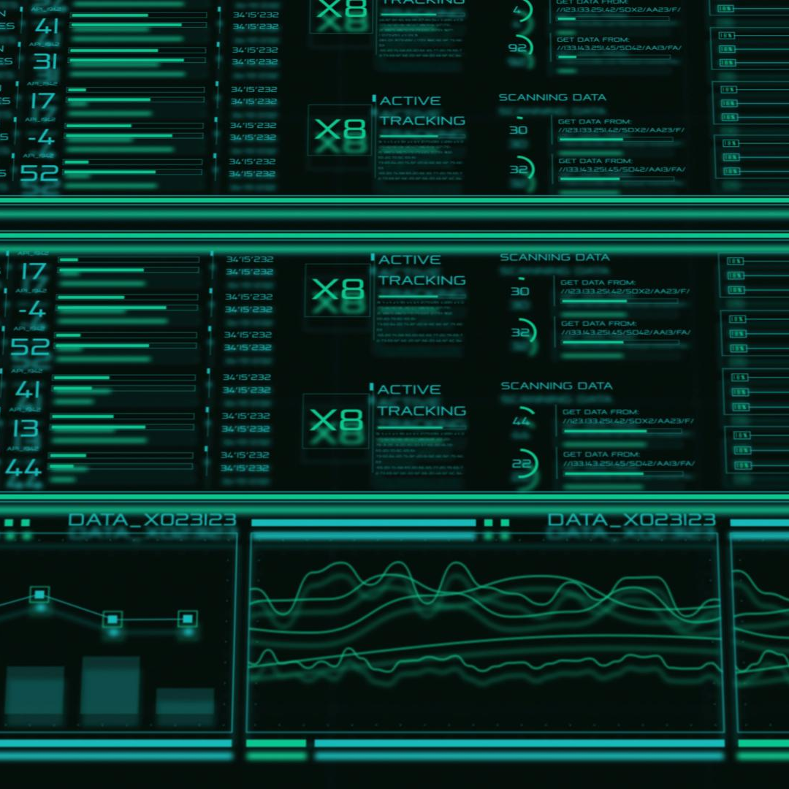
Dataset Description
Size: The dataset contains 31,653 train ride records with a wide range of journey, ticket, passenger, and performance attributes.
Grain: Each row represents a complete train-ride transaction for a single passenger, including ticket purchase details and the journey's actual outcome.
Purpose: The dataset is designed to support operational analysis, including ticketing behavior, travel performance, delay patterns, and customer refund activity. It provides the foundation for building dashboards that reveal key insights about passenger habits and railway efficiency.
Notes:
--- The project is structured into five analytical phases, each corresponding to a specific dashboard page and executive objective. Phase I (Foundation) focuses on defining core KPIs and operational status. Phase II (Deep Dive) analyzes customer behavior and market segment contributions. Phase III (Correlation) quantifies financial costs of delay causes. Phase IV (Forecasting) projects future revenue trends and operational risks. Phase V (Recommendations) translates insights into strategic mandates. This structured approach ensures comprehensive coverage of performance, financial, and strategic dimensions. Image source: Microsoft 365 content library

Slide 6
Dataset Description
Key Components of the Dataset
Transaction & Purchase Details: Transaction ID, Date of Purchase, Time of Purchase, Purchase Type (Online or Station), Payment Method.
Passenger & Ticket Information: Columns: Railcard type, Ticket Class, Ticket Type, Ticket Price.
Journey Information: Columns: Departure Station, Arrival Destination, Date of Journey, Scheduled Departure Time, Scheduled Arrival Time.
Performance & Delay Metrics: Columns: Actual Arrival Time, Journey Status (On Time, Delayed, Cancelled), Reason for Delay.
Customer Response: Columns: Whether a Refund Request was submitted.
Notes:
--- The project is structured into five analytical phases, each corresponding to a specific dashboard page and executive objective. Phase I (Foundation) focuses on defining core KPIs and operational status. Phase II (Deep Dive) analyzes customer behavior and market segment contributions. Phase III (Correlation) quantifies financial costs of delay causes. Phase IV (Forecasting) projects future revenue trends and operational risks. Phase V (Recommendations) translates insights into strategic mandates. This structured approach ensures comprehensive coverage of performance, financial, and strategic dimensions. Image source: Microsoft 365 content library

Slide 7
Dataset Description
Dataset Highlights
Covers a broad range of ticket types and purchase behaviors.
Includes both scheduled and actual arrival times, enabling delay analysis.
Provides rich categorical data suitable for segmentation and performance insights.
Data Limitations
The dataset covers only four months of the year, limiting the ability to analyze full-year seasonality.
The dataset lacks a user demographics or customer dimension table, making it challenging to analyze segmentation by user characteristics.
Journey records do not include distance or route-length information, preventing analysis linking delay duration to journey distance, or route complexity.
Notes:
--- The project is structured into five analytical phases, each corresponding to a specific dashboard page and executive objective. Phase I (Foundation) focuses on defining core KPIs and operational status. Phase II (Deep Dive) analyzes customer behavior and market segment contributions. Phase III (Correlation) quantifies financial costs of delay causes. Phase IV (Forecasting) projects future revenue trends and operational risks. Phase V (Recommendations) translates insights into strategic mandates. This structured approach ensures comprehensive coverage of performance, financial, and strategic dimensions. Image source: Microsoft 365 content library

Slide 8
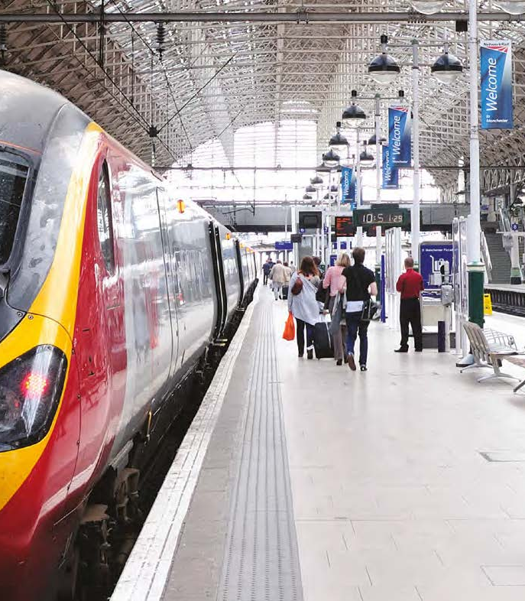
Key Diagnostic Questions
I. Operational Performance & Reliability
Punctuality vs. Benchmark
Root Cause Identification
Service Disruption Severity
II. Financial Health & Cost of Disruption
Revenue Stream Segmentation
Financial Leakage from Refunds
Refund Policy Effectiveness
III. Customer Behavior & Growth Momentum
Channel Preference
Growth Sustainability
Notes:
--- The UK Rail Analytics Project aims to establish a verifiable correlation between operational performance metrics, specifically service delays, and their commercial outcomes such as revenue generation. The final deliverable is a five-page interactive Power BI dashboard that spans descriptive analysis to predictive modeling. Additionally, the project incorporates smart alerts using Power Automate to notify stakeholders of critical risk metrics like 'Revenue at Risk'. These objectives ensure that the project delivers actionable insights and supports strategic decision-making across various operational domains. Image source: Microsoft 365 content library

Slide 9

Technical Deep Dive
Data Cleaning & Preparation
Source Data Ingestion: Loaded 31,653 raw transaction records.
Data Type Conversion: Ensured proper date and time formats for analysis.
Data Standardization: Unified and cleaned text entries (e.g., Journey Status, Reason for Delay).
Handling Missing Values: Imputed missing values in arrival times to correctly categorize journeys as Delayed or Cancelled.
Calculated Columns: Created derived columns for actual ride time and delay duration.
Notes:
--- The UK Rail Analytics Project aims to establish a verifiable correlation between operational performance metrics, specifically service delays, and their commercial outcomes such as revenue generation. The final deliverable is a five-page interactive Power BI dashboard that spans descriptive analysis to predictive modeling. Additionally, the project incorporates smart alerts using Power Automate to notify stakeholders of critical risk metrics like 'Revenue at Risk'. These objectives ensure that the project delivers actionable insights and supports strategic decision-making across various operational domains. Image source: Microsoft 365 content library

Slide 10

Technical Deep Dive
Data Enrichment & Dimension Tables
Date Dimension: Created a dedicated Date Dimension table to enable robust Time Intelligence calculations.
Hierarchies: Established hierarchies for geographical and temporal analysis (e.g., Station, Date).
Segmentation: Grouped and categorized Passenger attributes (e.g., Railcard holders) and Ticket details.
Notes:
--- The UK Rail Analytics Project aims to establish a verifiable correlation between operational performance metrics, specifically service delays, and their commercial outcomes such as revenue generation. The final deliverable is a five-page interactive Power BI dashboard that spans descriptive analysis to predictive modeling. Additionally, the project incorporates smart alerts using Power Automate to notify stakeholders of critical risk metrics like 'Revenue at Risk'. These objectives ensure that the project delivers actionable insights and supports strategic decision-making across various operational domains. Image source: Microsoft 365 content library

Slide 11


Technical Deep Dive
Exploratory Data Analysis (EDA)
Total Rides: 31,653 total transactions.
Total Revenue: £742K generated.
Performance Baseline: 86.82% of rides were On Time.
Disruption Volumes: 7.24% Delayed rides and 5.94% Cancelled rides.
Financial Leakage: £39K paid in refunds, with an Incident Refund Rate of 26.80%.
Growth Trajectory: Strong Month-over-Month Growth of 33.89%.
Notes:
--- The UK Rail Analytics Project aims to establish a verifiable correlation between operational performance metrics, specifically service delays, and their commercial outcomes such as revenue generation. The final deliverable is a five-page interactive Power BI dashboard that spans descriptive analysis to predictive modeling. Additionally, the project incorporates smart alerts using Power Automate to notify stakeholders of critical risk metrics like 'Revenue at Risk'. These objectives ensure that the project delivers actionable insights and supports strategic decision-making across various operational domains. Image source: Microsoft 365 content library

Slide 12
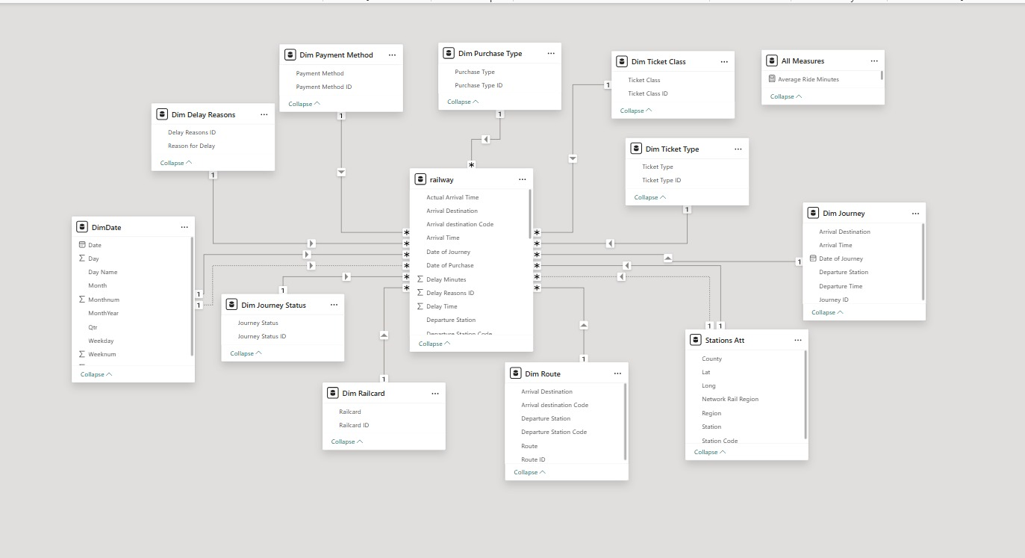
Technical Deep Dive
Data Modeling
Model Architecture: Implemented a Star Schema to optimize performance and query speed in Power BI.
Fact Table: Central UK Trains Rides table containing all transactional data.
Dimension Tables: Linked Date and Stations dimensions.
Relationships: Established robust One-to-Many relationships to ensure accurate measure calculations across filters.
Notes:
--- The UK Rail Analytics Project aims to establish a verifiable correlation between operational performance metrics, specifically service delays, and their commercial outcomes such as revenue generation. The final deliverable is a five-page interactive Power BI dashboard that spans descriptive analysis to predictive modeling. Additionally, the project incorporates smart alerts using Power Automate to notify stakeholders of critical risk metrics like 'Revenue at Risk'. These objectives ensure that the project delivers actionable insights and supports strategic decision-making across various operational domains. Image source: Microsoft 365 content library

Slide 13
Technical Deep Dive
Operational Measures: Calculated core metrics like PPM%, Delay Time Averages, and Service Failure Rates.
Financial Measures: Defined revenue totals, Average Ticket Price, and the financial impact of Refunds.
Time Intelligence: Utilized DAX functions (DATEADD, TOTALMTD) for Month-over-Month growth and trend analysis.
Segmentation Measures: Quantified passenger groups (Railcard holders vs. Non-Railcard holders).
DAX Measures Overview
Notes:
--- The UK Rail Analytics Project aims to establish a verifiable correlation between operational performance metrics, specifically service delays, and their commercial outcomes such as revenue generation. The final deliverable is a five-page interactive Power BI dashboard that spans descriptive analysis to predictive modeling. Additionally, the project incorporates smart alerts using Power Automate to notify stakeholders of critical risk metrics like 'Revenue at Risk'. These objectives ensure that the project delivers actionable insights and supports strategic decision-making across various operational domains. Image source: Microsoft 365 content library

Slide 14
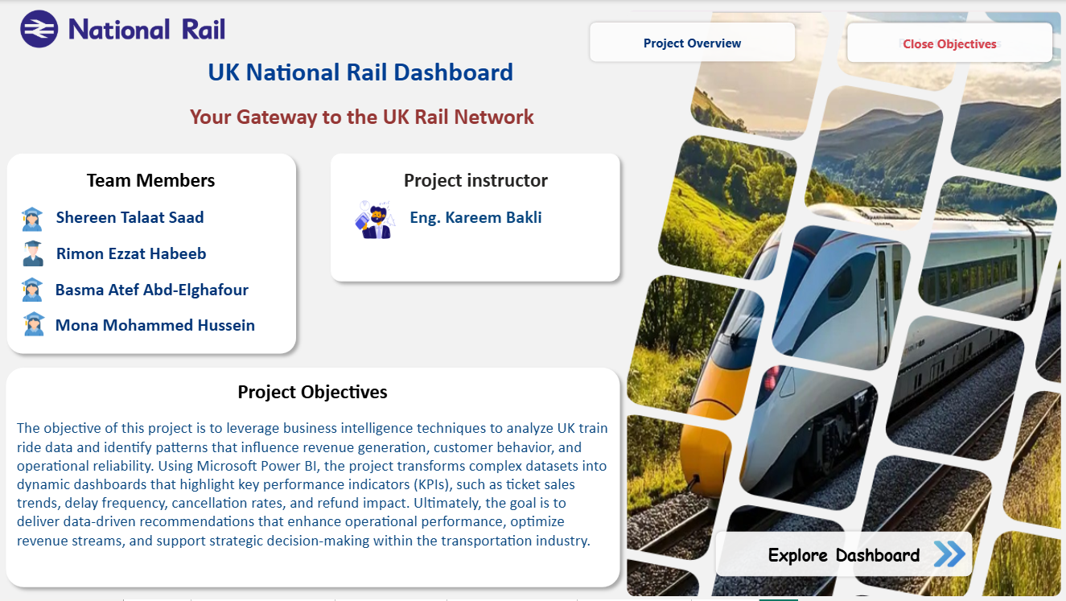
Dashboard Walkthrough
Intro Page
Notes:
--- The project is structured into five analytical phases, each corresponding to a specific dashboard page and executive objective. Phase I (Foundation) focuses on defining core KPIs and operational status. Phase II (Deep Dive) analyzes customer behavior and market segment contributions. Phase III (Correlation) quantifies financial costs of delay causes. Phase IV (Forecasting) projects future revenue trends and operational risks. Phase V (Recommendations) translates insights into strategic mandates. This structured approach ensures comprehensive coverage of performance, financial, and strategic dimensions. Image source: Microsoft 365 content library

Slide 15
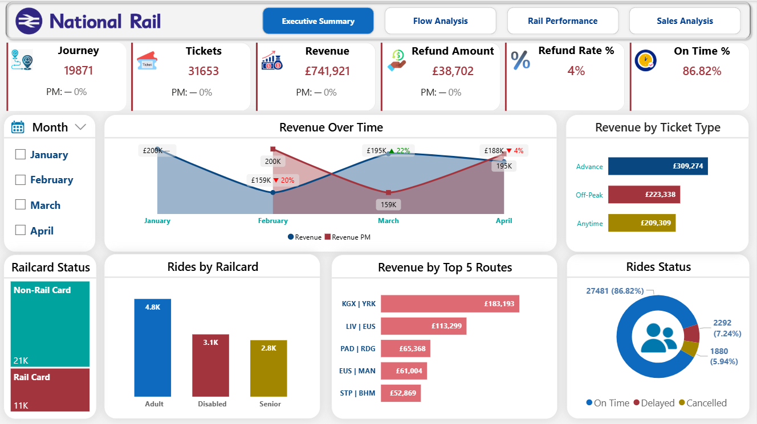
Dashboard Walkthrough
Executive Summery
Notes:
--- The project is structured into five analytical phases, each corresponding to a specific dashboard page and executive objective. Phase I (Foundation) focuses on defining core KPIs and operational status. Phase II (Deep Dive) analyzes customer behavior and market segment contributions. Phase III (Correlation) quantifies financial costs of delay causes. Phase IV (Forecasting) projects future revenue trends and operational risks. Phase V (Recommendations) translates insights into strategic mandates. This structured approach ensures comprehensive coverage of performance, financial, and strategic dimensions. Image source: Microsoft 365 content library

Slide 16
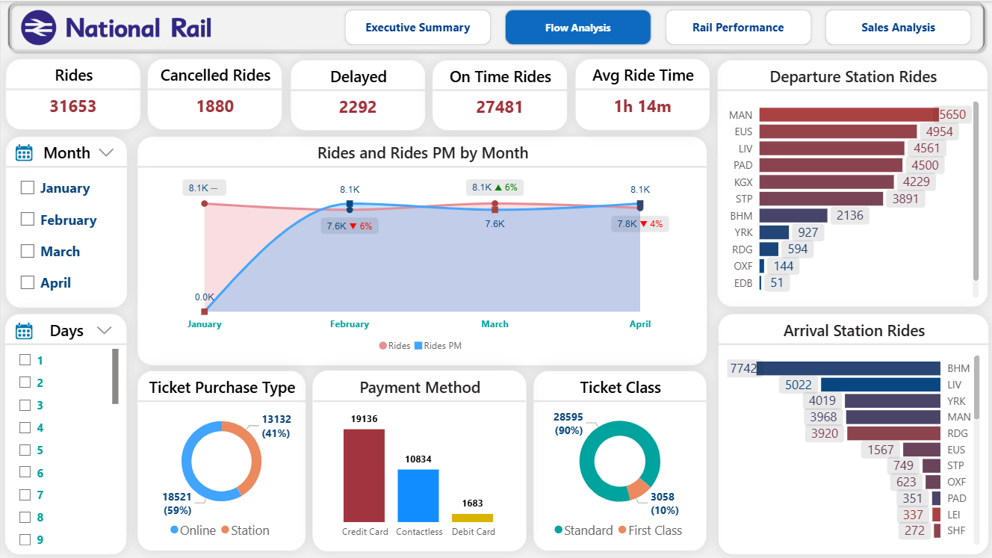
Dashboard Walkthrough
Flow Analysis
Notes:
--- The project is structured into five analytical phases, each corresponding to a specific dashboard page and executive objective. Phase I (Foundation) focuses on defining core KPIs and operational status. Phase II (Deep Dive) analyzes customer behavior and market segment contributions. Phase III (Correlation) quantifies financial costs of delay causes. Phase IV (Forecasting) projects future revenue trends and operational risks. Phase V (Recommendations) translates insights into strategic mandates. This structured approach ensures comprehensive coverage of performance, financial, and strategic dimensions. Image source: Microsoft 365 content library

Slide 17
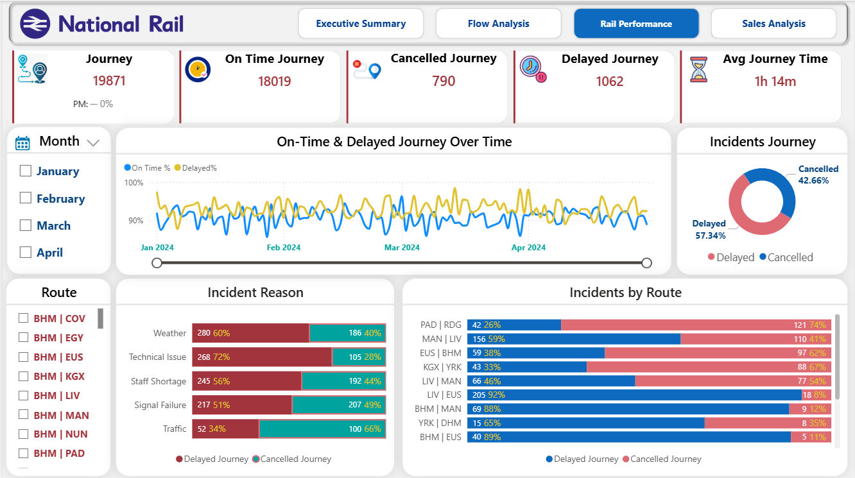
Dashboard Walkthrough
Rail Performance
Notes:
--- The project is structured into five analytical phases, each corresponding to a specific dashboard page and executive objective. Phase I (Foundation) focuses on defining core KPIs and operational status. Phase II (Deep Dive) analyzes customer behavior and market segment contributions. Phase III (Correlation) quantifies financial costs of delay causes. Phase IV (Forecasting) projects future revenue trends and operational risks. Phase V (Recommendations) translates insights into strategic mandates. This structured approach ensures comprehensive coverage of performance, financial, and strategic dimensions. Image source: Microsoft 365 content library

Slide 18
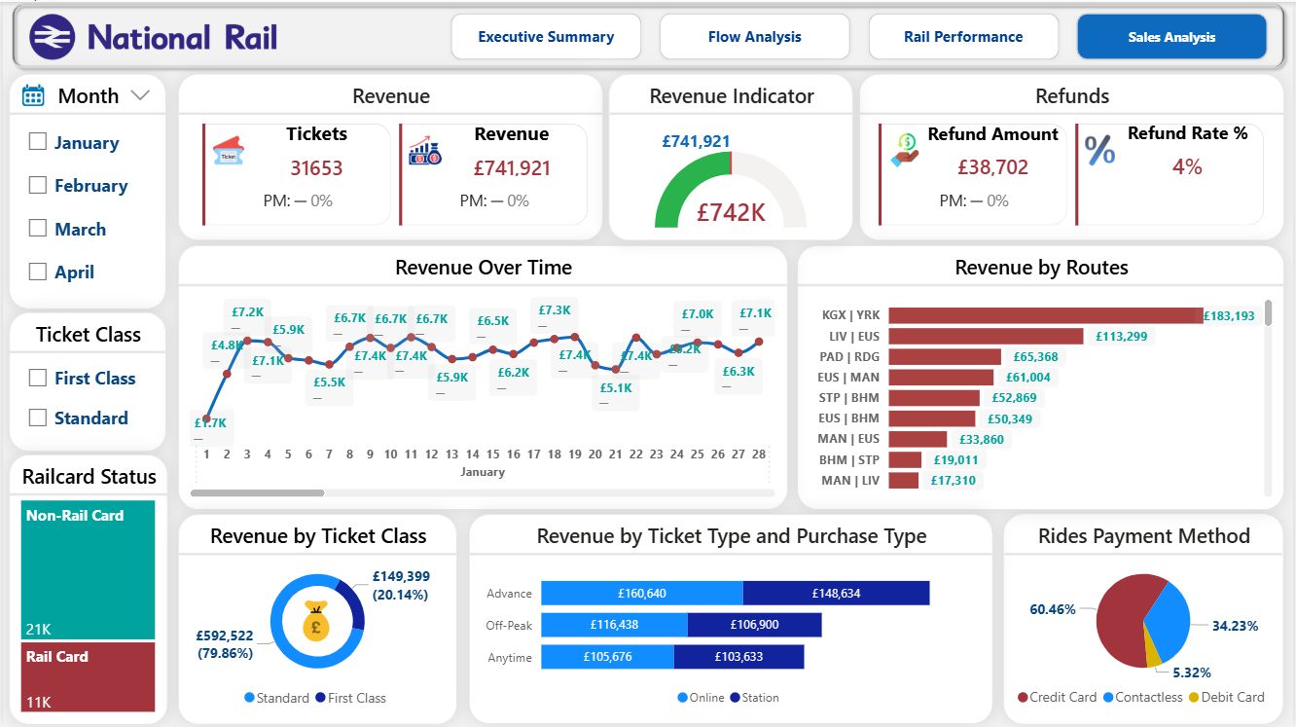
Dashboard Walkthrough
Sales Analysis
Notes:
--- The project is structured into five analytical phases, each corresponding to a specific dashboard page and executive objective. Phase I (Foundation) focuses on defining core KPIs and operational status. Phase II (Deep Dive) analyzes customer behavior and market segment contributions. Phase III (Correlation) quantifies financial costs of delay causes. Phase IV (Forecasting) projects future revenue trends and operational risks. Phase V (Recommendations) translates insights into strategic mandates. This structured approach ensures comprehensive coverage of performance, financial, and strategic dimensions. Image source: Microsoft 365 content library

Slide 19
Key Insights & Findings
Cancellation Crisis: The 5.94% cancellation rate exceeds the 5.0% threshold for severe disruption, highlighting critical service instability despite meeting the general PPM target.
Infrastructure Failure Dominance: Signal Failure is confirmed as the single largest root cause of delays, underscoring systemic reliability issues in the railway infrastructure.
Direct Cost of Disruption: £39K in refunds and a high 26.80% Incident Refund Rate quantify the direct financial penalty of operational failures, proving that poor performance is expensive.
Growth Vulnerability: The impressive 33.89% MoM Growth is at risk unless immediate action is taken to stabilize service reliability and convert new passengers into loyal customers.
Notes:
--- The UK Rail Analytics Project aims to establish a verifiable correlation between operational performance metrics, specifically service delays, and their commercial outcomes such as revenue generation. The final deliverable is a five-page interactive Power BI dashboard that spans descriptive analysis to predictive modeling. Additionally, the project incorporates smart alerts using Power Automate to notify stakeholders of critical risk metrics like 'Revenue at Risk'. These objectives ensure that the project delivers actionable insights and supports strategic decision-making across various operational domains. Image source: Microsoft 365 content library

Slide 20
Conclusions
Performance Gap: The network is punctual (86.82% PPM compliant) but severely unreliable (high cancellation rate).
Financial Impact: Unstable operational performance is directly translating into quantifiable financial losses through high refund rates.
Focus Area: The immediate priority must shift from simply tracking on-time performance to aggressively mitigating the root causes of delays and cancellations.
Notes:
--- The UK Rail Analytics Project aims to establish a verifiable correlation between operational performance metrics, specifically service delays, and their commercial outcomes such as revenue generation. The final deliverable is a five-page interactive Power BI dashboard that spans descriptive analysis to predictive modeling. Additionally, the project incorporates smart alerts using Power Automate to notify stakeholders of critical risk metrics like 'Revenue at Risk'. These objectives ensure that the project delivers actionable insights and supports strategic decision-making across various operational domains. Image source: Microsoft 365 content library

Slide 21

Recommendations / Actions
Pillar 1: Profitability Maximization (Revenue & Pricing)
Route Strategy: Prioritize the maintenance of the York route to protect revenue, while developing less profitable routes to improve their efficiency.
Dynamic Pricing: Implement a dynamic pricing model to maximize revenue during peak hours and stimulate demand during off-peak periods.
Notes:
--- The project is structured into five analytical phases, each corresponding to a specific dashboard page and executive objective. Phase I (Foundation) focuses on defining core KPIs and operational status. Phase II (Deep Dive) analyzes customer behavior and market segment contributions. Phase III (Correlation) quantifies financial costs of delay causes. Phase IV (Forecasting) projects future revenue trends and operational risks. Phase V (Recommendations) translates insights into strategic mandates. This structured approach ensures comprehensive coverage of performance, financial, and strategic dimensions. Image source: Microsoft 365 content library

Slide 22
Recommendations / Actions
Pillar 2: Operational Excellence
Delay Management: Conduct a diagnostic analysis (RCA) of the MAN|LDS route to reduce the 65-minute delay, and integrate weather data to move from descriptive to predictive analysis.
Resource Allocation: Restructure cabin configuration to balance demand between First and Standard classes and increase occupancy rates.
Pillar 3: Customer Experience and Loyalty
Digital Transformation: Enhance the website and app interface to improve the online booking experience, while incentivizing advance bookings with promotional offers to reduce congestion.
Notes:
--- The project is structured into five analytical phases, each corresponding to a specific dashboard page and executive objective. Phase I (Foundation) focuses on defining core KPIs and operational status. Phase II (Deep Dive) analyzes customer behavior and market segment contributions. Phase III (Correlation) quantifies financial costs of delay causes. Phase IV (Forecasting) projects future revenue trends and operational risks. Phase V (Recommendations) translates insights into strategic mandates. This structured approach ensures comprehensive coverage of performance, financial, and strategic dimensions. Image source: Microsoft 365 content library

Slide 23
Recommendations / Actions
Proactive Recovery: Automating the Proactive Recovery system to enhance customer loyalty and reduce customer turnover (churn rate) when delays occur.
Pillar 4: Financial Innovation (Data Monetization)
Data Monetization: Transforming passenger traffic data at major stations into a strategic asset and alternative revenue stream by selling analytical insights to the retail and restaurant sectors
Notes:
--- The project is structured into five analytical phases, each corresponding to a specific dashboard page and executive objective. Phase I (Foundation) focuses on defining core KPIs and operational status. Phase II (Deep Dive) analyzes customer behavior and market segment contributions. Phase III (Correlation) quantifies financial costs of delay causes. Phase IV (Forecasting) projects future revenue trends and operational risks. Phase V (Recommendations) translates insights into strategic mandates. This structured approach ensures comprehensive coverage of performance, financial, and strategic dimensions. Image source: Microsoft 365 content library

Slide 24
Forecasts
Revenue Projection: Forecast future revenue growth based on scenario analysis (e.g., impact of reducing cancellation rates by 1.0%).
Service Level Projection: Project the expected reduction in delay minutes if Signal Failure is mitigated by X%.
Financial Impact Forecasting: Model the potential savings in refund expenditure over the next fiscal period by improving punctuality.
Notes:
--- The UK Rail Analytics Project aims to establish a verifiable correlation between operational performance metrics, specifically service delays, and their commercial outcomes such as revenue generation. The final deliverable is a five-page interactive Power BI dashboard that spans descriptive analysis to predictive modeling. Additionally, the project incorporates smart alerts using Power Automate to notify stakeholders of critical risk metrics like 'Revenue at Risk'. These objectives ensure that the project delivers actionable insights and supports strategic decision-making across various operational domains. Image source: Microsoft 365 content library

Slide 25
Q & A
Notes:
--- The Foundation phase establishes the core KPIs that define the current operational status of the UK rail system. It identifies high-volume routes and evaluates whether performance metrics are above target. This phase sets the baseline for subsequent analysis by providing a clear picture of existing conditions and performance benchmarks. It is critical for understanding where improvements are needed and for contextualizing deeper analytical insights in later phases. Image source: Microsoft 365 content library

