Slide 1
Angle prediction
Criterion | RGB | Depth | RGBD- parallel | RGBD- early | RGBD- late
RMSE | 7.58 | 16.63 | 9.13 | 7.57 | 6.61
MAE | 5.18 | 12.37 | 6.98 | 5.62 | 4.73
68% error | -0.06±7.58 | -0.57±16.62 | -0.03±9.13 | 1.63±7.40 | 0.01±6.61
95% error | -0.06±15.15 | -0.57±33.25 | -0.03±18.27 | 1.63±14.79 | 0.01±13.21
Rank | 2 | 5 | 4 | 3 | 1
Radius prediction
Criterion | RGB | Depth | RGBD- parallel | RGBD- early | RGBD- late
RMSE | 0.68 | 1.04 | 0.7 | 0.62 | 0.68
MAE | 0.47 | 0.77 | 0.5 | 0.46 | 0.49
68% error | -0.23±0.64 | 0.04±1.04 | -0.10±0.69 | -0.01±0.62 | -0.01±0.68
95% error | -0.23±1.27 | 0.04±2.08 | -0.10±1.38 | -0.01±1.24 | -0.01±1.36
Rank | 3 | 5 | 4 | 1 | 2

Slide 2
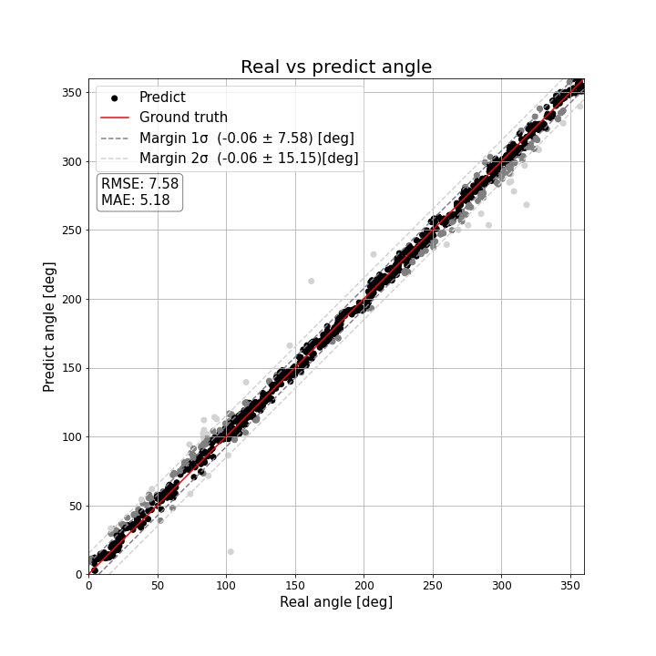
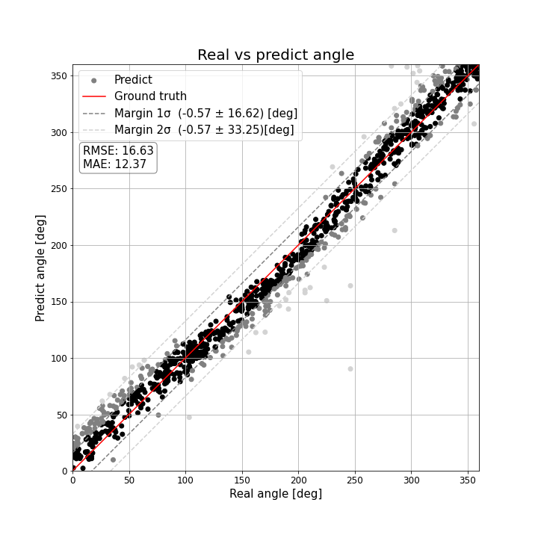
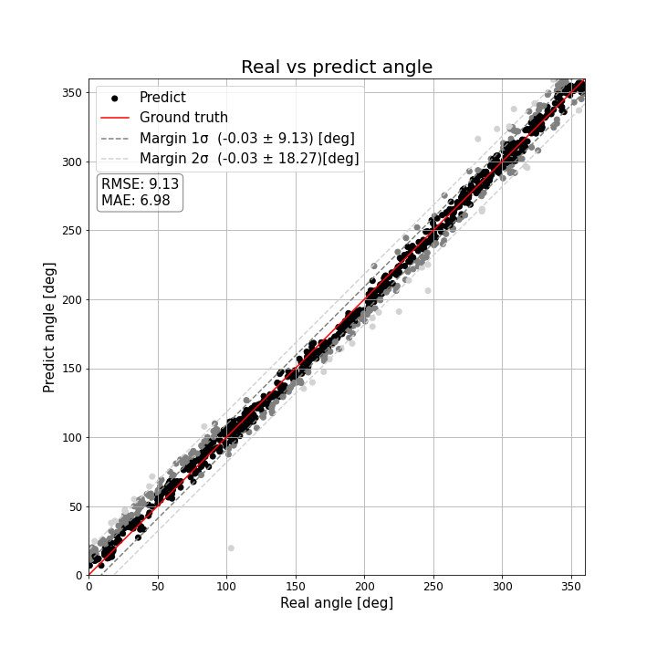
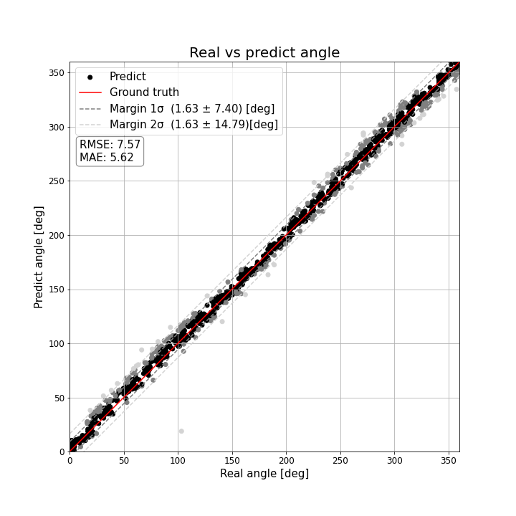
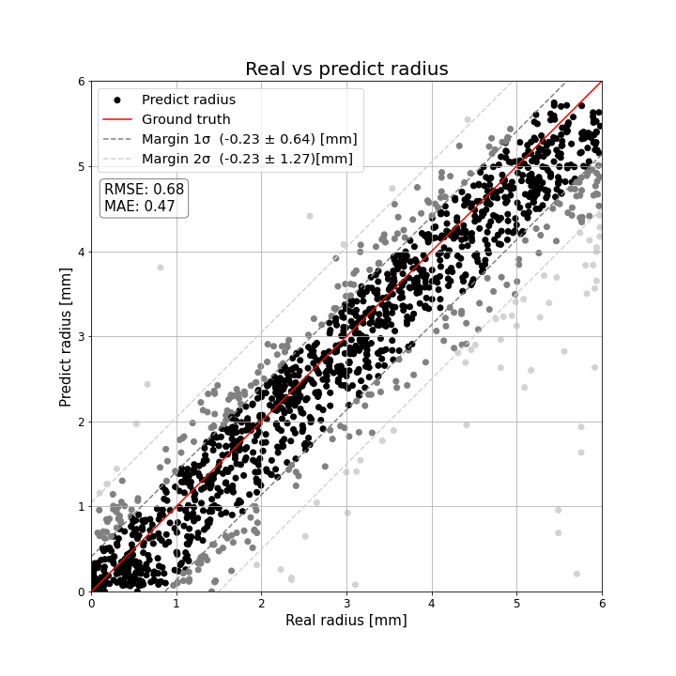
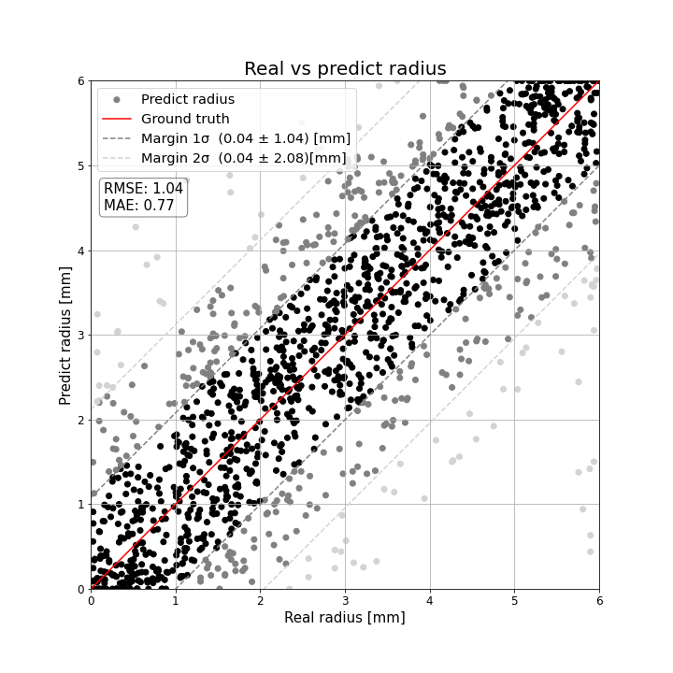
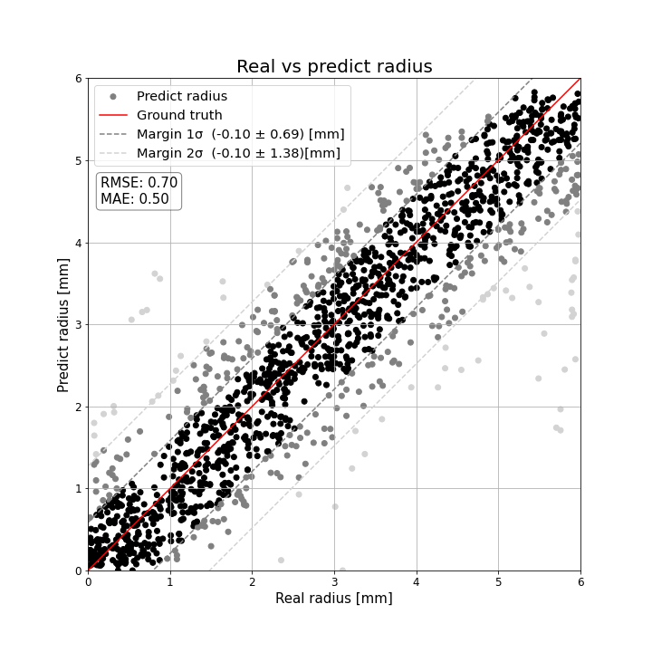
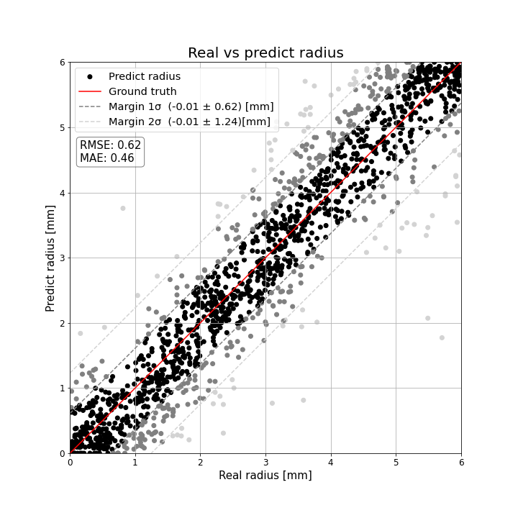
Angle prediction
RGB | Depth | RGBD- parallel | RGBD- early
Radius prediction
RGB | Depth | RGBD- parallel | RGBD- early

Slide 3

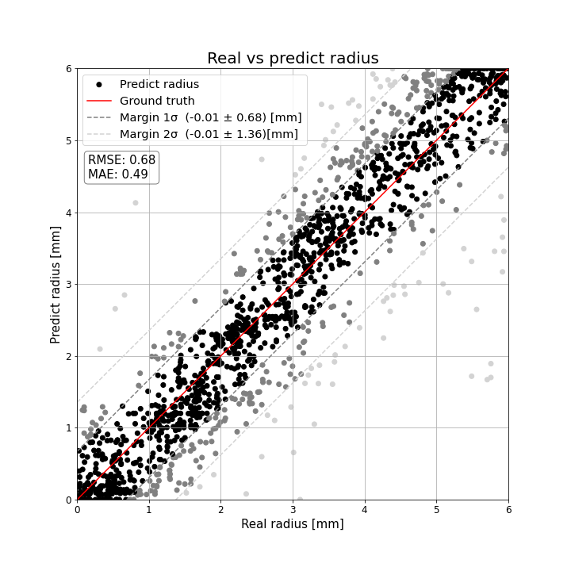
RGBD- late
Angle prediction | Radius prediction

Slide 4
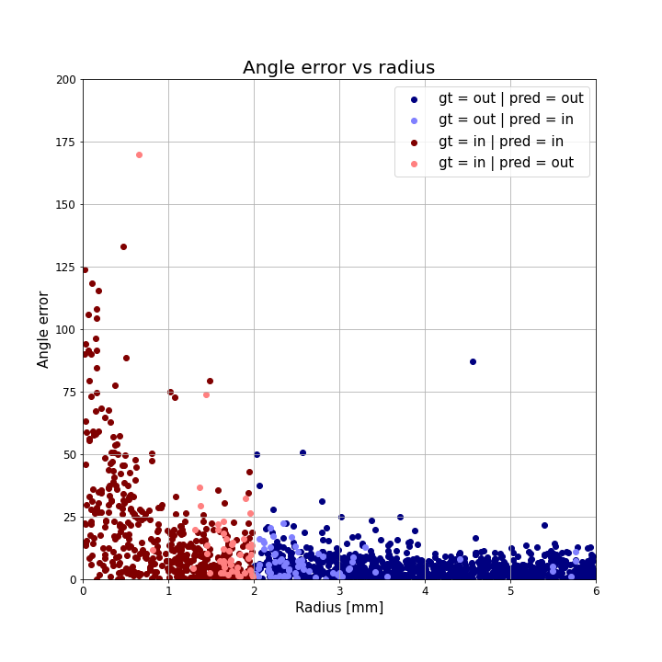
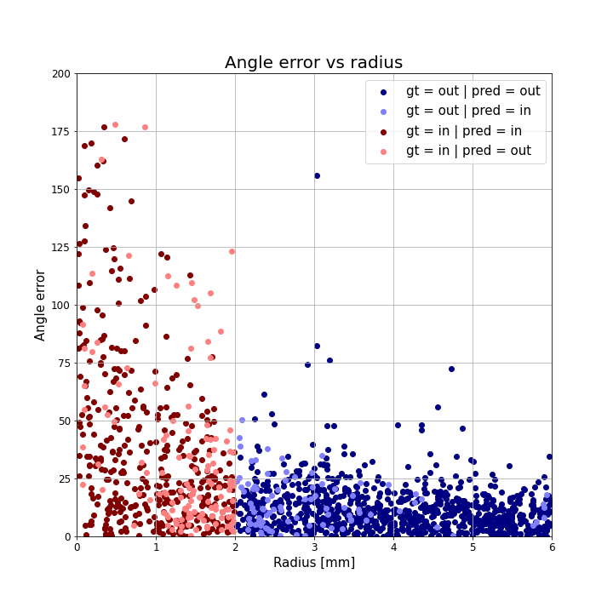
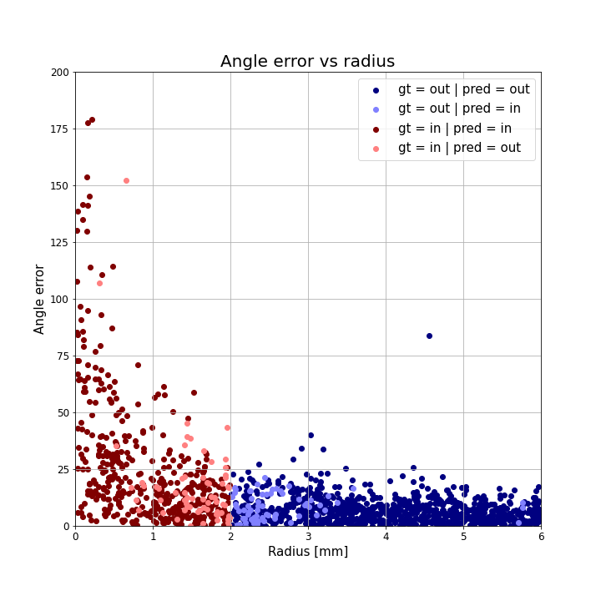
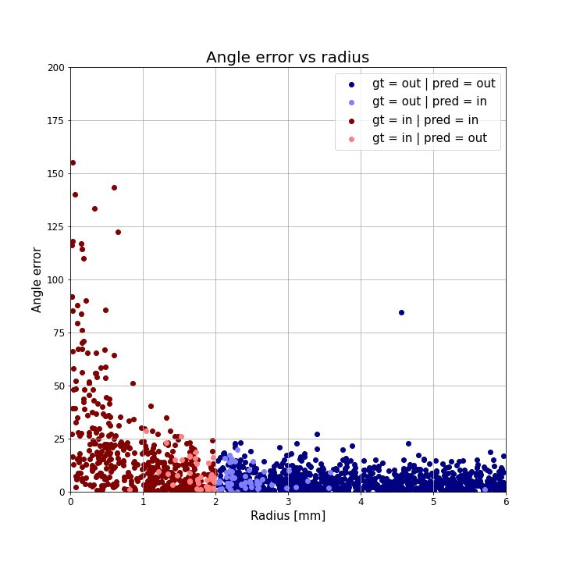
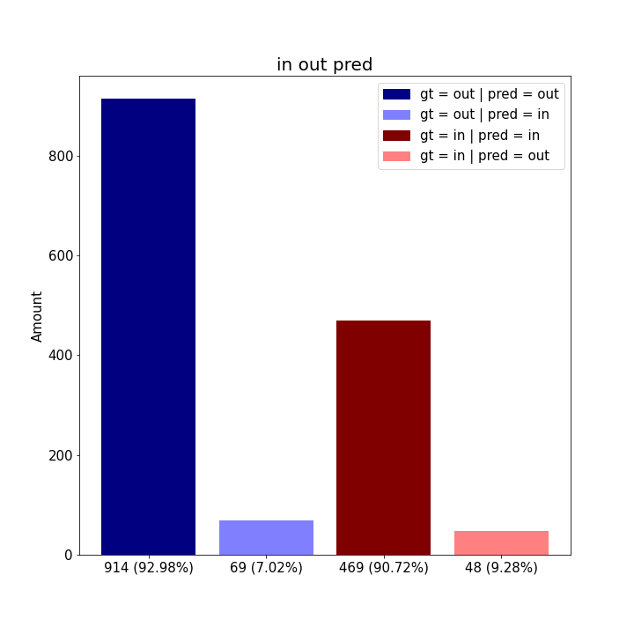
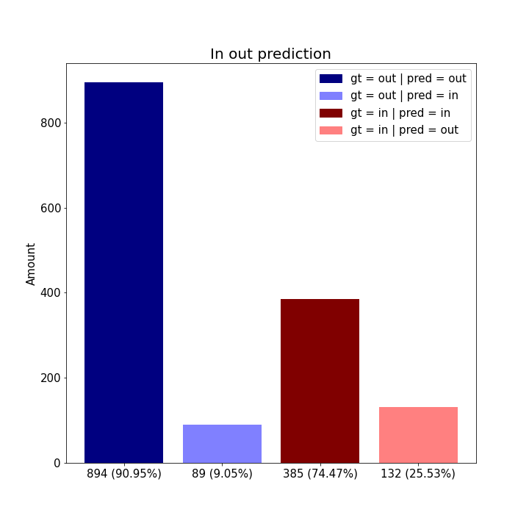
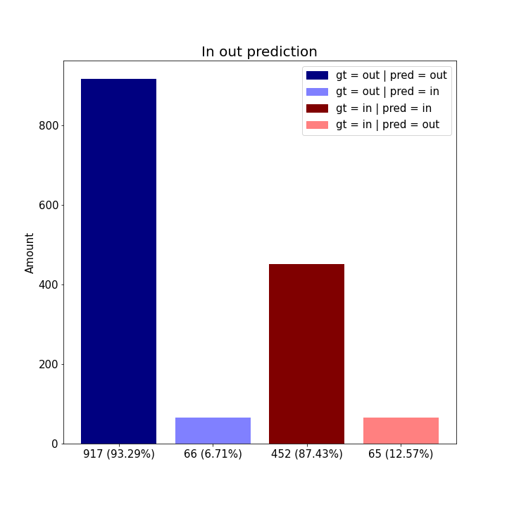
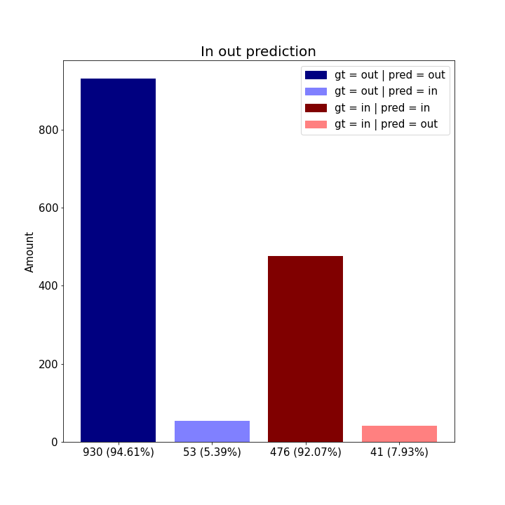
Angle error vs radius
RGB | Depth | RGBD- parallel | RGBD- early
In out prediction
RGB | Depth | RGBD- parallel | RGBD- early

Slide 5
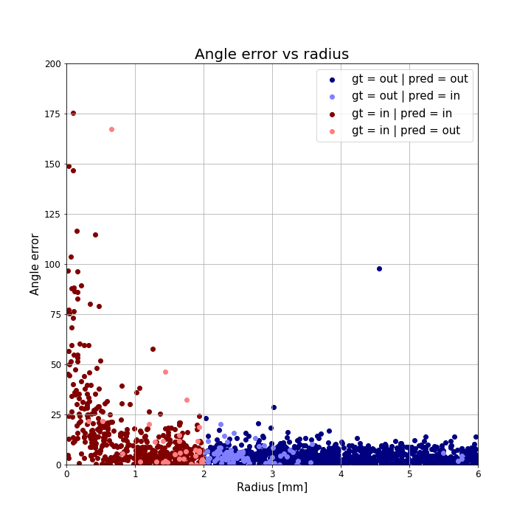
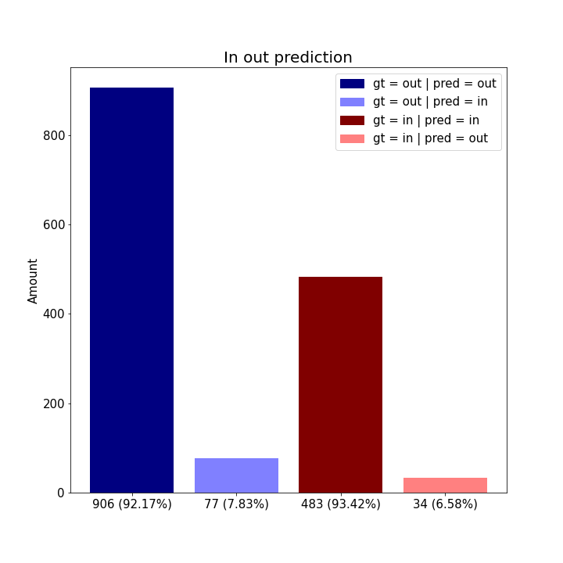
RGBD- late
Angle error vs radius | In out prediction

Slide 6
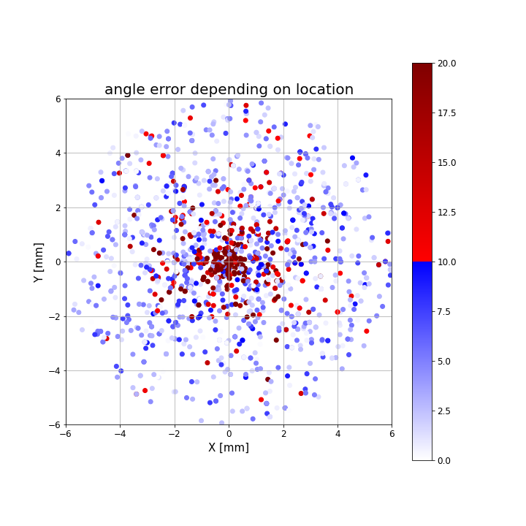
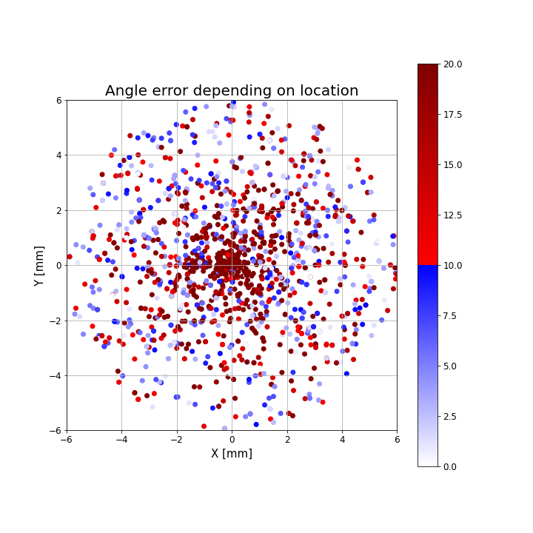
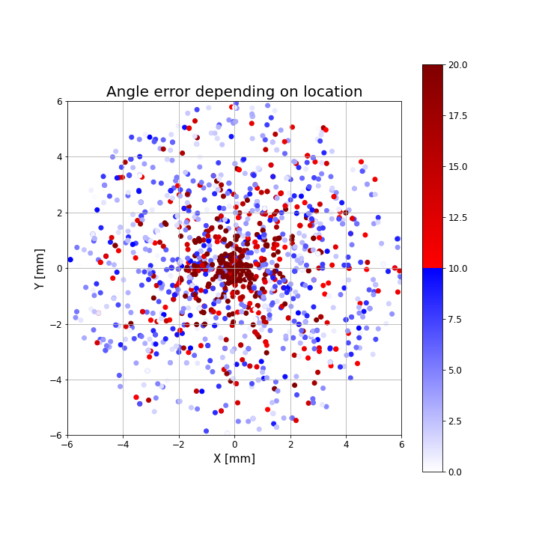
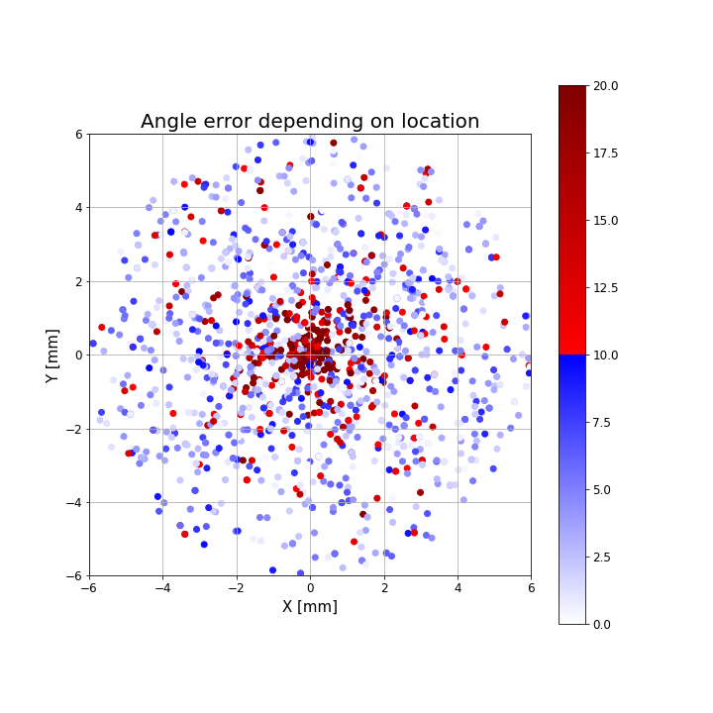
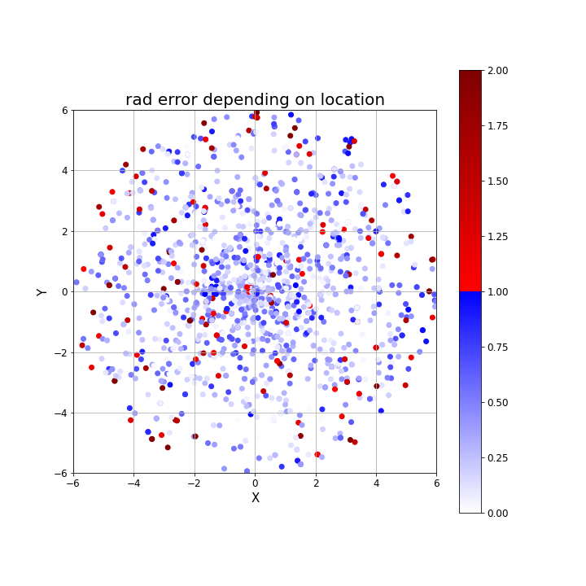
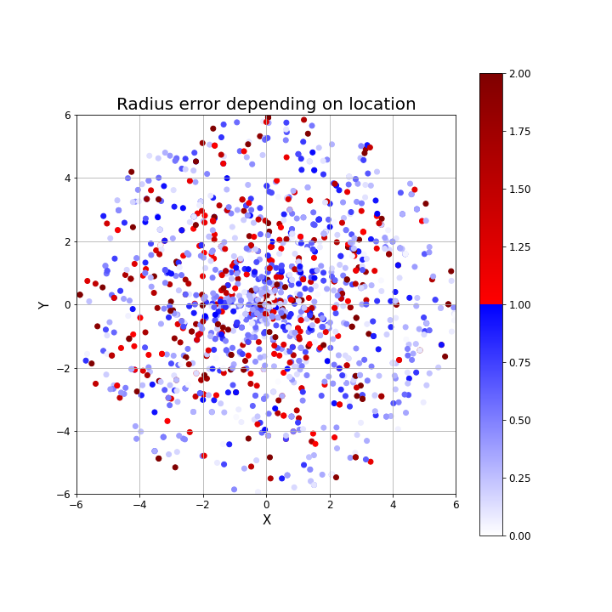
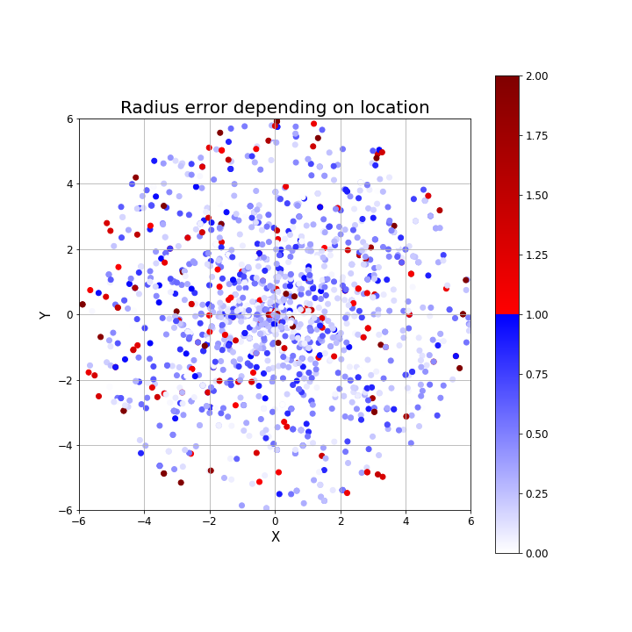
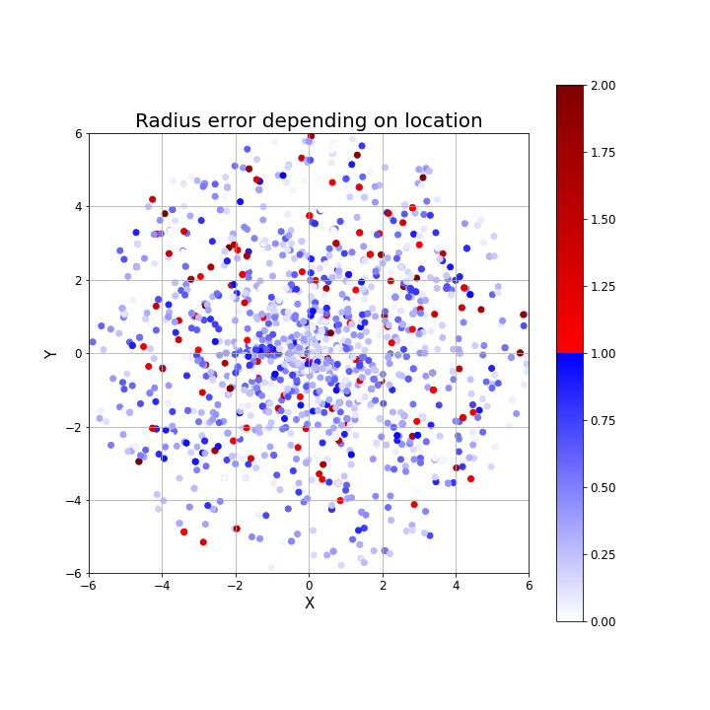
Angle error depending on location
RGB | Depth | RGBD- parallel | RGBD- early
Radius error depending on location
RGB | Depth | RGBD- parallel | RGBD- early

Slide 7
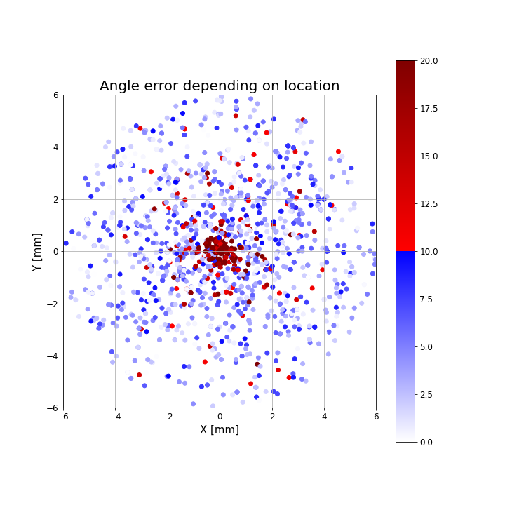
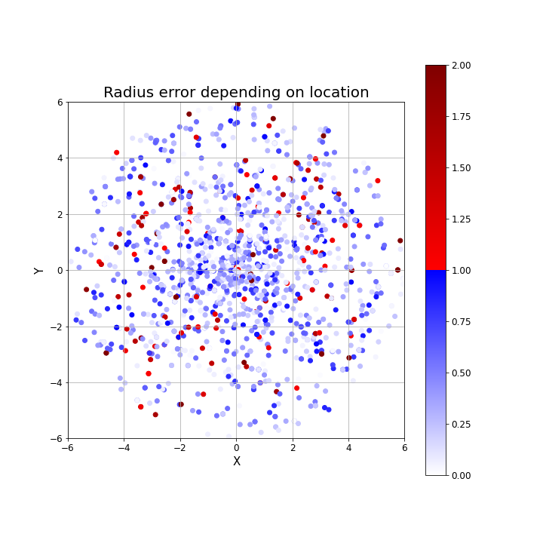
RGBD- late
Angle error depending on location | Radius error depending on location

